Slide 1

Hotel Rooms and Revenue Forecaster
Author: Artem Lukinov
Notes:
Hello and welcome to my capstone project. It took a long time to get to this point and I'm very excited to share my research and findings with you today. As you all know, I spent the last 15 years in hospitality and it still is very dear to my heart, so naturally my project had to deal with hotels. Unfortunately, it will not help you find a better deal on a hotel room. Honestly, it will do the opposite.

Slide 2

Hotel Rooms and Revenue Forecaster
Author: Artem Lukinov
Notes:
Hello and welcome to my capstone project. It took a long time to get to this point and I'm very excited to share my research and findings with you today. As you all know, I spent the last 15 years in hospitality and it still is very dear to my heart, so naturally my project had to deal with hotels. Unfortunately, it will not help you find a better deal on a hotel room. Honestly, it will do the opposite.

Slide 3

Room Nights Sold forecast: used for scheduling labor and controlling variable expenses to optimize business’s bottom line daily
Revenue forecast: used for renovation schedules, large investments in operations, expansions.
Notes:
Amount of rooms sold, also known as Occupancy and Revenue gained are the most important metrics in hotel industry. They serve as top line numbers that determine the rest of the P&L statement. How much housekeeping do we need on a given day? When is the best time for renovation? These and many other questions demand an optimal forecast that typically falls on the shoulders of Revenue Directors or General Managers.

Slide 4

Forecast Process
Story as old as time: ”The mean king and the manual labor”
60%
Accuracy
Notes:
A typical forecast starts with a rough baseline forecast, based on last year's performance or a typical weekly pattern. These first drafts are up to 40% off of the final numbers that hotels experience. The next step is to use intuition and domain knowledge to "true up" these forecasts and come up with the final version.

Slide 5
How Can We Help?
What can be done to optimize this process?

Slide 6
Machine Learning!
Reliance on data
Better analysis of historical data
Hidden insights
Computational power
Notes:
Even after completing the forecast, there are always those that would question the methods used to come up with these important numbers.
Some things get missed as people are people.
Since these depend a lot on human factor and require lots of input, a good amount of time is spent on this process and a whole lot of Excel.

Slide 7
We want to
Determine whether it is possible to improve the accuracy of the baseline forecast
Use Machine Learning to forecast future data based on historical data
Stretch: wrap our model into software
Notes:
The goal of this project is to determine whether it is possible to use Machine Learning and improve the accuracy of the baseline forecast for a hotel in San Francisco market using historical data as core algorithm for a potential software project.

Slide 8
Data Source
Anonymous hotel
Mutual benefit
Popular format
Large sample
Easy cleaning
Domain knowledge
*Multiple levels
Covid
Notes:
The data was acquired from a high end hotel in San Francisco, CA and contains historical sales data for 2017-2021. The hotel representatives were given a pitch and volunteered their data to be anonymously used for this project with hope of improving their forecasting process and save on systems cost - ~$5000/year on a simple forecasting system. The reports were pulled from an ORACLE's Opera Property Management System that is widely used by hotels around the world.
Market segment level data will be used in next stages of the project.
Covid

Slide 9
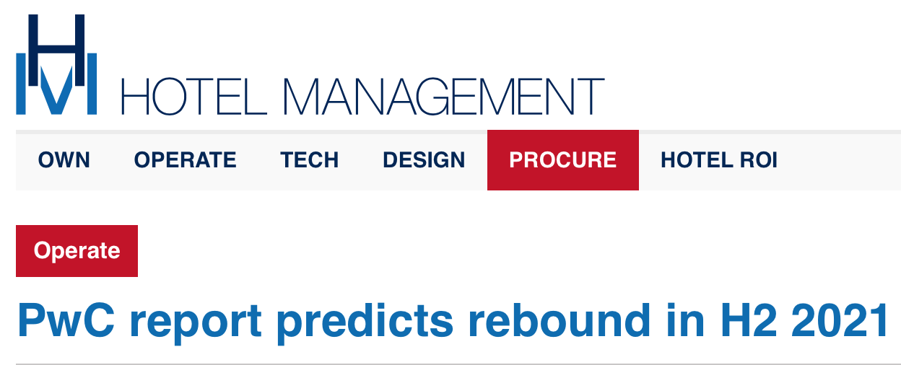
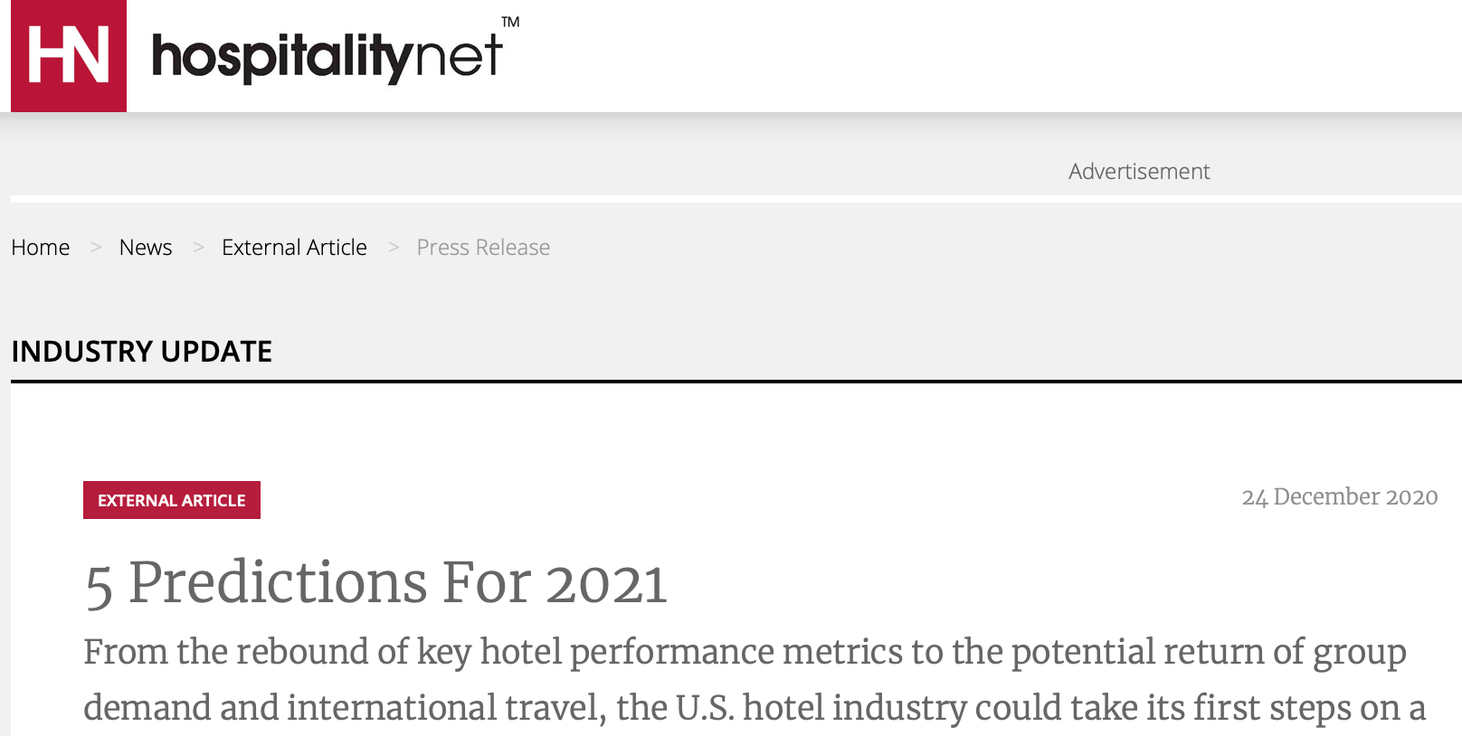
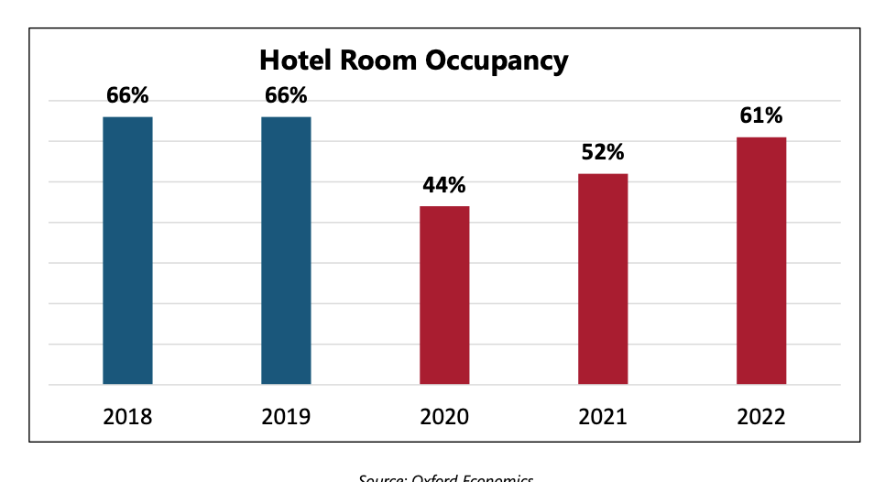
Covid data
Notes:
2020 is an outlier in the yearly data and should not be used in training or testing the models. There is enough domain knowledge that forecasts a rebound of hotel industry starting in H2 2021

Slide 10
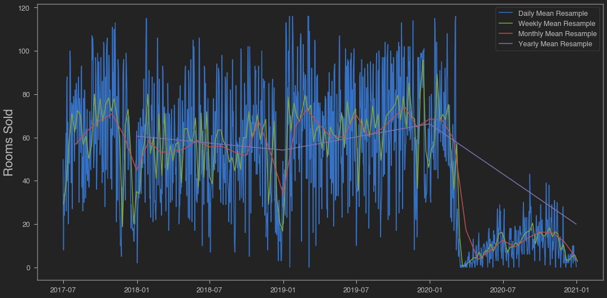
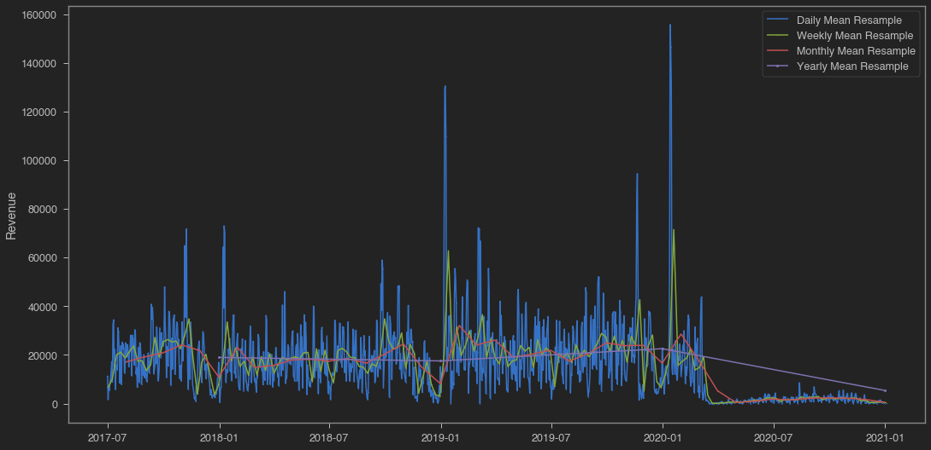
First Look
Notes:
For project's purpose the data was looked at from two viewpoints:
Rooms sold on a daily basis represented in 'no_definite_rooms' column
Revenue gained every day in 'revenue' column.
There are couple of immediate observations here:
the sudden drop to the right is due to Covid-19 and the hotel only operating for essential personnel
there seems to be no overall trend from the annual perspective. The green line representing annual resample is relatively flat
there are no days where rooms sold number is higher than the capacity of the hotel (120)
there is some annual seasonality on a monthly level as seen in dips towards the end of each year (holiday season)
there may be weekly seasonality which cannot be determined from this graph.
Since rooms and revenue are expected to be correlated (the more rooms sold, the higher the revenue), this graph looks almost identical albeit at a different scale.
the spikes represent big conventions in San Francisco that raise the hotel rooms demand and result in extreme room prices. January spikes fall on dates of JPMorgan conventions and October/November spikes represent Salesforce and Oracle.
the data (excluding 2020) seems to have no trend, but still needs to be checked for stationarity for use in time series models.

Slide 11
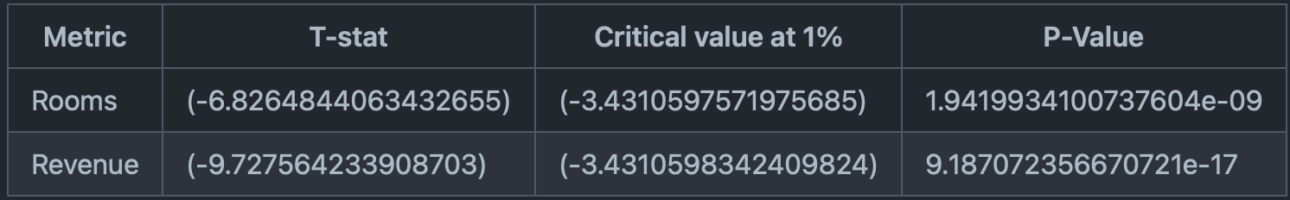
Stationarity Check
Augmented Dickey-Fuller Test
Notes:
Null Hypothesis is that our data is non-stationary.
We can see that our statistic values of -6.8 and -9.7 are less than the critical values of -3.43 at 1%. Moreover, the p-values are insignificant. This suggests that we can reject the null hypothesis (data is non-stationary) with a significance level of less than 1%.
Decomposition charts were also looked at (in notebook). Seasonality was present but not very distinct.
From the trend view we saw that there is a seasonal component on an annual level and there is seasonality present on rooms sold.

Slide 12
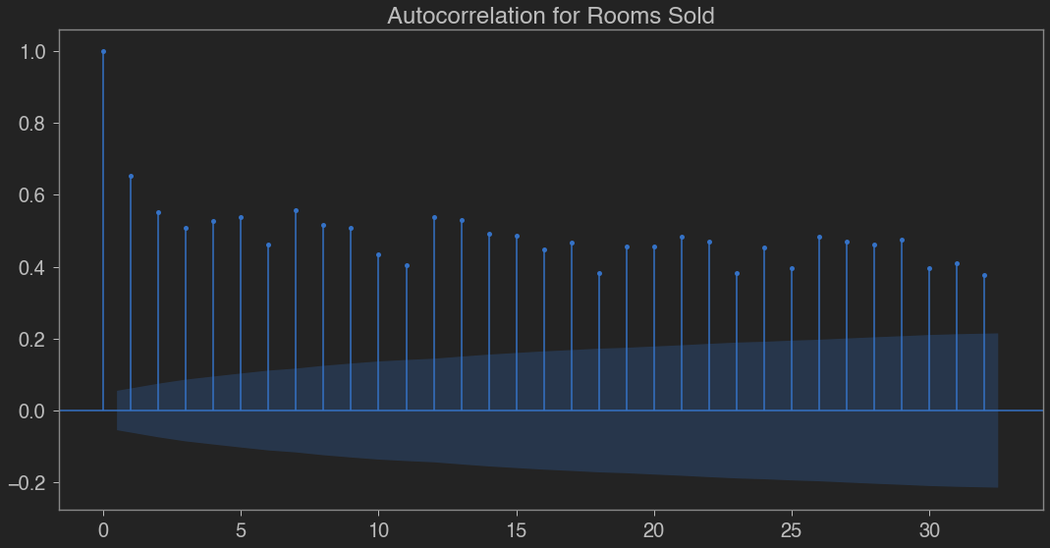
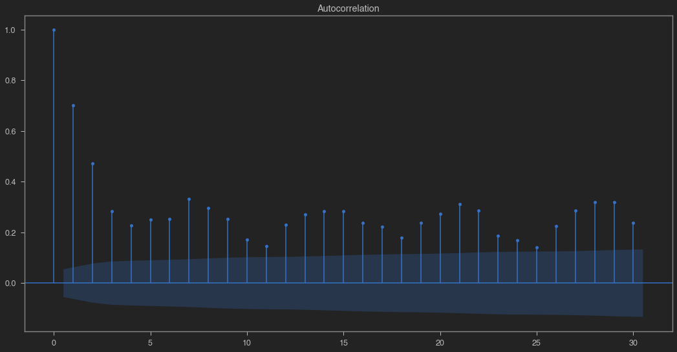
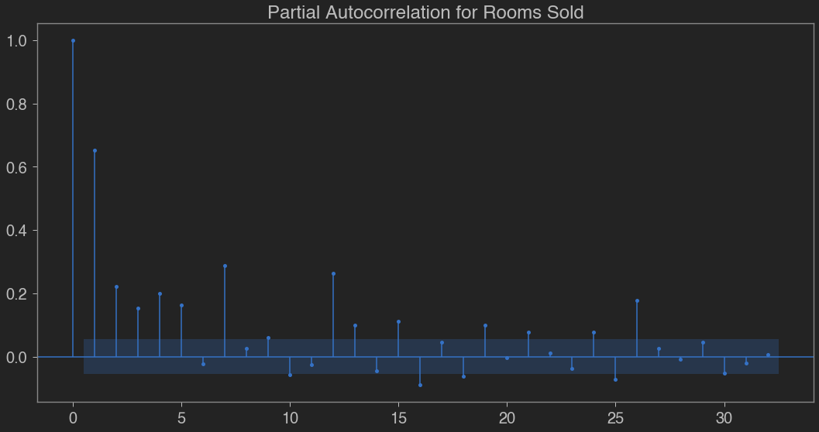
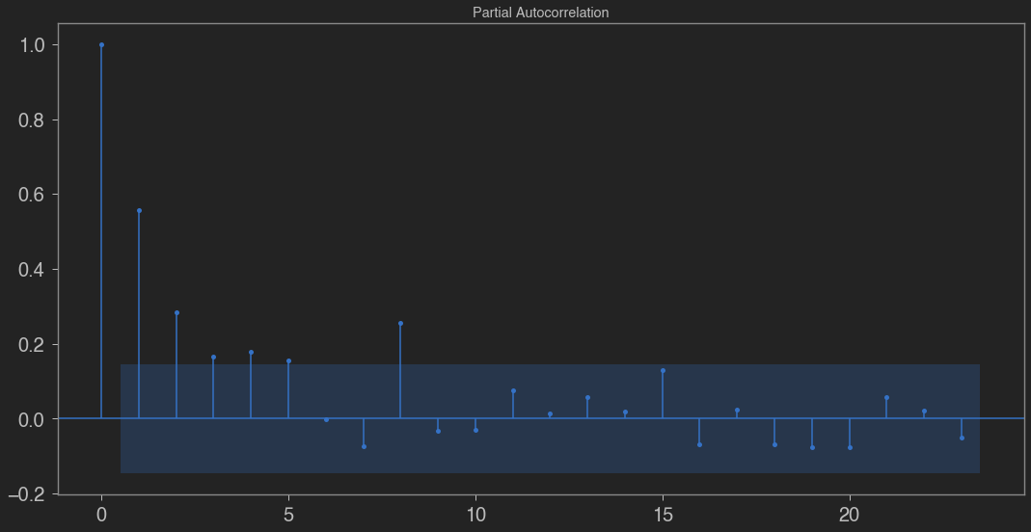
Stationarity Check
Revenue
Rooms
Notes:
In order to determine the most optimal parameters for time series models, we took a look at any autocorrelation and moving averages.
Based on the ACF plot there is evidence of a trend since the small lag values have large, positive autocorrelations. The "scalloped" shape of the graph shows a seasonal cycle at every 5-7 lags (weekly) for MA(1). If it was MA(2) we would see two spikes lag1 and lag2, repeated in a weekly cycle. Because of this, we will use a value of MA(1) for the baseline model. Now let's take a look at PACF:
This plots the correlation at a given lag (indicated by the horizontal axis), controlling for all of the previous lags. In the PACF plot we see some positive and some negative significant partial autocorrelations, which usually indicates strong seasonal fluctuations. There is a large dropoff after lag 1, which gives us the value for AR(1). This view also confirms seasonality at the weekly level as we see spikes on lag 7, 15, 21. However, this seasonality is not very strong. Let's explore daily revenue:
For an autoregressive (AR) time series, the ACF will go down gradually without any sharp cut-off, which is observed here. There is a MA(1) here, similar to rooms. This ACF tells us it is an AR series as well, then we turn to the PACF:

Slide 13



Model choice
Time Series:
ARIMA
SARIMA
RNN:
- LSTM
- GRU
Additional:
- Prophet
- NeuralProphet
Notes:
ARIMA model can be explored as the data has moving average and auto-regression based on ACF and PACF chart interpretations,
SARIMA should be a better choice since our data is seasonal,
Due to our data being sequential, with no gaps, and including time series RNNs make good candidates for this project.
LSTM helps with the neural network long-term memory problem due to vanishing gradient during back-propagation. It learns long-term dependencies and helps fine tune the network based on previous errors.
The GRU is the newer generation of Recurrent Neural Networks and is pretty similar to an LSTM. GRU is computationally more efficient due to less complex structure - GRU has just two gates: reset and update vs. LSTM having three gates: input, output and forget. This made it a worthwhile candidate for this project's data.
As part of the project, some time was set aside to research alternative models to tackle this project. Two specialized models were identified in the process and proved highly effective. The package installs were easy and the learning curve was rather short. In about 30 minutes, an average Data Science enthusiast can build a baseline model and start tweaking it.

Slide 14
Prophet and NeuralProphet
Logistic regressions
Linear and
non-linear
regressions
Seasonality
AR-Net
An Autoregressive Neural Network
Special events
Notes:
Prophet
Prophet is a procedure for forecasting time series data based on an additive model where non-linear trends are fit with yearly, weekly, and daily seasonality, plus holiday effects. It works best with time series that have strong seasonal effects and several seasons of historical data. Prophet is robust to missing data and shifts in the trend, and typically handles outliers well. Prophet is open source software released by Facebook’s Core Data Science team.
NeuralProphet
NeuralProphet is a Neural Network based user-friendly time series forecasting tool. This is heavily inspired by Prophet. NeuralProphet is developed in a fully modular architecture which makes it scalable to add any additional components in the future. NeuralProphet is a decomposable time series model with the components, trend, seasonality, auto-regression, special events, future regressors and lagged regressors. Auto-regression is handled using an implementation of AR-Net, an Auto-Regressive Feed-Forward Neural Network for time series.

Slide 15
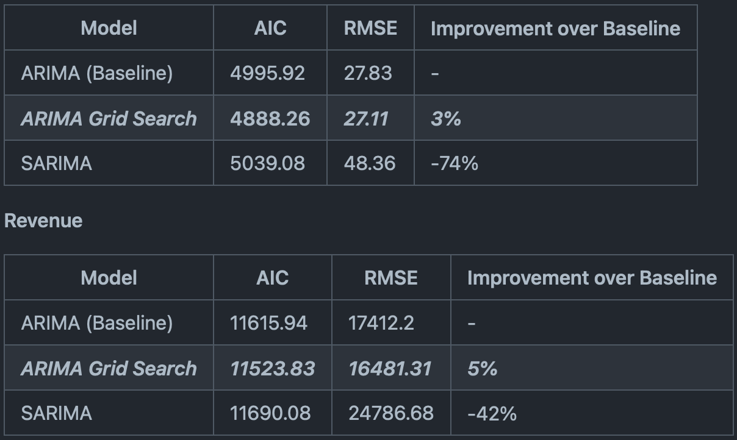
Time Series Models
Notes:
Both AIC and RMSE measurements were used in time series modeling in order to identify the best model in this class. As the ultimate focus is on the predicted values (forecast) measuring model strength by the RMSE of the predictions seemed more suited for this project.
With both KPIs ARIMA w/Grid Search performed the best.

Slide 16
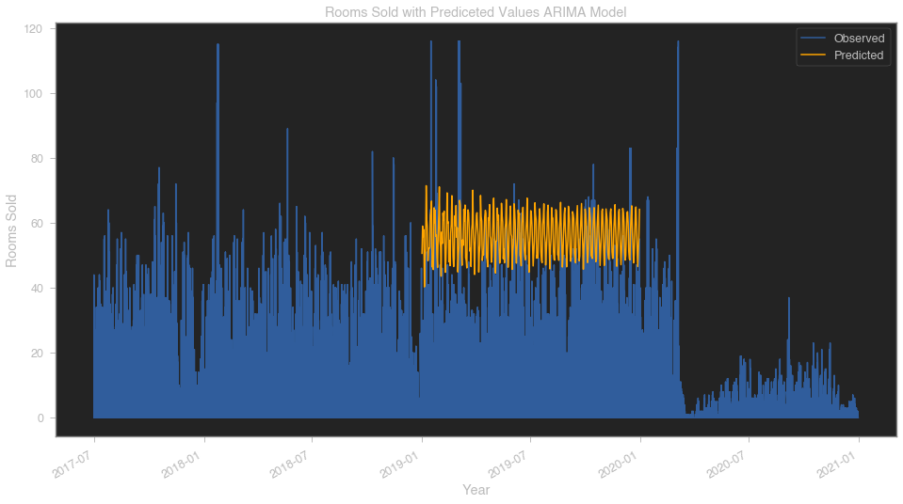
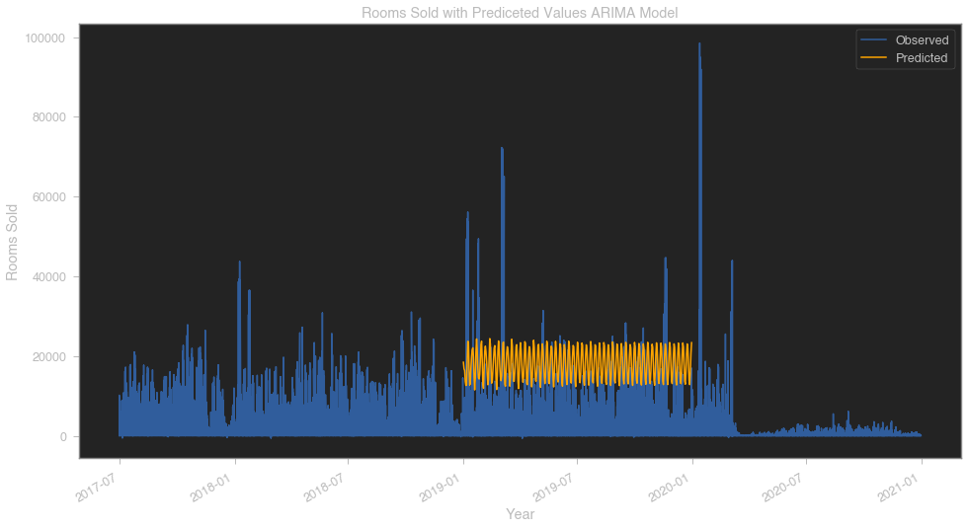
Best Time Series Model
Notes:
The orange line in the graph represents the expected future data based on the forecasting model: amount of rooms sold and revenue.
The results of this model do not look surprising - they represent the autoregressive nature of the data.
The reason for a steady graph with lack of spikes shows that ARIMA deals poorly with outliers in the data and that was one of the reasons to try SARIMA - a lot of outliers in our data have a 365 day seasonality (annual conventions, holidays, etc.)
The biggest surprise was SARIMA model's performance with this data. This might be due to a more complex nature of seasonality in our data. As mentioned earlier, the seasonality was not obvious when interpreting ACF graphs. It does not keep the same range throughout the data and has multiple levels. Even though there is seasonality on annual and weekly levels, some events shift year to year, which skews the model's effectiveness. This further proves the theory that it is more efficient to use machine learning for baseline forecast and then augment it using domain knowledge.

Slide 17
Recurring Neural Networks
Why LSTM and GRU? Memory!
Notes:
When you read the review, your brain subconsciously only remembers important keywords. You pick up words like “amazing” and “perfectly balanced breakfast”. You don’t care much for words like “this”, “gave“, “all”, “should”, etc. If a friend asks you the next day what the review said, you probably wouldn’t remember it word for word. You might remember the main points though like “will definitely be buying again”. If you’re a lot like me, the other words will fade away from memory.
And that is essentially what an LSTM or GRU does. It can learn to keep only relevant information to make predictions, and forget non relevant data.

Slide 18
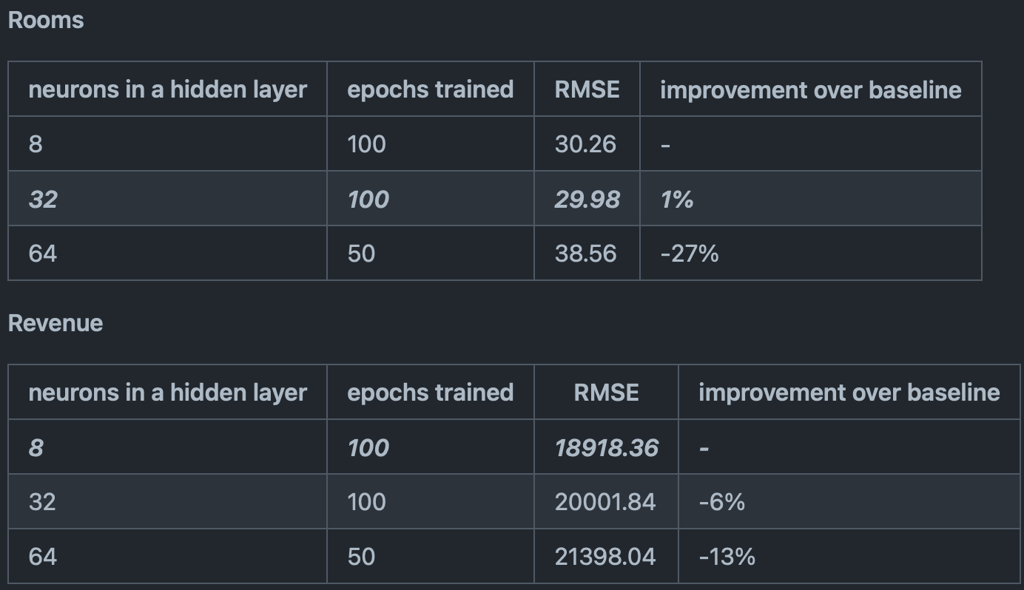
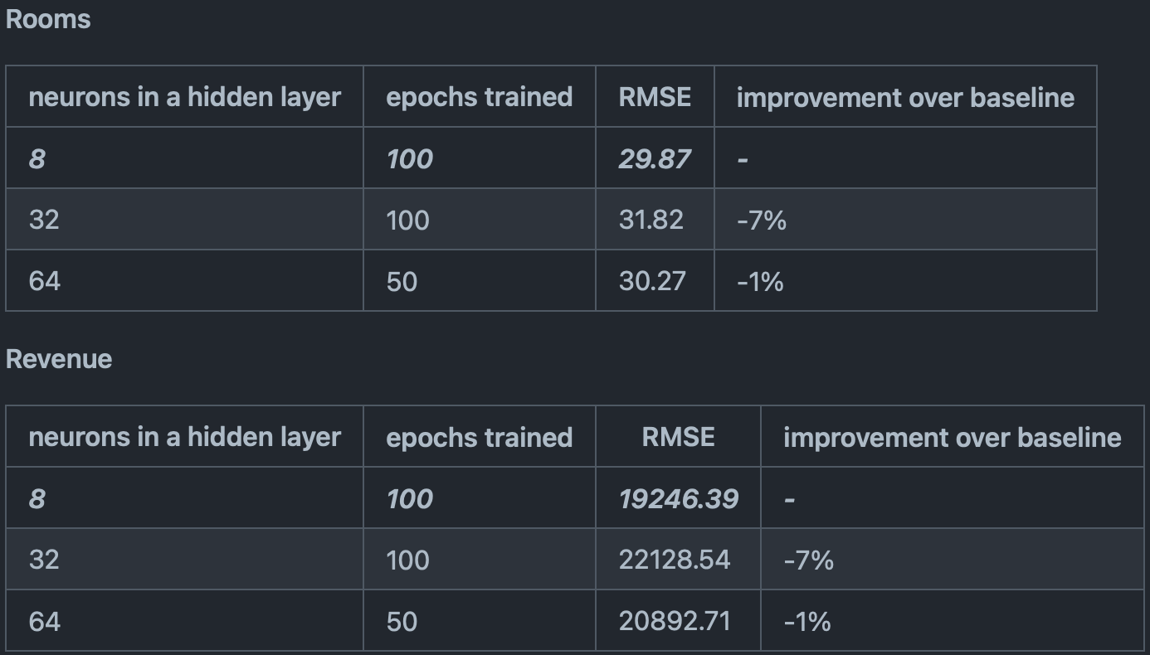
Recurring Neural Networks
LSTM
GRU
Notes:
Due to computational pressure, the grid search was performed manually with the following results
Early Stops were considered, but the loss charts determined it to be risky. 100 epochs was deemed the most appropriate length of training. This parameter can be readdressed in the future for further optimization.
GRU performed best for Rooms and LSTM for Revenue.

Slide 19
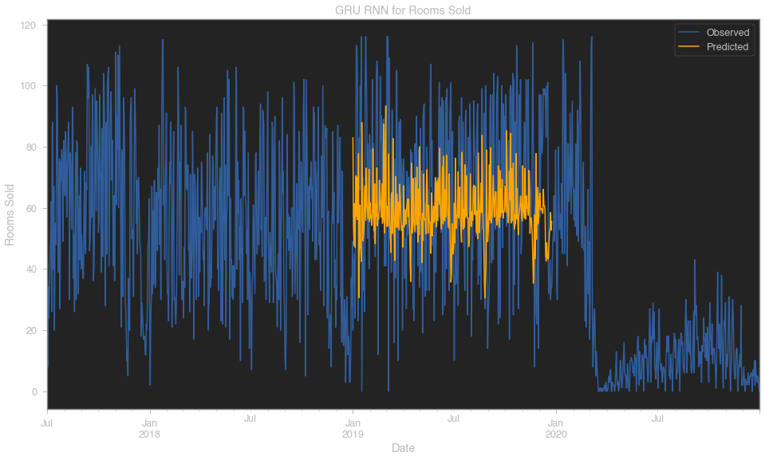
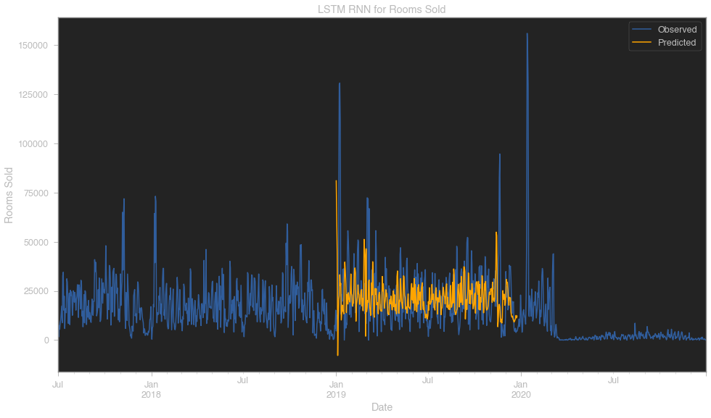
Best RNNs
Notes:
It is interesting to see how our model handles periods with high demand and forecast more rooms over periods of the highest rated demand drive for San Francisco. Similar spikes are observed in October/November where huge conventions take place and a big lull towards the end of the year - Christmas and New Year when travel is down. These particulars are one of the strength of GRU RNN that takes all that information into consideration.
Similar observations in revenue. Spike represent typical periods of high demand. Although this is not the most accurate model, the forecast line makes a lot of sense to domain experts. This may be a goof model to optimize in the next stages of the project.

Slide 20
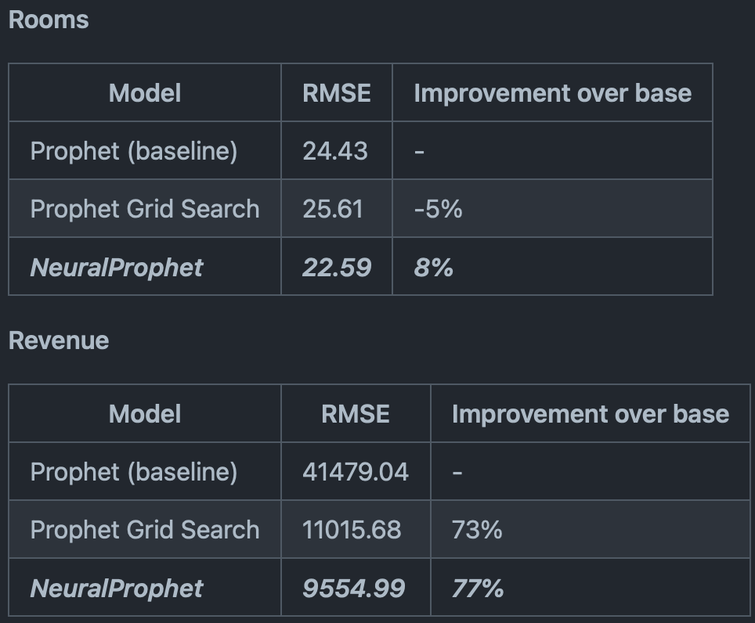
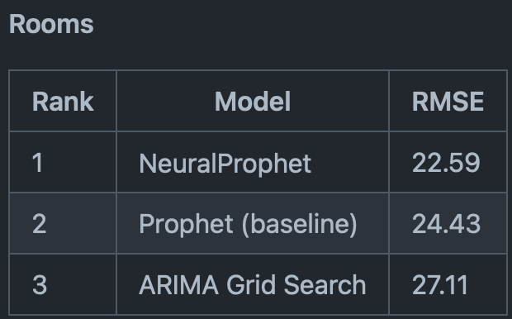
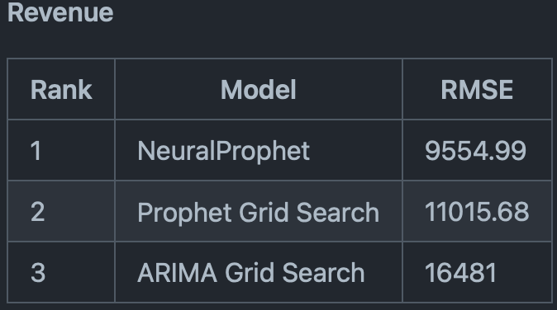
Prophet vs. NeuralProphet vs. the rest
Notes:
NeuralProphet showed a staggering 73% improvement in revenue RMSE and 8% RMSE improvement in rooms over baseline model. Since it is a new package, the default parameters are likely not the best and could be optimized efficiently.
As for overall ranking, NeuralProphet took the crown and, what’s most important… confirmed our initial assumptions that by using Machine Learning we can optimize the baseline foracast.
Rooms: from 36 room error on average down to 22.59 (+37.25% improvement)
Revenue: from 10,000 revenue error to 9554.99 (+4.5% improvement)

Slide 21
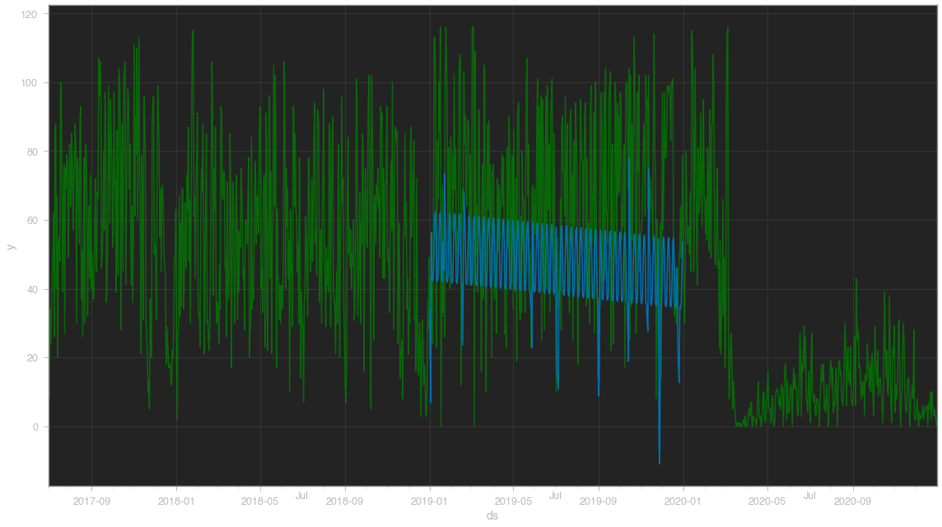
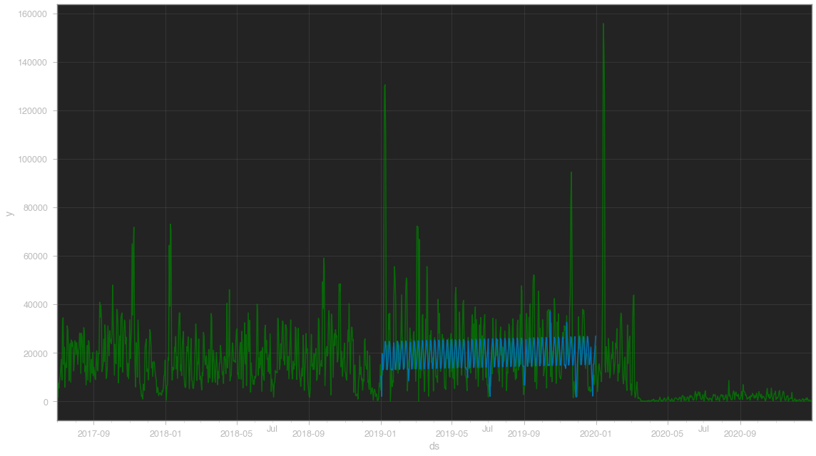
NeuralProphet
Notes:
Graphical representation on the forecast show that the model takes into consideration both the seasonality and outliers and forecasts optimally into the future.
Same observation as with rooms - all patterns are observed and outliers are considered. Just some neat looking graphs!

Slide 22
Key Takeaways
NeuralProphet was the best performer
RNNs have potential
Machine Learning can help in yet another industry
Exploration leads to efficiency
Notes:
Conclusions
It is an obvious conclusion that NeuralProphet is the top choice for this project.
It is important to note that the RNNs used in this project are not complex and may be improved upon.
However, given the overall time commitment, NeuralProphet should be still considered a winner in efficiency and results.
The project successfully proved that using Machine Learning we can get a better baseline forecast
Rooms: from 36 room error on average down to 22.59 (+37.25% improvement)
Revenue: from 10,000 revenue error to 9554.99 (+4.5% improvement)
save time and effort in the forecasting process and rely more heavily on data than intuition which will decrease doubt and back and forth.
During any project, there should be time budgeted to explore a constantly improving world of Data Science and mine for the newest and most effective ways to solve a problem.

Slide 23
How can we use this?
Explore NeuralProphet and others
Include all market segments
Use as core algorithm for a product
Notes:
Recommendations
Explore NeuralProphet interface to further improve the model
Work on a the next version of the forecasting models to incorporate 11 market segments. Although a complex RNN with multiple inputs and outputs should be pursued, NeuralProphet's development should be followed as the team is working on a multivariate version of the model (global forecasting).
Wrap the best model into a user-friendly software package with Opera PMS report upload and baseline forecast download functionality.

Slide 24
Thank you
Q&A

