Slide 1
Image
Category
Title
Description description description description description description description
4.05
Price (-discount %)
Buy (stock)

Slide 2
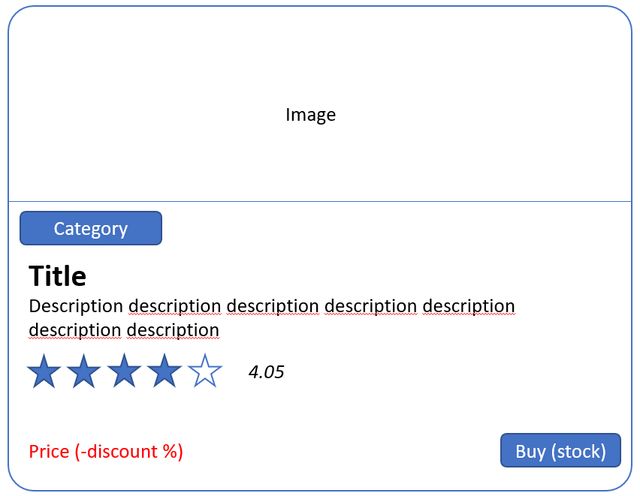
Desktop
Dummy Shop

Slide 3
Tablet
Dummy Shop

Slide 4
Smartphone
Dummy Shop

