Slide 1
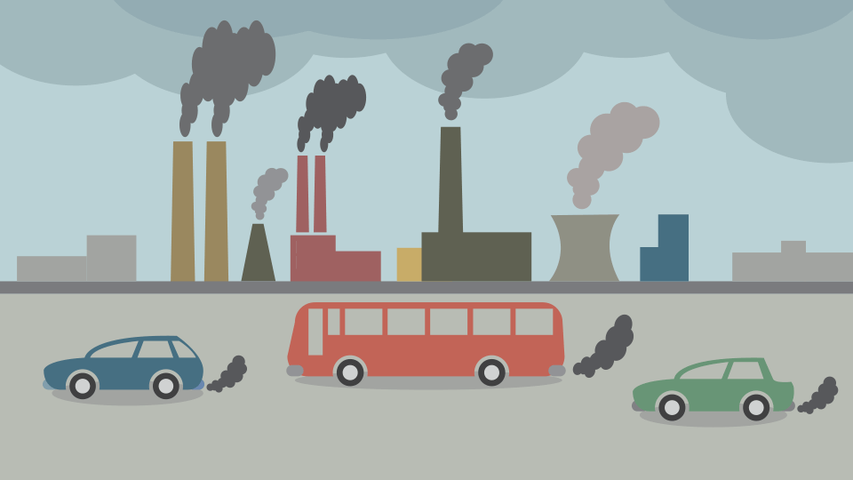
Air Pollution in India - Clustering
Presented by Artem Ramus

Slide 2
Introduction
The goal of this project is to find areas in India with similar air pollution characteristics.
Data set contains levels of 3 common air pollutant: NO2 - nitrogen dioxide from NOX family, SO2 - sulfur dioxide, and MP10 - particle matters that have a diameter of 10 micrometers (0.01 mm) or smaller.
The data was taken from Kaggle: https://www.kaggle.com/adityadeshpande23/pollution-india-2010.

Slide 3
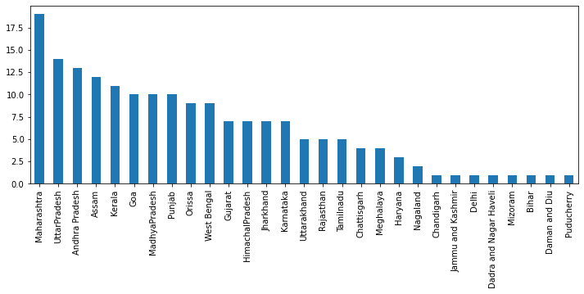
Data Analysis
Measurements were taken in 181 cities in 29 states. Cities counts are shown below.

Slide 4
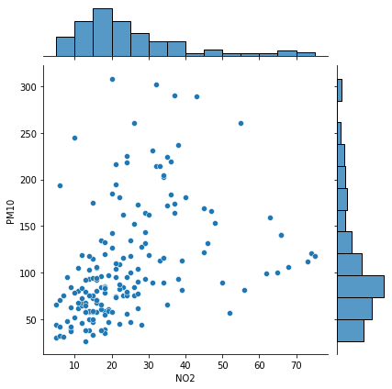
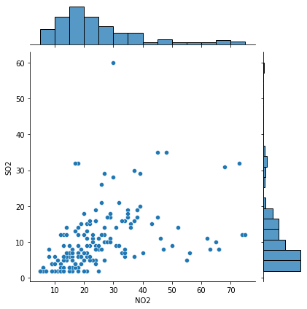
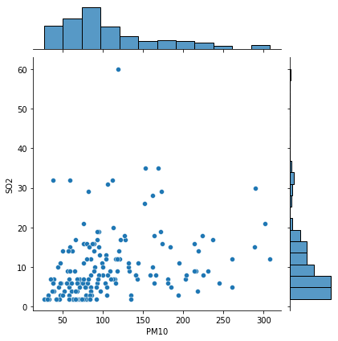
Data Analysis
There are 3 pollutants - NO2, PM10, SO2. Scatter plots are shown below:

Slide 5
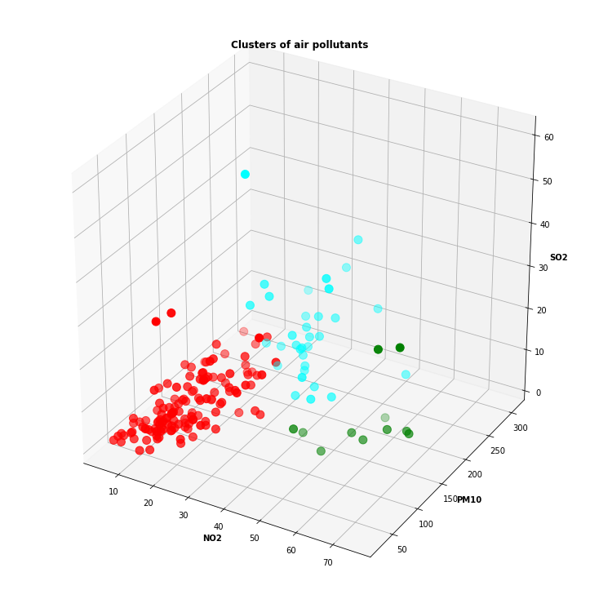
Results
Agglomerative clustering with 3 clusters was chosen.
Red cluster 1 comprises the least polluted areas by all means.
Light blue cluster 2 comprises the most polluted areas.
Green cluster 3 low in 'SO2' and high with 'NO2' and 'PM10'.

Slide 6
Methodology and Assumptions
Models of choice:
  Agglomerative clustering with 2 to 5 clusters
  DBSCAN clustering resulted in 2 clusters and one area of low density
Missing values ~2% were imputed with MICE approach under assumption of ‘data missing at random’.
MIN-MAX normalization was chosen.

Slide 7
The end
Thank you for your attention!

