Slide 1
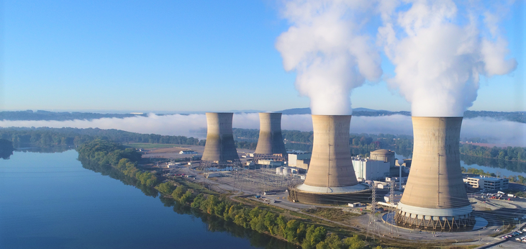
Combined cycle power plant performance prediction
Presented by
Artem Ramus

Slide 2
Background
Abstract
The data set contains 9568 data points collected from a Combined Cycle Power Plant over 6 years (2006-2011), when the plant was set to work with full load.
Source
Pınar Tüfekci, Çorlu Faculty of Engineering, Namık Kemal University, TR-59860 Çorlu, Tekirdağ, Turkey Email: ptufekci@nku.edu.tr
Heysem Kaya, Department of Computer Engineering, Boğaziçi University, TR-34342, Beşiktaş, İstanbul, Turkey Email: heysem@boun.edu.tr
https://archive.ics.uci.edu/ml/datasets/Combined+Cycle+Power+Plant

Slide 3
Introduction
The goal of this project is to predict combined power plant output from ambient properties and exhaust vacuum.
Features consist of hourly average ambient variables
Temperature (T) in the range 1.81°C and 37.11°C,
Ambient Pressure (AP) in range 992.89-1033.30 millibar,
Relative Humidity (RH) in range 25.56% to 100.16%
Exhaust Vacuum (V) in range 25.36-81.56 cm Hg
Net hourly electrical energy output (EP) 420.26-495.76 MW
The averages are taken from various sensors located around the plant that record the ambient variables every second.

Slide 4
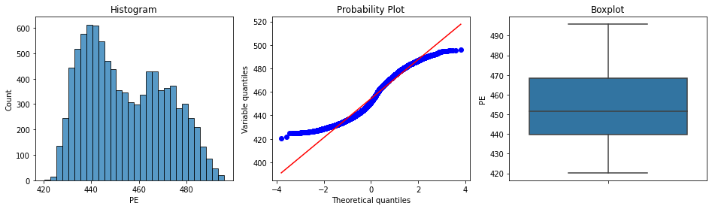
Exploratory Data Analysis
The target’s distribution seems to be combined from two distributions. Variables’ distributions are close to normal distribution.

Slide 5
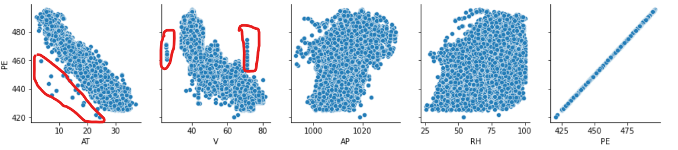
Exploratory Data Analysis
AT and V have great influence on the target PE.
AT-PE and scatter show possible outliers in left low area. V-PE scatter show possible outliers: a line near V=20 and and a line above the main ‘swarm’ near V=70. This atypical distribution might be related to rare weather condition, to special operation mode, sampling strategy or error in data.

Slide 6
Feature Engineering and Selection
Original distribution of all the variables selected.
Based on single feature shuffling method, variable ‘RH’ showed least influence of about 0.2%.
Selected variables: ‘AT‘, ‘V‘ and ‘AP‘.

Slide 7
Summary and Conclusions
Energy output was predicted using XGBoost regression.
RMSE_train is 9.92 and RMSE_test - 13.58 MW.
R2_train is 0.97 and R2_test – 0.95.

Slide 8
The end
Thank you for your attention!

