Slide 1

Company Bankruptcy Prediction
Presented by Artem Ramus

Slide 2
Introduction and Background
The goal of this project is to spot bankrupt companies from 95 financial book attributes.
Bankruptcy data from the Taiwan Economic Journal for the years 1999–2009
The data were collected from the Taiwan Economic Journal for the years 1999 to 2009. Company bankruptcy was defined based on the business regulations of the Taiwan Stock Exchange.
Source: Deron Liang and Chih-Fong Tsai, deronliang@gmail.com; cftsai@mgt.ncu.edu.tw, National Central University, Taiwan The data was obtained from UCI Machine Learning Repository: https://archive.ics.uci.edu/ml/datasets/Taiwanese+Bankruptcy+Prediction

Slide 3
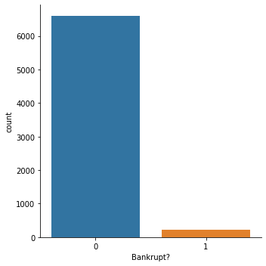
Exploratory Data Analysis - target
The target is imbalanced with underrepresented class 1, bankrupt.
class | 0 | 1
count | 6599 | 220

Slide 4
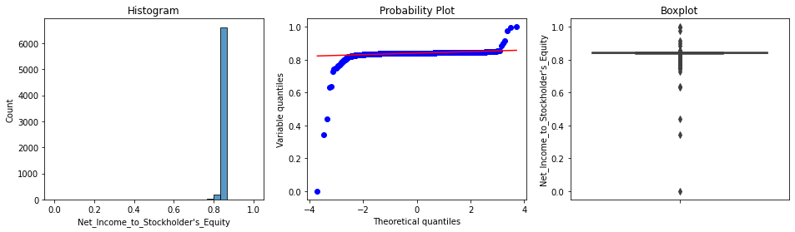
Exploratory Data Analysis
Most variables are skewed or/and have high kurtosis. Some of them have outliers on one or both sides. All the numerical variables have mean that differs between target classes.

Slide 5
Feature Engineering and Selection
Original features’ distribution
Shuffle feature selection didn't give any insight because all the features reduced the score by only 0.009 to 0.023.
Ordering features by single feature prediction and then iteratively selecting k best features gave ROC AUC score of 0.9581 and reduced number of features to 10.

Slide 6
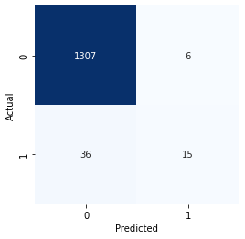
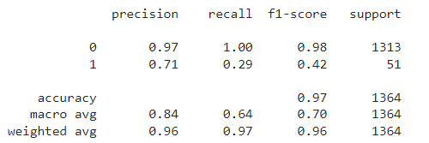
Performance
Probability cutoff 0.5 results in precision 0.71 and recall 0.29.

Slide 7
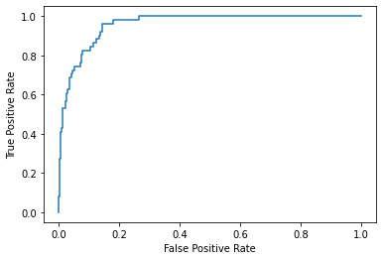
Performance
ROC AUC score:
0.9581

Slide 8
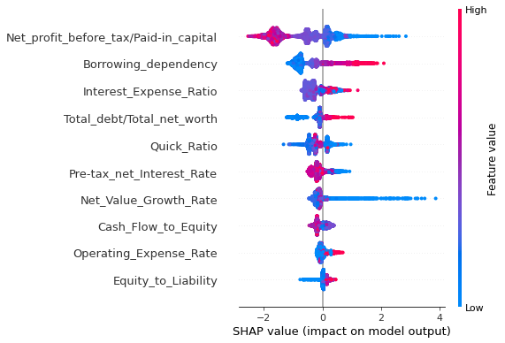
Feature Importance - SHAP

Slide 9
Summary and Conclusions
XGBoost modeling with 95 features gave ROC AUC score of 0.9588.
Shuffle feature selection didn't give any insight because all the features reduced the score by only 0.009 to 0.023.
Ordering features by single feature prediction and then iteratively selecting k best features gave ROC AUC score of 0.9581 and reduced nubmer of features to 10.

Slide 10
The end
Thank you for your attention!

