Slide 1

Concrete Strength Prediction from Composition and Age
Presented by Artem Ramus

Slide 2
Background
Abstract
Concrete is the most important material in civil engineering. The concrete compressive strength is a highly nonlinear function of age and ingredients.
Source
Original Owner and Donor Prof. I-Cheng Yeh Department of Information Management Chung-Hua University, Hsin Chu, Taiwan 30067, R.O.C. e-mail:icyeh@chu.edu.tw
Heysem Kaya, Department of Computer Engineering, Boğaziçi University, TR-34342, Beşiktaş, İstanbul, Turkey Email: heysem@boun.edu.tr
Citation Request
NOTE: Reuse of this database is unlimited with retention of copyright notice for Prof. I-Cheng Yeh and the following published paper:
I-Cheng Yeh, "Modeling of strength of high performance concrete using artificial neural networks," Cement and Concrete Research, Vol. 28, No. 12, pp. 1797-1808 (1998).

Slide 3
Introduction
The goal of this project is to predict compressive strength of concrete from composition and age.
Available variables
Cement, kg in a m3 mixture
Blast Furnace Slag, kg in a m3 mixture
Fly Ash, kg in a m3 mixture
Water, kg in a m3 mixture
Superplasticizer, kg in a m3 mixture
Coarse Aggregate, kg in a m3 mixture
Fine Aggregate, kg in a m3 mixture
Age, days

Slide 4
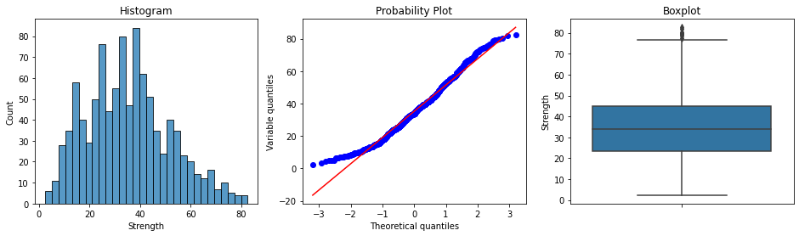
Exploratory Data Analysis
Distributions of numerical variables are reasonably close to normal. No acute outliers.

Slide 5
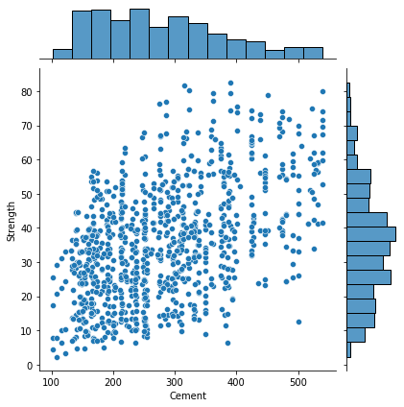
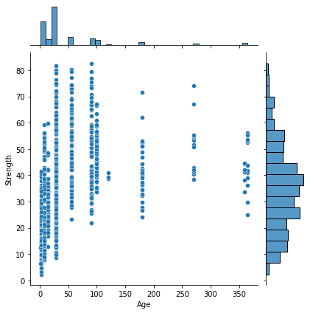
Exploratory Data Analysis
Target variable is highly dependable on ‘Cement’ and ‘Age’.

Slide 6
Feature Engineering and Selection
Original distribution of all the variables selected.
Based on single feature shuffling method, variables ‘Fly_Ash’ and ‘Superplasticizer’ showed least influence of about 1%.
Selected variables: ‘Cement’, ‘Blast Furnace Slag’, ‘Water’, ‘Coarse Aggregate’, ‘Fine Aggregate’ and ‘Age’.

Slide 7
Summary and Conclusions
XGBoost regression gave RMSE of 24.3 MPa and R square score of 92%.

Slide 8
The end
Thank you for your attention!

