Slide 1

Combined cycle power plant performance prediction
Presented by Artem Ramus

Slide 2
Background
Abstract:
Concrete is the most important material in civil engineering. The concrete compressive strength is a highly nonlinear function of age and ingredients.
Source:
Original Owner and Donor Prof. I-Cheng Yeh Department of Information Management Chung-Hua University, Hsin Chu, Taiwan 30067, R.O.C. e-mail:icyeh '@' chu.edu.tw TEL:886-3-5186511
Heysem Kaya, Department of Computer Engineering, Boğaziçi University, TR-34342, Beşiktaş, İstanbul, Turkey Email: heysem '@' boun.edu.tr
https://archive.ics.uci.edu/ml/datasets/Concrete+Compressive+Strength

Slide 3
Introduction
Given are the variable name, variable type, the measurement unit and a brief description. The concrete compressive strength is the regression problem. The order of this listing corresponds to the order of numerals along the rows of the database.
Citation Request:
NOTE: Reuse of this database is unlimited with retention of copyright notice for Prof. I-Cheng Yeh and the following published paper:
I-Cheng Yeh, "Modeling of strength of high performance concrete using artificial neural networks," Cement and Concrete Research, Vol. 28, No. 12, pp. 1797-1808 (1998).

Slide 4
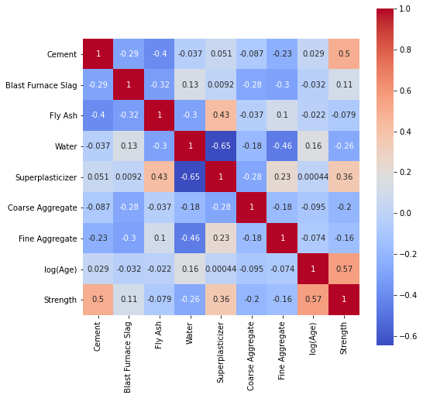
Methodology
The data set is checked for duplicates, null values and homogeneous features.
Data distribution is checked with histogram, distribution and box plots for skewness and outliers.
Correlation between features was examined with a correlation matrix.

Slide 5
Performance of the Model
Performance of the following models was estimated based on Pearson coefficient:
    Random forest
    XGBoost

Slide 6
Summary and Conclusions
XGBoost regression gave best R square score of 92%, random forest - 90%

Slide 7
The end
Thank you for your attention!

