Slide 1

Credit Card Fraud Detection
Presented by Artem Ramus

Slide 2
Background and Introduction
The goal of this project is to predict if a transaction is fraudulent from 28 anonymous features and an amount.
This data set is about credit card fraud detection. It was published by Rashida Sucky. The feature names aren't available. It has a binary column that indicates if a transaction is fraudulent or not. This data set can be used for classification models.
Link to the data set: https://github.com/rashida048/Datasets/blob/master/fraud_data.csv

Slide 3
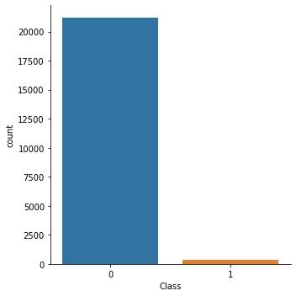
Exploratory Data Analysis - target
The target is imbalanced with under-represented class 1, fraudulent.
class | 0 | 1
count | 21204 | 346

Slide 4
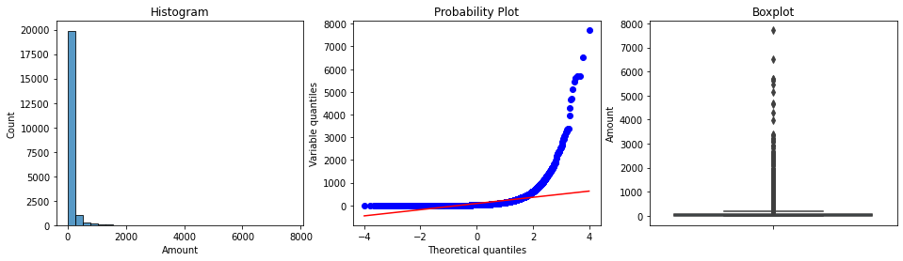
Exploratory Data Analysis
Amount is right skewed with high kurtosis and possible outliers at high values. Most of the variable are skewed or/and have high kurtosis. Possible outliers do not seem acute.

Slide 5
Exploratory Data Analysis
Variable | Mean trustworthy | Mean fraudulent
V1 | 0.0315 | -4.2053
V2 | -0.0094 | 3.3247
V3 | 0.0258 | -6.5457
... | ... | ...
... | ... | ...
... | ... | ...
V26 | 0.0016 | 0.041
V27 | -0.0017 | 0.1993
V28 | 0.0012 | 0.1177
Amount | 86.7 | 116.4
All the 28 variables are numerical. Each variable’s mean differs significantly for classes 0 and 1. This means that populations of classes 0 and 1 are different.

Slide 6
Feature Engineering and Selection
Using all the features for modeling
Original features’ distribution
Modeling with Random Forest and XGBoost

Slide 7
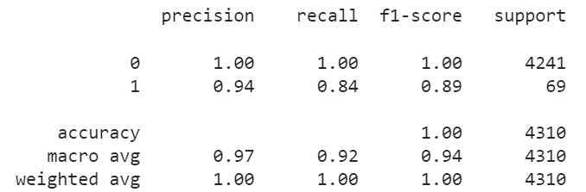
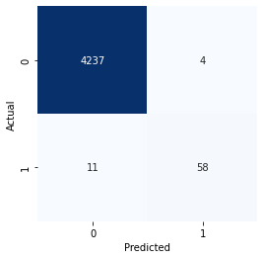
Performance
Probability cutoff 0.5 results in precision 0.94 and recall 0.84.

Slide 8
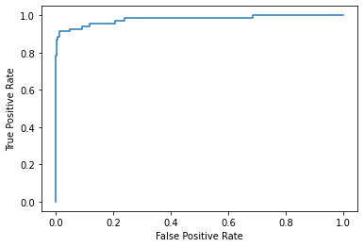
Performance
ROC AUC score: 0.9794

Slide 9
Summary and Conclusions
With all variables included and originally distributed, XGBoost classifier demonstrates ROC AUC score 0.979.
Probability cutoff 0.5 results in precision 0.94 and recall 0.84.

Slide 10
The end
Thank you for your attention!

