Slide 1

Driving Services Pricing
Presented by Artem Ramus

Slide 2
Background
Ride-hailing service is launched. This service matches riders with drivers for trips. It’ll be active for only 12 months. Riders are charged $30 for each ride. Drivers for each individual ride are chosen. The drivers pool is very deep. When a ride is requested, a very large pool of drivers see a notification informing them of the request. They can choose whether or not to accept it. Based on a similar ride-hailing service in the same market, there is some data on which ride requests were accepted and which were not. The PAY column is what drivers were offered and the ACCEPTED column reflects whether any driver accepted the ride request.
There are 10,000 riders available, but monthly limit is1,000. “Acquisition” means that the rider has downloaded the app and may request rides. Requested rides may or may not be accepted by a driver. In the first month that riders are active, they request rides based on a Poisson distribution where lambda = 1. For each subsequent month, riders request rides based on a Poisson distribution where lambda is the number of rides that they found a match for in the previous month. If a rider finds no matches in a month, they leave the service and never return.

Slide 3
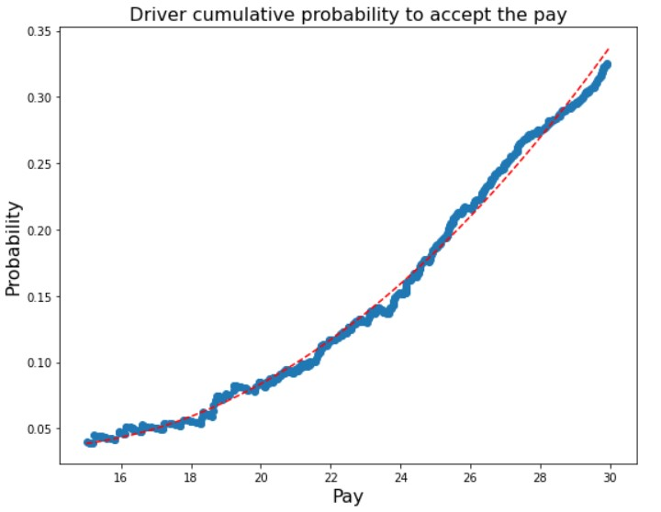
Solution and result
Maximization of a profit from a ride-hailing service is simulated as function of payment to drivers. Drivers work more as price goes up, so the dependency estimated with curve fitting. For each price in the range during 12 months, car pools of totally 10,000 potential riders simulated. Limitation of 1000 pulls per month taken into account.

Slide 4
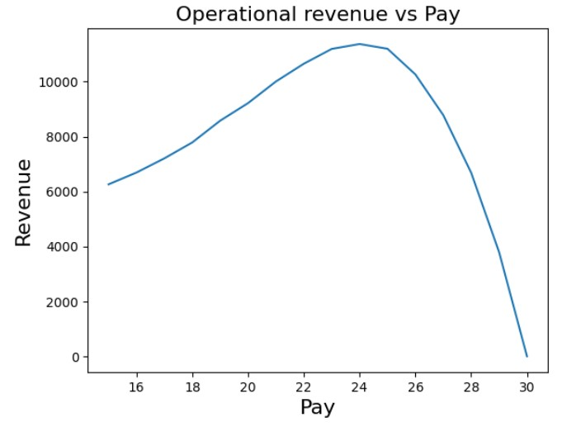
Solution and result
Solution, continued
First, average of 30 simulations taken in price range 15-30 to find that optimal price is near 24. Then, 120 simulations per price in range 23-25 with smaller step.
Result
Optimal price found to be 24.00 with revenue 11,440.

Slide 5
The end
Thank you for your attention!

