Slide 1
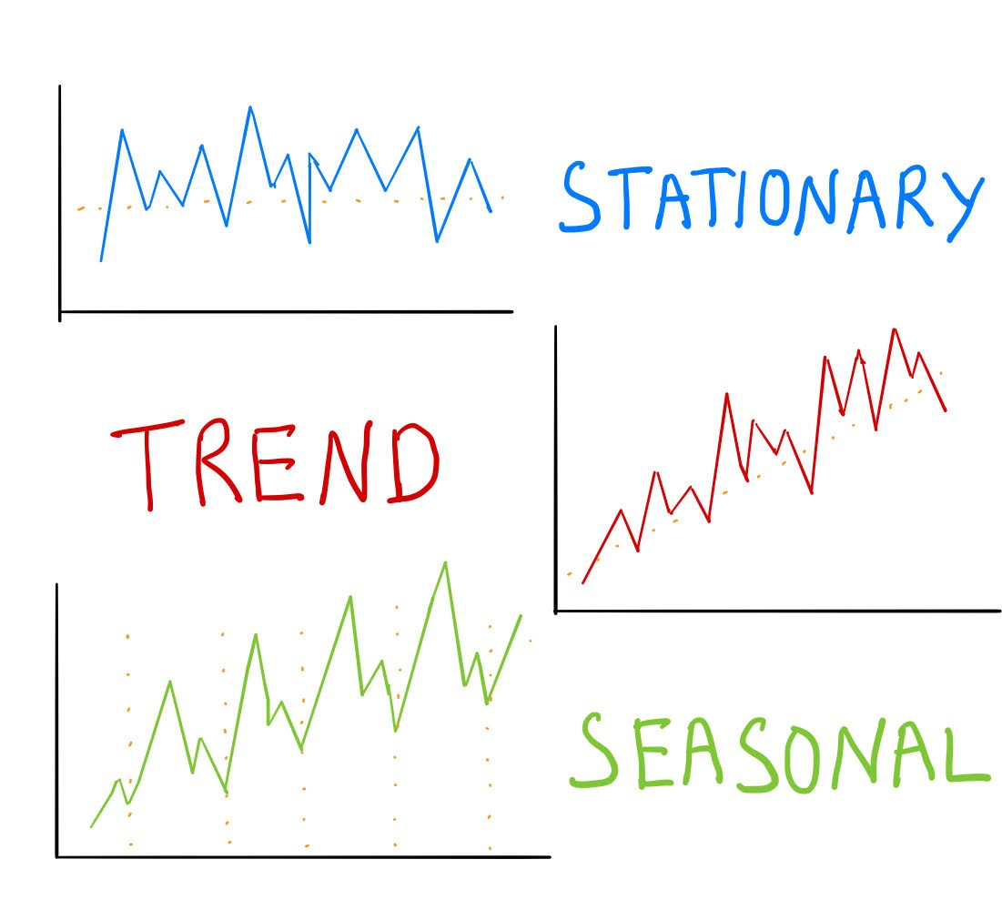

Hungarian Chickenpox Cases Forecasting
Presented by Artem Ramus

Slide 2
Background
Abstract: A spatio-temporal data set of weekly chickenpox cases from Hungary. The data set consists of a county-level adjacency matrix and time series of the county-level reported cases between 2005 and 2015.
Source:
Benedek Rozemberczki, The University of Edinburgh, benedek.rozemberczki '@' gmail.com
Link to hte dataset at UCI: https://archive.ics.uci.edu/ml/datasets/Hungarian+Chickenpox+Cases

Slide 3
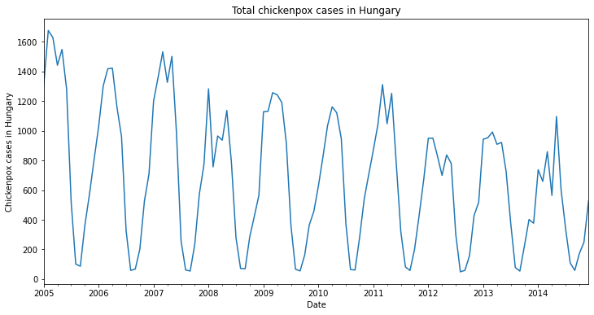
Introduction
The data set consists of a county-level adjacency matrix and time series of the county-level reported cases between 2005 and 2015. There are 2 specific related tasks: County level case count prediction and nation level case count prediction.
Attributes are weekly counts of chickenpox cases in Hungarian counties.
Data Set Characteristics: Time-Series
Number of Instances: 521
Area: Life
Attribute Characteristics: Real
Number of Attributes: 20

Slide 4
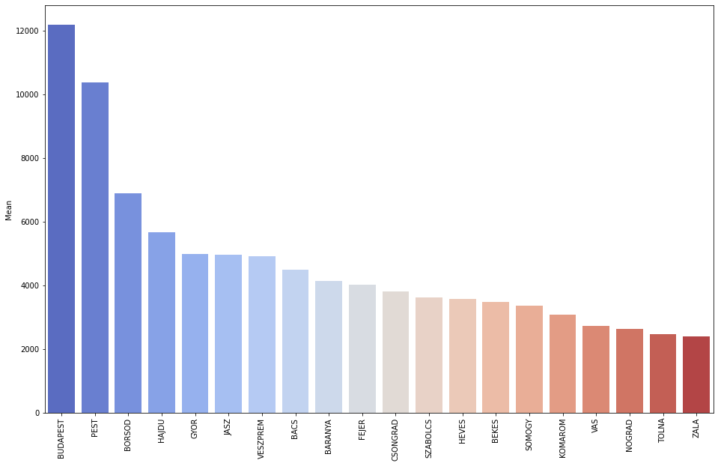
Exploratory Data Analysis
Distribution of total cases per areas in Hungary
Budapest and Pest areas cases count is prominently higher than others.
Tolna and Zala shows least cases.
Order of cases sum is consistent with mean for all the areas.

Slide 5
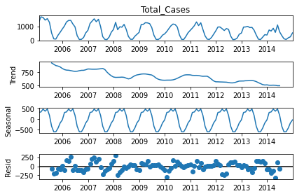
Decomposition
Yearly seasonality
Downward trend
Noise

Slide 6
Methodology
Optimal sampling frequency - monthly
SARIMA and RNN LSTM models
trained on 9 years train-set
1 year prediction

Slide 7
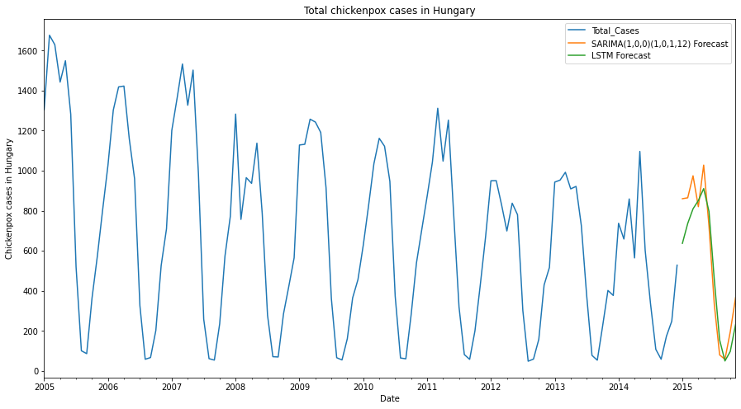
Performance of the Model
Predictions
along with
the original
data

Slide 8
Summary and Conclusions
SARIMA and LSTM RNN demonstrated similar performance.
RMSE of SARIMA is 140, LSTM - 165.

Slide 9
The end
Thank you for your attention!

