Slide 1

Credit Card Fraud Detection
Presented by Artem Ramus

Slide 2
Introduction
Modeling wine preferences by data mining from physic-chemical properties. There is two separate data sets – white and red wine.
In the above reference, two data sets were created, using red and white wine samples. The inputs include objective tests (e.g. PH values) and the output is based on sensory data (median of at least 3 evaluations made by wine experts). Each expert graded the wine quality between 0 (very bad) and 10 (very excellent). Several data mining methods were applied to model these data sets under a regression approach. The support vector machine model achieved the best results. Several metrics were computed: MAD, confusion matrix for a fixed error tolerance (T), etc. Also, we plot the relative importance of the input variables (as measured by a sensitivity analysis procedure).

Slide 3
Background
Created by:
Paulo Cortez (Univ. Minho), Antonio Cerdeira, Fernando Almeida, Telmo Matos and Jose Reis (CVRVV) @ 2009
Past Usage:
P. Cortez, A. Cerdeira, F. Almeida, T. Matos and J. Reis.
Modeling wine preferences by data mining from physicochemical properties.
In Decision Support Systems, Elsevier, 47(4):547-553. ISSN: 0167-9236.
Link to hte dataset at Kaggle: https://www.kaggle.com/danielpanizzo/wine-quality

Slide 4
Methodology
The data sets checked for duplicates and null values
Outliers and skewness checked
Constant, quasi-constant and highly-correlated features deleted
Cross-validation used
Rare target classes identified and deleted
Hyper-parameters optimization technique grid search used

Slide 5
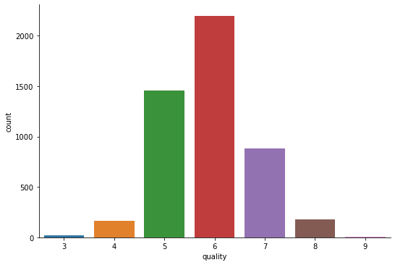
Methodology
Identification of
rare classes
The rare classes excluded from the prediction

Slide 6
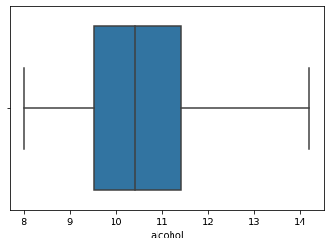
Methodology
Box plot of the alcohol content
Distribution of all the features verified and corrected

Slide 7
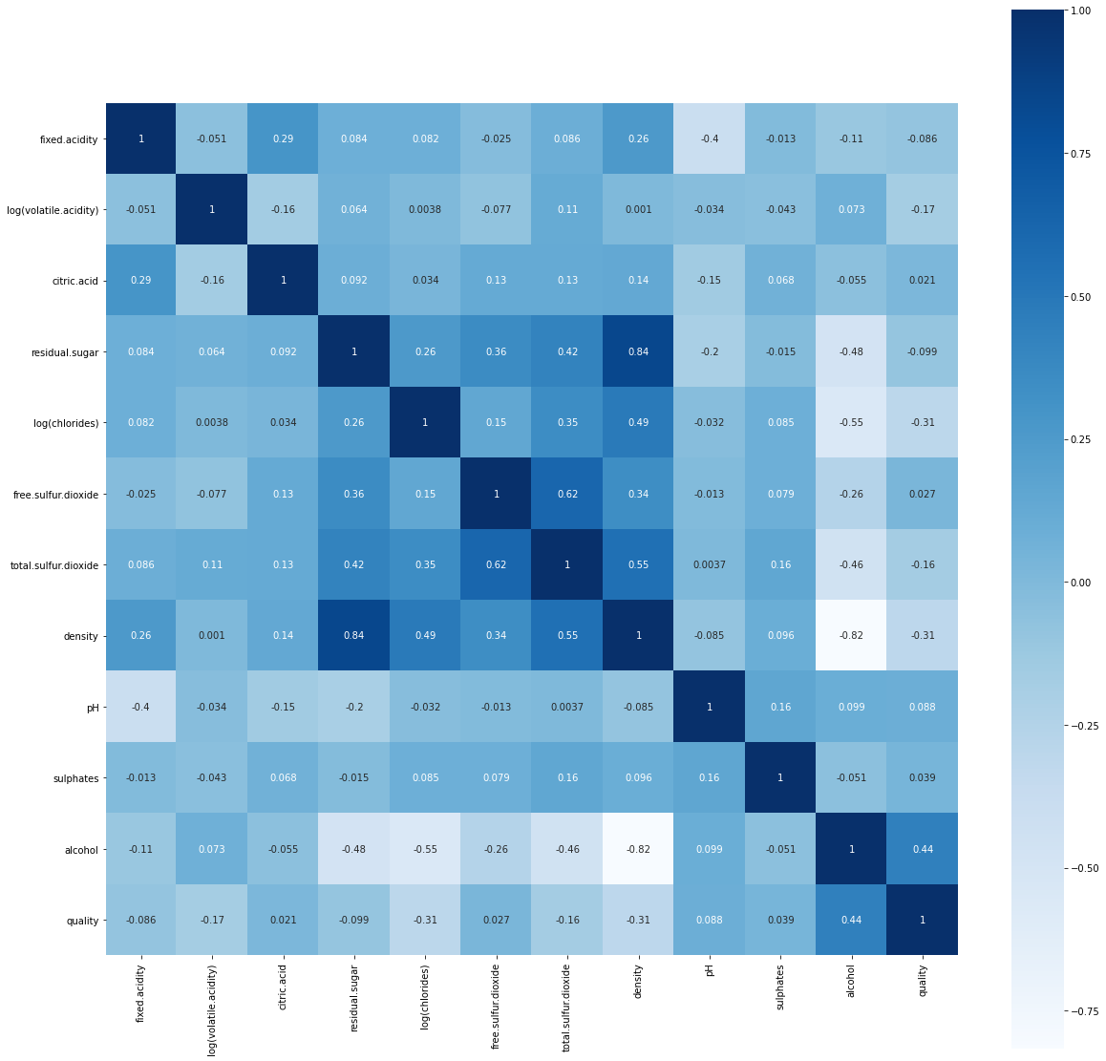
Methodology
Correlation matrix
Linear correlation of all the columns examined

Slide 8
Performance of the Model
Following models were tested:
  Logistic regression
  KNN
  SVM/Kernel SVM
  Naive Bayes
  Random forest
  XGBoost
  Cat boost
  ANN
Hyper-parameters optimization technique grid search used with the random forest that gave the best performance in this case

Slide 9
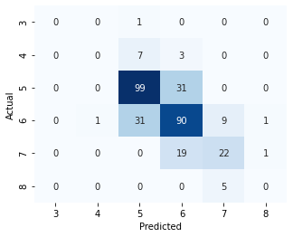
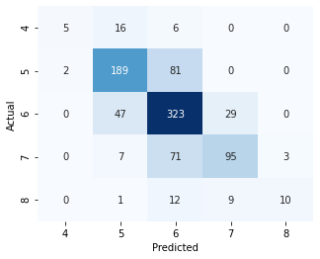
Performance of the Model
Red wine 66% White wine 70%

Slide 10
The end
Thank you for your attention!

