Slide 1

Energy Efficiency of Buildings
Presented by Artem Ramus

Slide 2
Background
Abstract
Energy effectiveness of buildings is crucial for choice of HVAC system and, traditionally, it's calculated based on geometrical and thermal properties of buildings.
Source
The data set was created by Angeliki Xifara (angxifara@gmail.com, Civil/Structural Engineer) and was processed by Athanasios Tsanas (tsanasthanasis@gmail.com, Oxford Centre for Industrial and Applied Mathematics, University of Oxford, UK).
Citation Request
A. Tsanas, A. Xifara: 'Accurate quantitative estimation of energy performance of residential buildings using statistical machine learning tools', Energy and Buildings, Vol. 49, pp. 560-567, 2012 (the paper can be accessed from [Web Link])

Slide 3
Introduction
The goal of this project is to predict heating and cooling load of buildings geometrical and thermal properties of buildings.
Variables
X1 Relative Compactness
X2 Surface Area - m²
X3 Wall Area - m²
X4 Roof Area - m²
X5 Overall Height - m
X6 Orientation - 2:North, 3:East, 4:South, 5:West
X7 Glazing Area - 0%, 10%, 25%, 40% (of floor area)
X8 Glazing Area Distribution (Variance) - 1:Uniform, 2:North, 3:East, 4:South, 5:West
y1 Heating Load - kWh/m²
y2 Cooling Load - kWh/m²

Slide 4
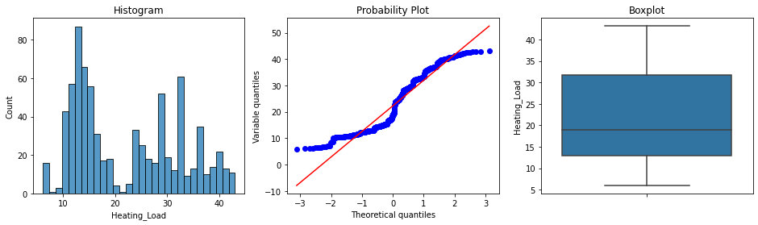
Exploratory Data Analysis
Distributions of numerical variables are reasonably close to normal.
No acute outliers.

Slide 5
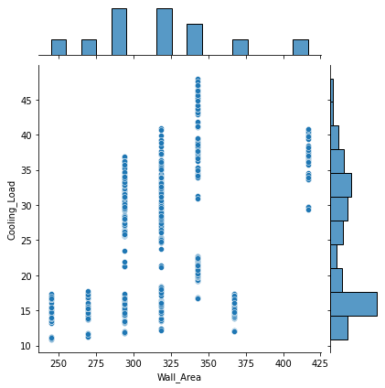
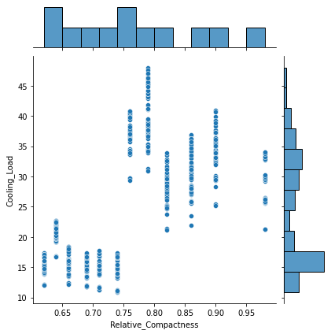
Exploratory Data Analysis
Target variables are correlated with all the variables.

Slide 6
Feature Engineering and Selection
Original distribution of all the variables selected.
One hot encoding applied to categorical variables.
All the features selected for modeling.

Slide 7
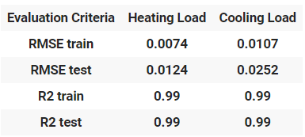
Summary and Conclusions
Both, heating and cooling load, predicted by XGBoost regressor with R square score of 0.99. RMSE of heating load is 0.011, cooling - 0.025 kWh/m².

Slide 8
The end
Thank you for your attention!

