Slide 1

Scientific Text Topic Classifier
Presented by Artem Ramus

Slide 2
Background, by the data publisher
Context
In India, every year lacs of students sit for competitive examinations like JEE Advanced, JEE Mains, NEET, etc. These exams are said to be the gateway to get admission into India's premier Institutes such as IITs, NITs, AIIMS, etc. Keeping in mind that the competition is tough as lacs of students appear for these examinations, there has been an enormous development in Ed Tech Industry in India, fortuning the dreams of lacs of aspirants via providing online as well as offline coaching, mentoring, etc. This particular data set consists of questions/doubts raised by students preparing for such examinations.
Content
The data set contains Students-questions.csv file in version 1 as of now. Inside the CSV file, we have two columns:
1. eng: The full question or description of the questions
2. Subject: Which subject does the question belong to. It has 4 classes, physics, chemistry, biology, and mathematics.
So, it's basically an NLP problem where we have the question description and we need to find out which subject does this question belongs to.

Slide 3
Introduction, by the data publisher
A note from a publisher of the data set
The goal is to classify the given texts into 4 subjects i.e, maths, physics, chemistry, and biology.
Challenges
Data cleaning (contains random special characters, symbols, expressions which might contain class dependent information. Also carries latex formulas, mathematical functions, etc.), class imbalance. Customized NLP techniques (lemmatization, stemming, stop word removal must be carried out carefully to distinguish between classes.). Overfitting.
A link to the data set
https://www.kaggle.com/mrutyunjaybiswal/iitjee-neet-aims-students-questions-data

Slide 4
Bag of Words modeling
Count vectorization and TF-IDF

Slide 5
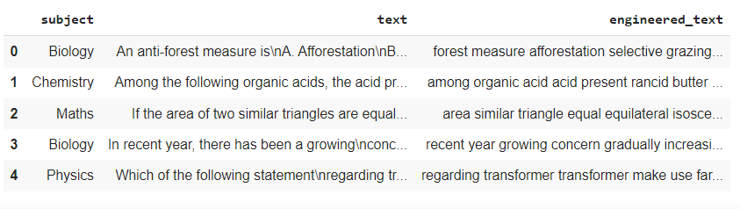
Data cleaning
Lemmatizing with nltk.stem.WordNetLemmatizer
Stopwords removal with NLTK and custom words, common to all the scientific texts.

Slide 6
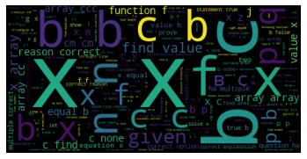
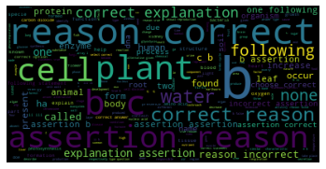
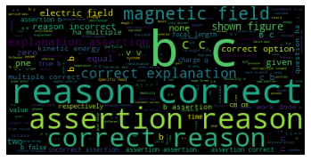
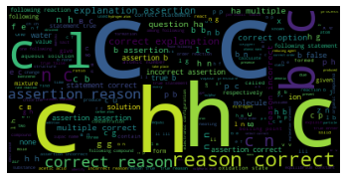
Exploratory Data Analysis – word clouds with default pipeline
Math
Biology
After leaving only alphabetical tokens and lemmatization
Common scientific words found in all the subjects, like ‘correct’ and ‘reason’
One-character symbols found in all the subjects.
Physics
Chemistry

Slide 7
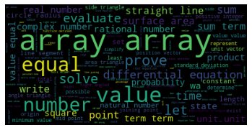
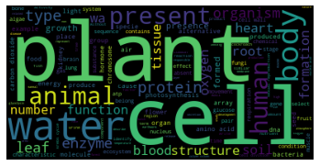
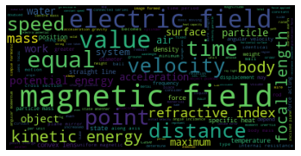
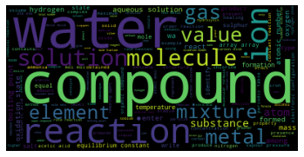
Feature Engineering – word clouds with customized pipeline
Math
Biology
After removing short words and common scientific words
Words distributions became more meaningful and representative for the subject.
Physics
Chemistry

Slide 8
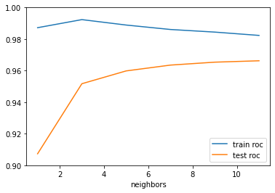
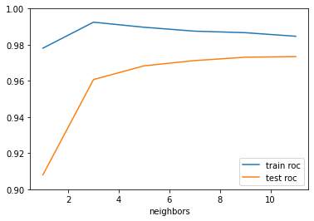
Results – overfitting mitigation
Modeling after default text preparation gave overfitting. After removal of short words and common scientific words, validity of the solution improved
TF-IDF vectorization with 1-grams vs. 1-grams & 2-grams testes. 1-grams’ scores are slightly better.
Default text preparation
After removal
of short words
and common scientific words

Slide 9
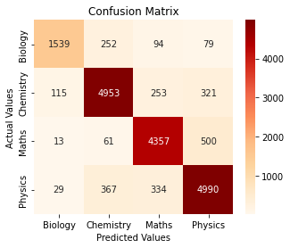
Results – confusion matrix
With 7 neighbors, one-vs-rest weighted ROC-AUC train score is 0.9875 and test - 0.9721.
Accuracy per class
Biology 1539/1964 0.78
Chemistry 4953/5642 0.88
Math 4357/4931 0.88
Physics 4990/5720 0.87

Slide 10
Neural Networks modeling
Transformers BertForSequenceClassification

Slide 11
Neural Networks modeling
BertTokenizer
BERT pre-trained Model
AdamW Optimizer, learning rate 1e-5, epsilon 1e-8
36 batches
2 epochs

Slide 12
Validation
Epoch 1
Training loss : 0.2170
Validation loss : 0.1573
F1 Score (Weighted) : 0.9465
Epoch 2
Training loss : 0.1204
Validation loss : 0.1416
F1 Score (Weighted) : 0.9527
Epoch 3
Training loss : 0.0867
Validation loss : 0.1516
F1 Score (Weighted) : 0.9542

Slide 13
Results
After second epoch
Accuracy per class
Biology 1767/1964 0.89
Chemistry 5353/5642 0.94
Math 4849/4931 0.98
Physics 5426/5720 0.94

Slide 14
The end
Thank you for your attention!

