Slide 1

Vehicle Fuel Economy Prediction
Presented by Artem Ramus

Slide 2
Introduction and Background
The goal of this project is to predict fuel consumption, aka 'combined MPG', from 80 cars' attributes.
Content
The purpose of EPA’s fuel economy estimates is to provide a reliable basis for comparing vehicles. Most vehicles in the database (other than plug-in hybrids) have three fuel economy estimates: a “city” estimate that represents urban driving, in which a vehicle is started in the morning (after being parked all night) and driven in stop-and-go traffic; a “highway” estimate that represents a mixture of rural and interstate highway driving in a warmed-up vehicle, typical of longer trips in free-flowing traffic; and a “combined” estimate that represents a combination of city driving (55%) and highway driving (45%). Estimates for all vehicles are based on laboratory testing under standardized conditions to allow for fair comparisons.

Slide 3
Introduction and Background
Acknowledgments
Fuel economy data are produced during vehicle testing at the Environmental Protection Agency's National Vehicle and Fuel Emissions Laboratory in Ann Arbor, Michigan, and by vehicle manufacturers with EPA oversight.
Link to the data set at Kaggle:
https://www.kaggle.com/prasy46/credit-score-prediction

Slide 4
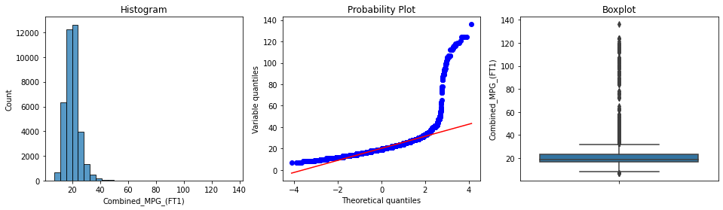
Exploratory Data Analysis – target
The target distribution is right skewed. Skewness of Combined_MPG_(FT1) is 5.73.

Slide 5
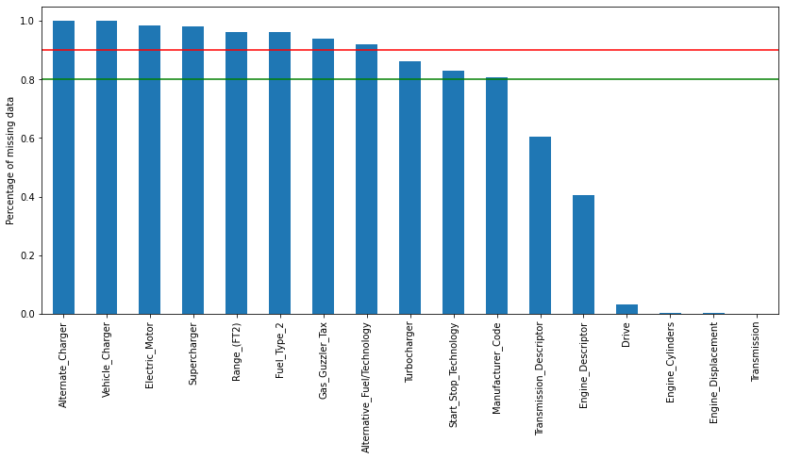
Exploratory Data Analysis – missing values
There are 17 variables with missing values. 9 of them has more than 90% missing values.

Slide 6
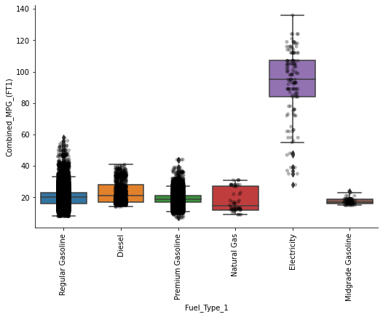
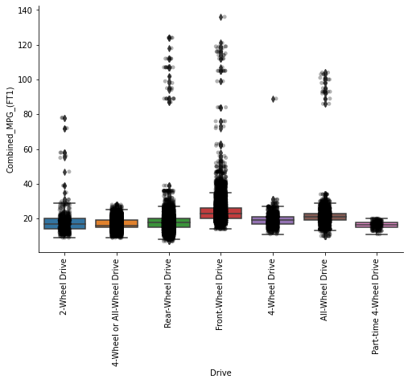
Exploratory Data Analysis – categorical variables
There are 18 variables. 9 of them vary with the target and may be used as predictors.

Slide 7
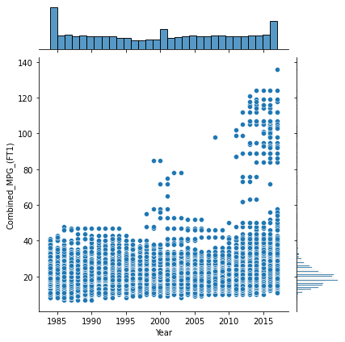
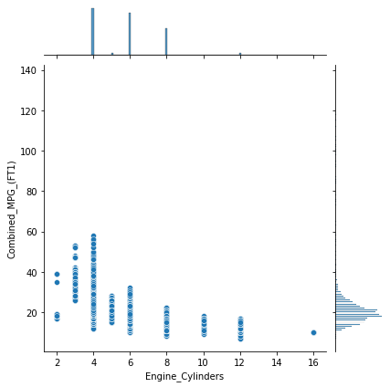
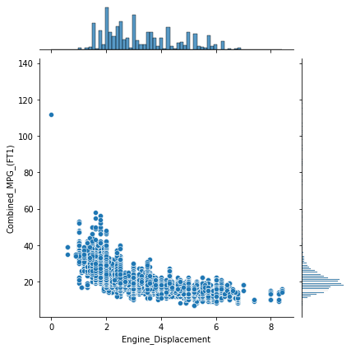
Exploratory Data Analysis – continuous variables
There are 10 variables . All of them are correlated with the target. Some variables, like engine cylinders and displacement are inter-correlated.

Slide 8
Feature Engineering – missing values imputation
Boolean
For boolean variables, N was imputed.
Categorical
For categorical variables, mode was imputed.
Numerical
engine displacement was imputed with the train set mean value.

Slide 9
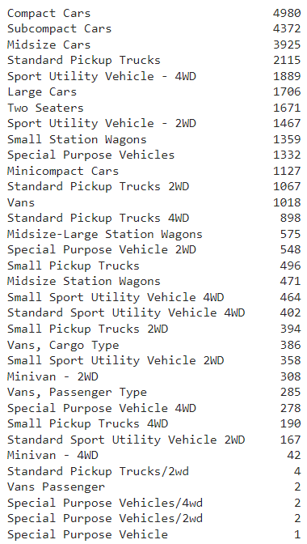
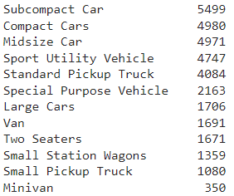
Feature Engineering – categorical variables
Some categorical variables are fixed based on domain knowledge and their influence on the target.
Class variable fixed

Slide 10
Feature Selection
Based on the correlation analysis, 4 inter-correlated numerical features removed.
Based on the correlation analysis, 2 low correlated with target features, quasi-constant categorical features removed
Based on feature shuffling, 3 features removed.
8 features selected for modelling

Slide 11
Performance
Model
XGBoost regressor
Cross validation
RMSE: 92.75 %, Standard Deviation: 1.09 %
Evaluation
RMSE train: 2.92 MPG
RMSE test : 3.01 MPG
r2 train : 0.94
r2 test : 0.94

Slide 12
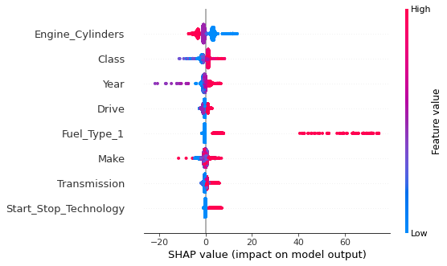
Feature Importance - SHAP

Slide 13
Summary
8 of 81 features are selected for modeling.
With the selected features credit scores were predicted with RMSE_train of 2.92 and RMSE_test of 3.01 MPG. R2_train 0.94 and R2_test 0.94.

Slide 14
The end
Thank you for your attention!

