Slide 1

HiveMind
Artem Skitenko
Joshua Madrigal

Slide 2
Use Case: Add Proposal(Student)
Actor
1. Go to website
3. Select one of the classes
5. Select prefer times
System
2. Show Classes that student needs to take
4. Show a table with time and weekdays
6. Save user selections

Slide 3
Use Case: Check Proposals(Professor)
Actor
1.Go to website
3. Click on Courses
System
2. Show Courses
4. Show proposals

Slide 4
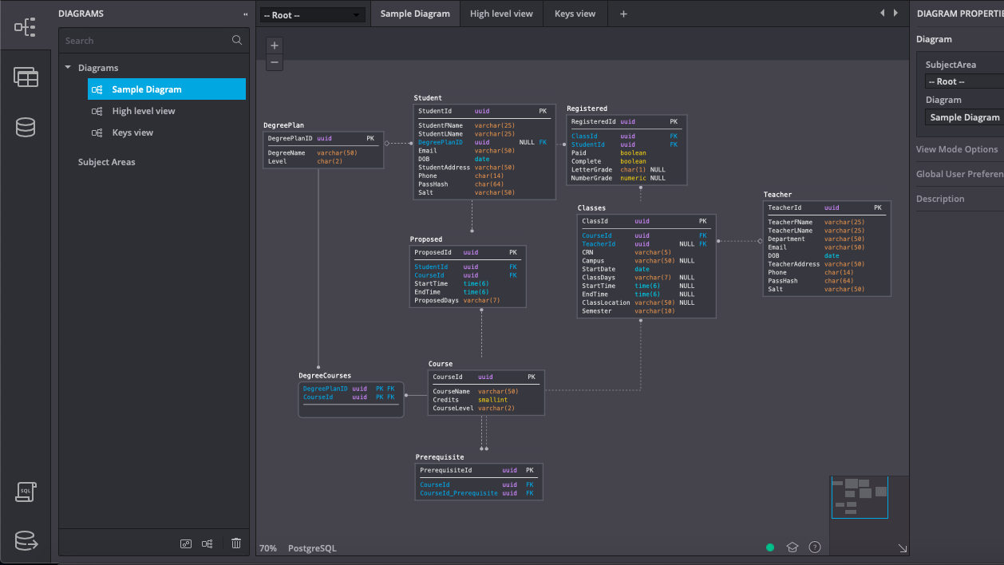

Slide 5
Demo

