Slide 1
Data Analytics for Inventory Management
Artem Nazarenko, Joao Sarraipa and Majid Zamiri
NOVA University Lisbon (UNL)

Slide 2
Table of Content
Table of Content:
Objectives
Chapter 1 – Introduction into Inventory Management
Inventory Management and its importance
Inventory Systems and Inventory Policies
Chapter 2 – Analytics in Inventory Management
Introduction into Machine Learning
Types of Analytics and Challenges
Predictive Analytics and Demand Forecsating
Chapter 3 – Practical Examples
Data sets
Typical ML Flow
PySpark Example
Deep Learning Example (LSTM)

Slide 3
Objectives
Objectives:
Giving an insight insight into typical Invnetory Management problems.
Introduce the taxonomie of Machine Learning approaches.
Introducing core types of Analytics.
Understanding of a typical ML flow.
Application of ML in the area of Inventory Management (Demand Forecasting)

Slide 4
Chapter 1 – Introduction into Inventory Management

Slide 5
Chapter 1.1 – Inventory Control and its importance

Slide 6
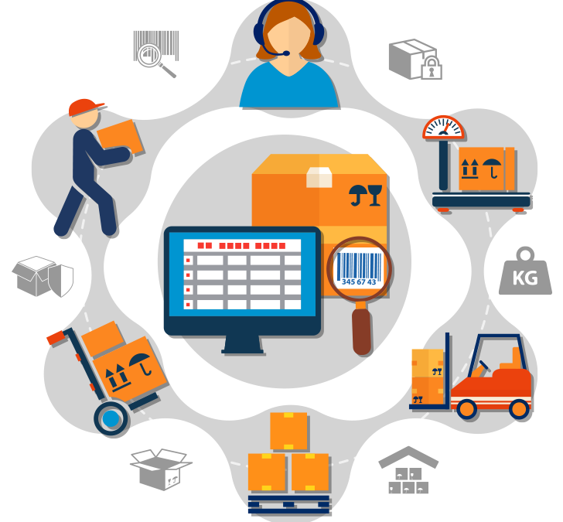
Overview to Inventory Management
Inventory management is a critical element of the supply chain, which deals with the governing and tracking of inventory from manufacturers to warehouses and from purchasing right to a point of sale.
At a basic level, inventory management works by tracking products, components, and ingredients across suppliers, stock on hand, production, and sales to ensure that stock is used as efficiently and effectively as possible.
It is used to manage required service level for internal and external customers and also inventory visibility in supply chains.
Notes:
Inventory management, a critical element of the supply chain, is the governing and tracking of inventory from manufacturers to warehouses and from purchasing right through to a point of sale.
At a basic level, inventory management works by tracking products, components, and ingredients across suppliers, stock on hand, production, and sales to ensure that stock is used as efficiently and effectively as possible.
It is used to manage required service levels for internal and external customers and also inventory visibility in supply chains.

Slide 7
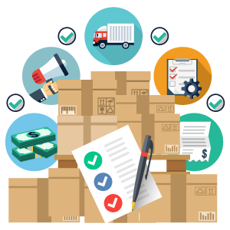

Objectives of Inventory Management
The main goals of inventory management are:
To know how much of the stock is needed, (in the right place, at the right time, and at the right cost).
To control inventory holding levels, minimize costs and bottlenecks, and manage current and future stock requirements.
To optimize the supply chain and increase reliability.
To fulfil incoming or open orders.
To minimize the chances of having items lost.
To meet customer demands.
Notes:
Inventory management is the fundamental cause of company longevity. When the inventory is properly organized, the rest of the supply-chain management will fall into place. The primary objective of inventory management is to strike a balance between inventory investment and customer service.
The main goals of inventory management are:
To know how much of the stock is needed, (in the right place, at the right time, and at the right cost) i.e. the business needs to manage inventory levels correctly.
To control inventory holding levels, minimize costs and bottlenecks, and manage current and future stock requirements.
To optimize the supply chain and increase reliability.
To fulfil incoming or open orders and raise profits.
To minimize the chances of having items lost.
To meet customer demands.

Slide 8
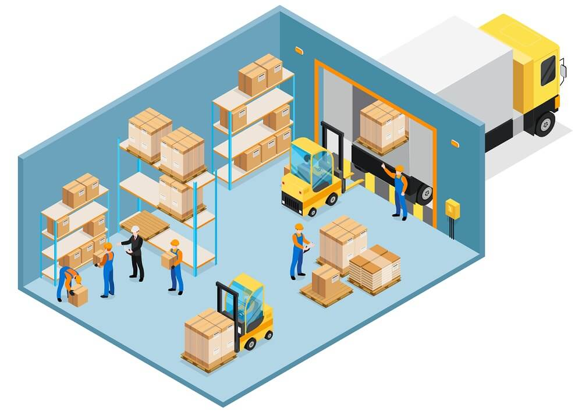
Overview to Inventory Control
Inventory control or stock control can be broadly defined as the process of keeping the right number of products and parts in the company stock to avoid shortages, overstocks, and other costly problems.
Inventory control refers to all aspects of managing a company’s inventories such as purchasing, shipping, receiving, tracking, warehousing, turnover, and reordering.
Notes:
Inventory control or stock control can be broadly defined as the process of keeping the right number of products and parts in the company stock to avoid shortages, overstocks, and other costly problems.
Inventory control includes managing a company’s inventory from time the item lands in the warehouse to the time it leaves the warehouse.
Inventory control refers to “all aspects of managing a company’s inventories: purchasing, shipping, receiving, tracking, warehousing and storage, turnover, and reordering.”

Slide 9
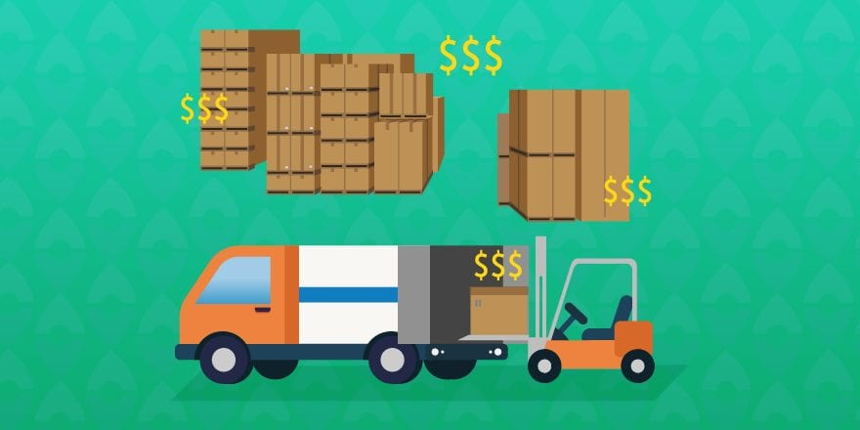
Costs Related to Inventory Control
There are several costs associated with Inventory control including but not limited to:
Working capital and capital costs,
Ordering costs,
Storage space costs,
Handling costs,
Shortage costs,
Transportation costs,
Spoilage costs,
Costs caused by Criminal
activities.
Notes:
There are several costs associated with Inventory control including but not limited to:
Working capital and capital costs: More often capital costs are the highest carrying costs that the business have to deal with. Capital costs involve the one-time fees required to physically carry and house inventory, such as purchasing land, building, equipment as well as setting up the machinery before starting the production.
Ordering cost: It is the cost associated with the ordering of raw material for the production process. It also includes the costs related to the advertisement, stationery, postage, transportation, etc. Generally, it reduces with the increase in the size of the order.
Storage space costs: Those costs cover recurring payments like rent, taxes, insurance, security, lighting, heating, upkeep, warehouse depreciation, some servicing costs, and other fees. In addition, they also include the wages for the security workers and janitors (i.e. the labor needed to uphold a clean, safe, and organized inventory storage facility).
Handling costs: are the costs related to safe inventory handling at the warehouse, they include, for instance, the tools and labor to move stock from one location to another within the space. Common handling costs include material handling equipment, forklift truck drivers, the upkeep of the robots that move the wares and expenses for workers who are responsible for managing and storing inventory.
Shortage cost: are the penalty cost for running out of stock. It includes the loss of current profit from not selling the item and the loss of reputation, even though it is sometimes difficult to estimate.
Purchase cost: The per-unit cost of purchasing an item. The purchasing cost usually depends on the amount if purchased items, usually the more the cheaper.
Spoilage costs: Perishable inventory stock can rot or spoil if not sold in time, so controlling inventory to prevent spoilage is essential. Products that expire are a concern for many industries. Industries such as the food and beverage, pharmaceutical, healthcare, and cosmetic industries, are largely affected by spoilage problems.
Costs due to Criminal activities: If a business fails to implement proper inventory controls, it is essentially leaving its inventory open to criminal activity, which can be incredibly costly. While theft might be the most obvious example leading to the additional expenses.

Slide 10
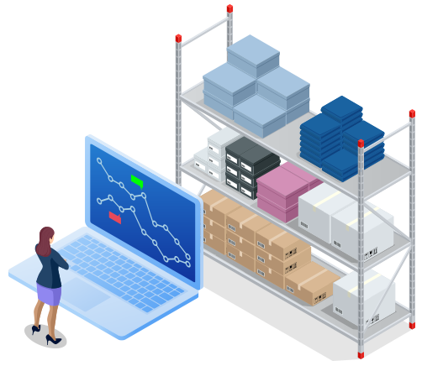
Importance of Inventory Control
Inventory control helps to:
protect a company in the case of demand fluctuations,
maintain control over the loss of materials due to carelessness or stealing,
minimize administrative workload, manpower requirement,
keep a smooth flow of raw materials and aids in continuing production operations,
check and maintain the right amount of stock,
avoid duplication in the ordering of stock,
simplify cost accounting activities
Notes:
Inventory control helps to:
protect a company in the case of demand fluctuations,
maintain control over the loss of materials due to carelessness or stealing,
minimize administrative workload, manpower requirement,
keep a smooth flow of raw materials and aids in continuing production operations,
check and maintain the right amount of stock,
avoid duplication in the ordering of stock,
simplify cost accounting activities

Slide 11
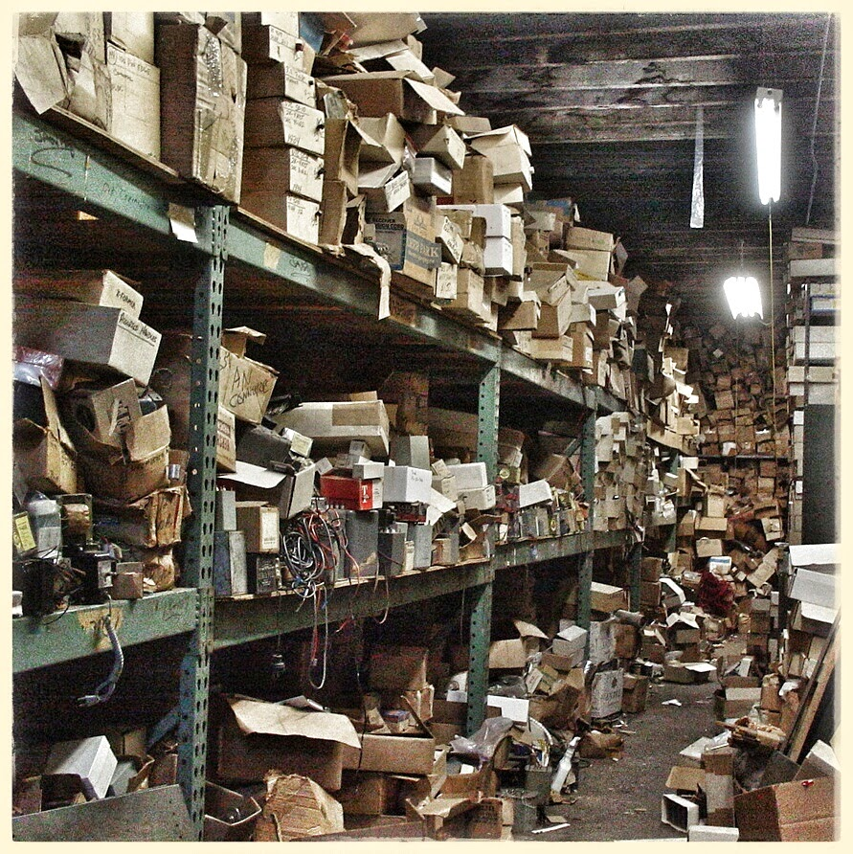
Common Inventory Control Problems
Lack of knowledge about the inventory,
Inefficient processes,
Rapidly fluctuating customer demand,
Inconsistent tracking,
Insufficient order management,
Inaccurate data/ Inadequate product
specifications,
Manual documentation/calculation,
High-cost of inventory,
Unorganized warehouse space,
Overstocking or stockouts of products,
Inadequate technological support,
Miscommunications/ Shipping wrong items.
Notes:
When it comes to controlling inventory, there are a lot of challenges that can cause problems. Due to not having a proper inventory system, the companies might have no understanding of the products demand in short or long term. As a result, they cannot find out when and how many product items they have to keep on stock and thus having difficulties with purchasing orders.
Common problems of Inventory Control include:
Lack of knowledge about the inventory,
Inefficient processes,
Rapidly fluctuating customer demand,
Inconsistent tracking,
Insufficient order management,
Inaccurate data/ Inadequate product
specifications,
Manual documentation/calculation,
High-cost of inventory,
Unorganized warehouse space,
Overstocking or stockouts of products,
Inadequate technological support,
Miscommunications/ Shipping wrong items.

Slide 12
Chapter 1.2 – Inventory Systems and Inventory Policies

Slide 13
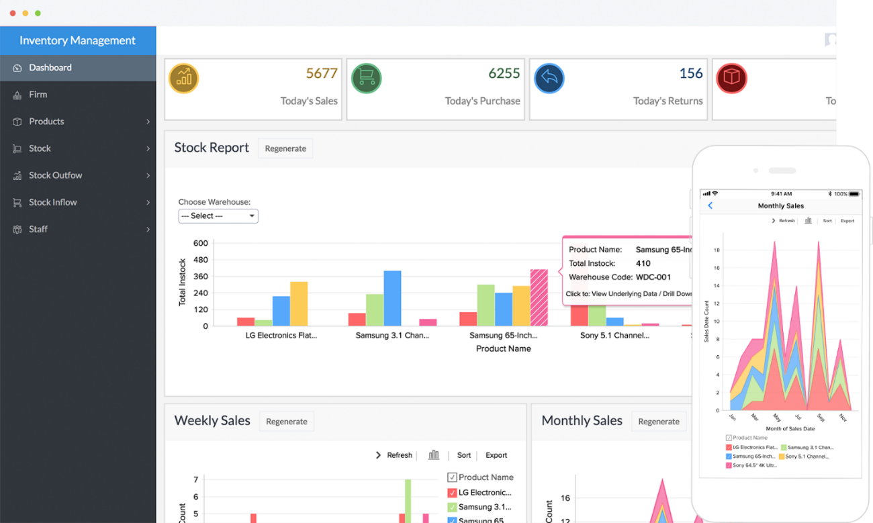
Inventory System
Inventory system is the combination of technologies (hardware and software), processes, and procedures used to integrate, track, and update all information regarding the maintenance of stocked products throughout the entire supply chain, from purchasing to production to end sales.
Inventory system enables businesses to save the time and effort required to manage their stock.
For example, an inventory system tracks and updates the raw materials, inventory purchases, products, inventory maintenance, demand forecast, inventory costs, and final sales.
Notes:
Inventory system is the combination of technologies (hardware and software), processes, and procedures used to integrate, track, and update all information (locations, vendor and supplier information, product specifications, and the total count of items) regarding the maintenance of stocked products throughout the entire supply chain, from purchasing to production to end sales.
Inventory system integrates the information from the various sources (i.e. item locations, vendor and supplier information, product specifications, and the total count of materials).
Inventory system enables businesses to save on the time and effort required to manage their stock effectively, with up-to-date information at their fingertips.
Inventory system helps businesses to have better, more transparent relationships with suppliers, vendors, and other partners.

Slide 14
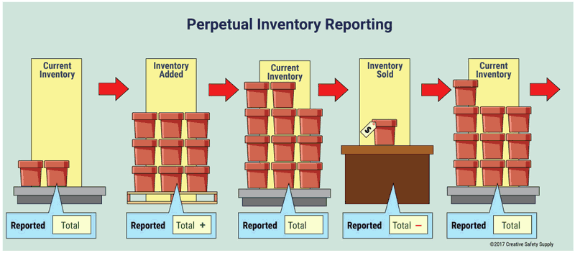
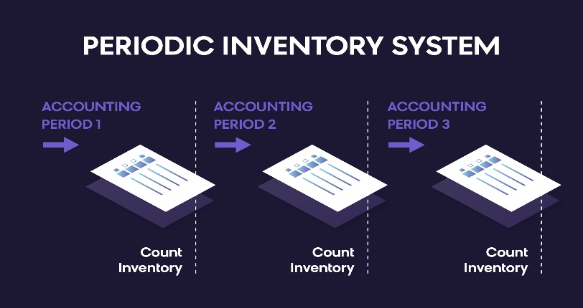
Types of Inventory System
There are several types of inventory systems available, the most commonly used include:
Perpetual inventory system – tracks inventory on a continual basis. This means that updates are automatically made to inventory levels when items are bought and new inventory is received, and purchases and returns are instantly recorded in the company’s inventory accounts.
Periodic inventory system – tracks inventory at the end of an accounting period. This can be on a weekly, monthly, quarterly, or annual basis. Companies will know the beginning and end of their inventory levels during the period by using physical inventory counts.
Notes:
Properly managing inventory requires a system of some sort. The different types of inventory management systems all have pros and cons.
There are several different kinds of inventory systems available, the most commonly used are:
Perpetual inventory system — tracks inventory on a continual basis. This means that updates are automatically made to inventory levels when items are bought and new inventory is received, and purchases and returns are instantly recorded in the company’s inventory accounts. Organizations prefer this type of inventory management system if they need up-to-date information and more minimal physical inventory counts.
Periodic inventory system — tracks inventory at the end of an accounting period. This can be on a weekly, monthly, quarterly, or annual basis. Companies will know the beginning and end of their inventory levels during the period by using physical inventory counts. Once it is completed, the balance is moved from the purchase accounts to the inventory account. It then adjusts to match the ending inventory costs. This method is mostly used by smaller businesses maintaining minimal inventory amounts.

Slide 15
Policies for Inventory System
The commonly used policies for inventory systems are:
Periodic review, order-up-to policy
When to order: Orders are placed like clockwork every R periods. The use of a fixed reorder interval is helpful to firms that cannot keep track of their inventory level in real-time or who prefer to issue orders to suppliers at scheduled intervals.
How much to order: The inventory level is measured and the gap computed between that current inventory level and the order-up-to level or target level Sx.
Comment: While the order size would be adequate to return the inventory level to S if replenishment were immediate, in practice there will be some replenishment delay (called lead time) during which time the inventory continues to drop, so the inventory level will rarely reach all the way up to S.
Notes:
Inventory policies are concerned with maximizing customer satisfaction and minimizing the costs associated with the inventory (e.g., ordering, storage, shortage).
Inventory policies should be aligned with the overall business’ financial goals and operational needs.
With a well-adjusted policy, companies can be more agile, efficient and profitable.

Slide 16
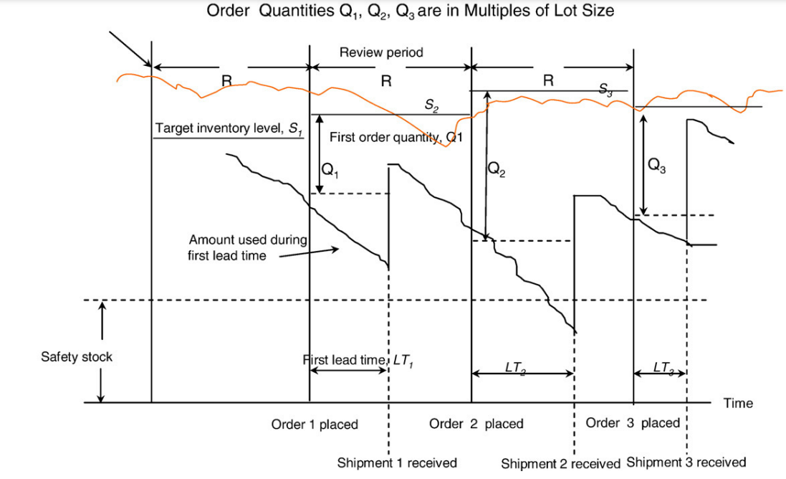
Policies for Inventory System
The commonly used policies for inventory systems are:
Periodic review, order-up-to policy

Slide 17
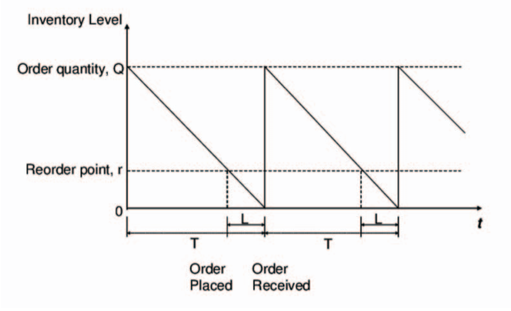
Policies for Inventory System
Continuous review, fixed order quantity policy
When to order: Orders are placed as soon as the inventory drops to or below the reorder point. In theory, the inventory level is checked constantly, but in practice, it is usually checked periodically at the beginning or end of each workday.
How much to order: The order size is always fixed.
Comment: The value of the fixed order quantity Q may not be entirely up to you. Often suppliers can dictate terms that restrict your choice of Q to values compatible with minima and multiples.
Notes:
Continuous review, fixed order quantity policy (Reorder Point, Order Quantity)
The shorthand notation for this policy is (R, Q), where R is the reorder point and Q is the fixed order quantity.
When to order: Orders are placed as soon as the inventory drops to or below the reorder point, R. In theory, the inventory level is checked constantly, but in practice, it is usually checked periodically at the beginning or end of each workday. Thus, the order is placed at the point r, but the amount of ordered items is as if it has already reached the zero level to compensate the delay or the lead time.
How much to order: The order size is always fixed at Q units.
Comment: The value of the fixed order quantity Q may not be entirely up to you. Often suppliers can dictate terms that restrict your choice of Q. For example, a supplier may insist on an order minimum of 20 units and always be a multiple of 5. Thus orders sizes must be either 20, 25, 30, 35, etc. (This comment also applied to the two other inventory policies.). As the order size is always the same, the model is less agile.

Slide 18
Chapter 2 – Analytics in Inventory Management

Slide 19
Chapter 2.1 – Introduction into Machine Learning

Slide 20
What is Machine Learning
The basic defintion of the ML can be formulated as follows [1]:
Machine Learning is the field of study that gives computers the ability to learn without being explicitly programmed.
Moreover, some authors define ML not only as a science area, but also as a kind of „art“ of programming machines so that they learn from data.
Machine Learning is used to solve the problems that otherwise cannot be solved or require significantly more efforts to be soilved with „conventional“ or „traditional“ approcahes and tools.
Importance of the ML become obvious in the case of, for instance, Big Data, where can be difficult to understand the structure of the data and to build a model of it.

Slide 21
Supervised, Unsupervised and Semi-Supevised
There are several categories how the ML approaches can be categorised:
Supervised, Unsupervised and Semi-Supevised
Online vs. Offline learning
Instance-based vs. Models Based

Slide 22
Supervised Machine Learning
Supervised learning is a type of ML that preumes that the engineer feeds the algorithm with the training data that already have the solution that is called „label“ [1]. Taking the previous example of spam classification, the label will be the data field indentifying if the email belongs to spam or not (i.e. boolean value, 1 for spam, 0 for non-spam). Thus, every unit of the data has this label assigned. In this regard, it is worth to mention the typical tasks of Supervised ML:
Classification that includes the previously mentioned example. Using the training data, the ML solution should be able to automatically classify the entities, such as, for instance, emails into classes of spam and non-spam.
Regression. One example could be the prediction of a numeric value. An example here could be the price of a product based on a set of features („old/new“, „brand“, etc.). Another example that is related to inventory management is the Demand Forecasting Problem, where the predicted value is the number of products that need to be available at certain time point to cover the demand. The features in this case could be the number of products solved at certain day/month/year, number of items at stock, number of defected item in batch, etc.

Slide 23
Supervised Machine Learning
Example of Supervised learning algorithms:
Support Vector Machine (SVM)
Linear Regression
Logistic Regression
Decision Trees
Some types of Neural Networks, the one should note that some types of NN can be unsupervised
K-Nearest Neighbours

Slide 24
Unsupervised Machine Learning
Unsupervised learning is a type of ML that is using unlabeled data for the training. In other words, the system tries to learn without a teacher [1]. Examples of some Unsupervised ML algortihms are given below:
Clustering. Is usually applied if it is important to extract some knowledge from the data. For instance, the one could wish to know who is the target audience that is buying certain product. The clustering algorithm can groupd the customers without a help of a „teacher.
Dimensionality Reduction. This taks can be sepcifically important when dealing with Big Data, as the intention is to simplify the data without loosing much information hidden in these data. One option is to merge several correlated features into one.
Anomaly Detection. The goal is to define the data units/instances that differ from the majority.

Slide 25
Unsupervised Machine Learning
Example of Unsupervised learning algorithms:
Principal Component Analysis (PCA)
Autoencoder
Isolation Forest
K-Means

Slide 26
Semi-supervised Machine Learning
Semi-Supervised learning. This type of ML presumes that the data are partially labeled, i.e. some portion of it.
An example of Semi-Supervised service is the Google Photos. When the photos are uploaded the service can define same person shown on different images, which is the unsupervised part. Then the user can label those people that are identified to appear on different photos, which is the supervised part. Thus, one label for each person and if the person comes up on different photos he/she will be immidiately recognised.
Usually Semi-supervised algorithms are composed of unsupervised and supervised parts. One example are Deep Belief Networks (DBN) relying on restricted Boltzman machine as an unsupervised part.

Slide 27
Online vs Offline Machine Learning
Oflline or Batch learning solutions are not capable of incremental learning [1]. This mean that the solution is trained once and then deployed without learning anymore. If there are new data, the solution should be stopped and the new version of solution trained on the whole batch including the new and old data is deployed instead.
Online learning solutions are learning incrementally, i.e. the new data are fed sequentially in so-called „mini-batches“. The online learning solutions are characterised by their agility or ability to adapt in a quick manner. The significant disadvantage of an online approach is the high risk that the solution will be continiously fed with bad data coming from, for instance, the broken sensor, which will cause a decline in performance of the ML solution.
Notes:
NB: In this course we will be mostly focused on offline or batch-learning solutions.

Slide 28
Model- vs. Instance-based Machine Learning
Model-based learning is a type of ML that uses certain mathematical model to describe the relations among features in the data set.
Instance-based or data-based learning is a type of ML that relies on the similarity measure between learned smaples and the new samples. Considering the already mentioned exmple of spam filter, the similarity measure can rely on the number and frequency (simple example) of words the two emails have in common [1].

Slide 29
Chapter 2.2 – Types of Analytics and Challenges

Slide 30
Analytics Types for Inventory Management
Descriptive Analytics is concerned with answering the question: “what has happened?”. Descriptive analytics can be seen in dashboard applications that support process execution in sales and operations management, allowing for real-time tracking and KPI investigation.
Predictive Analytics is concerned with answering the question: “what will happen?”. Predictive analytics has been defined to have data modelling as a prerequisite when making predictions about the future using business forecasting and simulation. Predictive analytics can be considered as a tool that uses statistical techniques, machine learning, and data mining in order to make predictions about unknown future events.
Prescriptive Analytics is concerned with answering the question: “how can we make it happen?”. Prescriptive analytics is defined as involving deriving optimal planning decisions given the predicted future. Interactive logistic network analysis and scenario simulation are examples of the practical uses of Prescriptive analytics in business.
Notes:
Descriptive Analytics is concerned with answering the question: “what happened?”. Descriptive analytics can be seen in dashboard applications that support process execution in sales and operations management, allowing for real-time tracking and KPI investigation. RFID tags and GPS data can be used to increase visibility into supply chain assets and material flows.
Predictive Analytics is concerned with answering the question: “what will happen?”. Predictive analytics has been defined to have data modelling as a prerequisite when making authoritative predictions about the future using business forecasting and simulation. Predictive analytics can be considered as a tool that uses statistical techniques, machine learning, and data mining to discover facts in order to make predictions about unknown future events.
Prescriptive Analytics is concerned with answering the question: “how can we make it happen?”. Prescriptive analytics is defined as involving deriving optimal planning decisions given the predicted future. Interactive logistic network analysis and scenario simulation are examples of the practical uses of Prescriptive analytics in business.

Slide 31
Analytics Challenges
The main Big Data Analytics Challenges:
Complex data representation. How to uniformly represent various types of features is a great challenge for big data with multimodality.
Super-high dimensionality. Specific domains is often extra-high dimensional. The problem is that existing algorithms are not well scalable to high-dimensional data.
Weak relation. Finding a relation is difficult while conducting big data analytics. For example, the labels may be missing or cases may be labeled falsely in classification tasks.
Unscalable computation ability. Both the problem complexity and computational ability increase remarkably, but the increase of computational ability does not match well with the increase of problem complexity.
Ubiquitous uncertainty. Uncertainty exists in every phase of big data learning. For example, big data often have much noise, and most attribute values of a case in big data are missing.
Notes:
The uniform/structured representation of data is the first step of data processing; it is indispensable. But due to big data’s multimodality, it is very difficult to uniformly represent various types of data. It means that using existing methodologies to handle big data is almost impossible.
Usually, with the increase of the data dimension, the required amounts of time or memory go up exponentially. Many machine learning and data mining algorithms are designed based on a distance measure, for instance, the popular k-nearest neighbor. Some studies show that, in a high-dimension space, the distance measure has a very strange phenomenon; that is, some fixed points are the nearest neighbors of every case in the space.
The high expense for labeling cases leads to the weakly supervised problem. Traditionally, we need to find a mapping from a set of cases to another set. In most situations in a big data setting, we only need to find a relation between two subsets of cases. This is because sometimes in a big data setting, we may not need an exact mapping, and often, it is impossible to find such a precise mapping.
When a data set is changing from a regular size to a large size with many type attributes, some frequently used data mining and machine learning algorithms, such as a support vector machine, a neural network, a decision tree, C-means, and C-modes, will not work well. In many domains, a learning/mining algorithm is recognized as being effective for big data only if its complexity is linear or quasi-linear.
Some traditional learning algorithms have obviously not been valid for processing the data with 90% missing values, and, therefore, how to design the new learning algorithm to tackle the large-scale missing data is difficult. Moreover, there are many models that can be selected for big data processing. Due to the growing uncertainty existing in the selection process, choosing an appropriate model based on the formulated uncertainty is another big challenge.

Slide 32
Data Sets Related Challenges
There are three big challenges that a company adapting Big Data and Machine Learning can face:
Data silos: Sales data, supply-chain data, inventory data, etc. may all be in silos. It can be beneficial, as well as challenging due to complexity of machine learning model that tries to derive insights from all these data points.
Missing Features: Features such as vendor location, weather conditions, etc. could add a lot of value to a machine learning algorithm. But such features are not always available.
Imbalanced dataset: Datasets for classification problems such as retail stock-out are traditionally very imbalanced with fewer cases for stock-out. Designing machine learning solutions by hand for such problems would be time consuming effort.

Slide 33
Examples of Data Analytics Types and Techniques
Analytics Type | Techniques | Applications
Descriptive | (i) Association rule mining (ii) Sequential pattern mining (iii) Querying, statistic reporting (iv) Data visualization | (i) Misbehaviour pattern capturing (ii) Product status checking (iii) Benchmark analysis
Predictive | (i) Classification, regression (ii) Machine learning (supervised/unsupervised) (iii) Deep learning | (i) Trajectory prediction (ii) Consumer behaviour prediction (iii) Device maintenance prediction
Prescriptive | (i) Simulation (ii) Optimisation (iii) Reinforcement learning (e.g., Q-Learning) (iv) Decision making: e.g., Analytic Hierarchy Process (AHP), The Technique for Order of Preference by Similarity to Ideal Solution (TOPSIS) | (i) System resilience (ii) System reliability (iii) System optimization
Notes:
Descriptive analytics is an exploratory analysis of historical data to tell what happened. During this stage, most of data mining and statistic methods can be used to reveal the data characteristics, recognize patterns and identify relationships of data objects.
Predictive analytics mainly utilizes historical data to anticipate the trends of data (i.e., what will occur in the future). Some broadly used techniques are: random forests (RFs), Support Vector Machine (SVM), various types of Artificial Neural Networks, etc.
Prescriptive analytics extends the results of descriptive and predictive analytics to make the right decisions in order to achieve predicted outcomes (i.e., what should we do to achieve the goal?). The prescriptive methods typically include simulation, decision-making, optimization and reinforcement learning algorithms. Some known techniques are: analytic hierarchy process (AHP), Timed Colored Petri Nets (CTPNs) and reinforcement learning (RL).

Slide 34
Chapter 2.3 – Demand Forecsating Problem

Slide 35

Demand Forecasting Problem
In demand prediction, time series can be used to predict demand based on the previously observed values or another relevant features. In other words, time series forecasting leverages a model, e.g. a stochastic model, to predict future values based on previously observed values.
Predicting demand is a fundamental activity, as it can reveal market trends and contribute to the strategic planning of the company. Demand forecasting is an essential tool to make the decision process faster and safer.

Slide 36
Demand Forecasting Problem
The common characteristics of several key techniques for demand forecasting:
Assume is that the causes that have influenced demand in the past will continue to act in the future;
Forecast accuracy decreases as the forecasting horizon increases;
Aggregated forecasts for product groups are more accurate than individual product forecasts.
Forecasting methods may be divided into quantitative and qualitative methods:
Quantitative methods rely on statistical models and data analysis predicting future trends based on historical data. These methods include simple statistical methods, simple ML approaches and Deep Learning.
Qualitative methods, in general, result from the opinion of process specialists to predict demand.

Slide 37
Forecasting Steps in Predictive Inventory
Data acquisition – the whole manufacturing chain includes multiple parties such as suppliers, manufacturers, distributors, logistics, retailers and customers. As a result, different types of data sources generate heterogeneous data.
Data preprocessing and storage – consists of two parts data preprocessing and storage.
Data preprocessing includes data cleaning, data integration and data compression. E.g. in industrial environment, sensory data is usually uncertain and erroneous due to the depletion of battery power of sensors, imprecise measurement of sensors and communication failures.
Data storage has two aspects: storage infrastructure and data management software.
Data analytics – has the goal to extract meaningful and useful information from the data. It includes statistical modeling, machine-learning and data visualization.

Slide 38
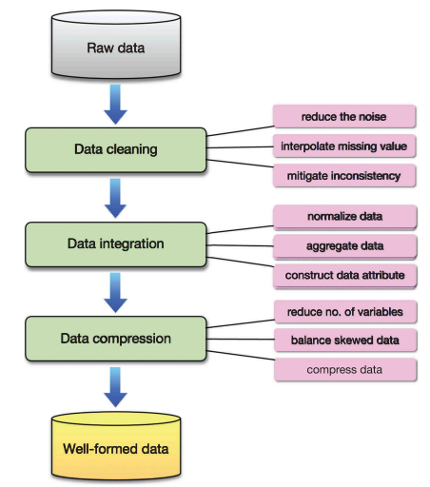
Data preprocessing and storage
Notes:
The Data Acquisition aspect is out of the scope of this particular course, thus we immediately jump into Data preprocessing. Data Preprocessing includes data cleaning, data integration and data compression to deal with the following data aspects:
Heterogeneous data types. The whole manufacturing chain generates various data types including sensory data, RFID readings, product records, text, logs, audio, video, etc. The data is in the forms of structured, semi-structured and non-structured.
Erroneous and noisy data. The data obtained from the industrial environment is often erroneous and noisy mainly due to the following reasons: (a) interference during the process of data collection especially in industrial environment, (b) the failure and malfunction of sensors or machinery, (c) intermittent loss or outage of wireless or wired communications. For example, wireless communications are often susceptible to harsh industrial environmental factors like blockage, shadowing and fading effects.
Data redundancy. Data generated in MIoT often contain excessively redundant information. For instance, there can be excessive-duplicated RFID readings when multiple RFID tags were scanned by several RFID readers at different time slots. The data redundancy often results in data inconsistency.

Slide 39
Chapter 3 – Practical Examples

Slide 40
Chapter 3.1 – Data sets

Slide 41
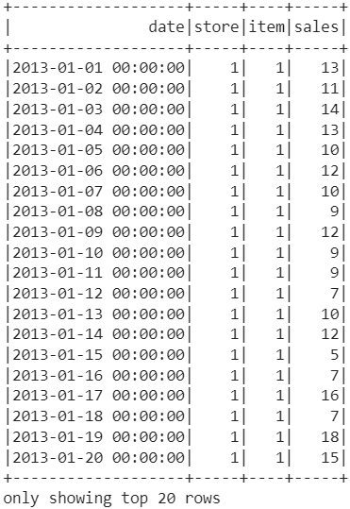
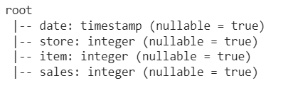
Data Set
What we have:
The store number or id, there are 10 stores that sell 50 different items.
The number or id of the item, which are sold by different stores.
The date year/month/day.
The amount of items sold at particular day.
Link: https://www.kaggle.com/competitions/demand-forecasting-kernels-only/overview
Notes:
The original Dataset is proposed to try different modelling approaches to solve the Store Item Demand Forecasting problem (predict the demand for some period). The dataset contains the following categories*: “Product_Cat”, “Store_ID”, “Product_ID”, “MONTH_CODE” and “Demand”. The following assumptions has been made regarding the dataset:
Dataset includes the data from 2012 to 2019.
Dataset has been split into train and test (0.75 on 0.25), where train includes values from 2012 to 2017 and the data for the rest two years are used for testing.

Slide 42
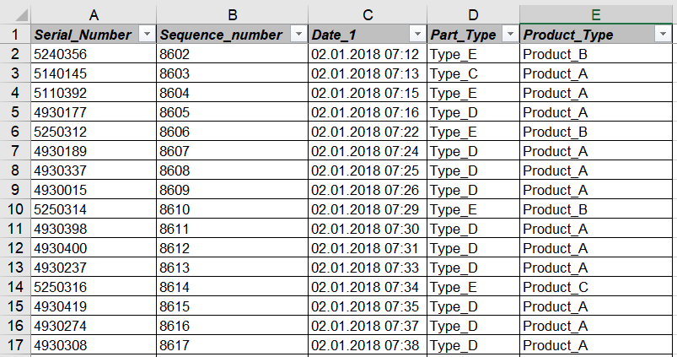
Data Set
The data with 5 columns and 12861 rows;
There are 3 product types that correspond to the car models being produced;
There are 5 part types (i.e. batterie types) that are used to equip the 3 produced models;
Date_1 column reflects the date and time when the product (i.e. car model) was produced;
Serial Number column provdes info on serial number of the product
The Sequence Number reflect the order of production (not important for particular use-case).
Link: https://www.kaggle.com/competitions/demand-forecasting-kernels-only/overview
Notes:
The totality of the dataset gathered during this study consists of the logs from the receiver correspondent to the car batteries from the start of 2018 to the end of February 2020, this dataset will be used to predict the future consumption by the production line of each type of batterie.

Slide 43
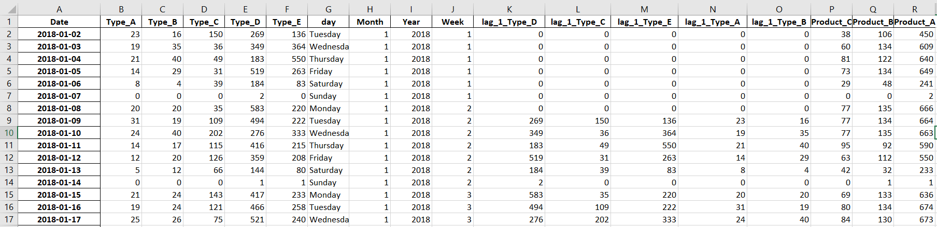
Data Set
The original dataset was preprocessed to obtain the data in the needed for further processing form.
The exact time is not that important, rather the day is more important, thus the data were aggregated on day/week/month/year basis;
The total amount of installed batteries by type was calculated;
The total amount of products (i.e. car models) equipped with certain types of batteries was calculated.
Link: https://www.kaggle.com/competitions/demand-forecasting-kernels-only/overview

Slide 44
Chapter 3.2 – Typical ML Flow

Slide 45

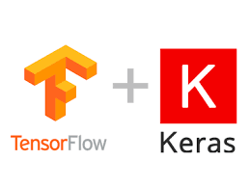



The ML Flow
Retrieve the Dataset in the .csv or .xlsx format
Prepare the Data for the processing by ML algorithms
Application of ML
Assessment of Results
Visualization of Data

Slide 46
Chapter 3.3 – PySpark Example

Slide 47
PySpark
Summary:
PySpark library to work with Big Data
PySpark for managing „Big Data“ having some functionality of Pandas that is aligned/oprimised to work with the „Big Data“
PySpark performs faster with BigData, for instance it outperforms the Pandas in terms of Data uploading in the context of big data chunks
Comparing Pandas and PySpark with „normal“ data the preformance is comparable.

Slide 48
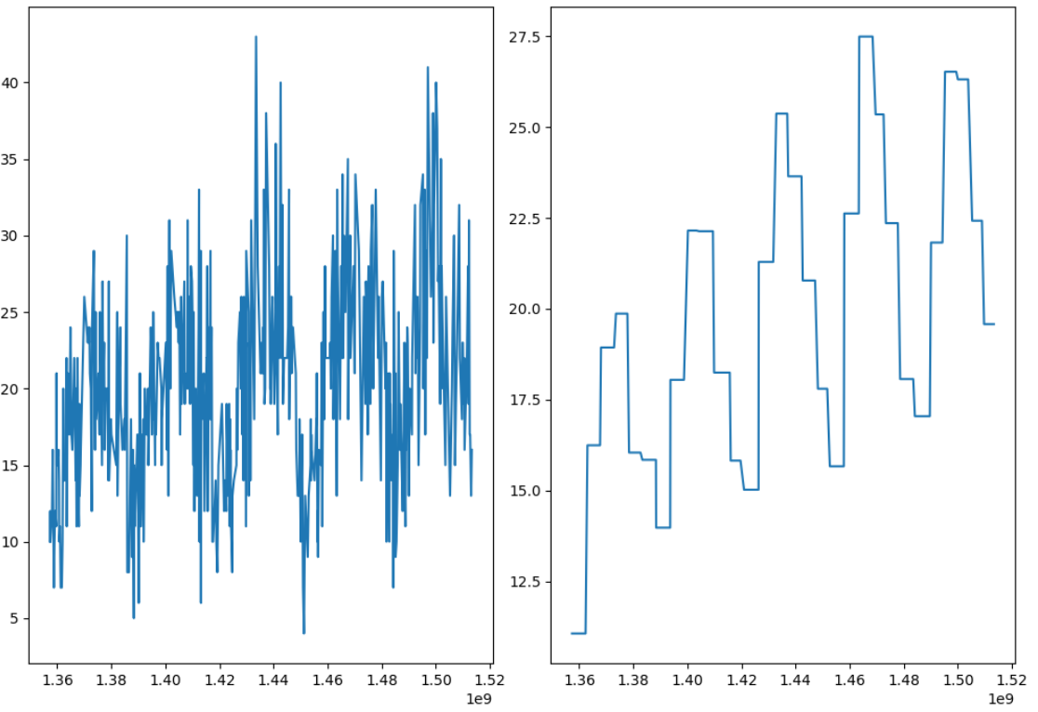
Big Data with PySpark
Original Data
Predictions Decision Tree

Slide 49

Example (PySpark approach)
Summary:
The Google Collab environment was used to implement 3 ML approaches provided by PySpark.
Advantage of Google Collab, there is no need in installing a lot of software, the only requirment Google account
3 tested approaches were Linear Regression, Random Forest and Decision Tree
RMSE was used as the assessment metric (the lower the better)
Best performing algorithm was the Decision Tree

Slide 50
Chapter 3.4 – Deep Learning Example (LSTM)

Slide 51
Example 2 (Automotive Example)
Automotive area use-case
The problem of overstocking is addressed, which is based on the difference between entries of batteries to the warehouse (receiving data) and the supplying of batteries
The dataset includes data of the entire 2018 year and the first 3 months of 2019.
Assumptions made:
steady production of 900 cars a day was considered,
it is considered that at the start of each day, we should have an inventory level of 3.5 days, the production of the day itself plus the security stock level of 2.5 days.

Slide 52
Example 2 (LSTM)
Lookback = 12
Predicted Label
„Independent“ features – predictors

Slide 53
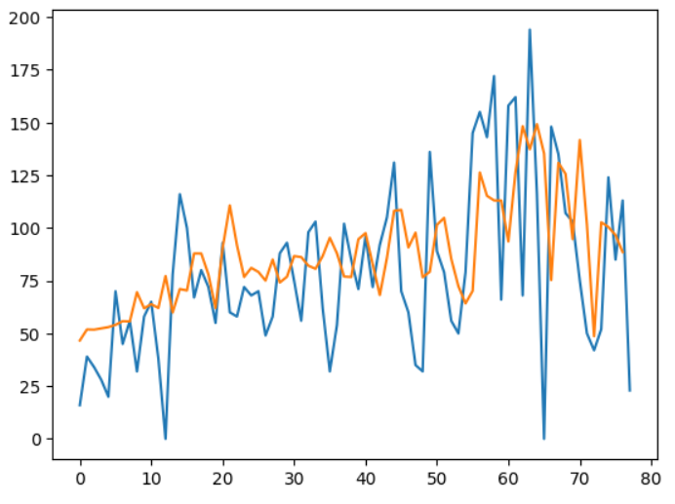
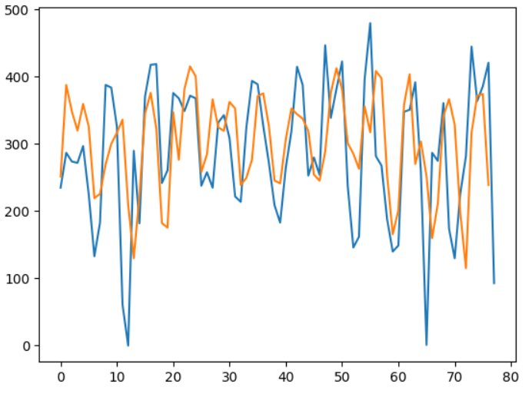
Example 2 (Automotive Example)
Prediction for Batteries Type_C
Prediction for Batteries Type_E

Slide 54
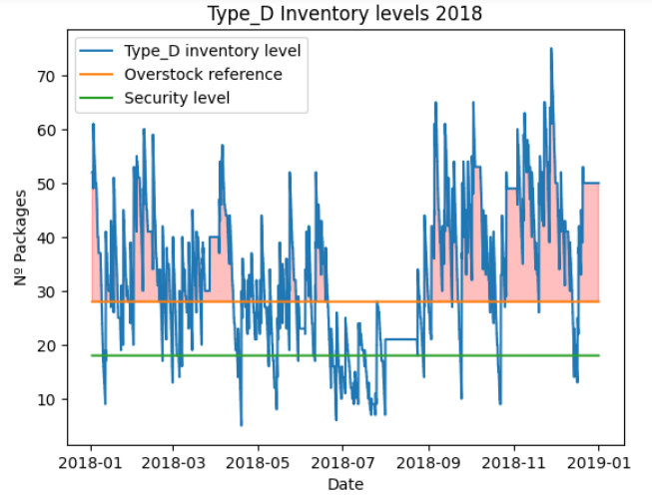
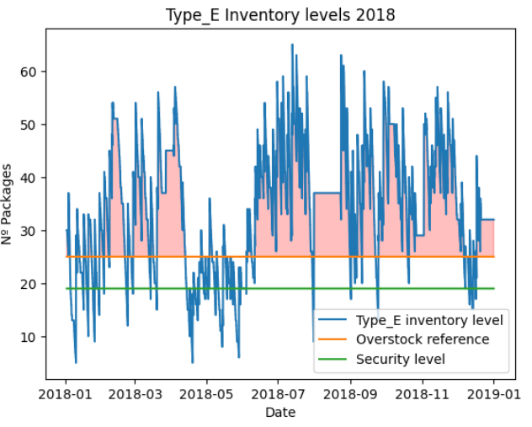
Example 2 (Automotive Example)
Notes:
Regarding the results from the entire system the actual results are not available because the system needs to be put in place to be tested and then it would require multiple months until conclusions on the actual results can be analysed. The application of this system on historical data to evaluate its performance would be clearly biased so it was disregarded.
However historical data can be used to estimate the possible optimizations. Moreover, it was defined (see figures) that in 2018 there were multiple cases of overstock of car batteries, particularly we can see that for some car batteries there was at least half of the time the overstock situations and 25% of the time in severe overstock. The green line demonstrates the so called security level, which is the threshold for the minimum batteries amount that should be available on stock, the orange line demonstrates the upper threshold for the amount of batteries.

Slide 55
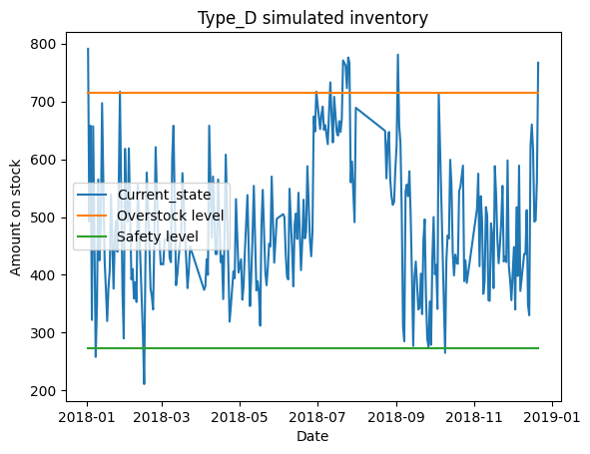
Example 2 (Prescriptive Analytics)
Notes:
Regarding the results from the entire system the actual results are not available because the system needs to be put in place to be tested and then it would require multiple months until conclusions on the actual results can be analysed. The application of this system on historical data to evaluate its performance would be clearly biased so it was disregarded.
However historical data can be used to estimate the possible optimizations. Moreover, it was defined (see figures) that in 2018 there were multiple cases of overstock of car batteries, particularly we can see that for some car batteries there was at least half of the time the overstock situations and 25% of the time in severe overstock. The green line demonstrates the so called security level, which is the threshold for the minimum batteries amount that should be available on stock, the orange line demonstrates the upper threshold for the amount of batteries.

Slide 56
References
Hands-On Machine Learning with Scikit-Learn, Keras and TensorFlow by Aurélien Géron (O’Reilly). Copyright 2019 Aurélien Géron, 978-1-492-03264-9.
https://datainmyuniverse.medium.com/tree-based-machine-learning-model-for-demand-forecasting-with-python-and-apache-spark-a-69ab07e9e833
https://www.kaggle.com/competitions/demand-forecasting-kernels-only/overview
https://colah.github.io/posts/2015-08-Understanding-LSTMs/
Shang, J., Tadikamalla, P.R., Kirsch, L.J., Brown, L. A decision support system for managing inventory at GlaxoSmithKline, 2008, Decision Support Systems 46(1):1-13 DOI:10.1016/j.dss.2008.04.004
Rossi, R. (2021). Inventory Analytics. Open Book Publishers. https://library.oapen.org/handle/20.500.12657/49414
Gilvan C. Souza. (2014). Supply chain analytics. Business Horizons, Vol 57 (5), Pages 595-605, https://doi.org/10.1016/j.bushor.2014.06.004
Shenoy, D., Rosas, R. (2018). Problems & Solutions in Inventory Management. doi:10.1007/978-3-319-65696-0
Toomey, J.W. (2000). Inventory Management: Principles, Concepts and Techniques. (Materials Management Logistics Series, 12) 2000th Edition, Springer.
Kleber, R. (2006). Dynamic Inventory Management in Reverse Logistics. Edition 1, Springer, Berlin, Heidelberg. DOI: https://doi.org/10.1007/3-540-33230-8
Silva, J.C., Figueiredo, M.C., Braga, A.C. (2019). Demand Forecasting: A Case Study in the Food Industry. In: , et al. Computational Science and Its Applications – ICCSA 2019. ICCSA 2019. Lecture Notes in Computer Science(), vol 11621. Springer, Cham. https://doi.org/10.1007/978-3-030-24302-9_5

Slide 57
Code Repository
https://github.com/ArtemUNINOVA/ENHANCE_proj

