Slide 1
Advanced Computational Science
Articulation Points in Multiplex Networks
Student: Artem Vergazov
Research Advisor: Vladimir Palyulin
January 2023

Slide 2
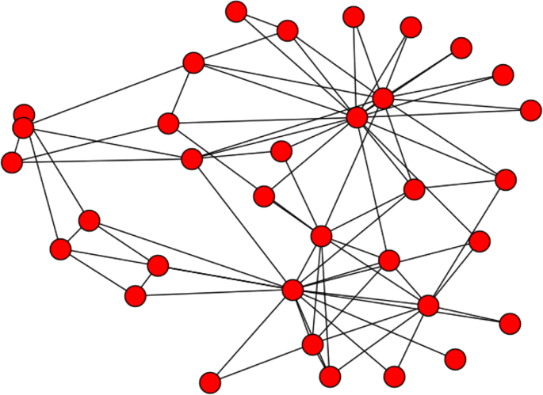
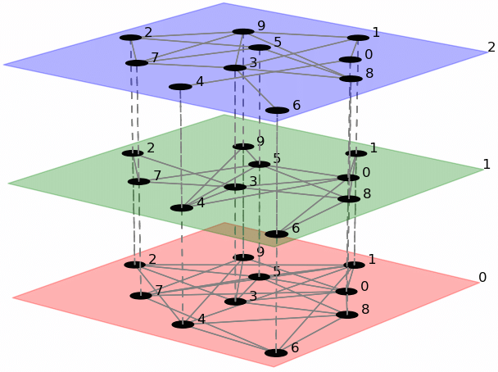
Introduction. Networks
Simple network
Multiplex network

Slide 3
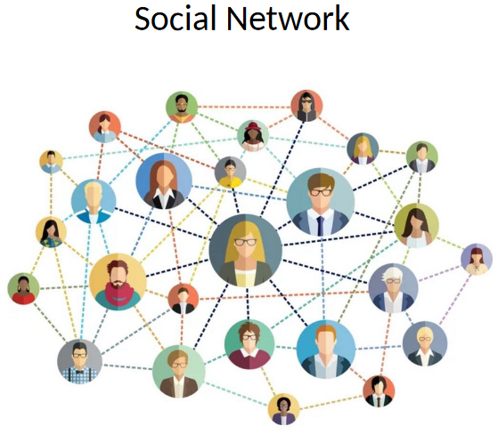
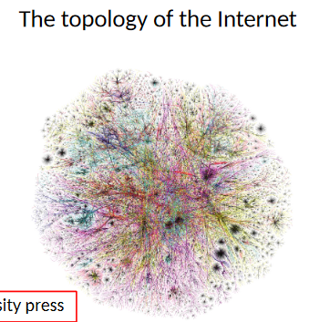
Introduction. Networks
Multiplex network examples
Transport
Underground layer
Bus layer
Social
Twitter layer
LinkedIn layer

Slide 4
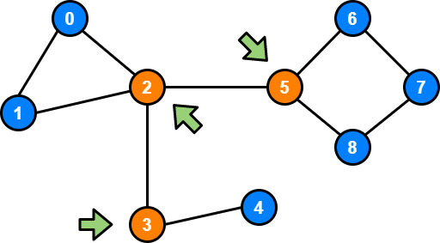
Introduction. Definitions
An articulation point (AP) is a node whose removal disconnects the graph
Articulation points (AP)

Slide 5
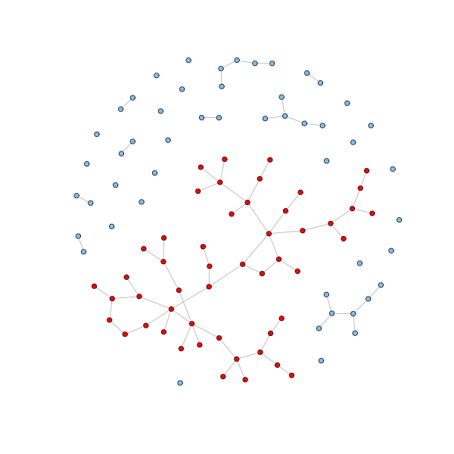
Introduction. Definitions
Giant connected component (GCC) is the largest connected component of the graph
Giant Connected Component (GCC)

Slide 6
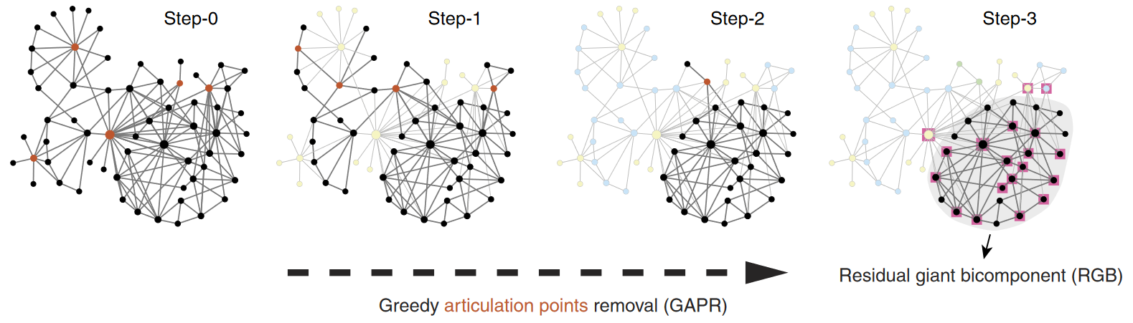
Introduction. Articulation points removal
Review: Tian, L. et al. Articulation points in complex networks.
Nat. Commun. 8, 14223 doi: 10.1038/ncomms14223 (2017).

Slide 7
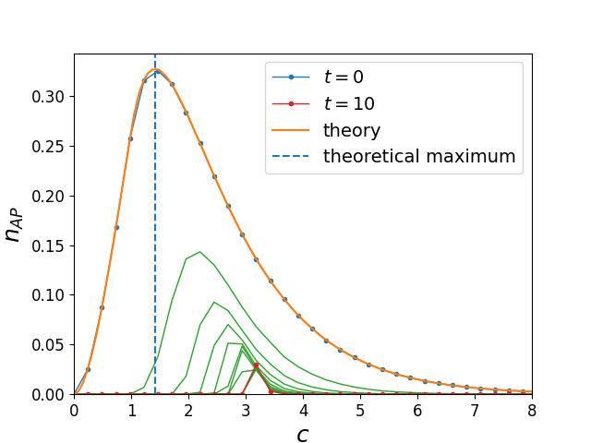
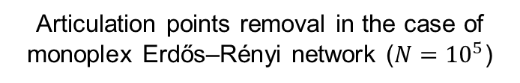
Introduction. Articulation points removal
Articulation points removal in the case of monoplex Erdős–Rényi network ($N={10}^{5}$)
Review: Tian, L. et al. Articulation points in complex networks.
Nat. Commun. 8, 14223 doi: 10.1038/ncomms14223 (2017).

Slide 8
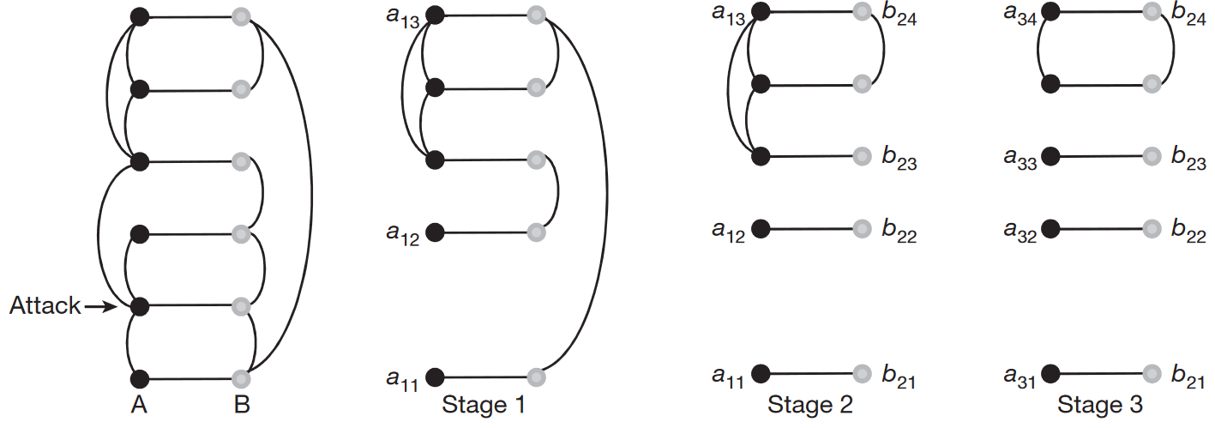
Introduction. Cascade failure of nodes
Review: Buldyrev, S., Parshani, R., Paul, G. et al. Catastrophic cascade of failures in interdependent networks. Nature 464, 1025–1028 (2010). https://doi.org/10.1038/nature08932

Slide 9
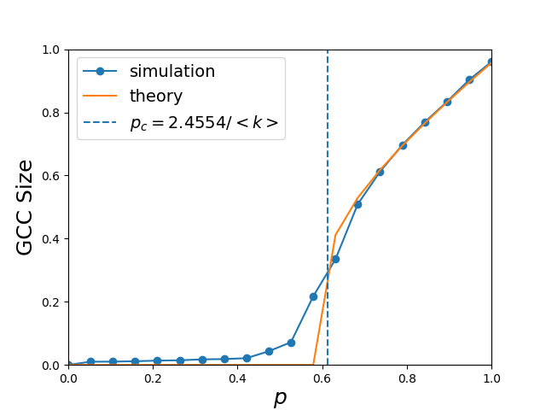
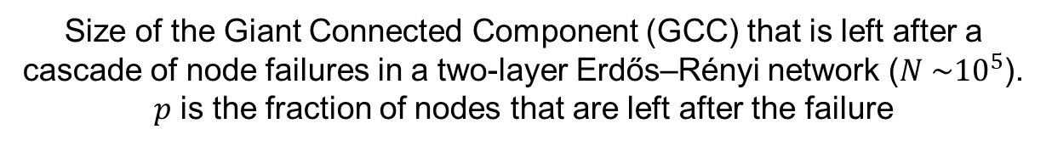
Introduction. Cascade failure of nodes
Size of the Giant Connected Component (GCC) that is left after a cascade of node failures in a two-layer Erdős–Rényi network ($N \sim {10}^{5}$). $p$ is the fraction of nodes that are left after the failure
Review: Buldyrev, S., Parshani, R., Paul, G. et al. Catastrophic cascade of failures in interdependent networks. Nature 464, 1025–1028 (2010). https://doi.org/10.1038/nature08932

Slide 10
Aim
Study AP in multiplex networks with
cascade failure of nodes
articulation points removal strategy.
Study the difference in behavior (network attacks, node failure) between simple and multiplex cases

Slide 11
Objectives
Study APs in Erdős–Rényi multiplex networks
Study APs in configuration networks
Check the statistics of real-world multiplex networks

Slide 12
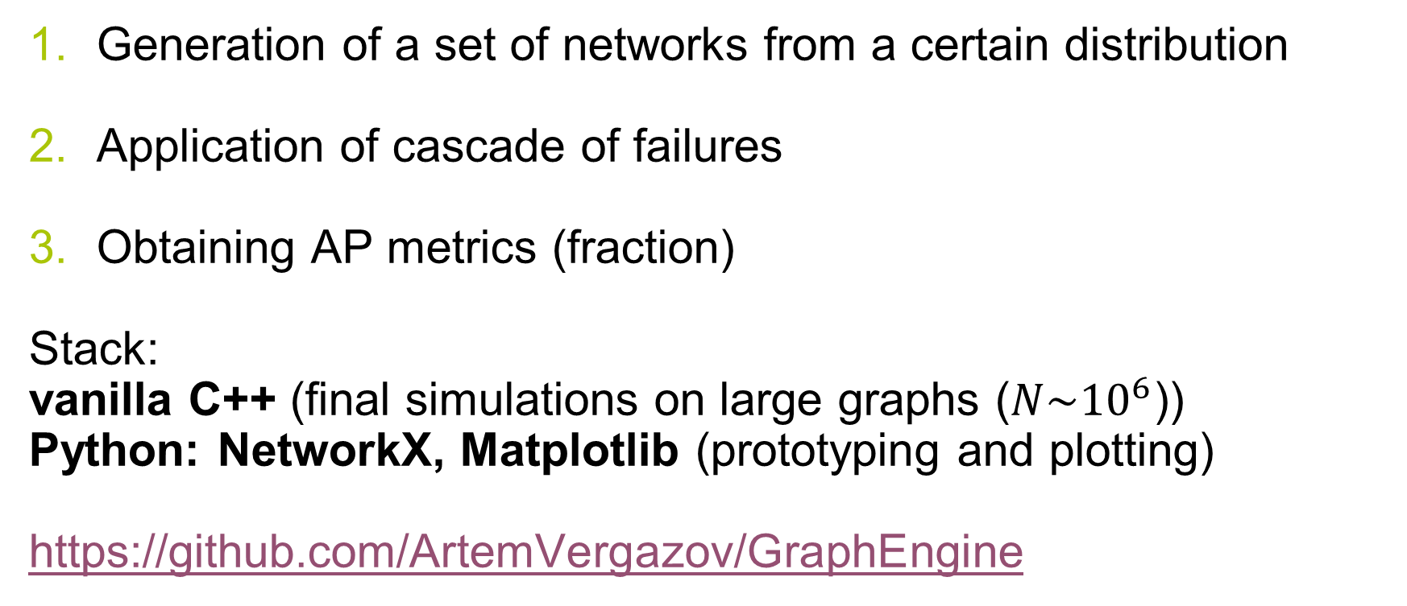
Algorithms and methodology
Generation of a set of networks from a certain distribution
Application of cascade of failures
Obtaining AP metrics (fraction)
Stack:
vanilla C++ (final simulations on large graphs ($N\sim {10}^{6}$))
Python: NetworkX, Matplotlib (prototyping and plotting)
https://github.com/ArtemVergazov/GraphEngine

Slide 13
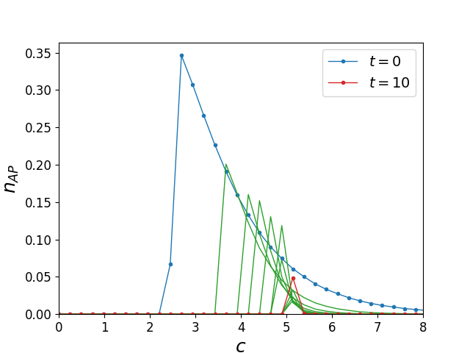
Results. ER multiplex network
Fraction of articulation points in Erdős–Rényi (ER) two-layer network ($N\sim {10}^{5}$). $c$ is the mean degree of the network nodes.

Slide 14
Results. ER multiplex network
Monoplex case
Multiplex case

Slide 15
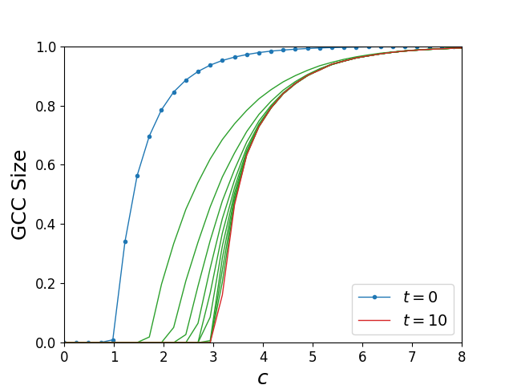
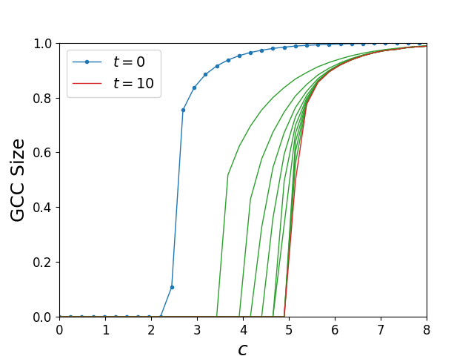
Results. GCC size
Relative size of the giant connected component (GCC) after t steps of AP removal, as a function of the mean degree c in ER monoplex and multiplex networks ($N\sim {10}^{5}$).
Monoplex case
Multiplex case

Slide 16
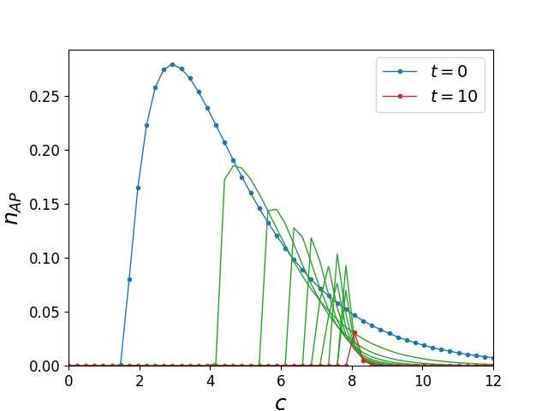
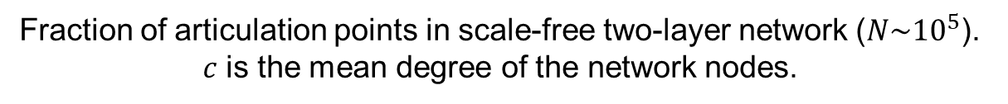
Results. Scale-free multiplex network
Fraction of articulation points in scale-free two-layer network ($N\sim {10}^{5}$). $c$ is the mean degree of the network nodes.

Slide 17
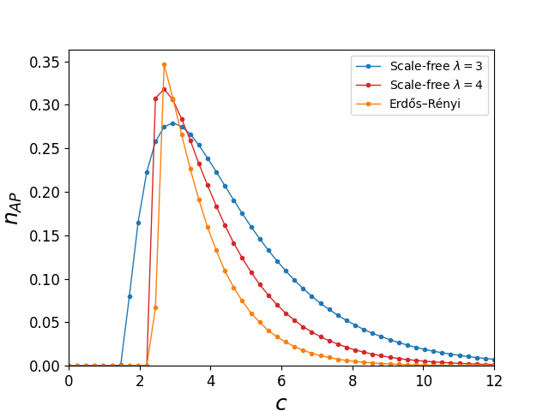
Results. Random graph models comparison

Slide 18
Discussion and conclusions
Multiplex networks are less stable with phase transitions shifting to the right than monoplex networks
Probability of failure of such networks jumps

Slide 19
Current status and outlook
A number of published results reproduced
APs removal strategy with cascade failure behavior studied on
Erdős–Rényi multiplex networks
scale-free multiplex networks
APs behavior comparison between different random graph model studied
Next steps:
May 2023: increase network size (millions of nodes)
May 2023: finalize thesis text

Slide 20
Acknowledgements
Prof. Vladimir Palyulin
Dr. Saeed Osat

Slide 21
Thank you for attention

Slide 22
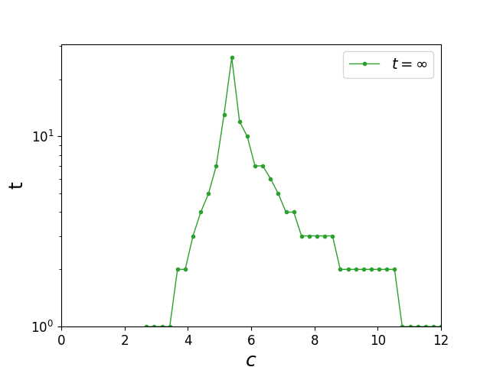
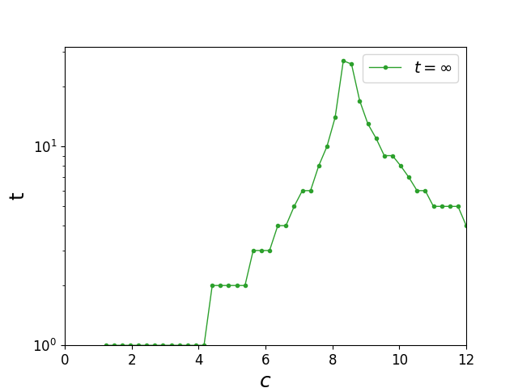
Appendix. Number of AP removal steps
Total number of AP removal steps as a function of mean degree c in multiplex ER and scale-free networks ($N\sim {10}^{5}$)
ER network
Scale-free network

