Slide 1


$$v$$
$$w$$

Slide 2
$$v$$
$$w$$

Slide 3
$$v$$
$$w$$

Slide 4
$$v$$
$$w$$

Slide 5
$$v$$
$$w$$

Slide 6
$$v$$
$$w$$

Slide 7
$$v$$
$$w$$

Slide 8
$$v$$
$$w$$

Slide 9
$$v$$
$$w$$

Slide 10
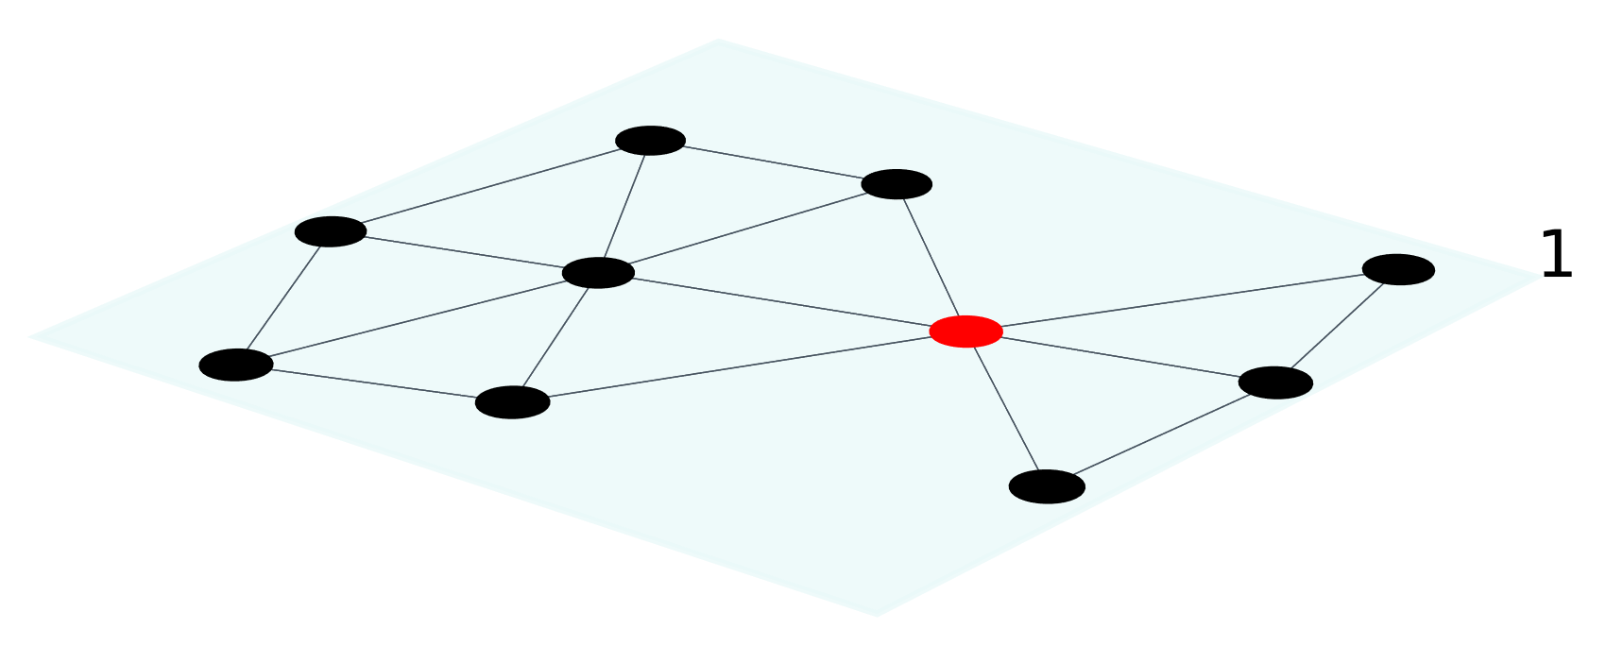
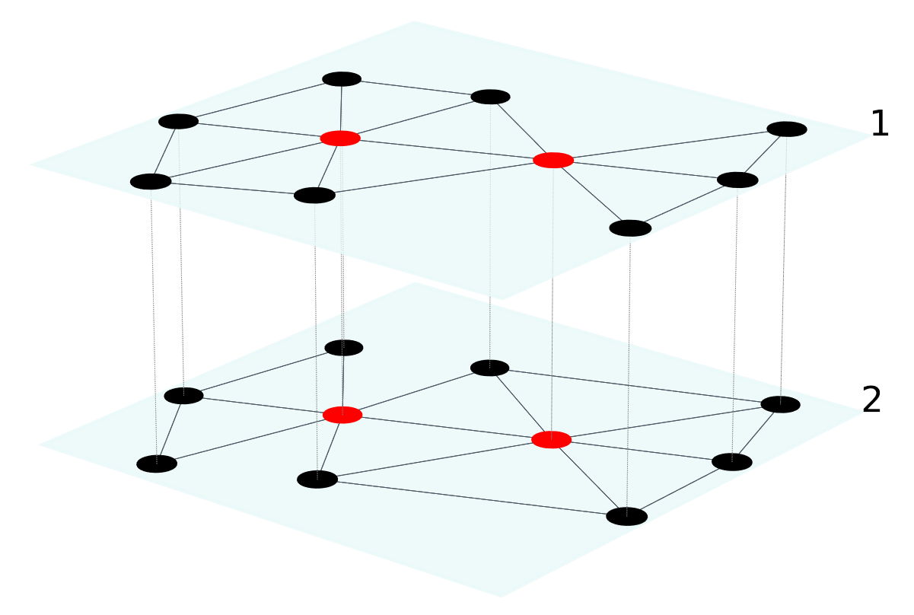



$$v$$
$$v$$
$$w$$

Slide 11

$$v$$

Slide 12


$$v$$
$$w$$

Slide 13


$$v$$
$$w$$

Slide 16
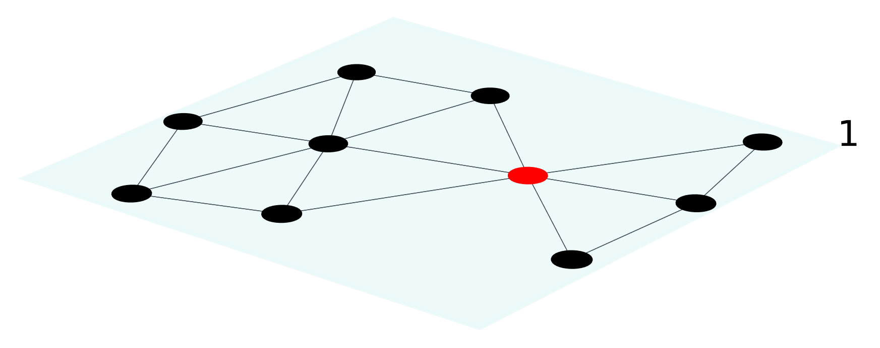
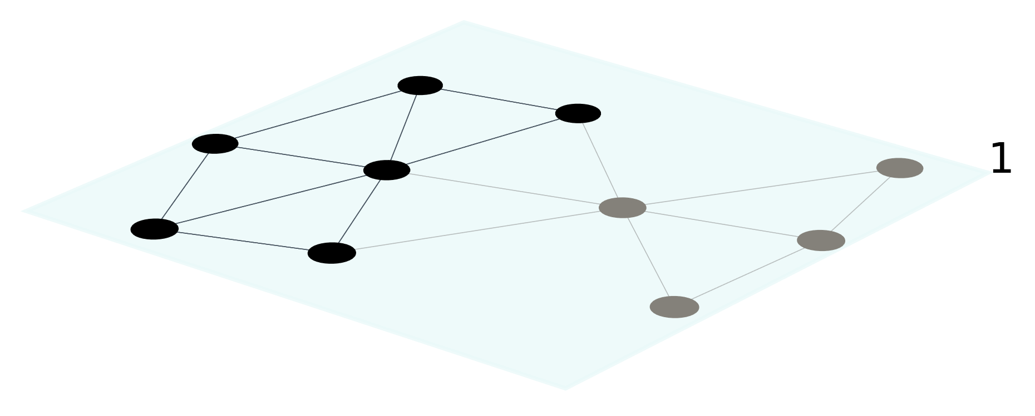
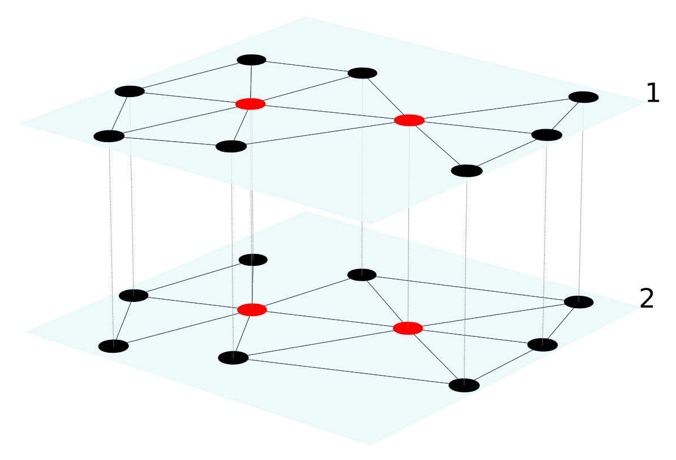
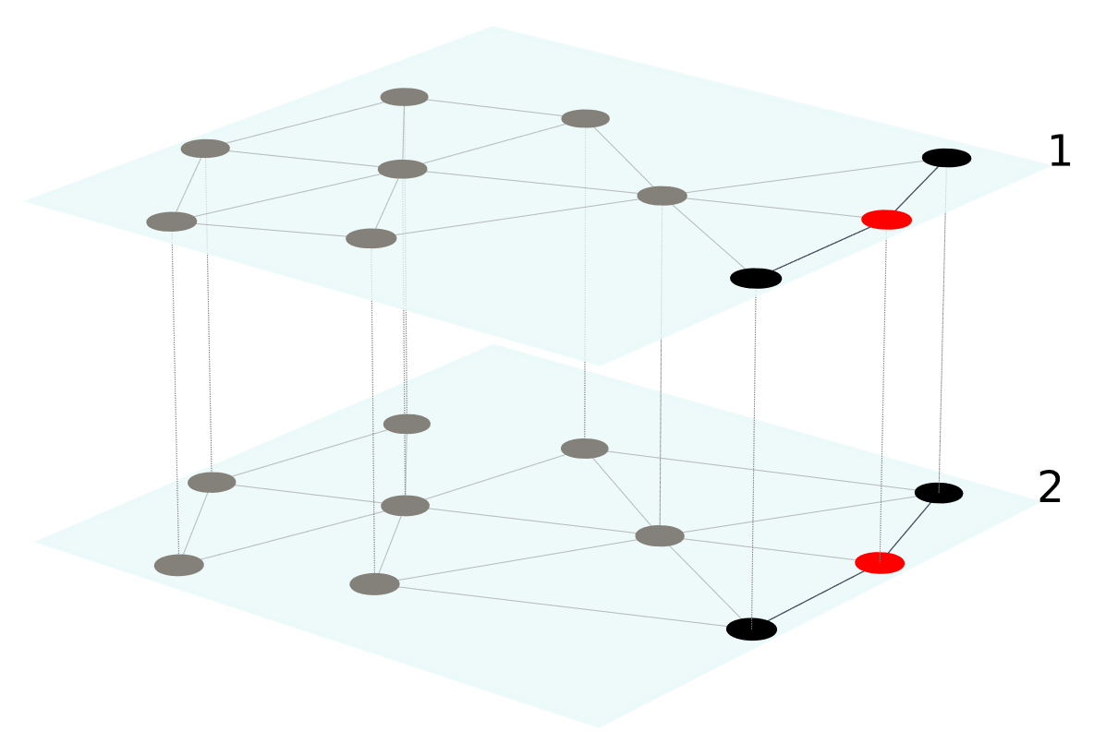
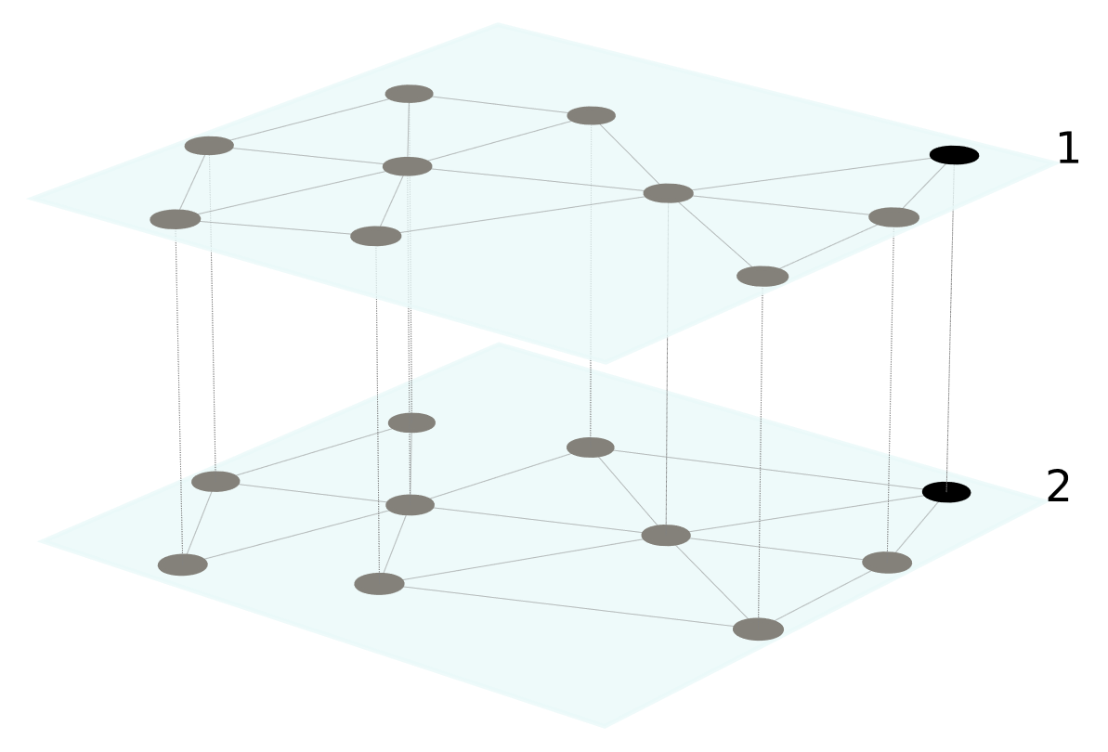
(a)
(b)
(c)
(d)
(e)

Slide 17
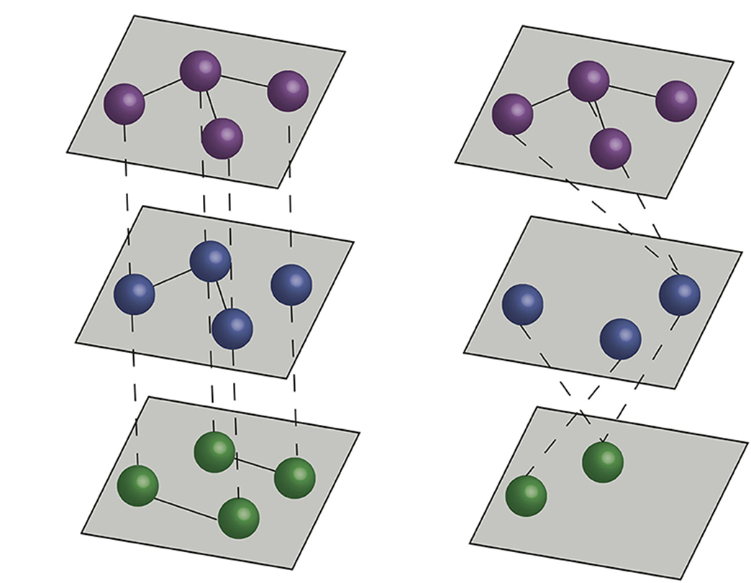
Multiplex vs Multilayer Networks
Multiplex
Multilayer

Slide 18
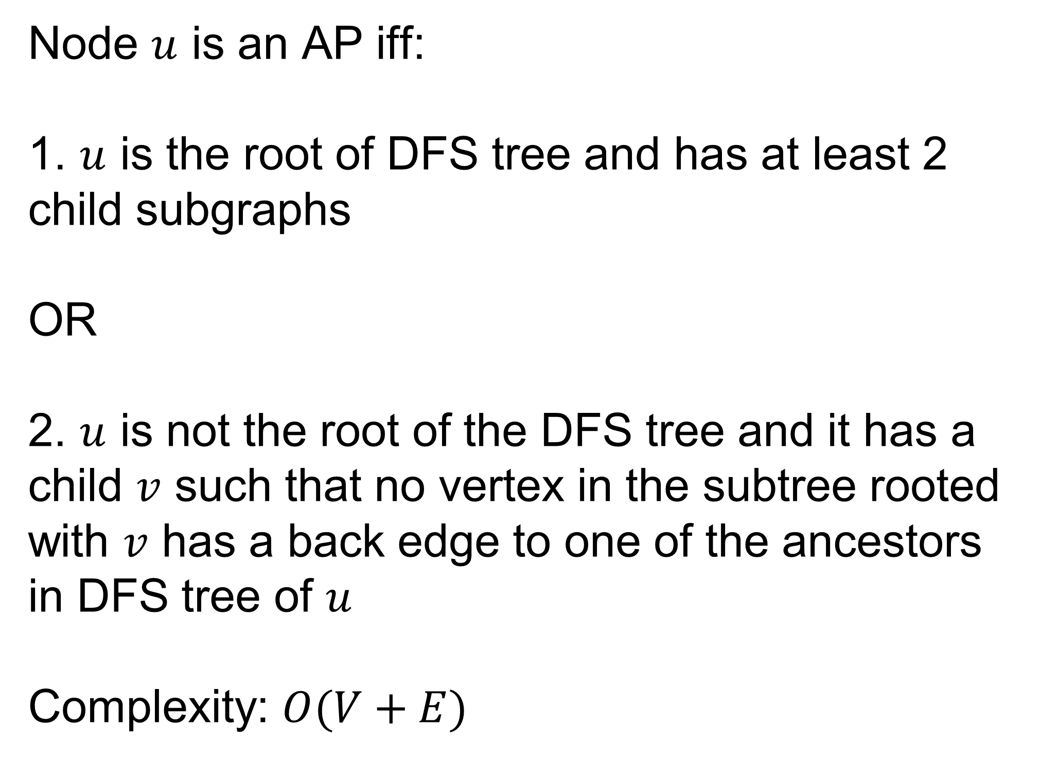
AP Identification Algorithm
Tarjan’s algorithm based on DFS
Node $u$ is an AP iff:
1. $u$ is the root of DFS tree and has at least 2 child subgraphs
OR
2. $u$ is not the root of the DFS tree and it has a child $v$ such that no vertex in the subtree rooted with $v$ has a back edge to one of the ancestors in DFS tree of $u$
Complexity: $O(V+E)$

Slide 21
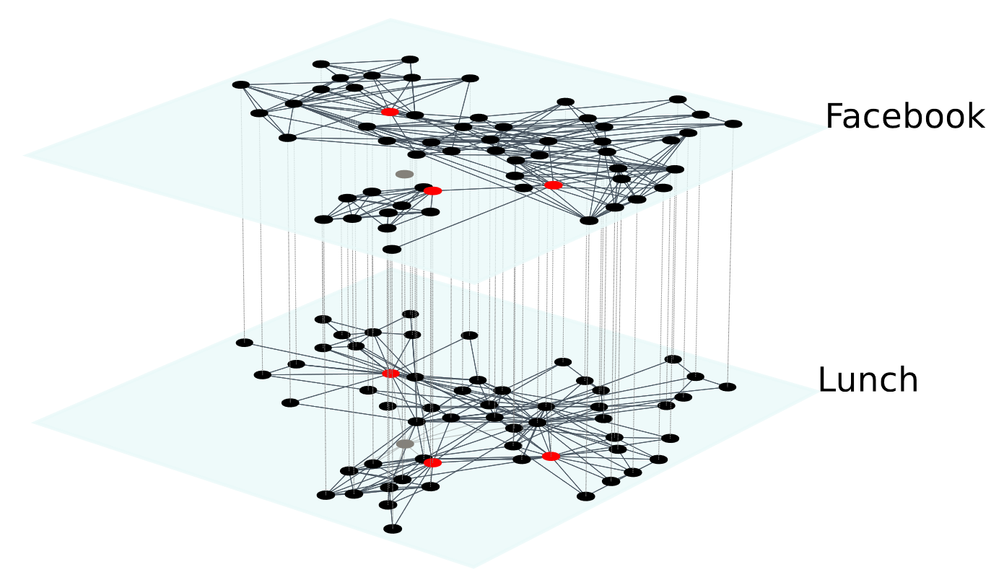
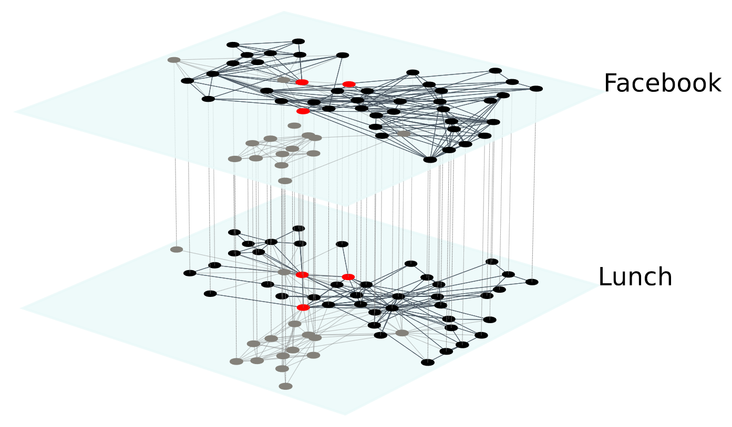
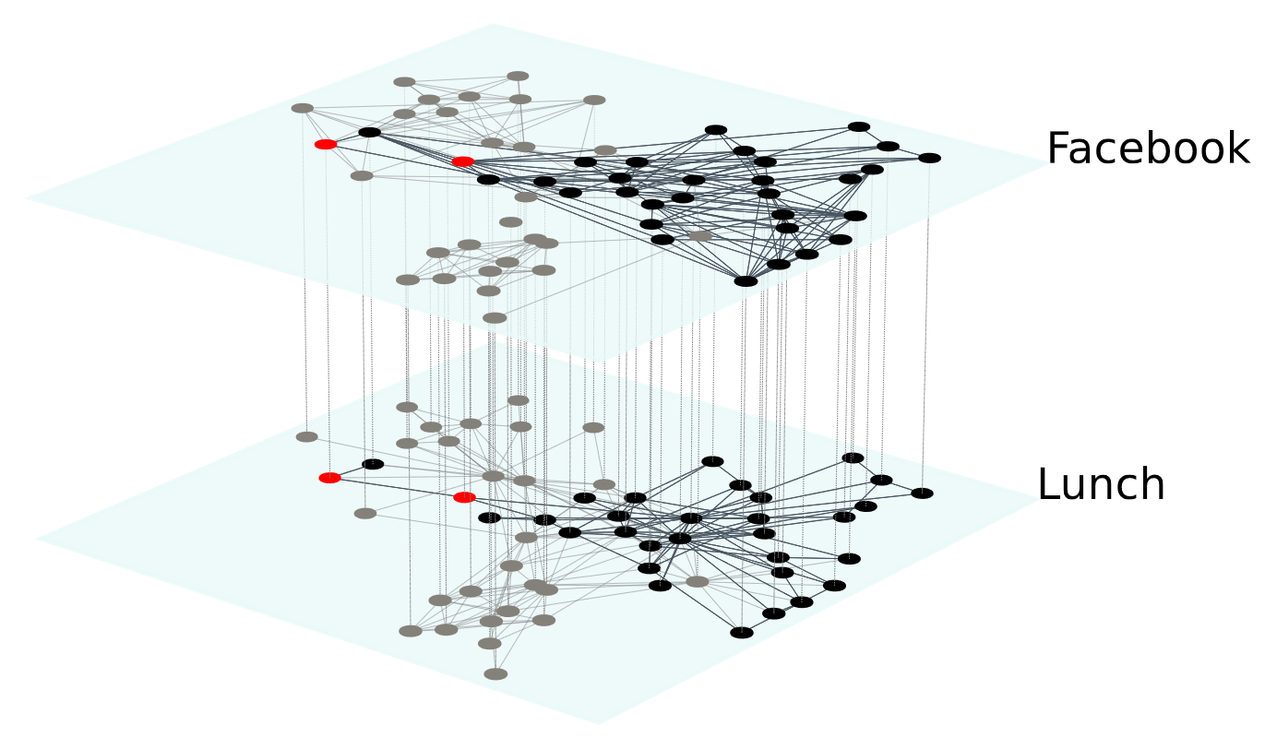
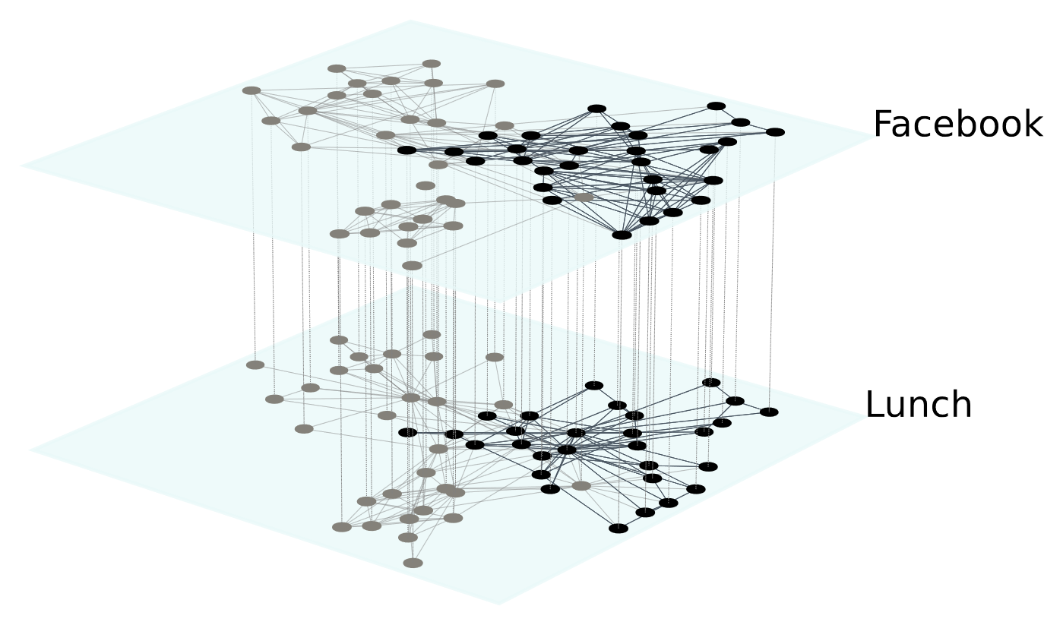
(a)
(b)
(c)
(d)

