Slide 1
Advanced Computational Science
Articulation Points in Multiplex Networks
Student: Artem Vergazov
Research Advisor: Vladimir Palyulin
January 2023

Slide 2
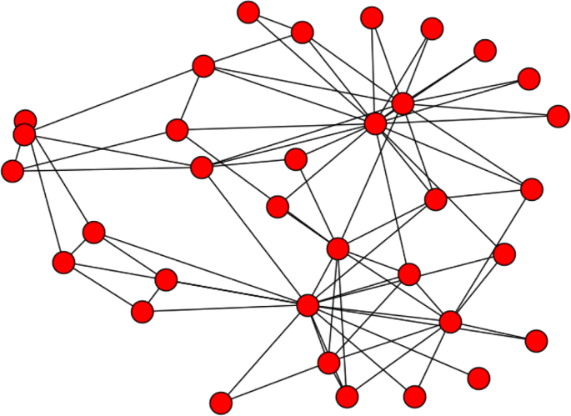
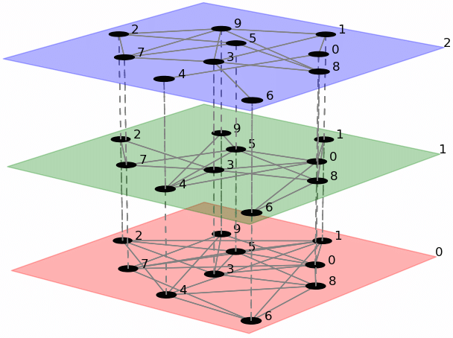
Introduction. Networks
Simple network
Multiplex network

Slide 3
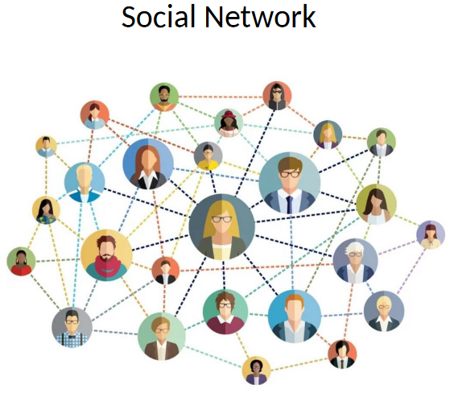
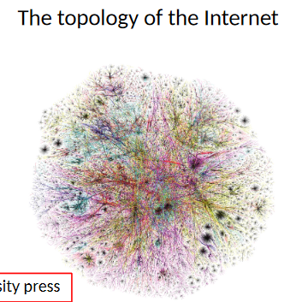
Introduction. Networks
Multiplex network examples
Transport
Underground layer
Bus layer
Social
Twitter layer
LinkedIn layer

Slide 4
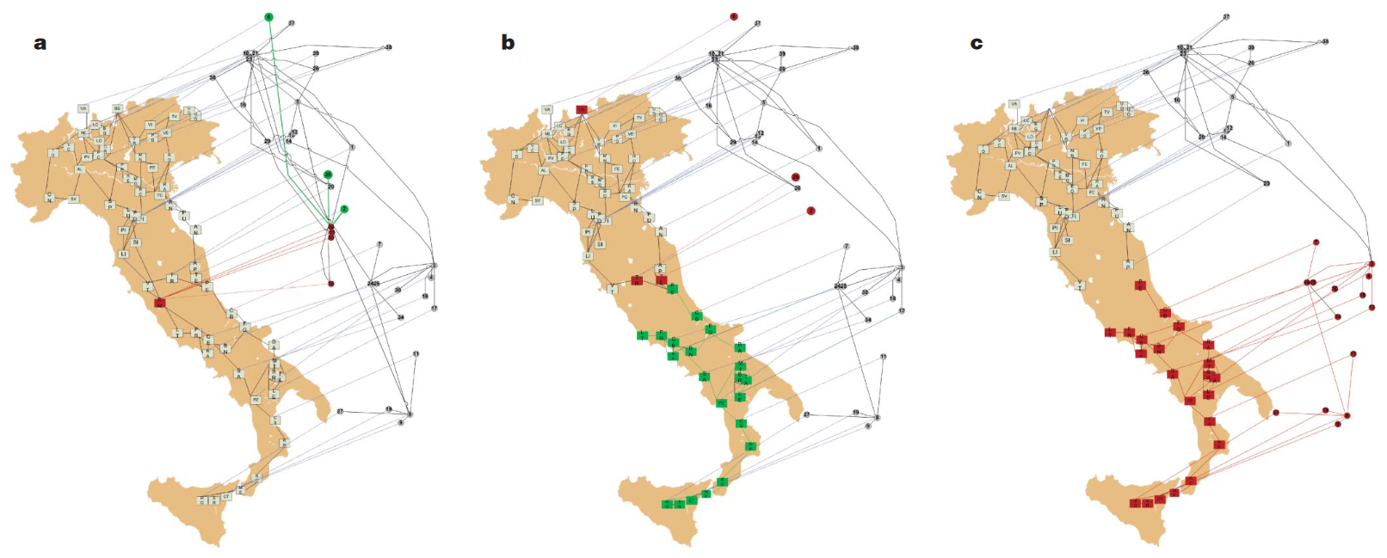
Introduction. Motivation
What defines stability of the network?
Sep 2003: cascade node failure

Slide 5
Introduction. Cascade failure of nodes
Power grids layer
Computer servers layer
Review: Buldyrev, S., Parshani, R., Paul, G. et al. Catastrophic cascade of failures in interdependent networks. Nature 464, 1025–1028 (2010). https://doi.org/10.1038/nature08932

Slide 6
Introduction. Cascade failure of nodes
Failure
Power grids layer
Computer servers layer
Review: Buldyrev, S., Parshani, R., Paul, G. et al. Catastrophic cascade of failures in interdependent networks. Nature 464, 1025–1028 (2010). https://doi.org/10.1038/nature08932

Slide 7
Introduction. Cascade failure of nodes
Power grids layer
Computer servers layer
Review: Buldyrev, S., Parshani, R., Paul, G. et al. Catastrophic cascade of failures in interdependent networks. Nature 464, 1025–1028 (2010). https://doi.org/10.1038/nature08932

Slide 8
Introduction. Cascade failure of nodes
Power grids layer
Computer servers layer
Review: Buldyrev, S., Parshani, R., Paul, G. et al. Catastrophic cascade of failures in interdependent networks. Nature 464, 1025–1028 (2010). https://doi.org/10.1038/nature08932

Slide 9
Introduction. Cascade failure of nodes
Power grids layer
Computer servers layer
Review: Buldyrev, S., Parshani, R., Paul, G. et al. Catastrophic cascade of failures in interdependent networks. Nature 464, 1025–1028 (2010). https://doi.org/10.1038/nature08932

Slide 10
Introduction. Cascade failure of nodes
Power grids layer
Computer servers layer
Review: Buldyrev, S., Parshani, R., Paul, G. et al. Catastrophic cascade of failures in interdependent networks. Nature 464, 1025–1028 (2010). https://doi.org/10.1038/nature08932

Slide 11
Introduction. Cascade failure of nodes
Power grids layer
Computer servers layer
Review: Buldyrev, S., Parshani, R., Paul, G. et al. Catastrophic cascade of failures in interdependent networks. Nature 464, 1025–1028 (2010). https://doi.org/10.1038/nature08932

Slide 12
Introduction. Cascade failure of nodes
Power grids layer
Computer servers layer
Review: Buldyrev, S., Parshani, R., Paul, G. et al. Catastrophic cascade of failures in interdependent networks. Nature 464, 1025–1028 (2010). https://doi.org/10.1038/nature08932

Slide 13
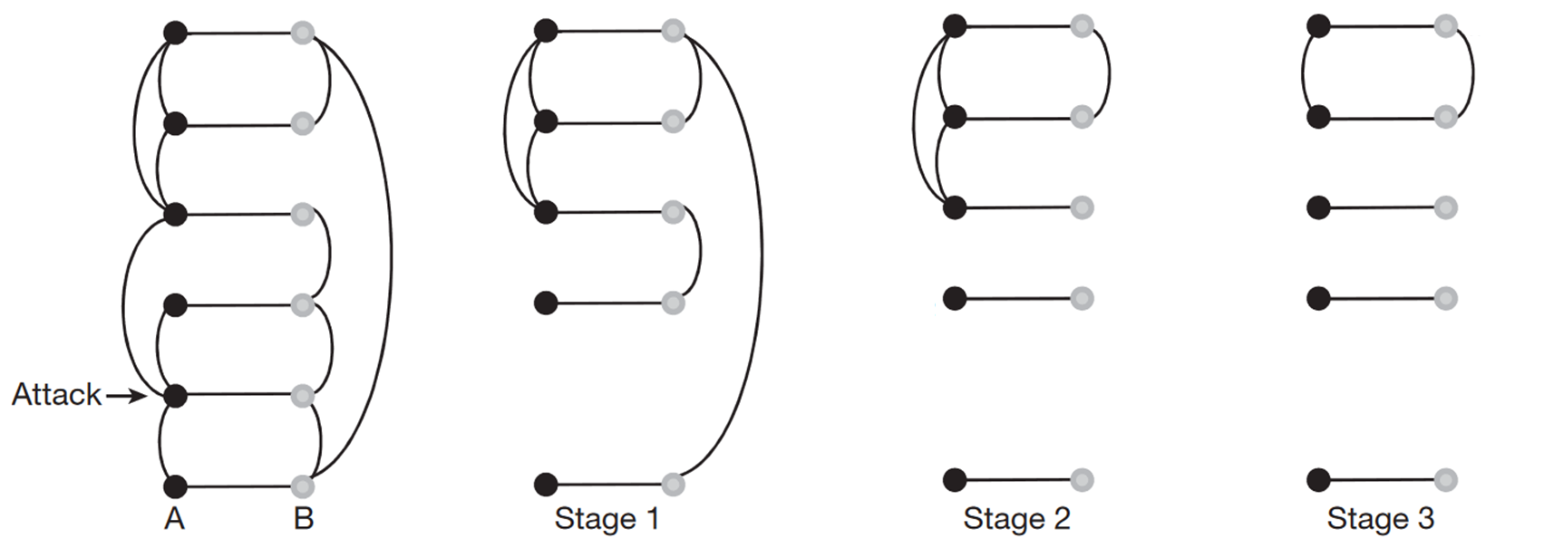
Introduction. Cascade failure of nodes
Review: Buldyrev, S., Parshani, R., Paul, G. et al. Catastrophic cascade of failures in interdependent networks. Nature 464, 1025–1028 (2010). https://doi.org/10.1038/nature08932

Slide 14
Introduction. Articulation points
An articulation point (AP) is a node whose removal disconnects the graph
Articulation points (AP)
Review: Tian, L. et al. Articulation points in complex networks.
Nat. Commun. 8, 14223 doi: 10.1038/ncomms14223 (2017).

Slide 15
Introduction. Articulation points removal
Step 0
Review: Tian, L. et al. Articulation points in complex networks.
Nat. Commun. 8, 14223 doi: 10.1038/ncomms14223 (2017).

Slide 16
Introduction. Articulation points removal
Step 1
Review: Tian, L. et al. Articulation points in complex networks.
Nat. Commun. 8, 14223 doi: 10.1038/ncomms14223 (2017).

Slide 17
Introduction. Articulation points removal
Step 2
Review: Tian, L. et al. Articulation points in complex networks.
Nat. Commun. 8, 14223 doi: 10.1038/ncomms14223 (2017).

Slide 18
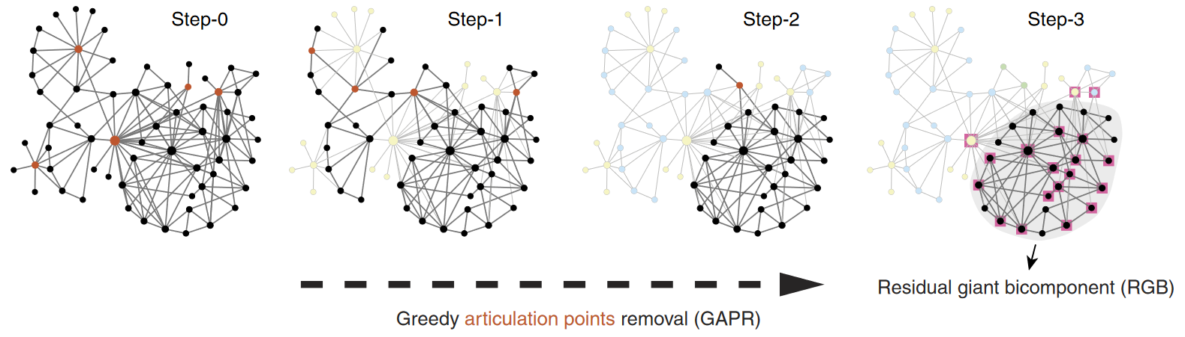
Introduction. Articulation points removal
Review: Tian, L. et al. Articulation points in complex networks.
Nat. Commun. 8, 14223 doi: 10.1038/ncomms14223 (2017).

Slide 19
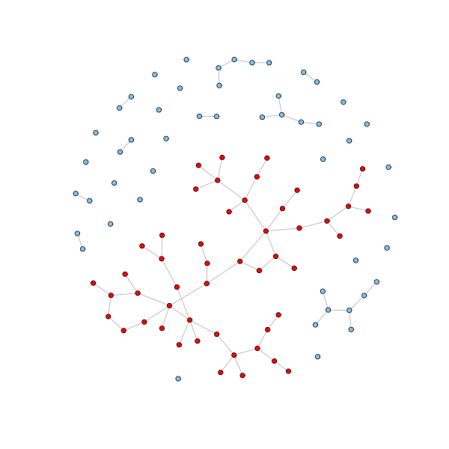
Introduction. Definitions
Giant connected component (GCC) is the largest connected component of the graph
Giant Connected Component (GCC)

Slide 20
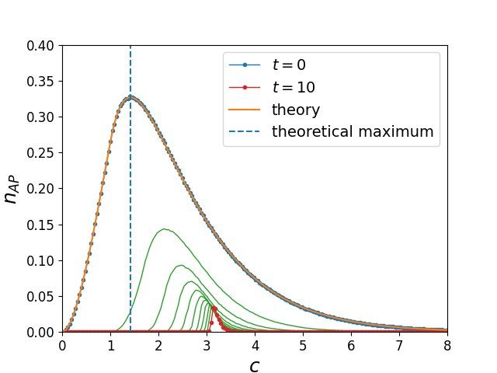
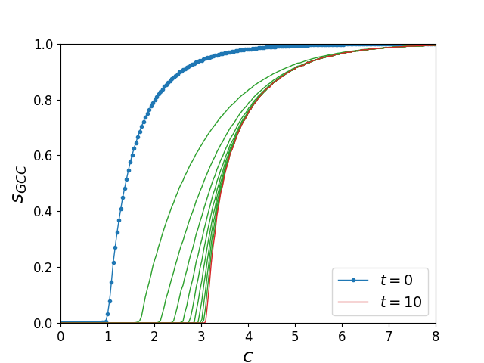
Introduction. Articulation points removal
Articulation points removal and GCC size in the case of monoplex Erdős–Rényi network ($N={10}^{5}$)
Review: Tian, L. et al. Articulation points in complex networks.
Nat. Commun. 8, 14223 doi: 10.1038/ncomms14223 (2017).

Slide 21
Aim & Objectives
Study AP removal process in multiplex networks applying cascade failure of nodes
in Erdős–Rényi multiplex networks
in scale-free networks
Study the difference in behavior between simple and multiplex cases
Compare different random graph models

Slide 22
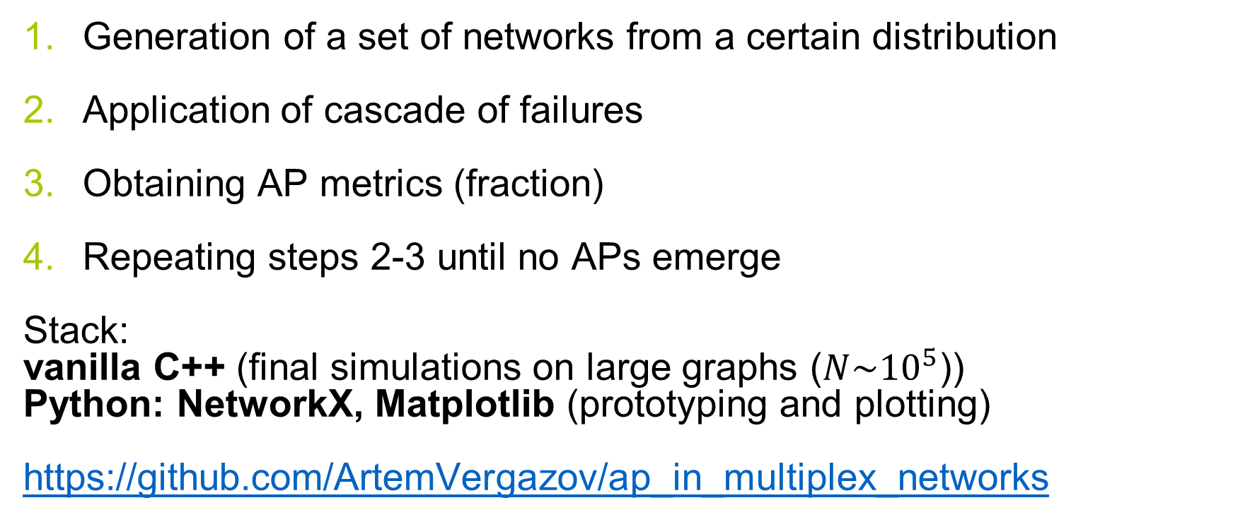
Algorithms and methodology
Generation of a set of networks from a certain distribution
Application of cascade of failures
Obtaining AP metrics (fraction)
Repeating steps 2-3 until no APs emerge
Stack:
vanilla C++ (final simulations on large graphs ($N\sim {10}^{5}$))
Python: NetworkX, Matplotlib (prototyping and plotting)
https://github.com/ArtemVergazov/ap_in_multiplex_networks

Slide 23
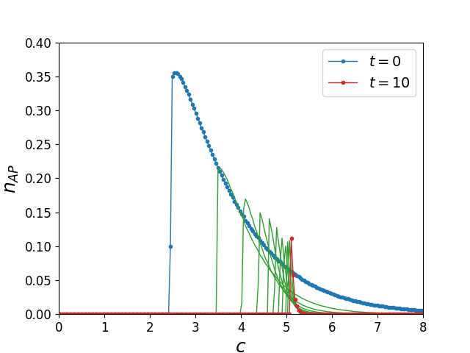
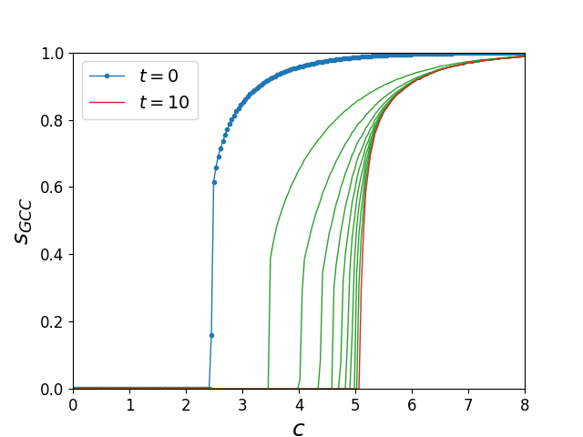
Results. ER multiplex network
Articulation points removal and GCC size in the case of two-layer multiplex Erdős–Rényi network ($N={10}^{5}$)

Slide 24
Results. ER multiplex and monoplex comparison
Multiplex case
Monoplex case

Slide 25
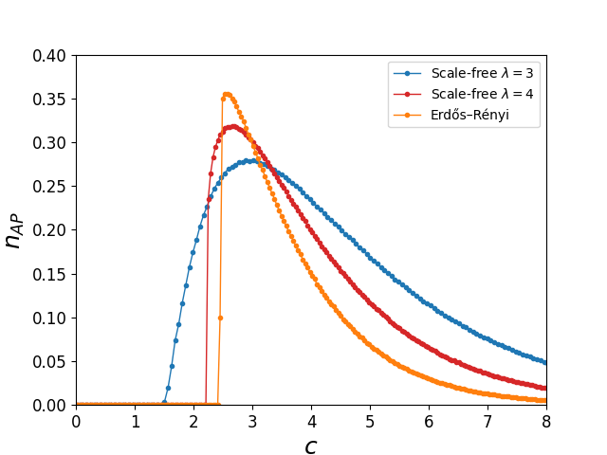
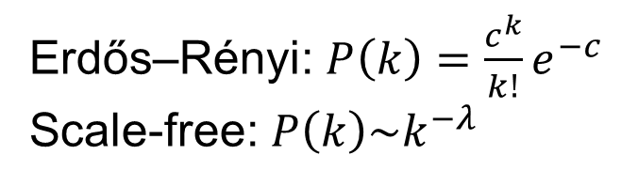
Results. Random graph models comparison
Erdős–Rényi: $P\left(k\right)=\frac{c^{k}}{k!}e^{−c}$
Scale-free: $P\left(k\right)\sim k^{−λ}$

Slide 26
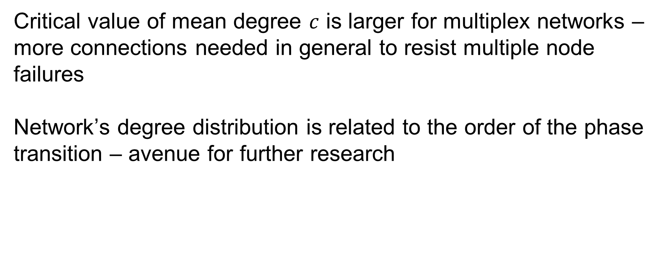
Discussion and conclusions
Critical value of mean degree $c$ is larger for multiplex networks –more connections needed in general to resist multiple node failures
Network’s degree distribution is related to the order of the phase transition – avenue for further research

Slide 27
Current status and outlook
APs removal strategy with cascade failure behavior studied on
Erdős–Rényi multiplex networks
scale-free multiplex networks
comparison between different random graph models
Next step:
Preparation of the paper for submission

Slide 28
Acknowledgements
Prof. Vladimir Palyulin
Dr. Saeed Osat

Slide 29
Thank you for attention

Slide 30
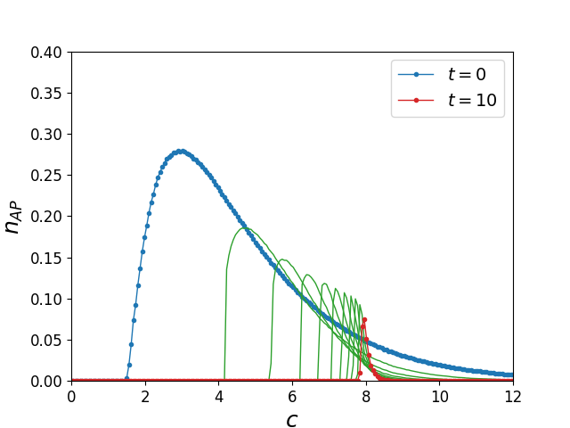
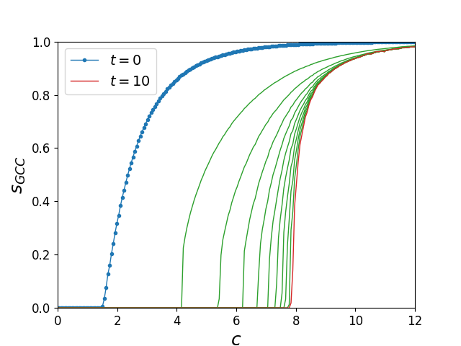
Results. Scale-free multiplex network
Articulation points removal and GCC size in scale-free two-layer multiplex network ($N\sim {10}^{5}$) with the degree exponent $λ=3$. $c$ is the mean degree of the network nodes.

Slide 31

Results. Scale-free and ER comparison
Scale-free network, $λ=3$
ER network

Slide 32
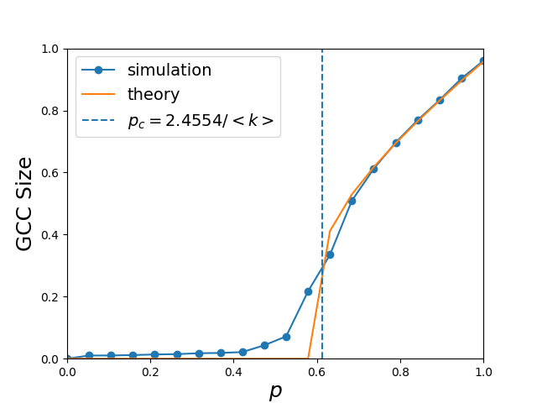
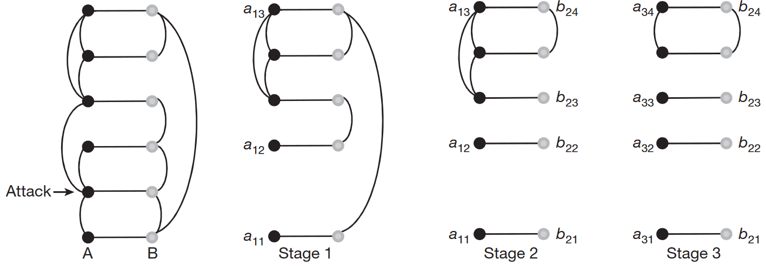
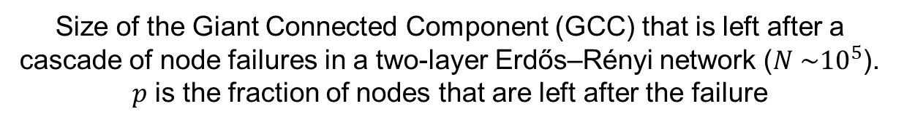
Introduction. Cascade failure of nodes
Size of the Giant Connected Component (GCC) that is left after a cascade of node failures in a two-layer Erdős–Rényi network ($N \sim {10}^{5}$). $p$ is the fraction of nodes that are left after the failure
Review: Buldyrev, S., Parshani, R., Paul, G. et al. Catastrophic cascade of failures in interdependent networks. Nature 464, 1025–1028 (2010). https://doi.org/10.1038/nature08932

Slide 33
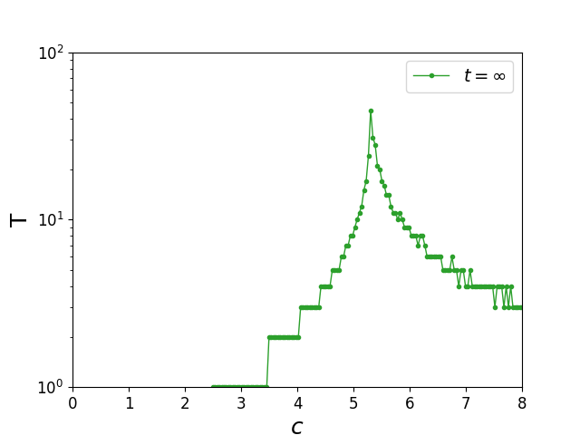
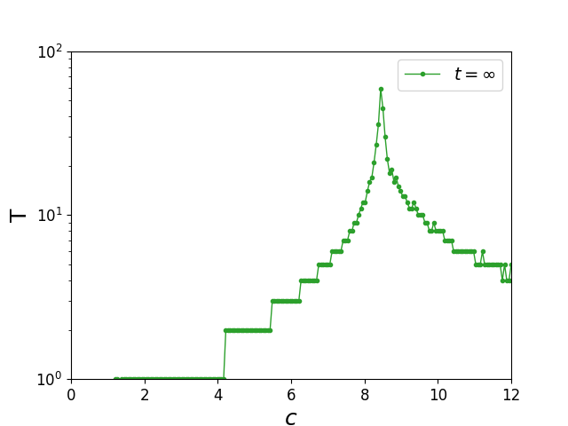
Appendix. Number of AP removal steps
Total number of AP removal steps as a function of mean degree c in multiplex ER and scale-free networks ($N\sim {10}^{5}$)
ER network
Scale-free network

Slide 34
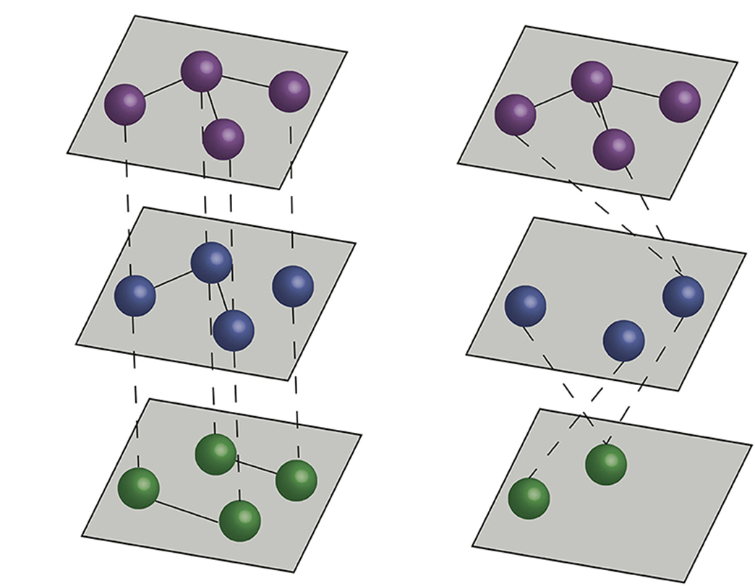
Multiplex vs Multilayer Networks
Multiplex
Multilayer

Slide 35
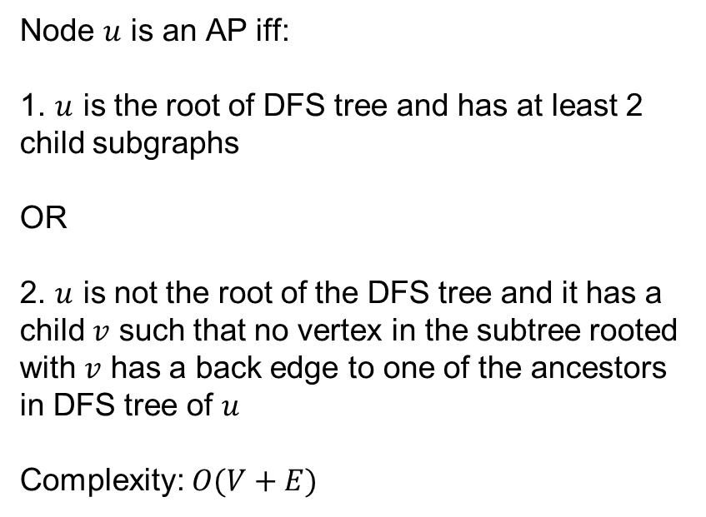
AP Identification Algorithm
Tarjan’s algorithm based on DFS
Node $u$ is an AP iff:
1. $u$ is the root of DFS tree and has at least 2 child subgraphs
OR
2. $u$ is not the root of the DFS tree and it has a child $v$ such that no vertex in the subtree rooted with $v$ has a back edge to one of the ancestors in DFS tree of $u$
Complexity: $O(V+E)$

