Slide 1

$$v$$

Slide 2


$$v$$
$$w$$

Slide 3


$$v$$
$$w$$

Slide 7
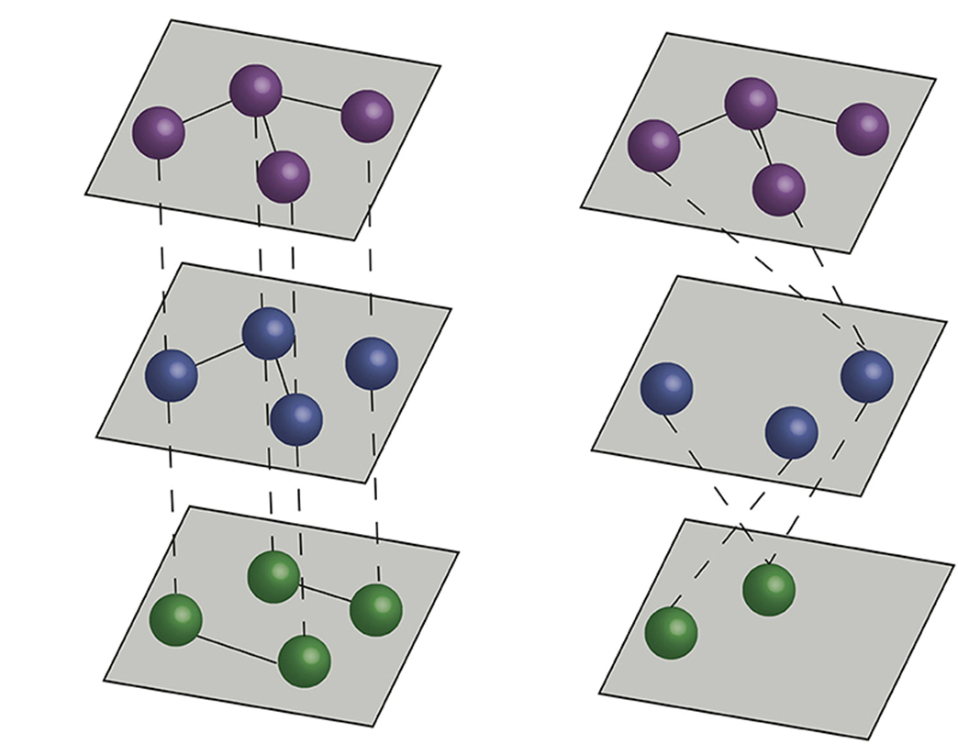
Multiplex vs Multilayer Networks
Multiplex
Multilayer

Slide 8
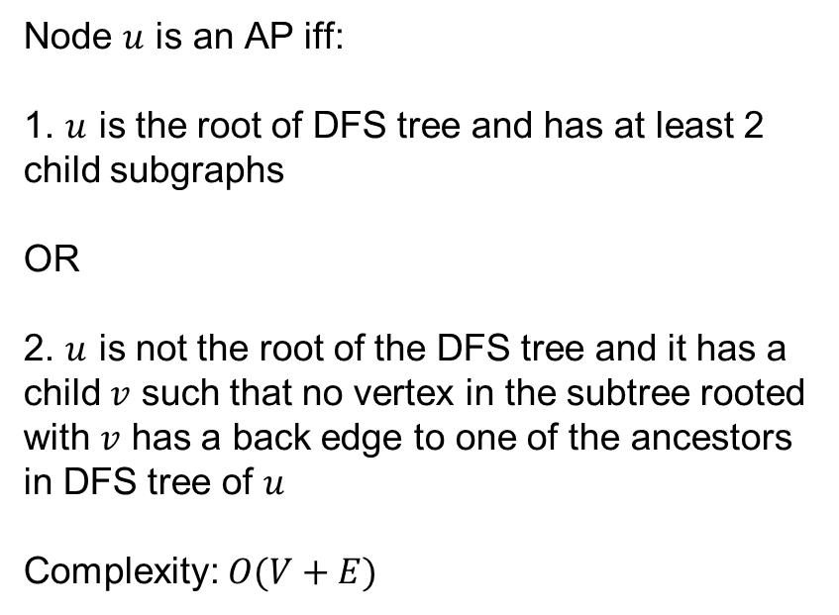
AP Identification Algorithm
Tarjan’s algorithm based on DFS
Node $u$ is an AP iff:
1. $u$ is the root of DFS tree and has at least 2 child subgraphs
OR
2. $u$ is not the root of the DFS tree and it has a child $v$ such that no vertex in the subtree rooted with $v$ has a back edge to one of the ancestors in DFS tree of $u$
Complexity: $O(V+E)$

