Slide 1
Project goals
Develop a predictive model for searching for potentially suspicious passengers
The model should be at least as good as the security measures that were used by the company earlier and at the same time comply with new government regulations
The model should help reduce economic losses from fraud and optimize passenger screening and monitoring processes.

Slide 2
Main Findings (Executive Summary)
Conducting premature inspections from various sources will help identify suspicious passengers and risks (loss of the aircraft - $150-200M, compensation for injured passengers - $50M, etc.)
Analysis of airline and passenger data has revealed several suspicious travel patterns that may pose a potential security threat. Combining data from various sources (booking sites, frequent flyer forums and ticket agencies) made it possible to identify:
the presence of non-individual or forged documents guarantees a risk and does not comply with the law and airline regulations
Checking for duplicate names and PNR help to track down offenders - The PNR is unique and should not be repeated.
This project provides guaranteed availability of the system. The model can run in ~10 minutes after receiving the data

Slide 3
Approach (for Sponsors)
Analyze data from various sources such as airline booking sites, frequent flyer forums, and ticket agencies to identify suspicious passengers.
Combining the data made it possible to create a complete picture of routes and passenger behavior. Duplicate entries and incorrect data have been eliminated.
A model has been developed to identify suspicious passengers, which analyzes inconsistencies, unique information and missing important data.
The results of the analysis make it possible to improve the safety of the airline, preventing possible incidents.

Slide 4
Approach (for Analysts)
Data was collected and combined from various sources: airline booking sites, frequent flyer forums and ticketing agencies. Data was cleaned to remove duplicates, errors and incorrect values.
Data processing methods were used, including merging data by unique passenger and flight identifiers, as well as removing missing and incorrect values.
The model can identify anomalies in passenger behavior - The model was tested on the collected data, showing a high accuracy in identifying suspicious passenger behavior patterns.
Implementation of the model through SQL code allows for quick evaluation of new data and integration with existing airline systems for continuous passenger monitoring.

Slide 5
Model Description
Overview of Basic Methodology: predict which passengers pose a threat and identify suspicious passengers based on their actions, behavior and information
Model: Unified Data Processing Model
Dependent variable: DataFrame or tab-separated values, of malicious passenger / harmless passenger
Scope: - 443 272 people who have used air transportation services, based of different sources within a 365 day period after 1/1/2017 - 130.000 flights by skyteam within a 365 day period after 1/1/2017
The model developed has predictive power at least as good as the Yoyoflot security and monitoring system

Slide 6
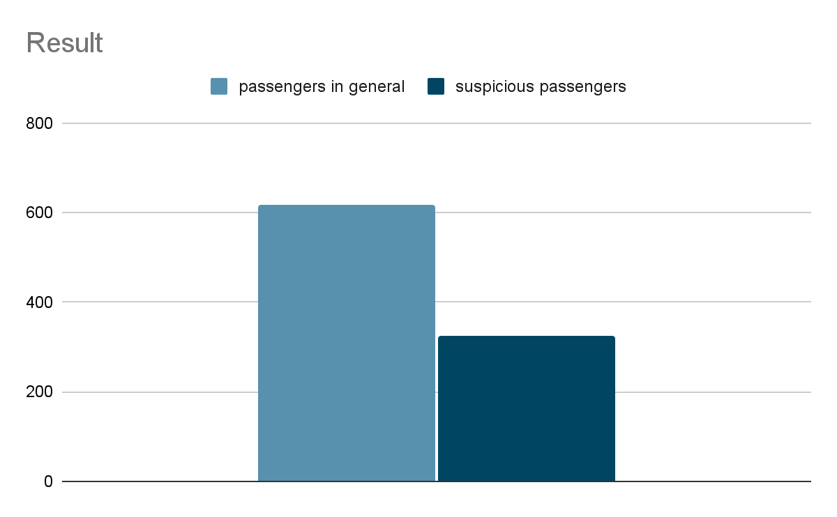
Key Points

Slide 7
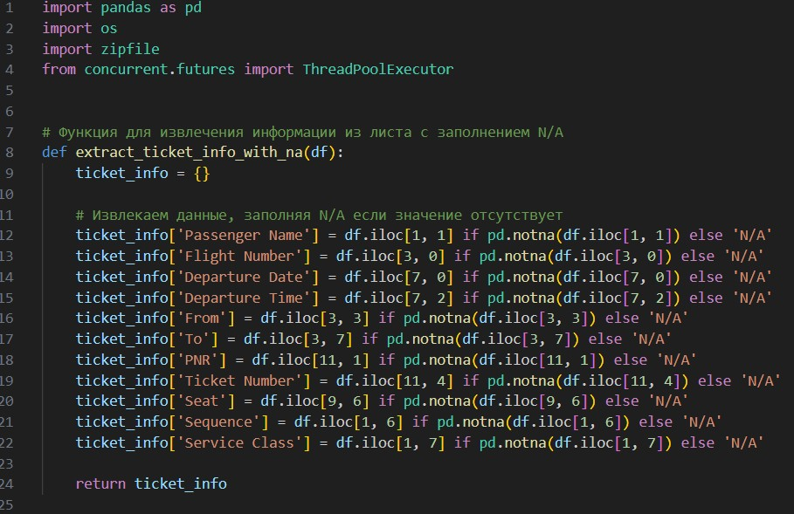
Model Details
Many of the files have non-repeating variables to process. Therefore, instead of using one common format, it was decided to use different models (internal device) for groups of files

Slide 8
Recommendations
Supplement recommendations with insights on model improvements and deployment in a production environment.
Implement the model as a pilot to assess accuracy and performance on real data. Use pilot testing results to fine-tune the model and enhance its effectiveness.
Run the model regularly to monitor new passengers, such as on a daily or weekly basis, to proactively identify suspicious individuals.
Integrating the model into the database will allow quick processing of large datasets and detection of suspicious activities within minutes.
Preventing potential incidents can save the company millions of dollars in avoided consequences for both the airline and its passengers.

