Slide 1



Intro To Data Science
מגיש: ארטיום זיננקו
מרצים: ד"ר יהונתן שלר ד"ר נעמה קופלמן
תאריך הגשה: 12.02.2021

Slide 2

Project Intro
Research question
This project deal with the Israeli real estate market
It is known that the real estate market is very expensive in Israel
In our project we wanted to check what is affected by real estate prices and to predict the price of the new real estate

Slide 3
Project
Breakdown
Step - 1 Identify Data Group
This project we use the data from YAD2
YAD2 reputed to a great website from real estate market
Step - 2 Data Extraction
using the method Crawling to get the data from website YAD 2
Using the Software Selenium
Step - 3 Data Processing
Data cleaning,Completion of missing data and outliers
Using Pandas
Step - 4 Exploratory Data Analysis (EDA)
Data transformation, normalization and data engineering
Data Visualization
Step - 5 Machine Learning
Supervised methods
Model validation and Hyperparameters fine-tuning
Step - 6 Conclusions

Slide 4
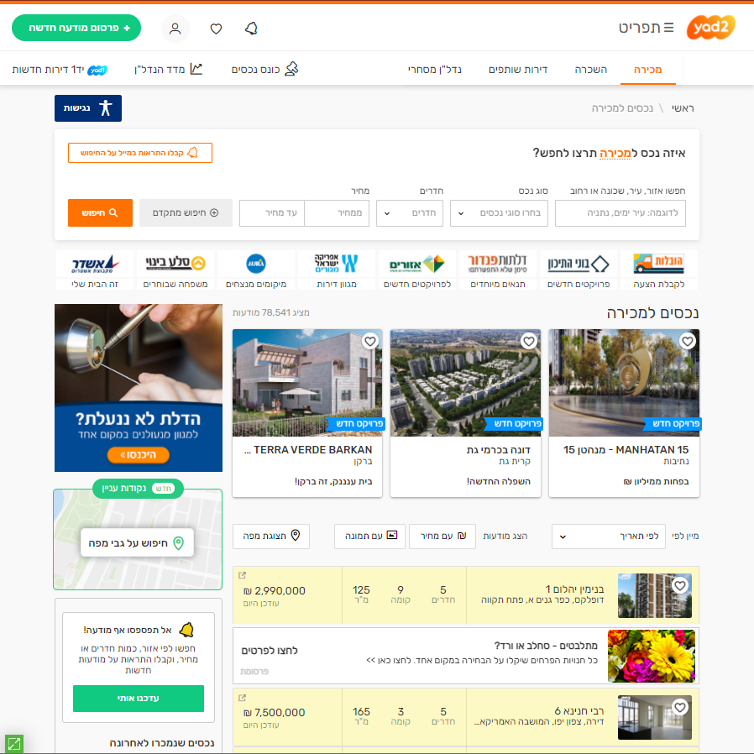
Step 1 Identify Data Group
We chose to use the Yad2 website To get the data for use in the project.
Yad2 is considered a very large site and has come full of ads for real estate to sell.
URL: https://www.yad2.co.il/

Slide 5
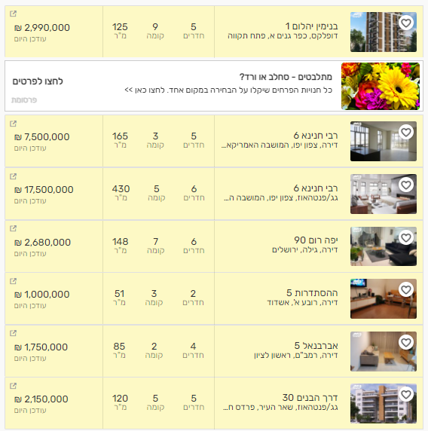
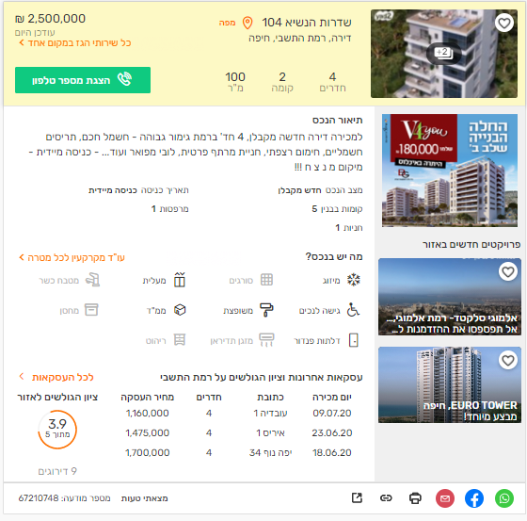
Step - 2 Data Extraction
As you can see the site has a large amount of ads for sale.
Using the Selenium software, we were able to extract Data from the site.
We encountered a problem that could not be downloaded an entire page. So we had to use Selenium to click on each ad to open it to access inner information of ads.
We repeat this process between all the ads and all the pages we predefined.
Save the data in the EXCEL file

Slide 6
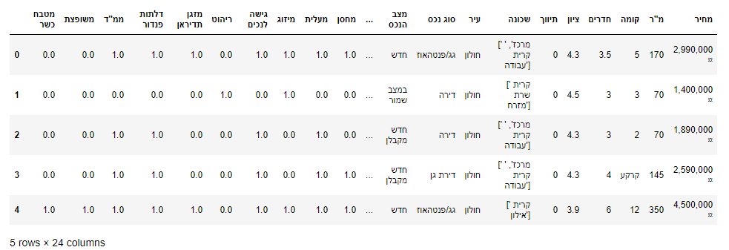
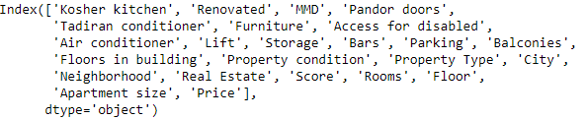
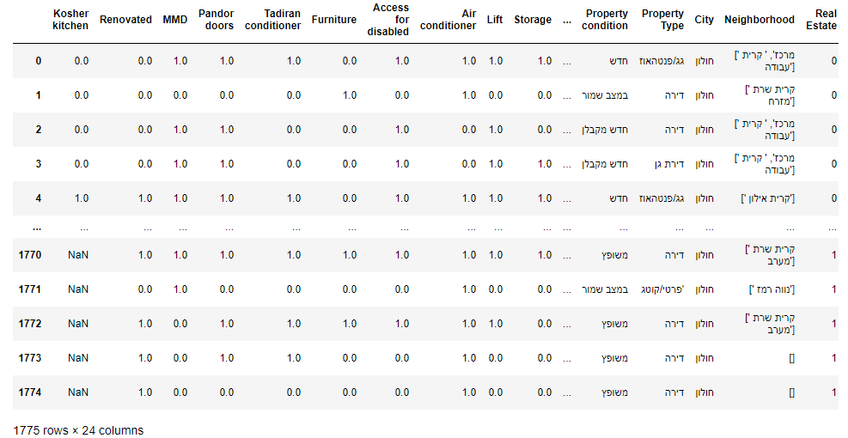
Step - 3 Data Processing
Cleaning Data
The data we received were not the cleanest
First we changed the names of columns from Hebrew to English
In addition to None values there were also values like
"לא צוין מחיר","ללא","לא צוין"
The values of the price are string type
And there a sign of shekel
The names of the neighborhoods also did not just look like a string
And more

Slide 7
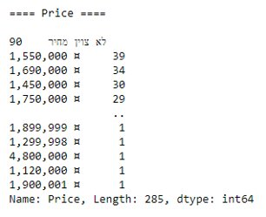
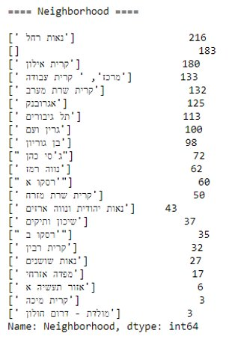
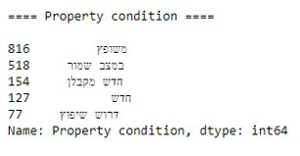
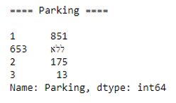
Step - 3 Data Processing
More examples
Replacing string variables with int
After all the cleanings we got a dataframe with 1546 row and 24 columns

Slide 8
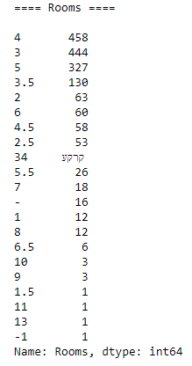
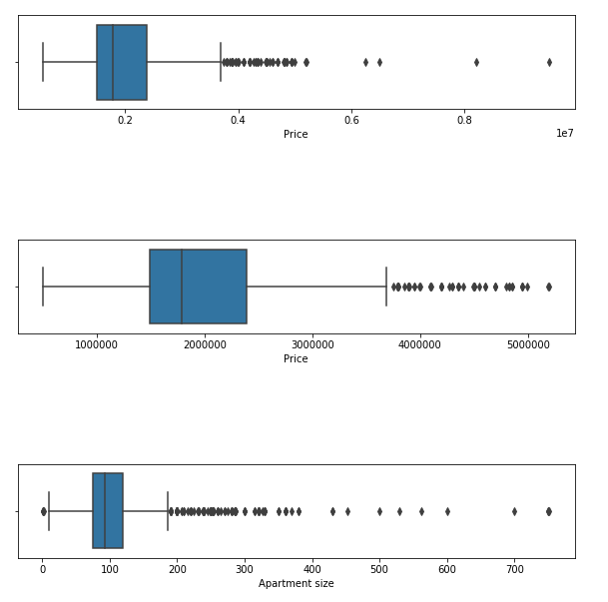
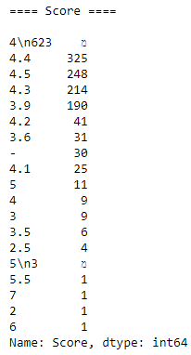
Step - 4 Exploratory Data Analysis (EDA)
Completion outliers
Using Box Plot
Number of rooms - can not be negative
The maximum score for the value of the apartment must be between 1-5
The size of the apartment is not more than 1000 dunams
The prices of apartments were not more than 5 million

Slide 9
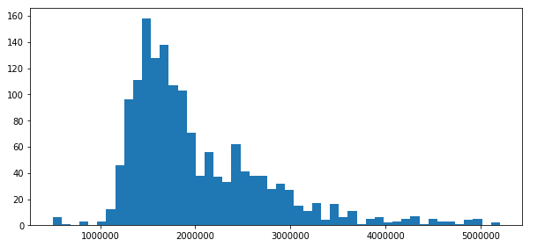
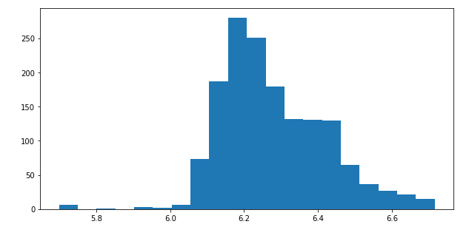
Step - 4 Exploratory Data Analysis (EDA)
Before and After Normalization
Completion outliers
Data Normalization
For the price variable do Normalization to decrease the values

Slide 10
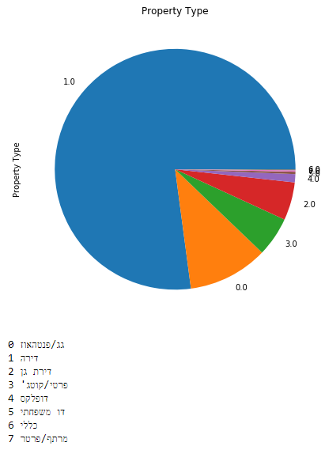
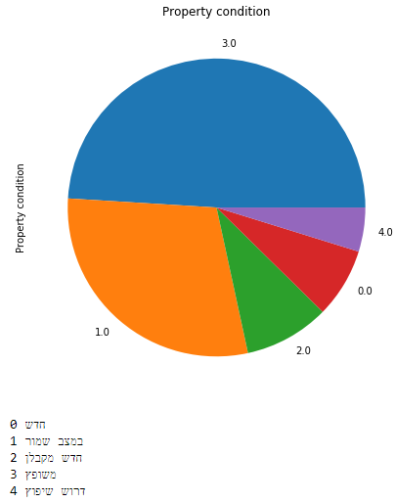
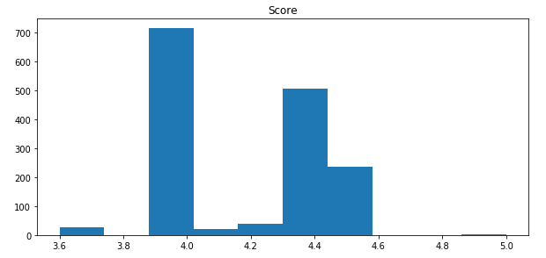
More visualization

Slide 11
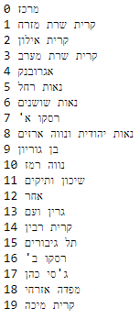
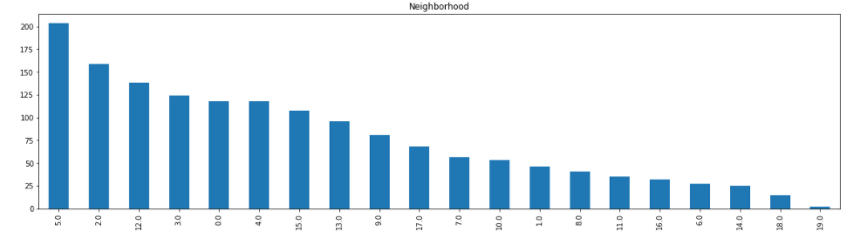
More visualization

Slide 12
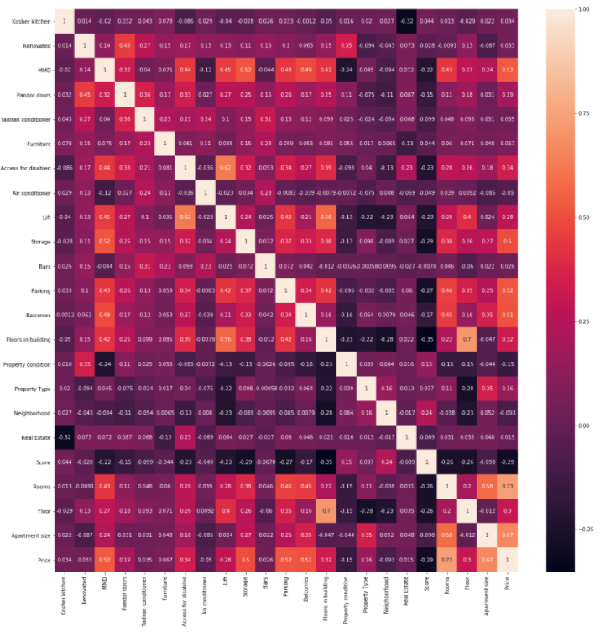
Step - 4 Exploratory Data Analysis (EDA)
We will check the correlation between our columns using a Heat Map

Slide 13
Step -4
Exploratory Data Analysis (EDA)
Data Engineering
Created three more columns
First for the Extras variables of the apartment add them into one column
Second for "Storage", "Balconies", "Parking" that add them to one column
Third Go to unify the number of rooms into 3 categories
Rooms between 0 to 3.5 get the value 1
Rooms between 3.5 to 5 get the value 2
Rooms between 5 and more get the value 3
Data Transformation
After that I use StandardScaler to prepare the data for working with Machine Learning algorithms

Slide 14
Step - 5
Machine Learning
Model Selection
To predict the Price using Linear Regression
We will also use Linear Regression Lasso and Ridge
Division the Dataset to train and test
Model validation
Hyperparameters fine-tuning
Selection of the best models
Testing models in a new unseen dataset
Adaptation of the models to the real needs

Slide 15

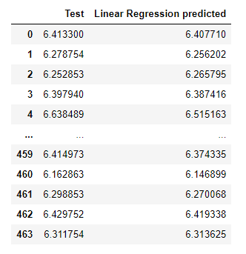
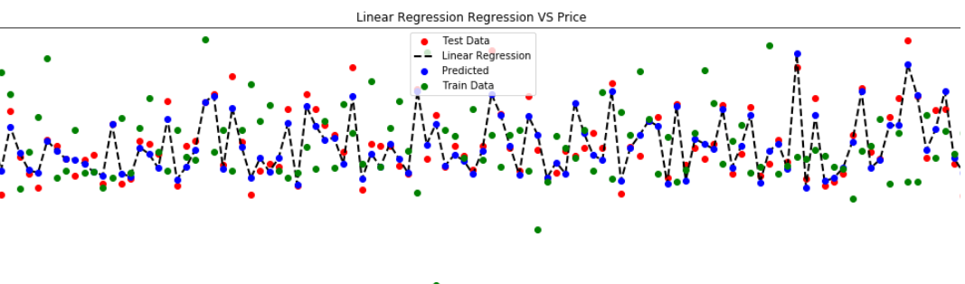
Linear Regression

Slide 16

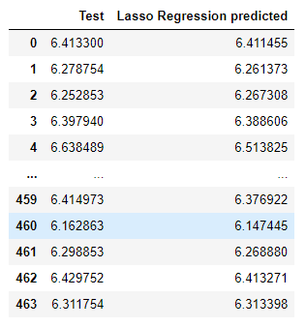
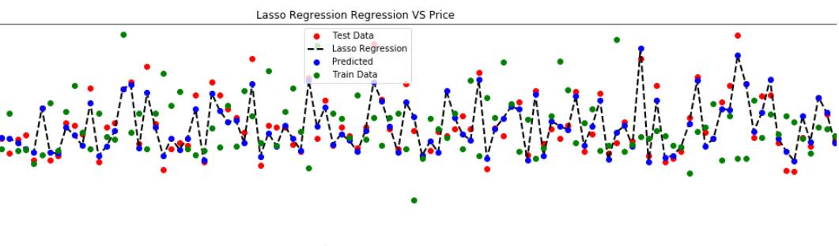
Lasso Regression

Slide 17

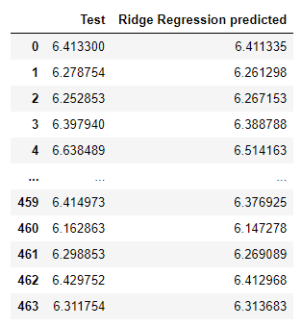
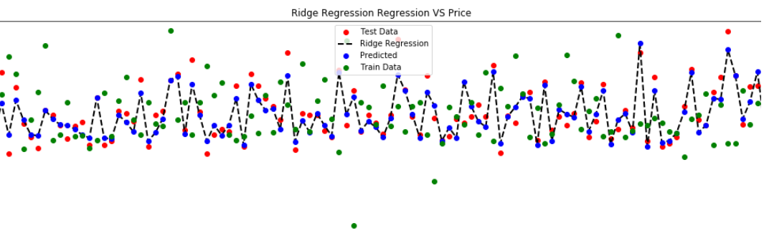
Ridge Regression

Slide 18

Step - 6
Conclusions
Model Selection
We will choose the model that gives the best predict
In our case the Linear Regression model gave the best prediction
Accuracy on test data = 0.843
Accuracy on train data = 0.6417
We want save the model and we will use it for our needs

Slide 19

Thank you for listening

