Slide 1


Hotel Booking System Project
Welcome to our presentation on the Hotel Booking System, a project designed to streamline the reservation process for guests and hotel staff.

Slide 2
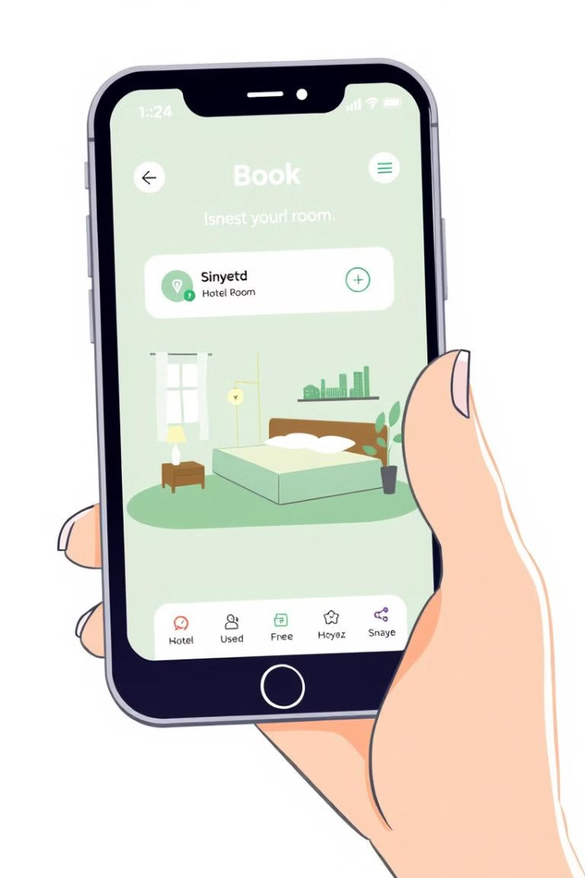
Introduction
1
Project Goal
2
Project Significance
To simplify the process of booking hotel rooms via a user-friendly interface.
Speed up the booking process, minimize errors, and enhance user and administrator convenience.

Slide 3

Team & Roles
Team Members
Project Roles
Ten Artem
Designing a good visually looking and intuitive user interface.
Eremin David
Implementing abstract classes and code optimization.

Slide 4
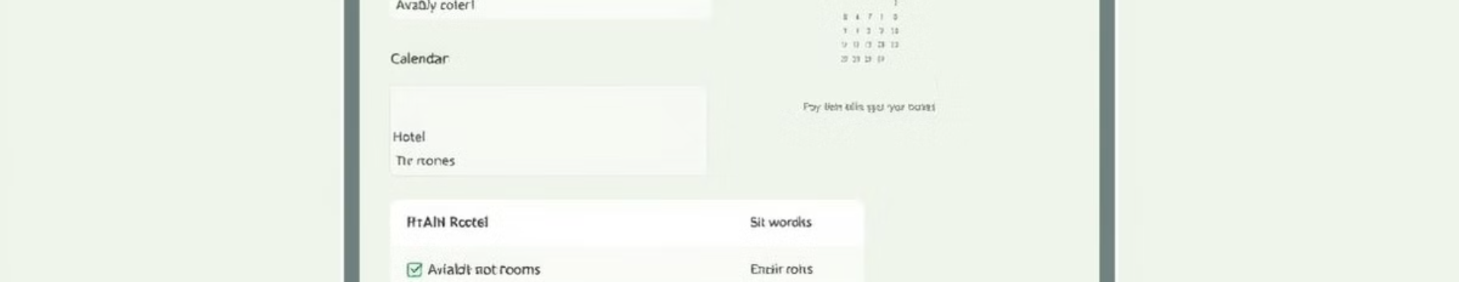
Project Requirements
Functional Requirements
Non-Functional Requirements
User input form for contact information.
User-friendly and intuitive interface for seamless navigation.
Selection of available hotel rooms based on desired criteria.
Fast processing and responsiveness of the system.
Automatic calculation of booking costs.
Support for multi-user access (optional).

Slide 5
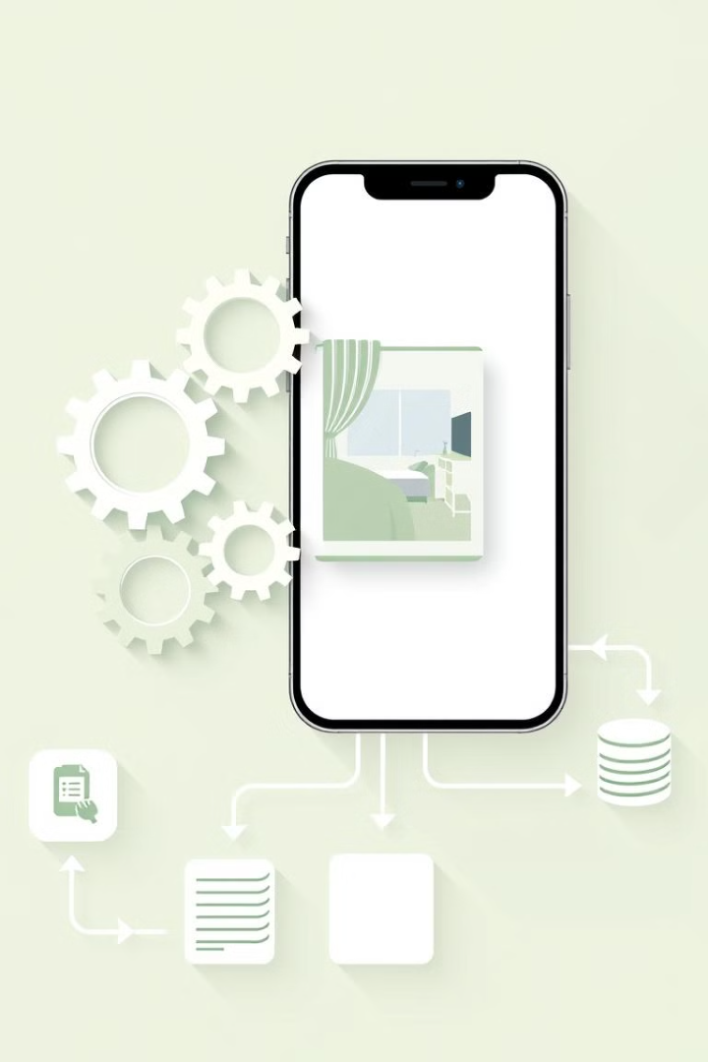
Code Overview
1
GUI module: Responsible for the visual elements and user interaction.
2
Logic module: Handles business rules, data validation, and calculations.
3
Database module: Stores and manages booking data using a relational database management system.

Slide 6
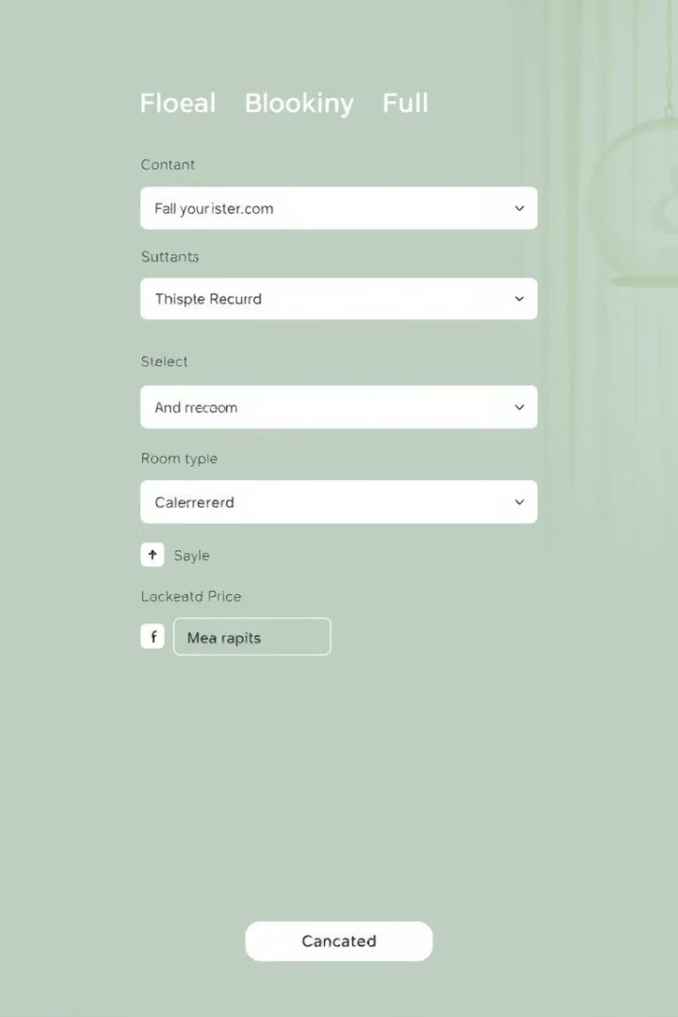


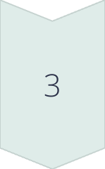
System Demonstration
User Input
The user enters their contact information, including name, email address, and phone number.
Room Selection
The user selects their desired room type based on available options and dates.
Confirmation
The system automatically calculates the booking cost, displays it to the user, and allows confirmation.

Slide 7
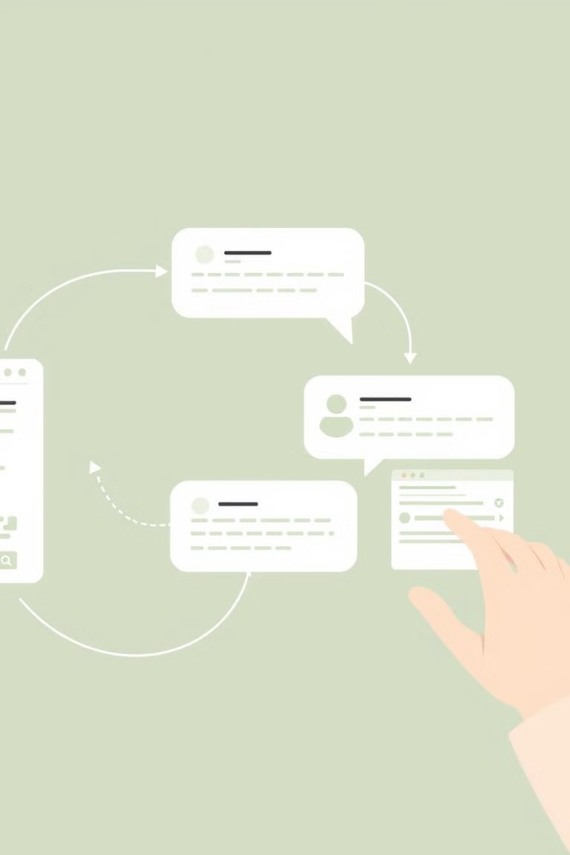


Feedback and Improvements
Feedback
Improvements
We would like to receive the feedback from you to further understand what we need to improve or change.
Improvements are going to be made after the feedback and testing under different scenarios.

Slide 8



Future Enhancements
Online Payment
1
Implement secure online payment integration for streamlined bookings.
Review System
2
Integrate a rating and review system for guest feedback.
Mobile Optimization
3
Optimize the system for mobile devices for greater accessibility.

Slide 9

Conclusion
1
2
Learnings
Successes
We gained valuable experience in designing, developing, and testing a complex software system.
The project successfully created a functional and user-friendly hotel booking system.

