Slide 1


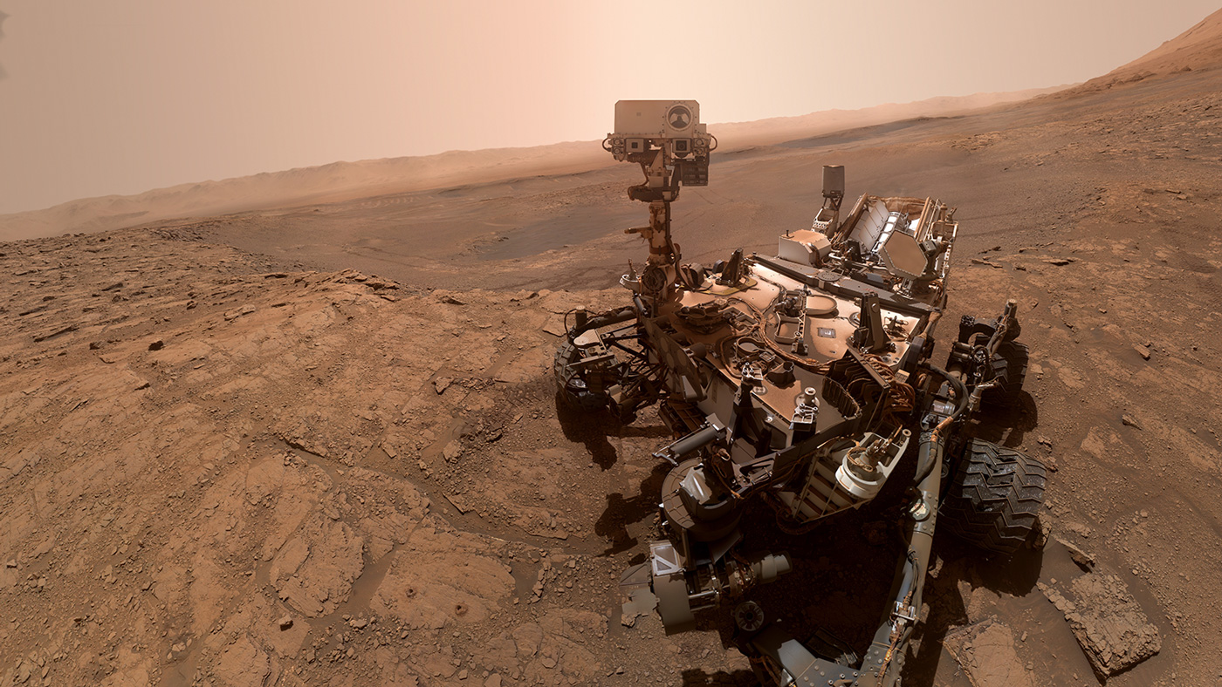
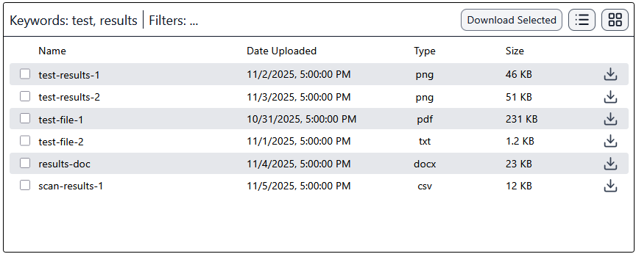






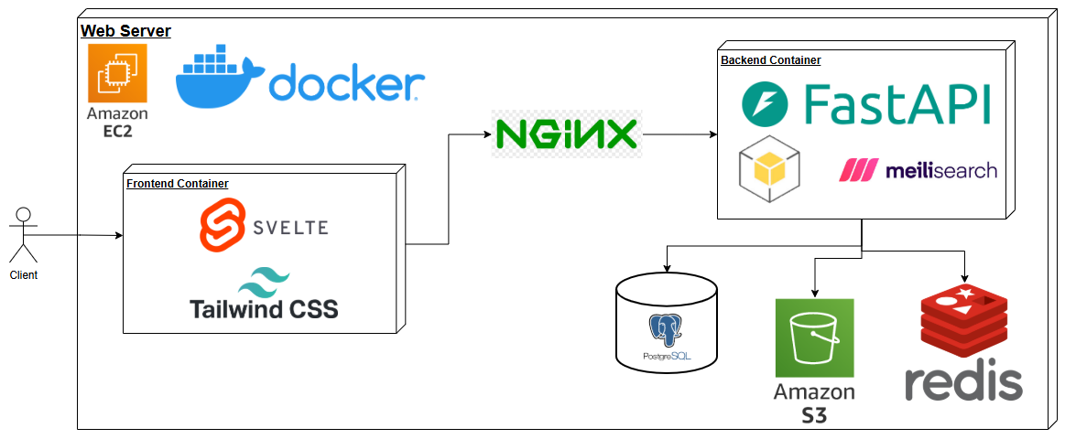




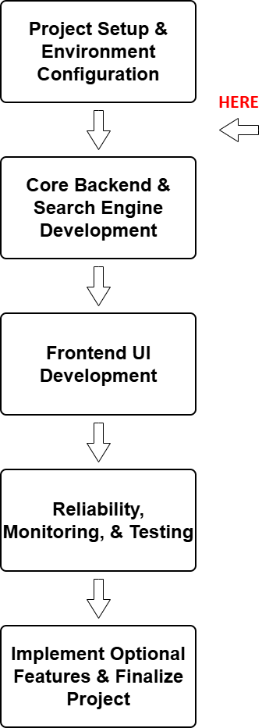

ArtemiS3
Team: Joseph Laity, Jeffrey Hoelzel, Samuel Bodenheimer, Travian Lenox
Team Mentor:
Md Nazmul Hossain
Client: Trent Hare. Cartographer. USGS Astrogeology Center. Flagstaff, AZ
Background
The Vision
The MVP
The Astrogeology Science Center, part of USGS, provides support for several NASA satellite and robotic planetary missions.
They also support the infrastructure required to archive and serve the data to scientists, students and the public.
To be able to handle this data, they use AWS S3 cloud storage.
Key features include:
Full text and metadata search
Metadata indexing
An interactive dashboard
Using tagging and collaboration
Caching and rate control
Administrative security auditing
Geospatial visualization
What is the Problem?
NASA and the USGS Astrogeology Science Center store many petabytes of planetary mission data in AWS S3 buckets.
Currently, researchers must browse folders through a simple S3 browser with no global search or filtering.
An intelligent search tool for AWS S3 buckets
Technologies Planned
Our Proposed Solution
Project Plan & Progress
We are currently in between the initial project setup and environment configuration, and the core backend development.
Our functional requirements have been prototyped and will continue to be refined throughout the development process.
We are confident we can deliver a high-quality product by the end of May 2026.
ArtemiS3 is an intelligent web-application designed to index, search, and visualize publicly accessible NASA and USGS AWS S3 buckets.
Our solution will be a web-app utilizing Svelte and Tailwind CSS for the frontend UI, Python’s FastAPI for the backend, fully Dockerized and hosted on an AWS EC2 instance.
Python’s Boto3 module will be used to access NASA and USGS’s AWS S3 bucket storage, and Meilisearch will be used as the search engine.
Redis will be used for hot-path caching and rate control, and PostgreSQL will store user data like recent searches and tagged files.
Visit Our Website!
https://www.sce.nau.edu/capstone/projects/CS/2026/ArtemiS3_F25/

