Slide 1

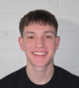
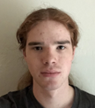



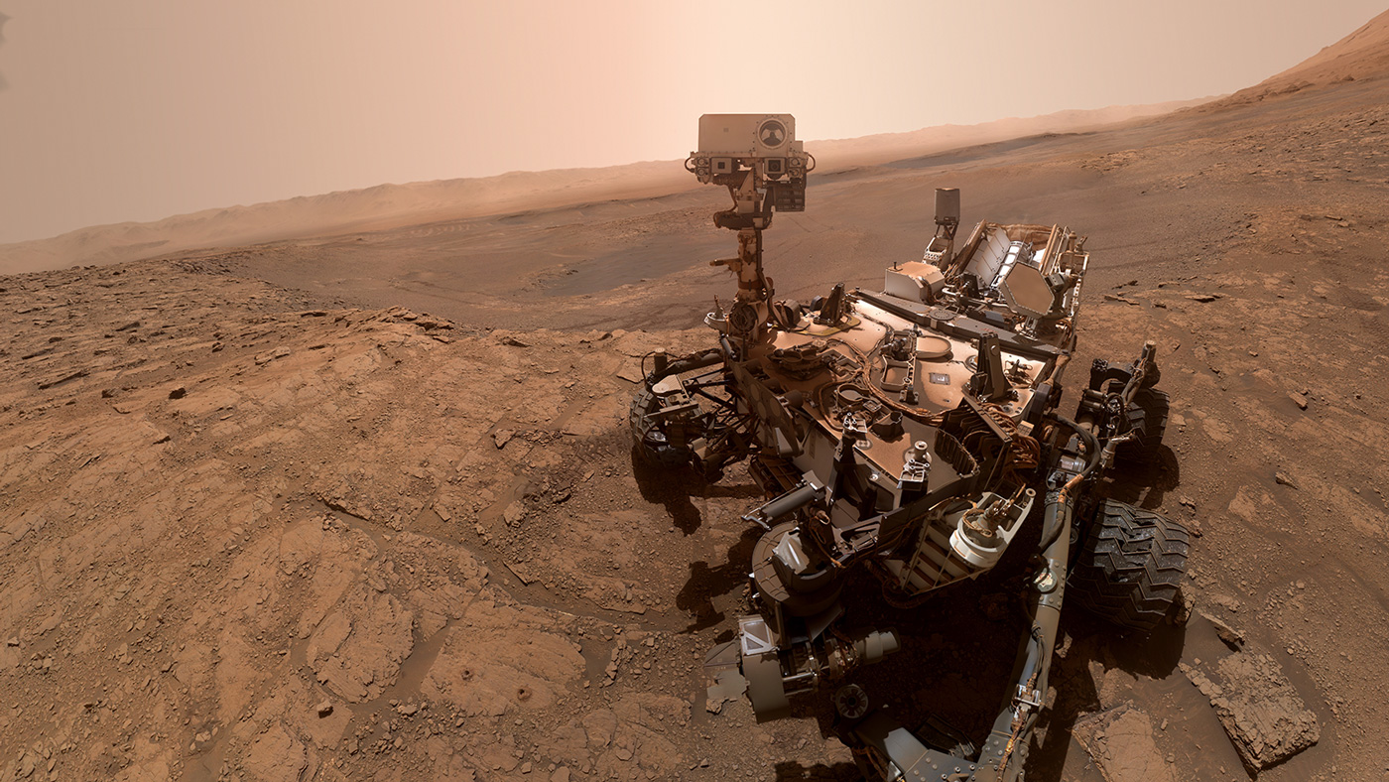
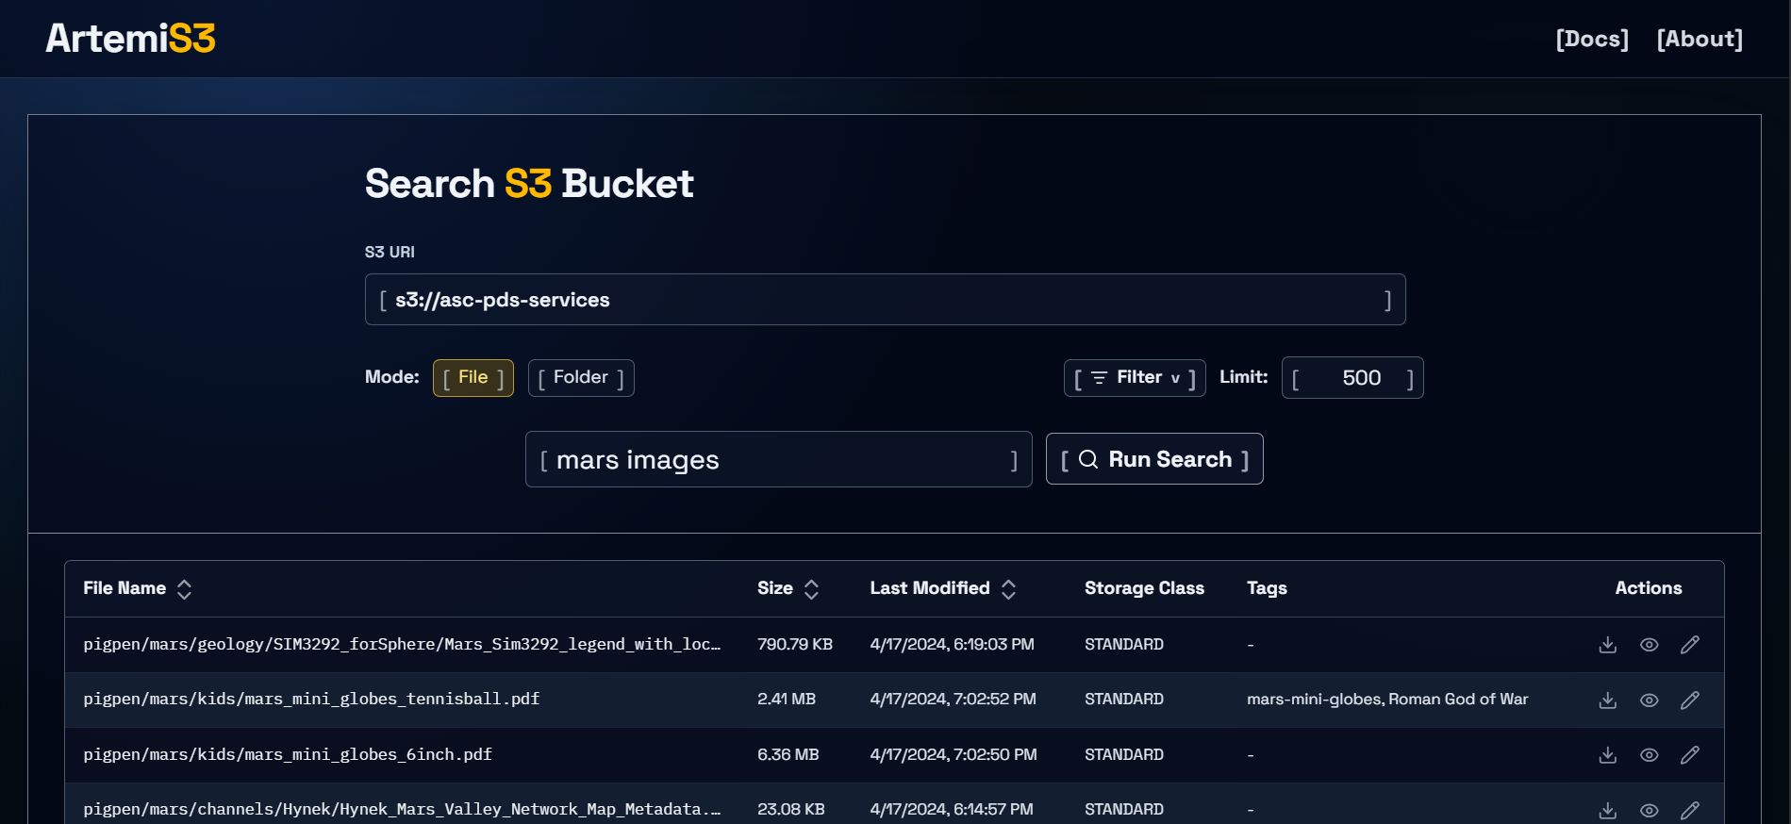


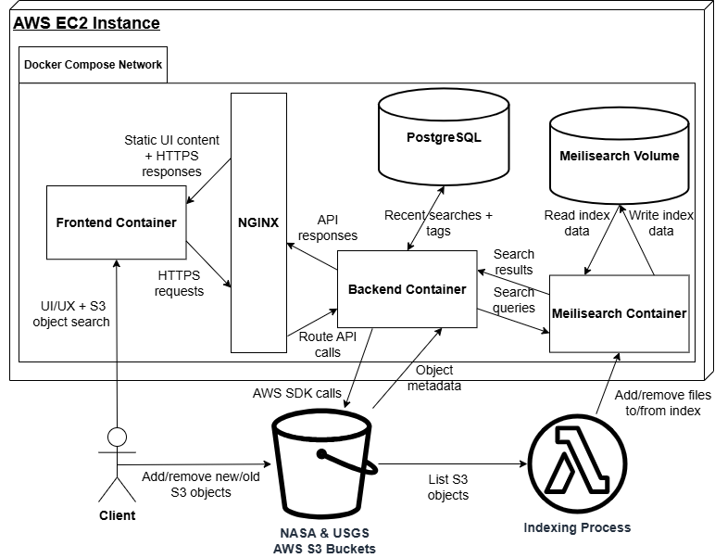









ArtemiS3
Client: Trent Hare
USGS Astrogeology Center
Flagstaff, AZ
Jeffrey Hoelzel
Architect
Joseph Laity
Team Lead
Samuel Bodenheimer
Release Manager
Travian Lenox
Software Lead
Team Mentor:
Md Nazmul Hossain
Background
The Vision
Key Features
The Astrogeology Science Center, part of USGS, provides support for several NASA satellite and robotic planetary missions.
They also support the infrastructure required to archive and serve the data to scientists, students and the public.
To be able to handle this data, they use AWS S3 cloud storage.
Key features include:
Full text and metadata search
Metadata indexing
An interactive dashboard
Folder and file view
Using tagging and collaboration
Geospatial visualization
What is the Problem?
NASA and the USGS Astrogeology Science Center store many petabytes of planetary mission data in AWS S3 buckets.
Currently, researchers must browse folders through a simple S3 browser with no global search or filtering.
An intelligent search tool for AWS S3 buckets
Technologies
Solution Overview
Boto3
Challenges & Future Work
Challenges: Debugging subtle search issues like edge cases with specific search configurations, which were difficult to isolate and reproduce.
Future Work: Implement caching and rate control for scalable deployment and security auditing.
ArtemiS3 is an intelligent web-application designed to index, search, and visualize publicly accessible NASA and USGS AWS S3 buckets.
Our solution is a web-app utilizing Svelte and Tailwind CSS for the frontend UI, Python’s FastAPI for the backend, fully Dockerized and will be hosted on an AWS EC2 instance.
Python’s Boto3 module is used to access NASA and USGS’s AWS S3 bucket storage, and Meilisearch is the search engine used.
PostgreSQL stores user data like recent searches and tagged files.
Outcomes
Visit Our Website!
Before ArtemiS3 | After ArtemiS3
Manual folder navigation | Instant search
No global filtering | Advanced filters
Difficult to find files | Fast discovery
Static storage | Interactive system
https://www.sce.nau.edu/capstone/projects/CS/2026/ArtemiS3_F25/

