Slide 1

Luxembourg’s external trade data.
How to turn trade data into essential levers for understanding and action
Hackathon 2026 – DAT’ARTEMIS TEAM
Octobre 2026
01

Slide 2
The key results of the work
01
02
Use of data
Innovation & experimentation
Relative Importance
Dependence
Geographic comparison
A new form of dashboard
Herfindahl–Hirschman Index
Finger-Kreinin index
03
04
Functional Proof of Concept
Reproducibility & Openness
A dashboard as a report:
Interactive
Working offline
Free software & Open sources packages
Available codes
Everything stored in a public GitHub
CRITERES D’EVALUATION
artemis.lu
02

Slide 3


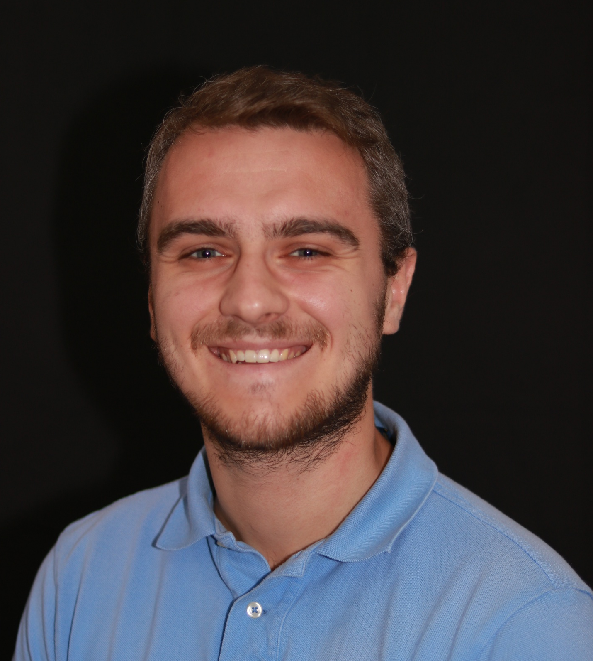

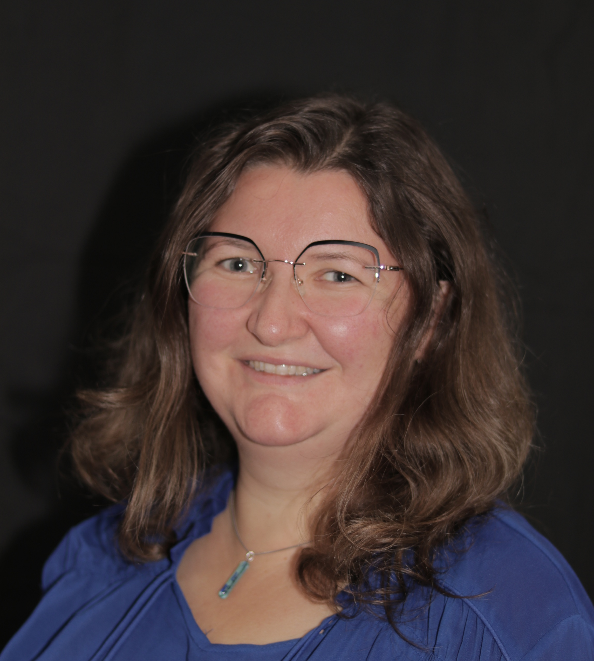
Kévin Alati
Data Scientist
Quentin Schmidt
Economist
Thank you!
Mathieu Scheffer
Data Scientist
Hackathon STATEC
Team Dat’Artemis
Quentin Barthel
Data Scientist
ARTEMIS Information Management S.A.
artemis.lu
Sandrine Herbeth
Project Manager Statistics
Insight you can trust.
Impact you can measure
12

