Slide 1




Урок вот-вот начнется.
Приготовься, сейчас будет что-то новенькое!

Slide 2



Disclamer

Slide 3



Who we are?

Slide 4



Slide 5

Namecheap
Domain and hosting products
Over 10 million domains under management
SSL security certificates, WhoisGuard,
Private Email, WordPress, VPN
Reseller services

Slide 6

ZONE3000
Software developing company
21-year on the IT-market
Full-cycle program engineering
Sharing technical philosophies and expertise

Slide 7

Our contribution in DevOps community
The course is

Slide 8

DevOps Culture Propaganda
The course is

Slide 9


DevOps Course
Starting point of DevOps journey
Concepts and instruments
Real-world examples and best practices
Homework with feedback

Slide 10

DevOps Culture

Slide 11

The main idea:
DevOps is not a role!
This is philosophy!

Slide 12
Testing

Slide 13


Continuous Integration/Continuous Delivery

Slide 14

Deployment

Slide 15


Monitoring

Slide 16


Communication

Slide 17
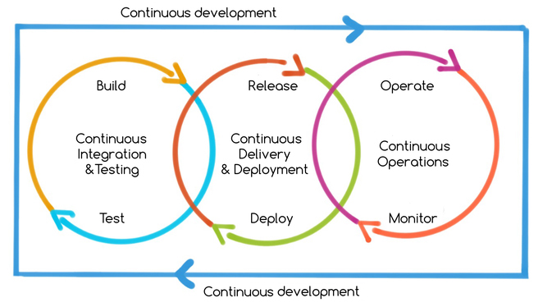

Slide 18
Hiring to company
The course is not

Slide 19



Learning Programming
The course is not

Slide 20

Learning System Administration
The course is not

Slide 21
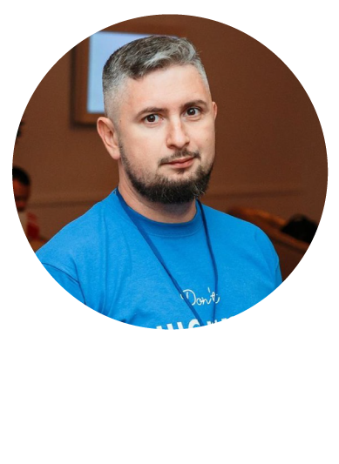
Nick Lototskiy
DevOps Evangelist at Namecheap
More than 5 years of work as a trainer
More than 20+ years in IT
About Trainer:

Slide 22


Questions ?

Slide 23



Let’s start!!!

