Slide 1
NY Style Pizza in the Heart of Chicago
By Artem Moshkin

Slide 2
The Challenge
Chicago is home to over five hundred pizza locations. However, we want to find a suitable location for our NY style pizza restaurant to open. Therefore the location has to be:
1. In a Neighborhood with some established pizza locations, known for being available.
2. Not too crowded with pizza options
3. Provides an opportunity for a new pizza location

Slide 3
Data Sources
We pulled information on Chicago Neighborhoods from Wikipedia.
Overlayed this information with area data on neighborhoods provided by the city of Chicago.
Foursquare provided data on the pizza locations in Chicago
And OpenCage Geocode allowed us to locate the coordinates for the Chicago Neighborhoods.

Slide 4
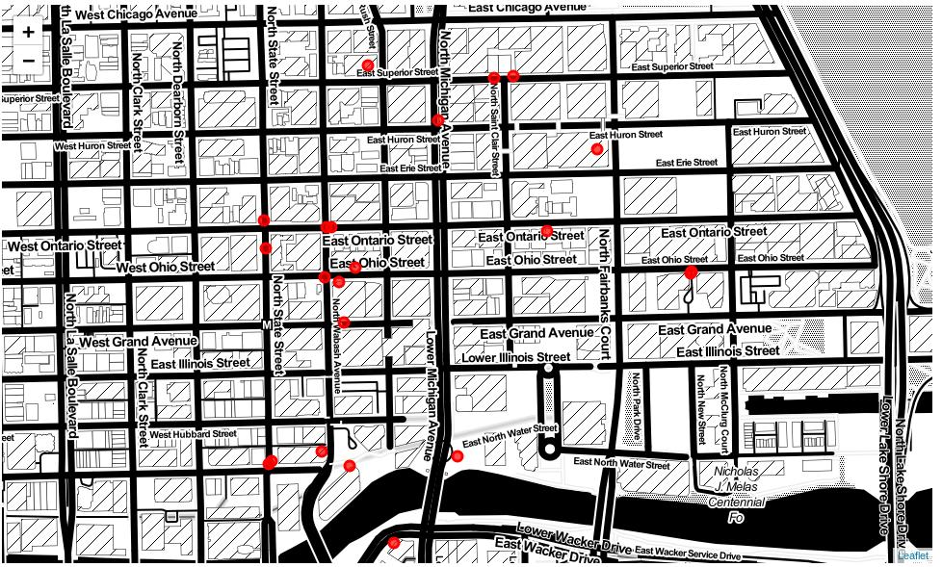
Crowded Locations (E.G. The Gap)
Some Neighborhoods already contain a plethora of pizza locations scattered throughout. This is one example of The Gap where every circle is a separate pizza restaurant.

Slide 5
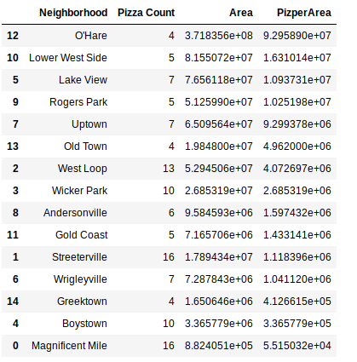
Pizza Locations Per Area of the Neighborhood
Taking a look at the number of locations per area of the neighborhoods it appears that O’Hare is the most beneficial place to open a pizza place. However, this is the airport! Therefore opening a pizza place in the airport would be a very challenging task. Instead lets take a look at the next three options.

Slide 6
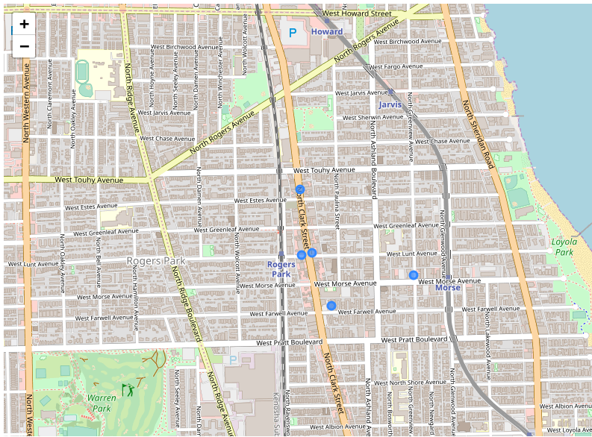
Rogers Park
One of the locations that we’re able to identify as being a possible location for opening a pizza place is Rogers Park. Taking a look at the pizza locations already open in Rogers park it is visible along one of the maps that a majority of pizza locations are only found on the main road with one outlier located outside of North Clark Street. Roger’s Park does not seem a suitable location as the majority of pizza locations are along the main road and stiff competition for those traveling to our pizza location would prove difficult in the long run.

Slide 7
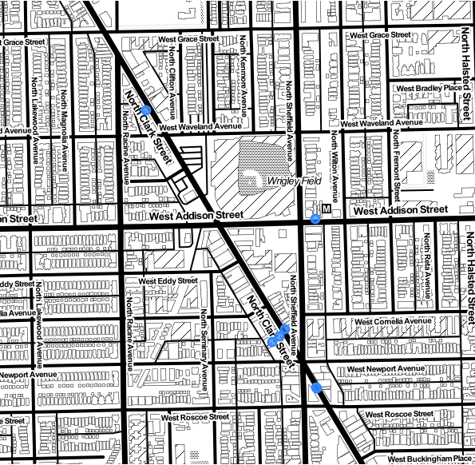
Lake View
Taking a look at Lake View we see that a similar trend emerges with all the pizza locations being along North Clark Street. This wouldn’t provide an optimal location for a new pizza place as all the competition would be readily available while driving down the street. Additionally this neighborhood contains Wrigley Field which would limit our ability to capture a majority of possible clients as they would be going to or coming from a baseball game during which they are likely to have consumed food.

Slide 8
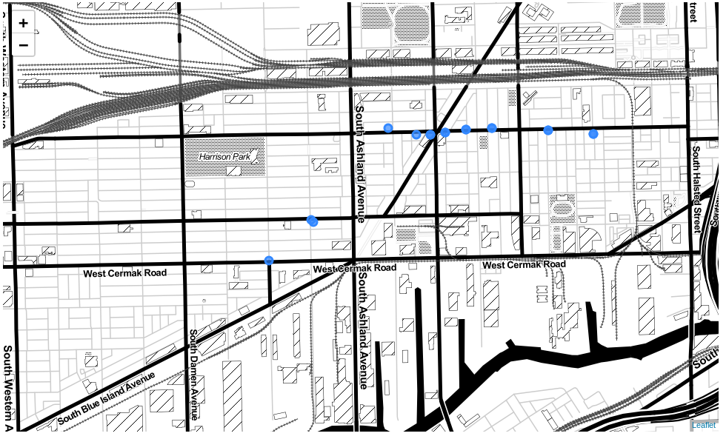
Lower West Side
Our final location has a concentration of pizza locations open along west 18th street. However, there is a lack of pizza locations around Harrison Park. This seems to be the most advantageous of the neighborhoods. It provides a location with a number of established pizza locations but a large area giving us a number of clients.

Slide 9
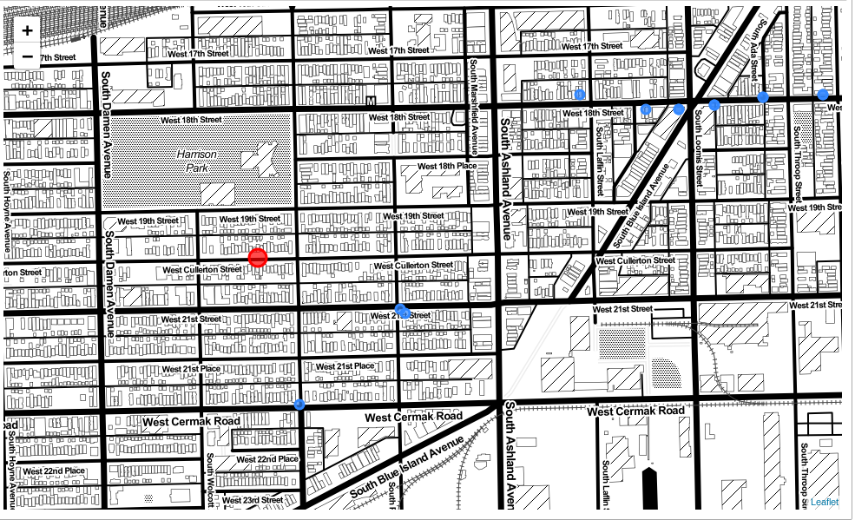
Conclusion
During our examination of the Chicago area, we have found a suitable location for opening a new pizza restaurant. Taking a look at different neighborhoods, we can conclude that the Lower West Side is going to be the best balance between already establish pizza locations nearby and a suitable client base that would appreciate some pizza. The ideal location would be opening a pizza place around the red location in the Lower West Side.

