Slide 1

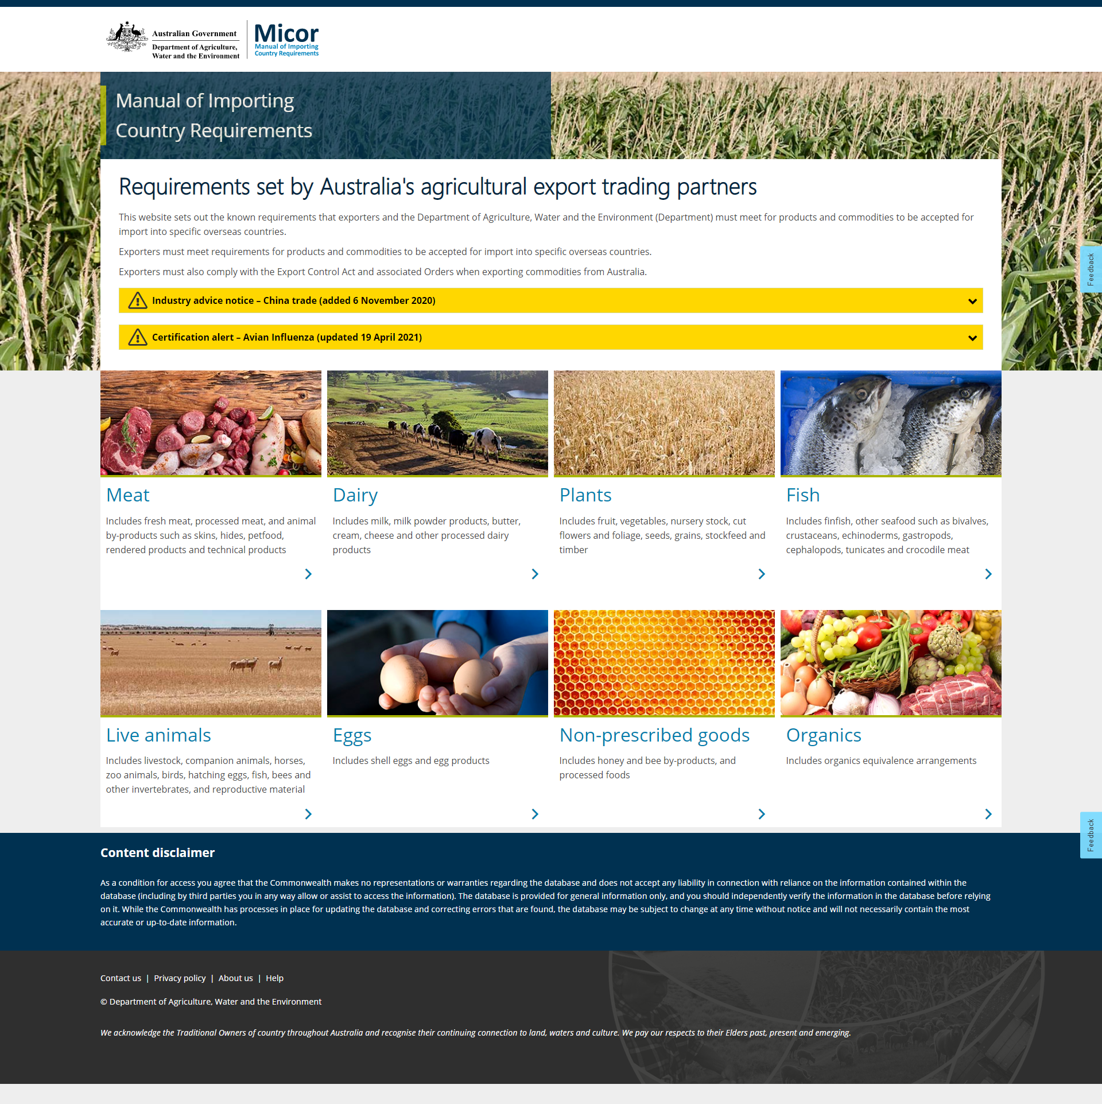
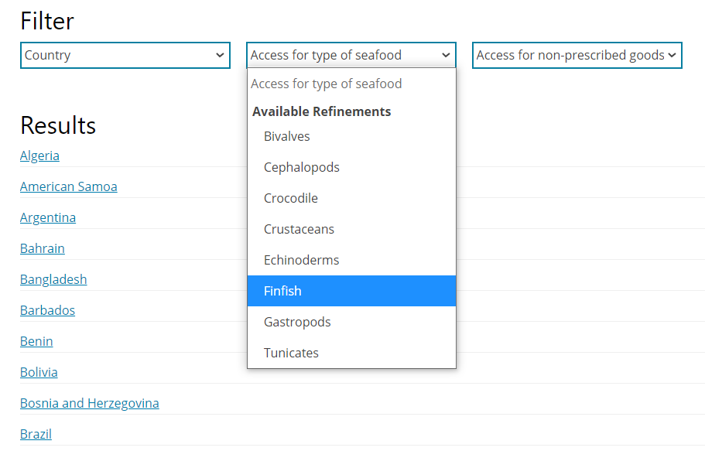
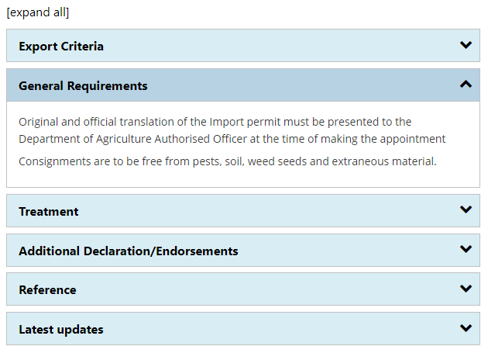







Micor QuickStart Guide
1. Choose
2. Search
3. Read
Click on one of the seven commodity types to find the importing country requirements for your exports.
Use the filters to refine your search and then choose a result to see the importing country requirements.
Click on an expandable “accordion” to reveal the
text within.
You can also
Print Micor content in a report-like format
Use Micor on a
phone or tablet
Search by keyword, chemical or disease
See when a page was last updated
Sign up for regular updates by email
See what has been added or deleted from the previous version of a page

