Slide 1
extended project qualification: Artificial Intelligence, the ethical challenges that it presents and how Governments have and should approach its regulation?
By Henry McMahon
Candidate number:
Centre number:

Slide 2
What I will cover:
Aims and objectives
Why I chose this subject
My question
Key areas covered and their sources
Conclusion
Did I fulfil my aim?
What I learnt during my EPQ
What I will do differently next time
How does this EPQ impact my future

Slide 3
Aims and objectives:
To write a 5,000-word essay on AI, its ethics and its regulation
To use various sources that show all sides to the story, so my arguments are detailed, fair and balanced
To develop my project, essay and research skills
To broaden my knowledge of AI and regulation

Slide 4
Why I chose this subject:
It is very relevant to my education
The variety of arguments and viewpoints
It is a recurrent theme in the media
Its ever-increasing rate of development and growth
Ethical concerns from consumers and developers

Slide 5
My question:
Artificial Intelligence, the ethical challenges that it presents and how Governments have and should approach its regulation?
Question breakdown | Associated questions
Artificial Intelligence | What is AI, and what does it do?
The ethical challenges that it presents | How can artificial intelligence be unethical?
How Governments have and should approach its regulation? | What have governments already done to regulate it, and how should they regulate it in the future?

Slide 6










Key areas covered and their sources:
The different ‘types’ of AI
Ethical concerns for consumers and developers
Case studies UK and EU

Slide 7
Conclusion:
Long term, regulation will increase consumer trust and adoption of AI
Regulations are needed to make sure fundamental rights are not overstepped
By regulating now, we can study the difference it makes and conclude the best next steps
It must be controlled by guidelines and regulations to ensure that the correct kind of growth is promoted

Slide 8
Did I fulfil my aim?
Yes, I did achieve my aim of writing a 5000-word essay
Yes, I did research and use sources for all sides of the argument
I have developed my essay and research skills
Yes, I have expanded my knowledge on the inner workings of AI
I have also expanded my knowledge on the wider effect AI has on society, the economy and governance
Finally, I have learnt more about the processes of regulation

Slide 9
What I have learnt during my epq:
Time management: modifying the time frame when required
Research skills: evaluation of sources
Analysis skills: comparison of sources and research

Slide 10
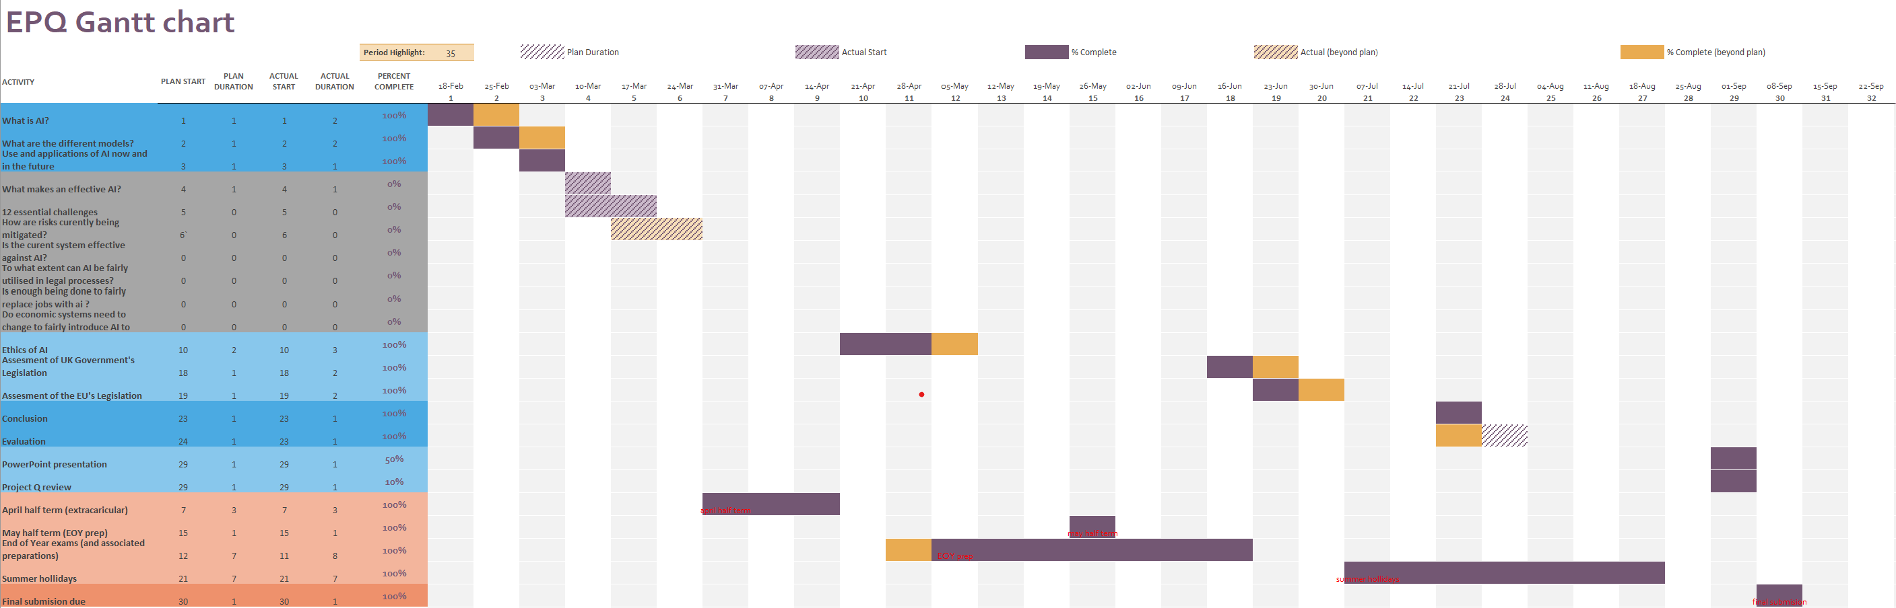
What I would do differently next time:
Build a clearer picture of the structure of the project from the start
Create a more detailed plan and research from the beginning of the project
Populate my Gantt chart with more achievement milestones

Slide 11
How does this EPQ impact my future:
Knowledge of AI terminology will be key to studying Computer Science at University
A greater interest in the regulatory journey of AI has inspired me to keep up to date with laws directly relevant to my career journey
Evidence to show my passion for AI and the effect it has on society

Slide 12
Any questions?

