Slide 1



Automatic Generation of a Real-Time Task Model for Deep Neural Networks Internship Defense October 4th, 2023 Hadi MEKDAD Supervisors: Prof. Mourad DRIDI & Prof. Yasmina ABDEDDAÏM Defended in front of the jury: Prof. Sahar HOTEIT Prof. Mihai MITREA

Slide 2
Outline
Lab Presentation
Introduction
Problem Statement
Proposition
Implementation
Experiment
Results
Conclusion & Future work
Notes:
Basic information about real-time systems, then DNN, then GPU

Slide 3
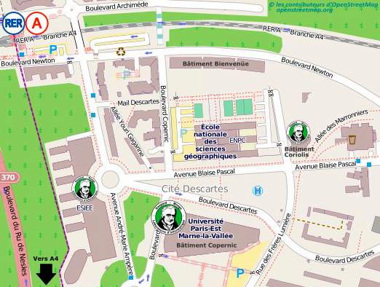
Lab Presentation
The Laboratory Informatique Gaspard Monge is a computer laboratory.
Location: Cité Descartes campus in Champs sur Marne.
There are 6 research teams.
My team and I are a part of the LRT team working in the ESIEE building specializing in the domain of real-time systems.
Notes:
Copernic
Coriolis

Slide 4
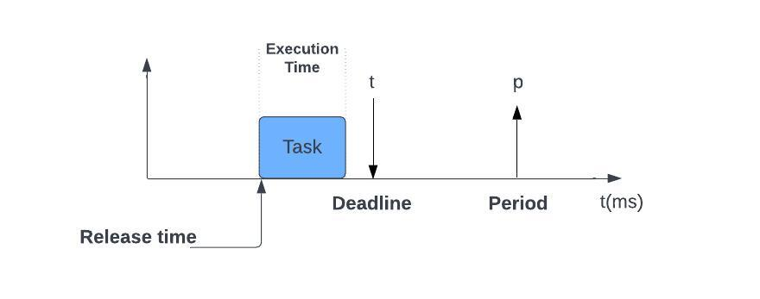
Introduction - Real Time Systems
Real-time systems
A real-time system is a computing system that must process and produce results within predetermined time limits.
Types:
Hard real-time systems.
Soft real-time systems.
Examples:
Automotive safety systems, medical devices, air traffic control systems.
Multimedia streaming, online gaming.
We consider the case where tasks are executed by DNNs
Notes:
In our project, we consider the case where tasks are executed by DNNs

Slide 5
Introduction - DNNs
Deep Neural Networks:
Deep Neural Networks (DNNs) are artificial networks which are inspired by the human brain structure.
DNNs consist of
Neurons
N1
N1
N2
Grouped Together
N2
N3
N3
N4
N4
Layer
Notes:
2 parts, training, and inference

Slide 6
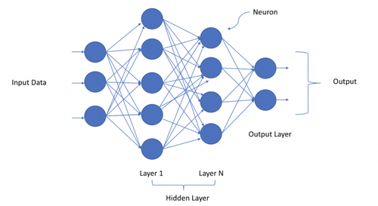
Introduction - DNNs
Deep Neural Networks:
First layer processes input data to the network.
Final layer yields the output of the network.
Notes:
Add DNNs computationally intensive

Slide 7
Introduction - DNNs
DNNs have two phases:
Training phase.
Teaching the neural network by adjusting its parameters to minimize errors on a labeled dataset.
Inference phase.
Using the trained model on new, unseen data without further parameter updates.
DNNs are computationally intensive
Require a hardware architecture to deploy them.
→They are commonly executed on hybrid architectures that combine Central Processing Units (CPUs) and Graphics Processing Units. (GPUs)

Slide 8
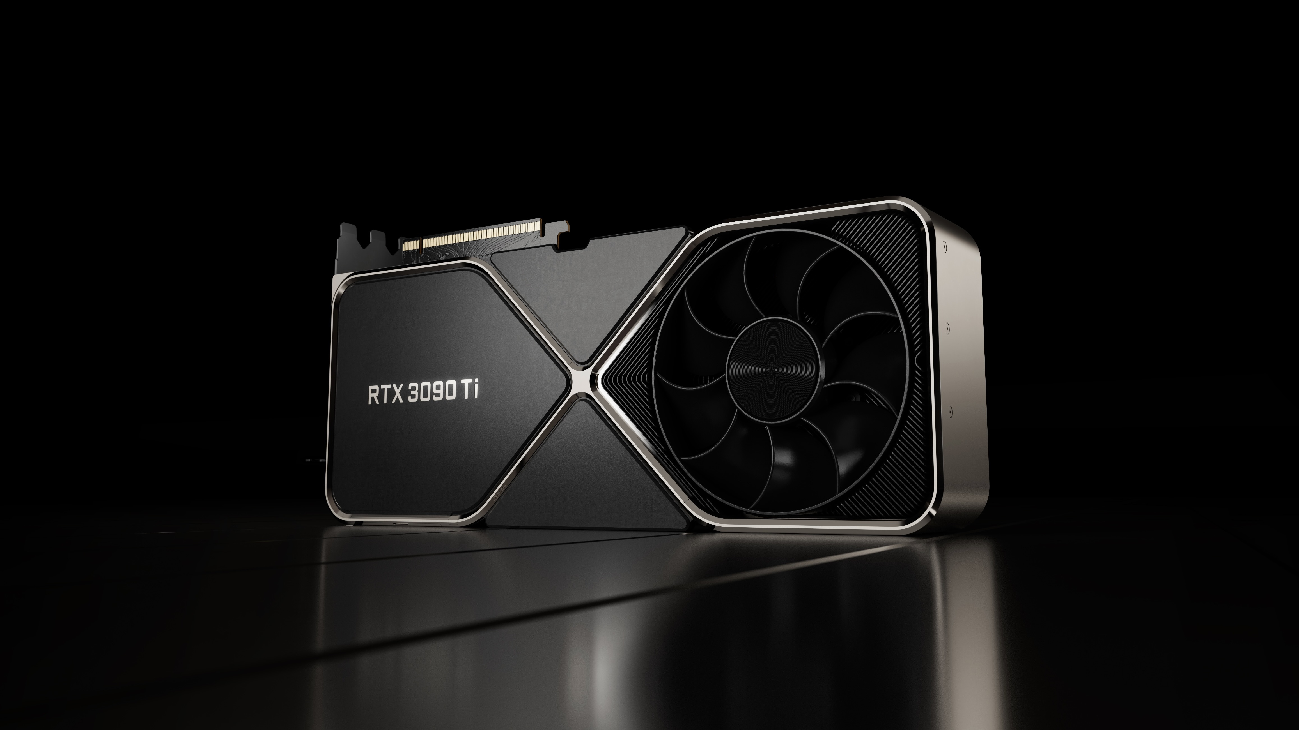
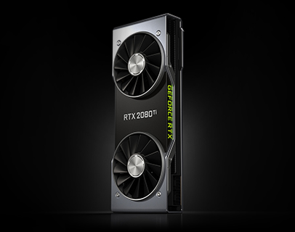
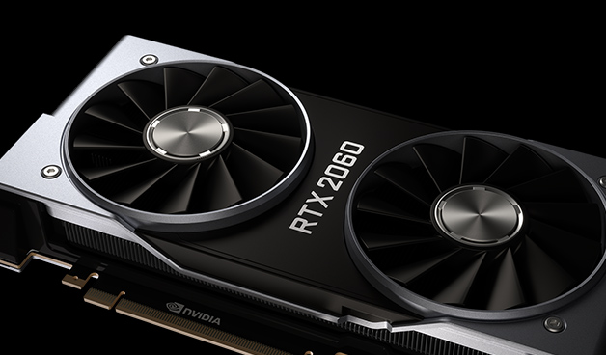
Introduction - GPU
Graphics Processing Unit
Graphics Processing Unit (GPU) is a specialized hardware component designed to accelerate the processing of graphics-related tasks.
They have evolved into handling a wide range of computationally intensive tasks beyond graphics.
Nvidia GPUs
They are known for their advanced CUDA architecture, and they are specialized for parallel processing tasks.

Slide 9
Introduction - GPU
GPUs consist of multiple elements. Some of these elements are:
Streaming Multiprocessors (SMs): It consists of multiple processing cores and various components necessary for executing instructions in parallel.
Kernels: They are functions that are designed to execute in parallel.
Host
Device
Kernel 1
Grid 1
Grid 2
Block(0,0)
Block(1,0)
Block(2,0)
Block(0,0)
Block(1,0)
Block(2,0)
Kernel 2
Block(0,1)
Block(1,1)
Block(2,1)
Block(0,1)
Block(1,1)
Block(2,1)

Slide 10
Introduction - GPU
Blocks: They are a group of threads that are scheduled to execute together on an SM.
Threads: They are individual units of execution within a block.
Stream: It is a sequence of kernels that are submitted for execution and processed in a specific order.
Block(2,0)
Grid 1
Block(0,0)
Block(1,0)
Block(2,0)
Thread (0,0)
Thread (1,0)
Thread (2,0)
Thread (3,0)
Thread (0,1)
Thread (1,1)
Thread (2,1)
Thread (3,1)
Block(0,1)
Block(1,1)
Block(2,1)
Notes:
Each thread executes the same kernel code but operates on different data elements.

Slide 11
Problem Statement
Context: Integrating DNNs into real-time systems.
→ Meeting strict timing constraints is crucial.
Classical real-time task models are designed to analyze the timing behavior of traditional software tasks.
PB: They cannot predict the behavior of DNN execution on hybrid CPU-GPU architectures, as they introduce complexities which can’t be captured by conventional real-time techniques.
Notes:
Classical real-time task models are designed to analyze the timing behavior of traditional software tasks with predictable execution times.

Slide 12
Proposition
We propose a real-time task model deployed over a GPU architecture.
This model is a set of tasks which is able to describe at the same time the characteristics of a real-time DNN and that of a GPU architecture.
A Kernel can be a layer in a DNN or a set of Nodes.
Task Model
We model each kernel as a task.
We model these tasks as two sets of tasks: CPU Task Set and GPU Task Set.
CPU Task Set (Ω_{CPU}) describes tasks executed on CPU.
GPU Task Set (Ω_{GPU}) describes tasks executed on GPU.
Ω_{CPU =} {ζ₁, ζ₂, ζ₃, … , ζ_{n}}
Ω_{GPU} = {ζ₁, ζ₂, ζ₃, … , ζ_{m}}
Each task is characterized by parameters which describe our system.
Notes:
Kernel can be a layer from a DNN or a set of nodes
In GPU architecture, kernels can be executed on a CPU part or a GPU part.
We consider GPU tasks and CPU tasks in our model.

Slide 13
Proposition
Parameters:
Each task ζ in the CPU or GPU task sets is characterized by parameters.
Parameters of a task ζ in CPU task set Ω_{CPU} :
Release time. The time at which a task is ready to execute.
Period. Time interval between release times.
Deadline. Time at which a task must have completed its execution.
Priority. Used for order of execution.
Execution time. Time needed for a task to execute.
Node. The corresponding CPU responsible for executing the task.
Next. The following task to execute in respect to the current one.
Real-time requirements

Slide 14
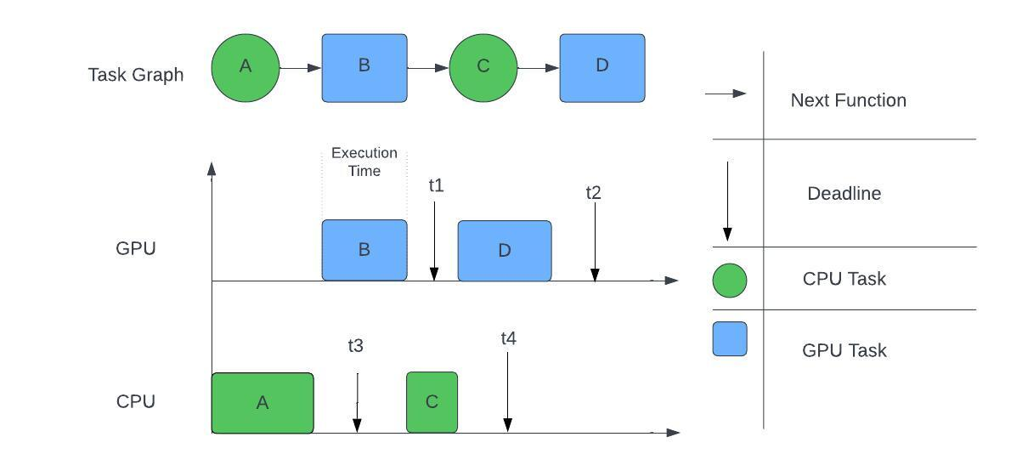
Proposition
Parameters of a task ζ in GPU task set Ω_{GPU} :
Release time.
Period.
Deadline.
Priority.
Execution time.
Stream.
Corresponding stream a task belongs to.
Type.
Type of operation being performed.
Size.
Refers to the number of blocks.
Data.
Data being used for the operation.
Next.
Real-time requirements

Slide 15
Proposition
Task Model
CPU Task Set
Tasks (1, 2, …, n)
GPU Task Set
Tasks(1, 2, …, m)
Parameters
Parameters

Slide 16
Proposition
We generate this model using source files:
CUDA File (.cu File)
Specification File (.txt File)
CUDA File
Specification File
Task Model
Produced file: XML Format
.cu File
.txt File
.xml File

Slide 17
Proposition
CUDA File
Specification File
Task Model
Why CUDA Files?
Deploying a DNN over a Nvidia GPU.
.cu File
.txt File
.xml File
Why Specification Files?
Contains real-time system parameters.
Why XML File?
→ Using the file as input for scheduling analysis tool called “Cheddar”.

Slide 18
Implementation - Rules
How do we collect the parameters from CUDA Files?
We propose a set of 10 Rules to be applied in order to accurately detect and capture the parameters in the CUDA file.
Rules:
CUDA kernel function name:
Example:
__global__ void FullyConnected(float *input, float *output) → GPU Task
host void Kernel(int data) → CPU Task
“global” → GPU Task.
“host” → CPU Task.

Slide 19
Implementation - Rules
Rules:
Identification of the Stream parameter:
Through the arguments when calling the kernel function.
3. Identification of the Next parameter:
→ The next kernel to execute is just the following kernel function in the queue of its stream.
Example:
DNN_Kernel_1<<<grid, block, 0, stream_A>>>(data1, data2);
→ Stream_A
DNN_Kernel_2<<<grid, block, 0, stream_B>>>(data3, data4);
-→ Stream_B
DNN_Kernel_1<<<grid, block, 0, stream_A>>>(data1, data2);
DNN_Kernel_2<<<grid, block, 0, stream_B>>>(data3, data4);
DNN_Kernel_3<<<grid, block, 0, stream_A>>>(data1, data3);
→ Next of DNN_Kernel_1: DNN_Kernel_3

Slide 20
Implementation - Rules
Rules:
A GPU task associates a CPU task.
Due to memory management, when a GPU task is detected, a CPU will also be created for it.
Identification of the size parameter:
→ The size is the number of blocks which can be determined in the code through dimensions of the dim3 gridDim function.
Example:
__global__ void FullyConnected(float *input, float *output)
→ GPU Task detected
Tasks:
GPU Task ζ₁ , CPU Task ζ₁ .
Dim3 gridDim(3,2);
→ Size = nb of blocks = 3*2 = 6 blocks.

Slide 21
Implementation - Program
Program:
Written in python.
Takes .cu and .txt files as input
Applies the proposed rules.
Generates task model in xml format.
CUDA Source File
Python File
DNN Task Model
.cu File
DNN Task Model Generator (DTGM)
.xml File
CPU-GPU Architecture
DNN Application
Steps:
Reading our input files.
Scanning our files for keywords.
Applying the specific rule to each associated keyword.
Deduce the specific parameter of our task.
Write the parameter in the .xml file.
CPU Task Set
GPU Task Set

Slide 22
Experiment
DNNs:
YOLO v3-tiny
ResNet-18
13 Convolutional Layers
6 Maxpool Layers
2 Route Layers
2 YOLO Layers
1 Up-sampling Layer
YOLO v3-tiny:
Purpose: Object detection
It can identify and locate objects in images and video streams.
ResNet-18:
Purpose: Image classification
Known for its skip connections or residual connections.
17 Convolutional Layers
1 Fully Connected Layer Followed by a SoftMax Activation Function
Notes:
Skip connections are a technique in neural network architectures that allow the output of one layer to bypass one or more intermediate layers and directly connect to a deeper layer

Slide 23
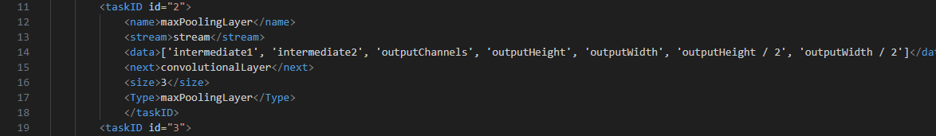
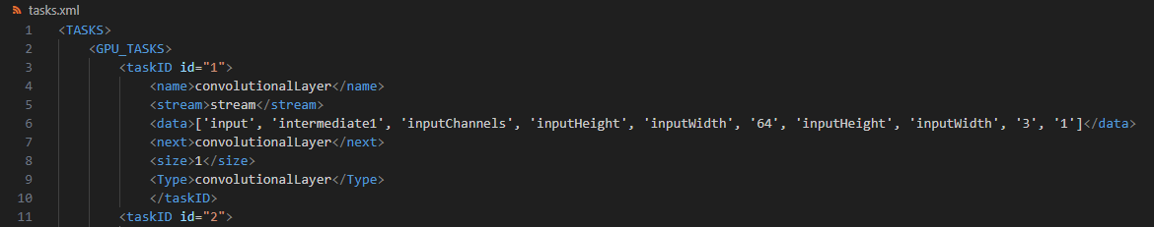
Results
We develop CUDA files:
YOLO v3-tiny
ResNet-18
1 Stream-File
2 Streams-File
4 CUDA Files
Output of DTM Generator (XML Files)

Slide 24

Conclusion & Future Work
We introduced a DNN Task Model Generator:
CPU-GPU Architecture
Real-time DNN
Notion of streams
From CUDA and specification source files, we are now able to automatically generate a Task Model.
In future work, we intend to make use of a generated model
XML File integrated in Cheddar.
Conduct a scheduling analysis of the system.

Slide 25
References
Insup Lee, J. Y. (2007). Handbook of real-time and embedded systems. CRC Press.
Dehua Zheng, W. Z. (January, 2021). Short-term renewable generation and load forecasting in microgrids. In Microgrid Protection and Control (p. 4.4.3.4 Deep neural network).
Morrison, A. (2023). NVIDIA CUDA ARCHITECTURE.
Pranav Adarsh, M. K. (2020). YOLO v3-Tiny: Object Detection and Recognition using one stage improved model.
Paolo Napoletano, F. P. (2018). Anomaly Detection in Nanofibrous Materials by CNN-Based Self- Similarity.

Slide 26
Thank you for your attention!

Slide 27
Evaluation
We measure the execution time for generating the task model in XML format for each DNN.
1 Stream
2 Streams
 | 1 Stream | 2 Streams
YOLO v3-tiny | 0.1308 s | 0.1722 s
ResNet18 | 0.1191 s | 0.1603 s
Notes:
Side Slide; only needed if asked to compare between streams.

