Slide 2
“SPEED OF DIAGNOSIS IS ITSELF A TREATMENT”

Slide 3
Hospital resistance reports take 12 months.

Slide 4
Hospital resistance reports take 12 months.
• Static PDFs. Hospital-wide averages. Manual spreadsheets.

Slide 5
Hospital resistance reports take 12 months.
• Static PDFs. Hospital-wide averages. Manual spreadsheets.
• By the time the report is ready, the ward has changed.

Slide 6
Hospital resistance reports take 12 months.
• Static PDFs. Hospital-wide averages. Manual spreadsheets.
• By the time the report is ready, the ward has already changed.
• Human lives depend on empirical choices that arrive too late.

Slide 7
THE COST OF BEING SLOW

Slide 8
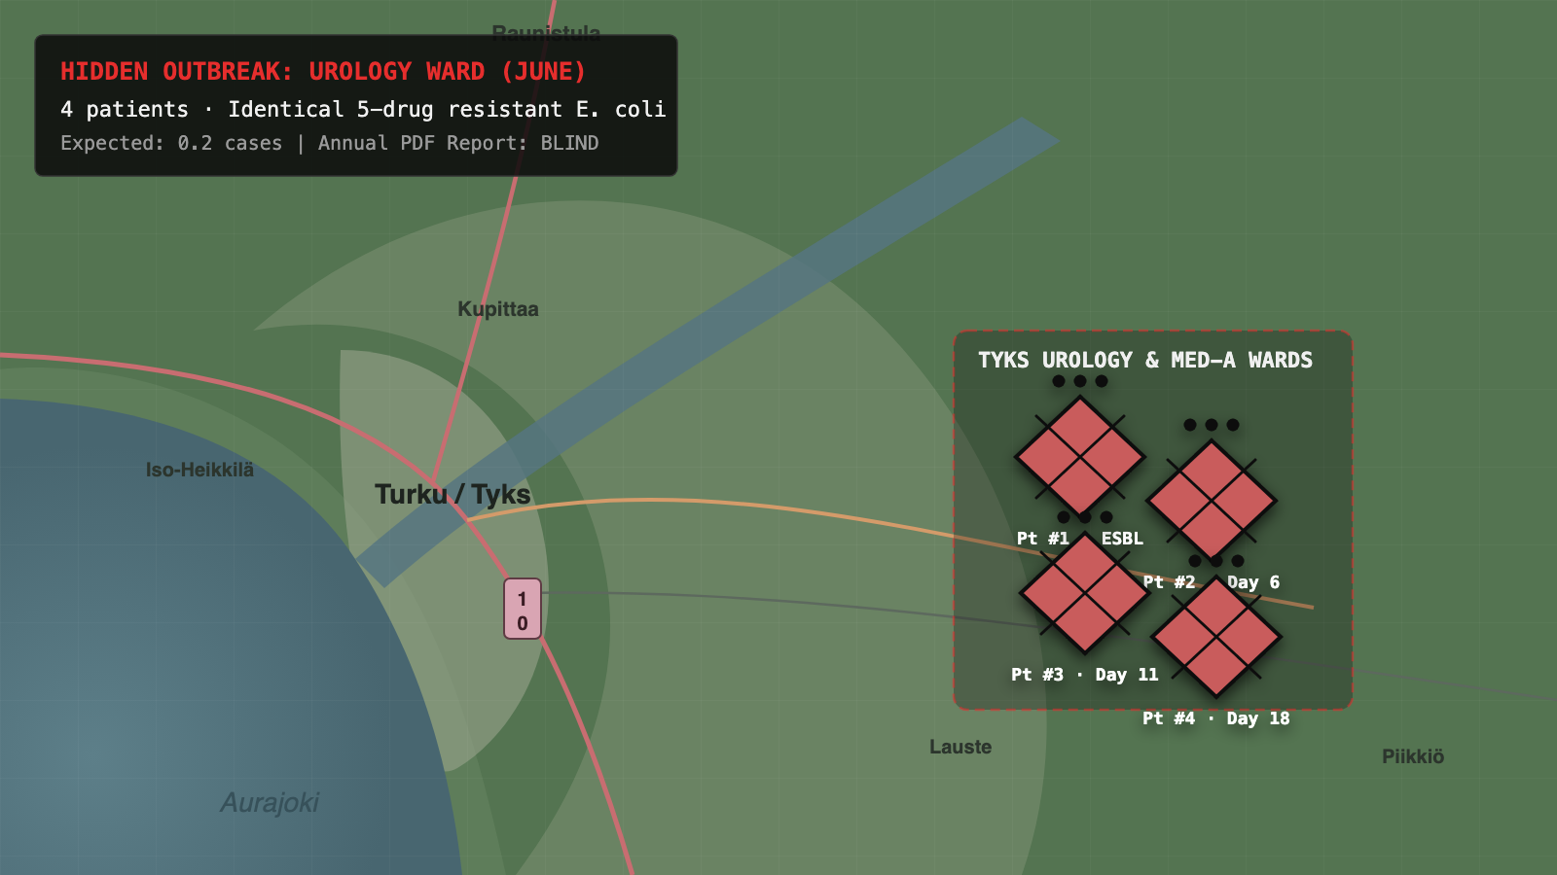

Slide 9
The bacteria don't wait for your
annual resistance report to be
ready...

Slide 10
AEI
ANTIBIOTIC EFFICACY INDICATOR

Slide 11
AEI Platform
1. Streams live HL7 lab data across 9 wards & THL national feeds
2. Ward treatment rankings & outbreak detection in seconds rather than a year
3. All-in-one reproducible workbench with 1-click R, Python & LaTeX export

Slide 12
The Team
Clinical & Statistical Engine · Full-Stack & HL7 Pipeline · Workbench & UX

Slide 13
THANK
YOU!

