Slide 1
The Process
Process
is any program which is executed by computer’s operation system.
Kernel
is Operation System, that interacts with hardware and provides services like
Memory Management, CPU scheduling, Filesystem, I/O Device access, etc.
System Call
is direct entry point, provided by Kernel, through which active Process can obtain
the service
Process Representation in Memory
User Context
Context Switch
Kernel Context
Stack
Dynamically allocated per each function call Stack Frames, containing return address linkage local variables,
function parameters, etc.
Kernel Data
Heap
Data space, dynamically
allocated by the Process
Uninitialized Data
Uninitialized (implicitly zeroed) global variables declared in program
program counter
Initialized
Read-Write Data
Explicitly initialized global variables declared in program
data read from
program file
when program
is launched
Initialized
Read-Only Data
Constants and literals
declared in program
Text
Actual machine instructions
to be executed by hardware

Slide 2
Thread
Thread is separate part of process, providing it’s specific working flow, and sharing the process data and resources with other threads.
Multi-Processing
Multi-Threading
Thread Attributes:
Thread ID
Set of registers
(stack pointer,
program counter, etc.)
Stack
(local variables,
return addresses)
errno
Signal mask
Priority
Process 1
Process 2
Thread 1
Thread 2
Stack
Stack
Stack 1
Stack 2
Heap
fork
Heap
Heap
Uninitialized Data
Uninitialized Data
Uninitialized Data
Initialized Read-Write Data
Initialized Read-Write Data
Initialized Read-Write Data
P1
Initialized Read-Only Data
Initialized Read-Only Data
T1
Initialized Read-Only Data
Text
Text
P2
Text
T2
Text
Multi-Processing | Multi-Threading
New processes created by means of expensive fork call, copying memory and descriptors to allocated resources. | Thread is “light-weight” process. Its creation is 10-100 times faster than process creation, and does not require copying of memory and descriptors.
Different processes have separate address spaces and resources | Multiple threads directly share memory and resources
Inter-Process communication requires usage of specific IPC mechanisms. | Shared data segment of process is used for inter-thread data exchange
Context switching is expensive. | Context switching is cheap.
Each process uses system calls to allocate its own resources ( IPC, synchronization, other resources). | Thread uses system calls for synchronization needs. All other resources could be shared.
Single-threaded process could be executed each time by single CPU | Multi-threaded process can utilize multiple CPUs for simultaneous execution of multiple threads.

Slide 3
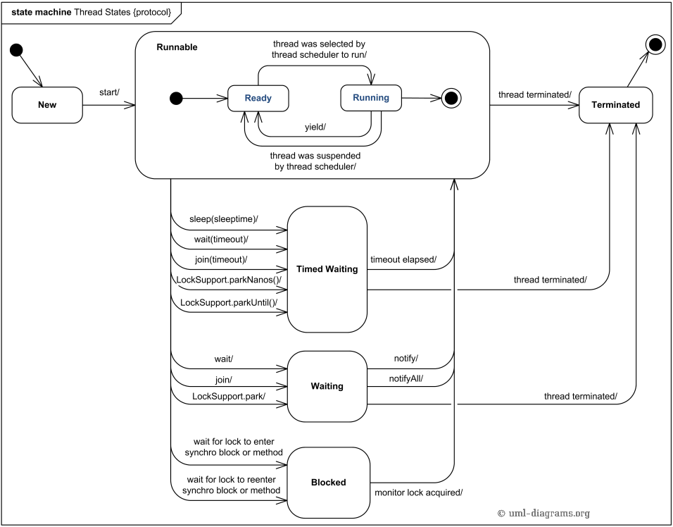
Java Thread State Diagram
Scheduler

Slide 4
Java Thread & Runnable
//===== variant A
class MyThread extends Thread{
@Override
public void run() {
// do something
}
}
//===== variant B
class MyRunnable implements Runnable {
@Override
public void run() {
// do something
}
}
//======= launch the thread =======
// variant A
Thread myThread = new MyThread();
myThread.start();
// variant B
Runnable myRunnable = new MyRunnable();
Thread coreThread = new Thread(myRunnable);
coreThread.start();
// sketch of standard Java core class Thread
class Thread implements Runnable {
private Runnable r = null;
public Thread(){}
public Thread(Runnable r) {
this.r = r;
}
@Override
public void run() {
if (r!=null) r.run();
}
public void start() {
// Ask JVM (or Operational System)
// to create new Stack in our process and
// to begin run() method execution on this stack
}
…
}

Slide 5
Thread Start
optional Runnable object
logical object
MyThread
run()
start()
Other Runnable
run()
physical thread
(stack)
start() – asks JVM to start execution of method run() - of current Thread object or of other Runnable object - on new Stack
ask to create new stack
JVM
OS

Slide 6
Sketch of “Home-baked” Thread Interruption
class MyThread {
….
boolean isInterrupted = false;
// called by interrupting thread
void interrupt(){
isInterrupted = true;
}
// thread "sleeping"
public void sleep(long millisPeriod) throws InterruptedException{
long time0 = System.currentTimeMillis();
while (currentTimeMillis() - time0 < millisPeriod){ // unjustified CPU load
if (isInterrupted) {
isInterrupted = false;
throw new InterruptedException();
}
}
}
}`
In real class Thread, the methods sleep, join and other “slow calls” are executed by JVM (OS) without CPU load
This also requires the “isInterrupted” flag to be maintained by JVM on per-thread basis
When thread is not “waiting”, it could ask about flag value from JVM

Slide 7
Thread Interruption
Thread1
run()
start()
Thread2
run()
start
interruption
status flag
interrupt() – set interruption flag for other thread
interrupted() – check and clean interruption flag for calling thread
sleep(), join(), wait() – “slow” calls are interrupted immediately by JVM if interruption flag was set, and InterruptedException is thrown on stack of “slow” call caller thread
check flag
set flag

