Slide 1
Certificate analysis for popular android apps
INSE6110, Winter 2023, Concordia University, Montreal

Slide 2
Used two android emulator
- One has play store (to download the app and extract apk file)

Slide 3
Used two android emulator
- One has play store (to download the app and extract apk file)
- Other has root permission (to conduct circumvent pinning)

Slide 4
How we conducted the analysis
Static analysis

Slide 5
How we conducted the analysis
Static analysis
- used apktool to decode android apps

Slide 6

How we conducted the analysis
Static analysis
- used apktool to decode android apps
- try to find any embede certificate

Slide 7

How we conducted the analysis
- used ripgrip to search string recursively from decoded app data.
* rg 'networkSecurityConfig’ -i
* rg ‘BIGIN CERTIFICATE' -i

Slide 8
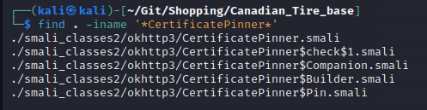
How we conducted the analysis
* search for hash
Search for certificate pinner

Slide 9
How we conducted the analysis
Dynamic analysis
- used mitmproxy to proxy traffic and conduct man in the middle.

Slide 10
How we conducted the analysis
Dynamic analysis
- used mitmproxy to proxy traffic and conduct man in the middle.
- First run the app on emulator without any interruption, app will run fluently.

Slide 11
How we conducted the analysis
Dynamic analysis
- used mitmproxy to proxy traffic and conduct man in the middle.
- First run the app on emulator without any interruption, app will run fluently.
- Then start mitmproxy server and connect the emulator to redirect the traffic into mitmproxy server.

Slide 12
How we conducted the analysis
Dynamic analysis
- used mitmproxy to proxy traffic and conduct man in the middle.
- First run the app on emulator without any interruption, app will run fluently.
- Then start mitmproxy server and connect the emulator to redirect the traffic into mitmproxy server.
- At this stage App will not work if it uses https.

Slide 13
How we conducted the analysis
Dynamic analysis
- used mitmproxy to proxy traffic and conduct man in the middle.
- First run the app on emulator without any interruption, app will run fluently.
- Then start mitmproxy server and connect the emulator to redirect the traffic into mitmproxy server.
- At this stage App will not work if it uses https.
- Finally install mitmproxy certificate into the emulator’s certificate store and run the app again.

Slide 14
How we conducted the analysis
Dynamic analysis
- used mitmproxy to proxy traffic and conduct man in the middle.
- First run the app on emulator without any interruption, app will run fluently.
- Then start mitmproxy server and connect the emulator to redirect the traffic into mitmproxy server.
- At this stage App will not work if it uses https.
- Finally install mitmproxy certificate into the emulator’s certificate store and run the app again.
- If the app still doesn’t works, this indicates certificate pinning is present on the app.

Slide 15
How we conducted the analysis
Circumventing Pinning
- Used Frida to hook the app.

Slide 16
How we conducted the analysis
Circumventing Pinning
- Used Frida to hook the app.
- First started the emulator with root permission, then started Frida server on the emulator.

Slide 17
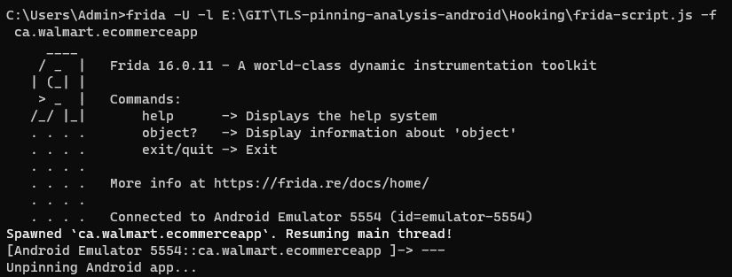
How we conducted the analysis
Circumventing Pinning
- Used Frida to hook the app.
- First started the emulator with root permission, then started Frida server on the emulator.
- The used Frida script to hook the specific application.

Slide 18
Outcome
We analyzed X app from categories mentioned bellow –
Social (6)
Financial (6)
Shopping (6)
Entertainment (4)
Browser (5)
Others (4)

Slide 19
Outcome
Type | Static | Dynamic
Social(6) | 5 | 6
Financial(6) | 6 | 6
Shopping(6) | 5 | 5
Entertainment(4) | 4 | 4
Browser(5) | 0 | 0
Others(4) | 3 | 4

Slide 20
Outcome
Finally, out of out X app, X is using pinning, which is X%.

Slide 21
Outcome
Finally, out of out X app, X is using pinning, which is X%.
Tried to hook 15 app, successfully disabled pinning for 13.

Slide 22
Thank you

