Slide 1

Campus Recruitment App

Slide 2
Credits
Created By :
Rajat Joshi
Dixit Baravaliya
Arthkumar Patel
Bhagya Patel
Guided By :
Prof. Sandip Modha

Slide 3
Overview
Final Year for engineering students as well as their colleges is very crucial, because it is the time when the companies come. For every student and company needs each other to work it out and hence this system comes in picture.
Campus Recruitment System as the name states it is purely used for helping the companies to get the best candidate and directly come in contact with the student, in the same way student get to know about the jobs and the companies directly.

Slide 4
The student when registering has to enter his personal and academic details which can be updated later also.
He/She can check for their recent job applications or any new applications filtered according to their categories and can also give a feedback to admin. While the company can post new jobs, see the students or new applications.

Slide 5

It will provide information about all the companies that will come for recruitment in college.

Slide 6
As Student Registration
Registration : The student has to register into the system with his personal and academic details.
Login : The student has to sign in and will be signed in till he signs out.
Profile : The user can update his personal as well as academic details.

Slide 7
Applications : List of applications the user has applied while he can also withdraw the applications.
New Jobs : List of jobs and its details according to the criteria and eligibility of the student.

Slide 8
As Company Registration
Registration : The Company has to register into the system with the company details.
Login : The Company has to sign in and will be signed in till he signs out.
Profile : The user can update their details.

Slide 9
Applications : List of new applications they have received today & total.
Jobs : List of jobs which also can be deleted or updated.
Add Job : Company can post new jobs.

Slide 10
Software Requirements
Windows XP, Windows 7 or Upper Versions
Android Studio 3.4.2
Firebase Real-Time Database

Slide 11
Testing Details
Device – Oneplus 6
Processor – Snapdragon 845
RAM – 6 GB
ROM – 64 GB
Operating System – Android Pie 9.0

Slide 12
Hardware Requirements
Processor – i3/i5/i7
Hard Disk – 10 GB Or More
Memory – 1 GB RAM
Android Phone – Lollipop 5.0 Or Higher

Slide 13
Advantages
Company can directly contact the student.
Student can directly contact the company.
The jobs each student see are based on their eligibility and criteria.

Slide 14
Disadvantages
Student can manipulate the data, so fake data can also be written.
Student can’t edit their application once sent. It would require admin to change the data.
Requires active internet connection.

Slide 15
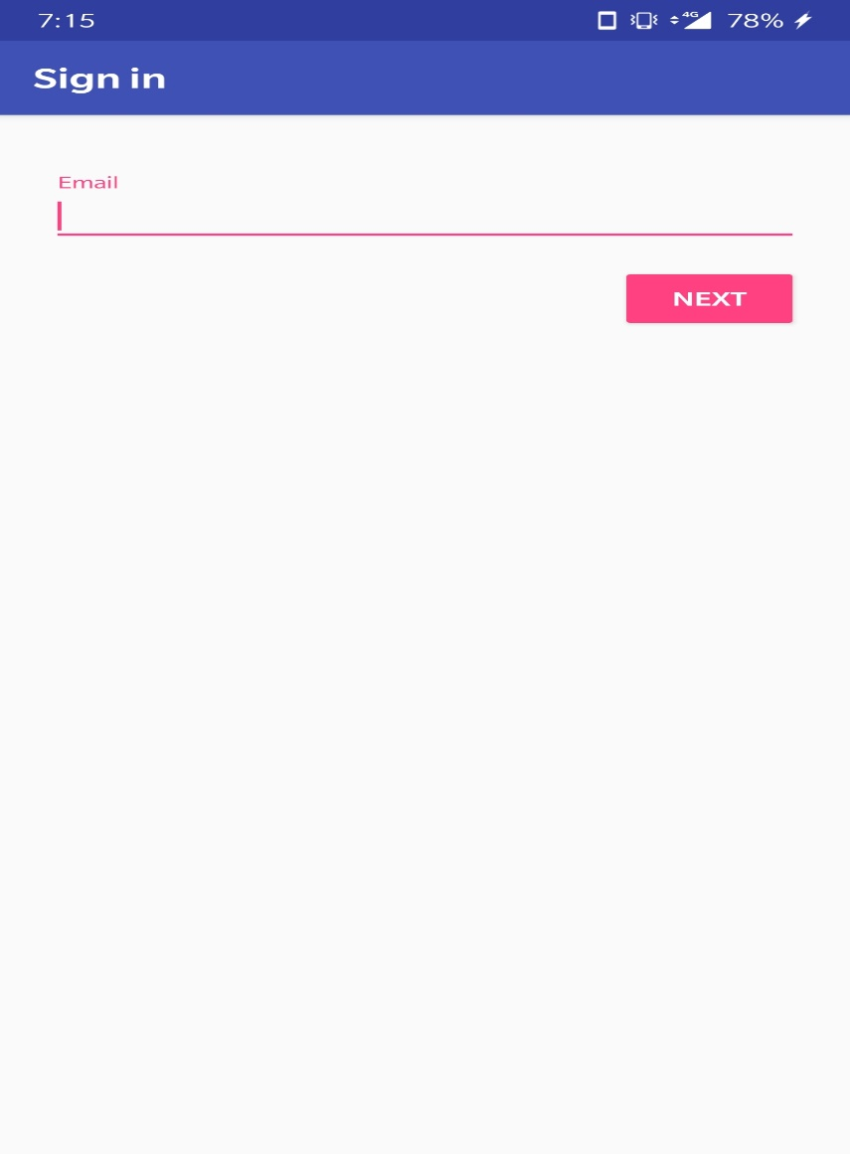
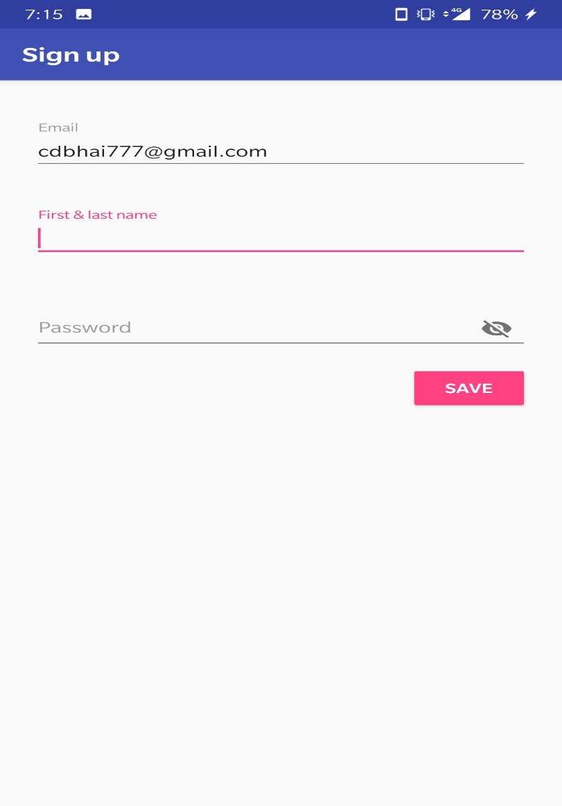
Screenshots

Slide 16
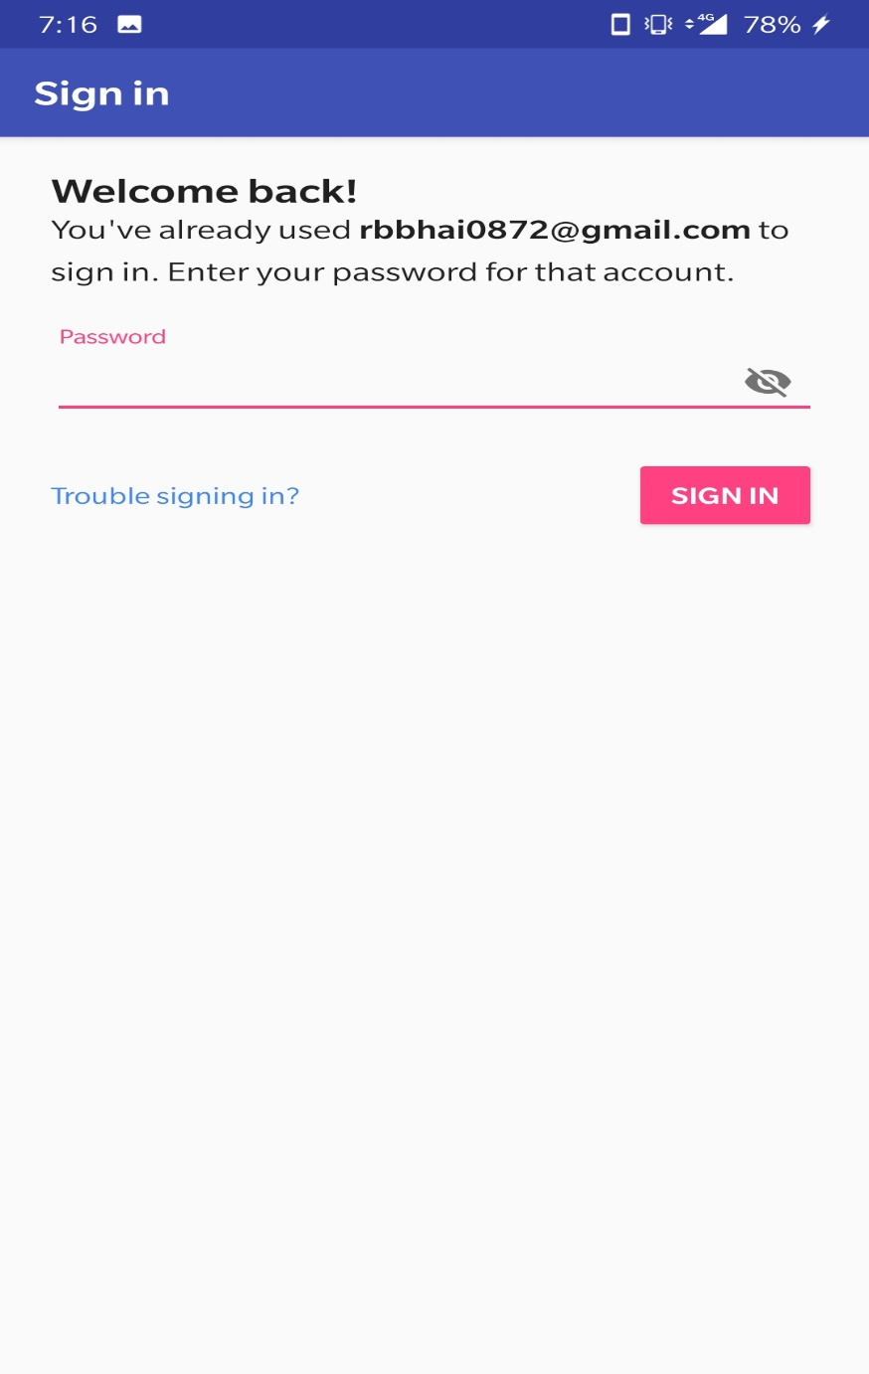
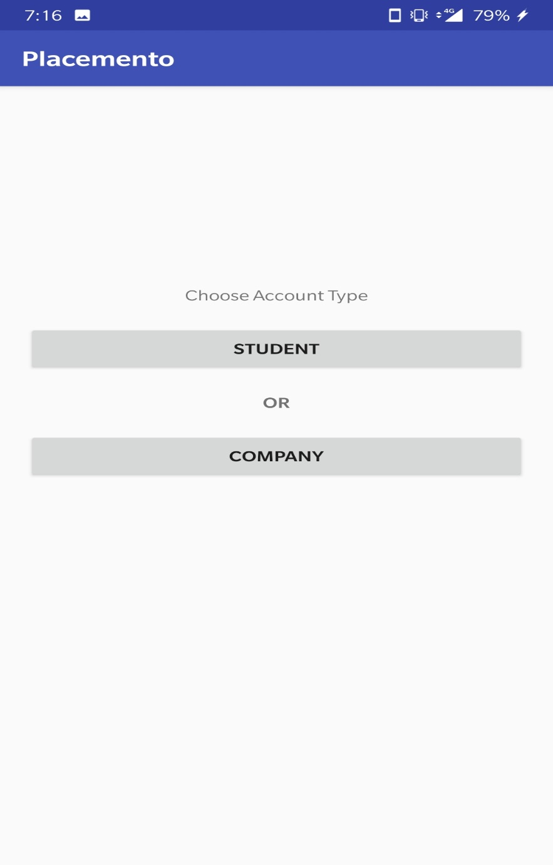

Slide 17
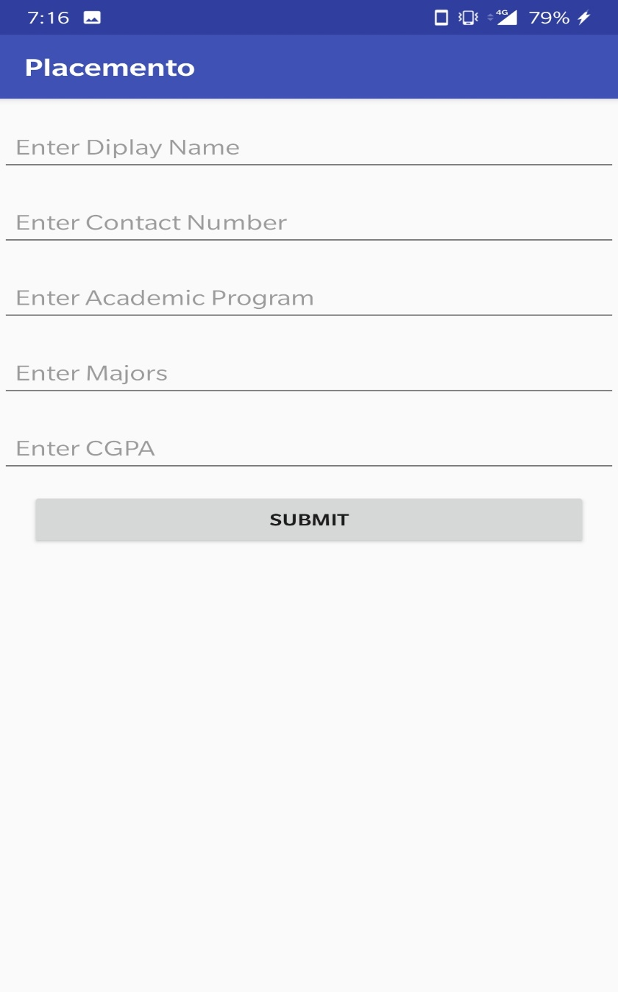
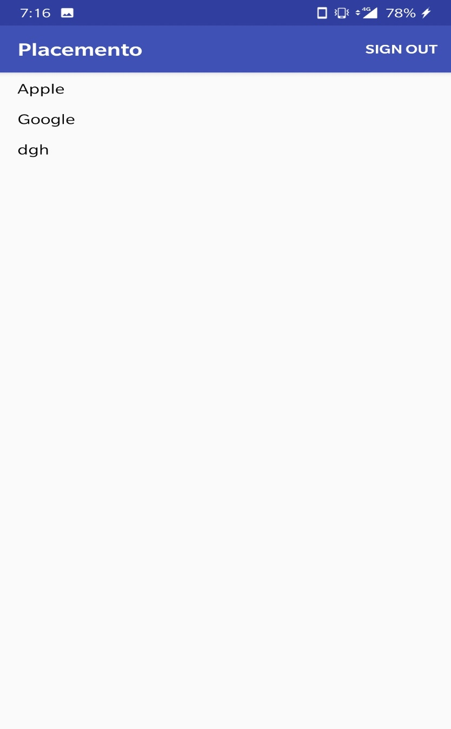

Slide 18
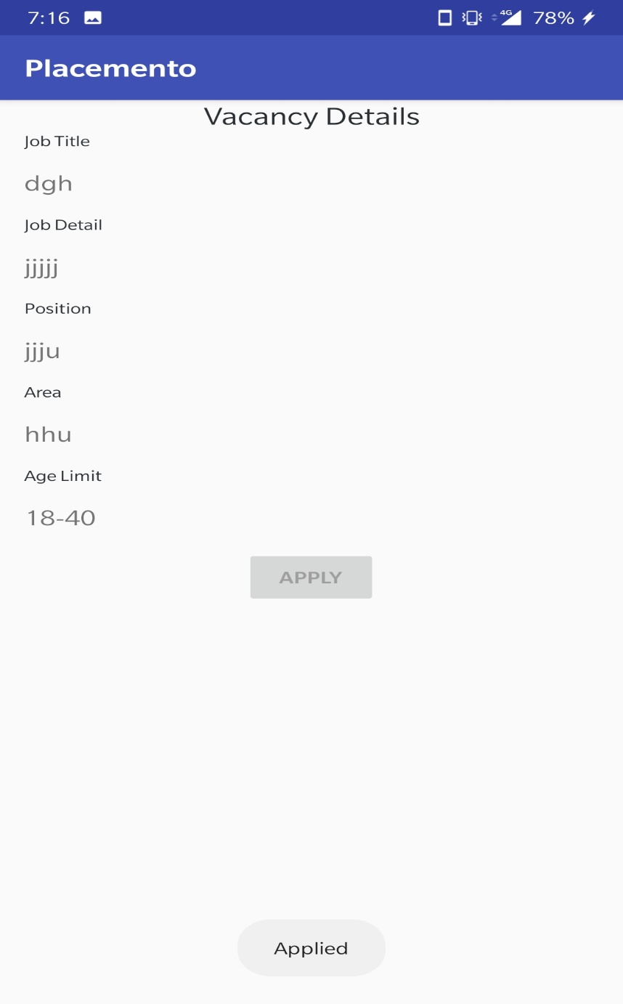
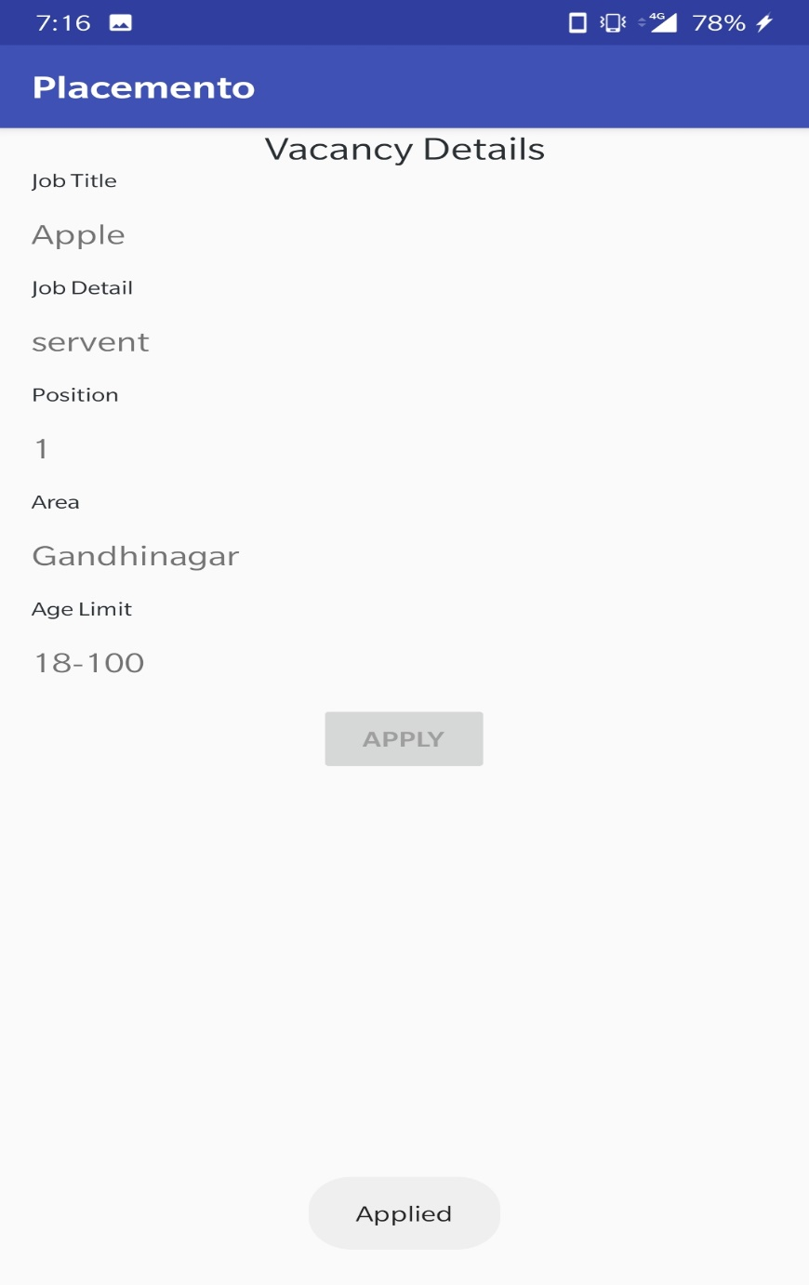

Slide 19
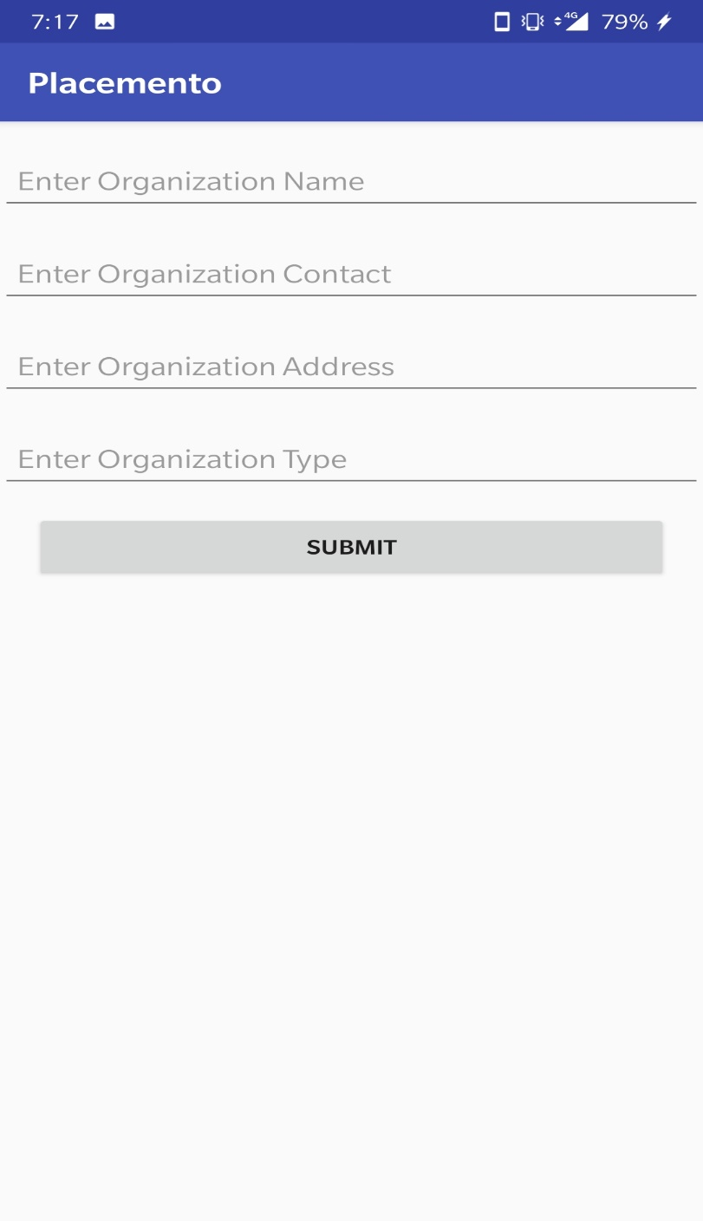
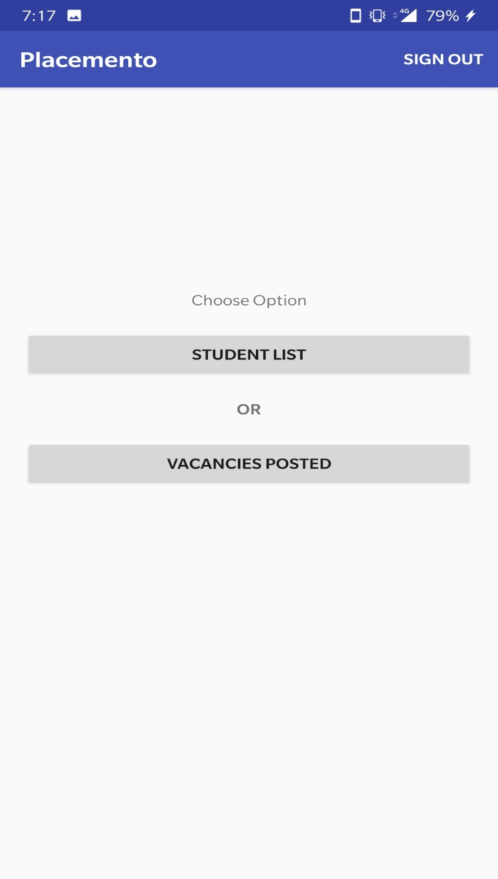

Slide 20
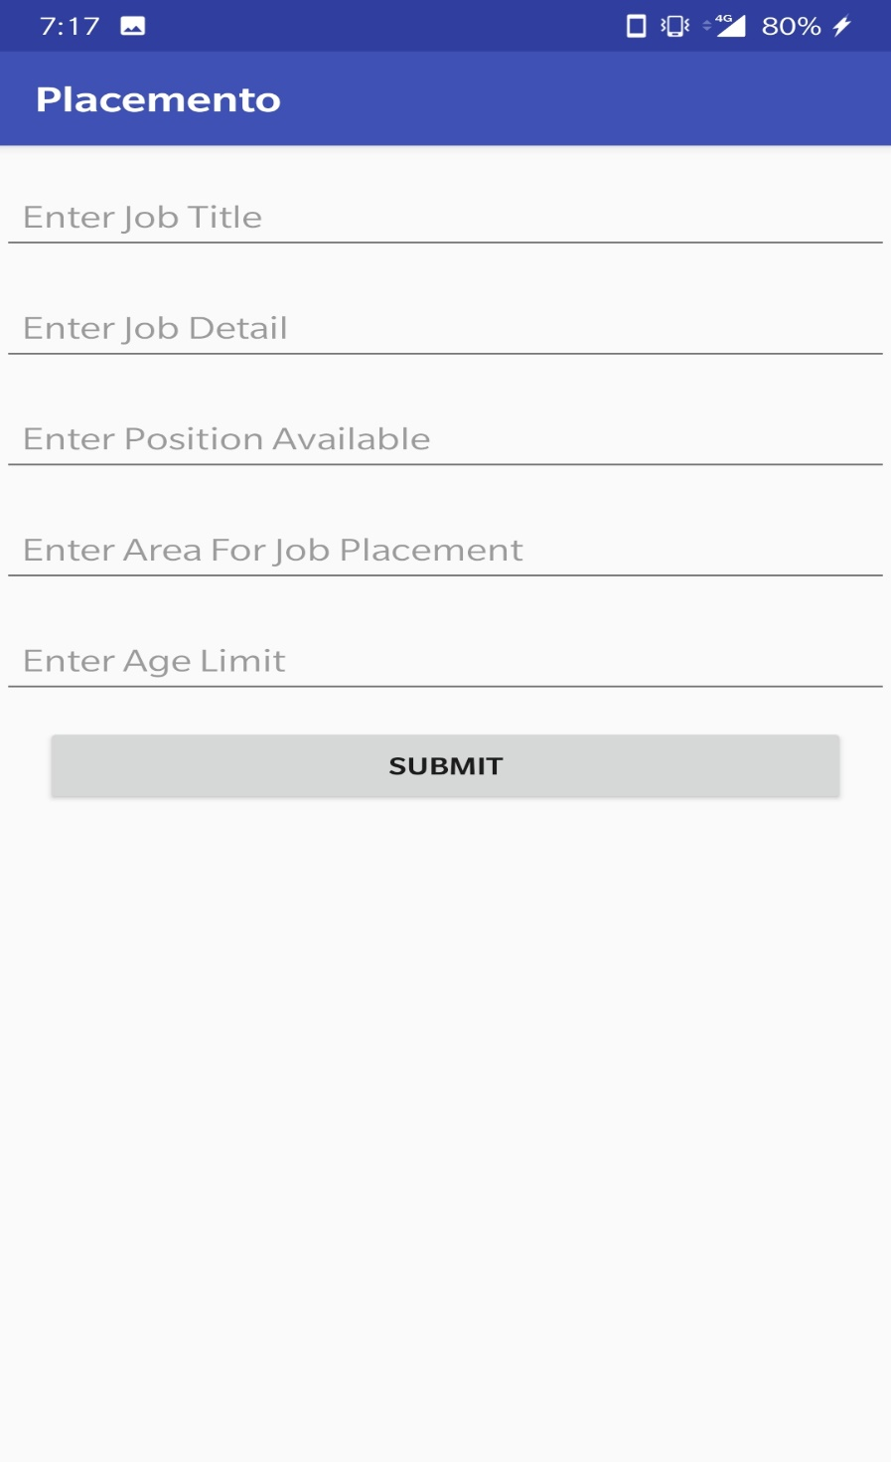

Slide 21
References
www.youtube.com
https://stackoverflow.com
https://firebase.google.com/docs/cloud-messaging/android/client
https://developer.android.com/studio/profile/inspect-gpu-rendering
https://firebase.google.com/docs/android/setup

Slide 22


