Slide 1
Daily Checklist & Daily Routine iOS Application

Slide 2
Credits
Created By :
Rajat Joshi
Dixit Baravaliya
Arthkumar Patel
Bhagya Patel
Guided By :
Prof. Sandip Modha

Slide 3
Index
Project Overview
Modules
Development Tools
Hardware Requirements
Screenshots
Advantages
Disadvantages
References

Slide 4
Project Overview
Nowadays everyone has busy schedule, and many don’t have time to organize their everyday life, people face difficulties to manage their daily routines, to schedule time and focus on big tasks.
To overcome these issues, we have come up with this daily routine application which will helps us to schedule our daily routine and maintain daily checklist.

Slide 5
In this to-do list app, we can update our daily routine as well as weekly tasks. We can also delete and add the task from morning to night and set reminder, we can also see the previous task performed in previous months, weeks and days.
We get reminders for a particular task through notification. This is how, we can schedule our tasks as per our timing and will help us to remind and complete every task in an easy and efficient way.

Slide 6
Modules
Home : Home has tabs with days of week listing such from Monday to Sunday which symbolizes current week.
Day of the week : Every day of week has its task mentioned which can be set to completed.
Manage Task : User can add, update or delete a task.

Slide 7
Reminders : While adding tasks user can set a reminder of the corresponding task.
Task History : User can view his daily routine for a particular day which does not fall on the current week.
Notification : Notification or reminder of the task.

Slide 8
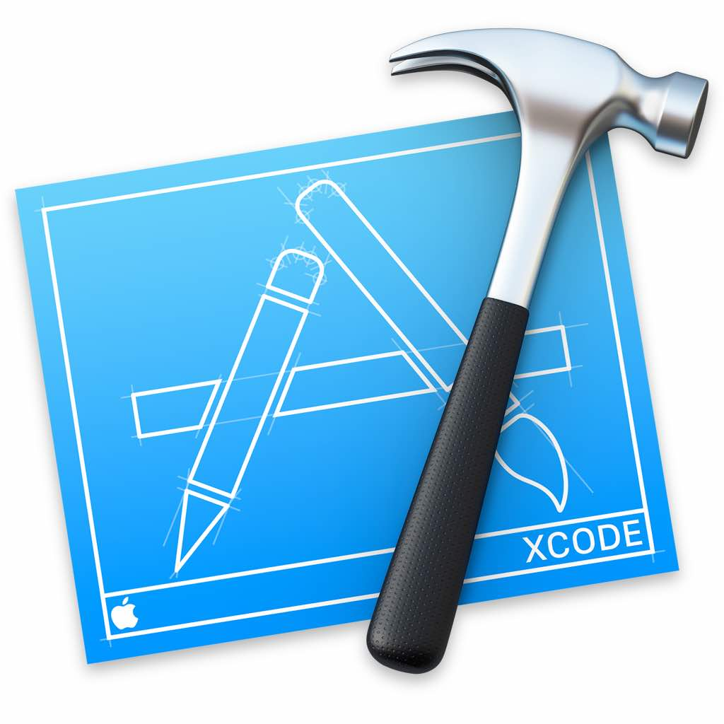
Development Tools
Xcode:
Xcode is an integrated development environment for macOS containing a suite of software development tools developed by Apple for developing software for macOS, iOS, iPadOS, watchOS, and tvOS.
Features:
1. Declarative Syntax
2. Design Tools
3. Native on all Apple Platforms
4. Live Mode

Slide 9
Hardware Requirements
Processor – i5/i7
Hard Disk – 10 GB Or More
Memory – 1 GB RAM
iPhone 5s or More
Macbook Air or Macbook Pro

Slide 10
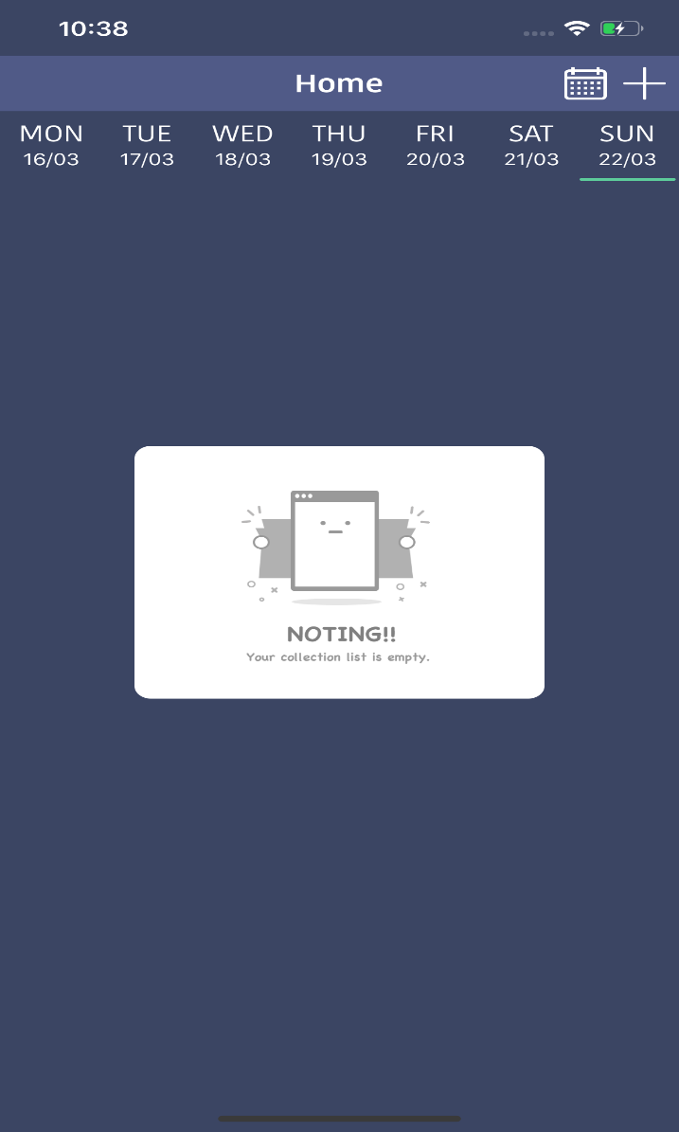
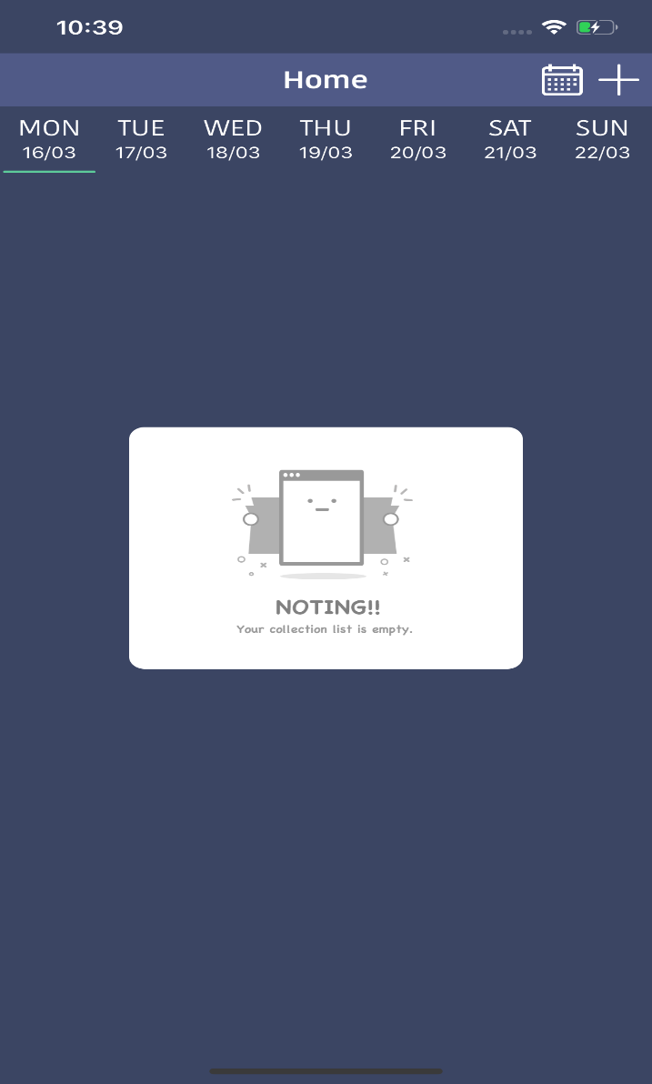
Screenshots
Home Screen
Day of The Week

Slide 11
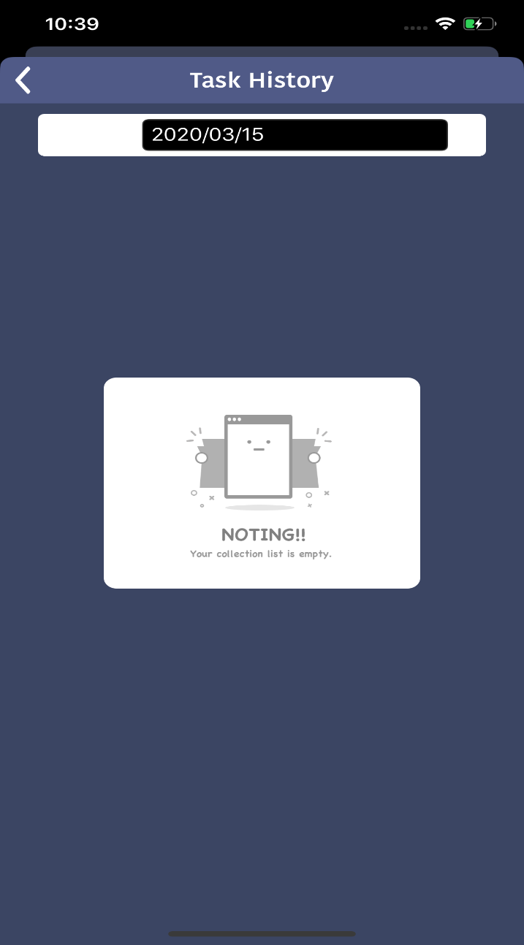
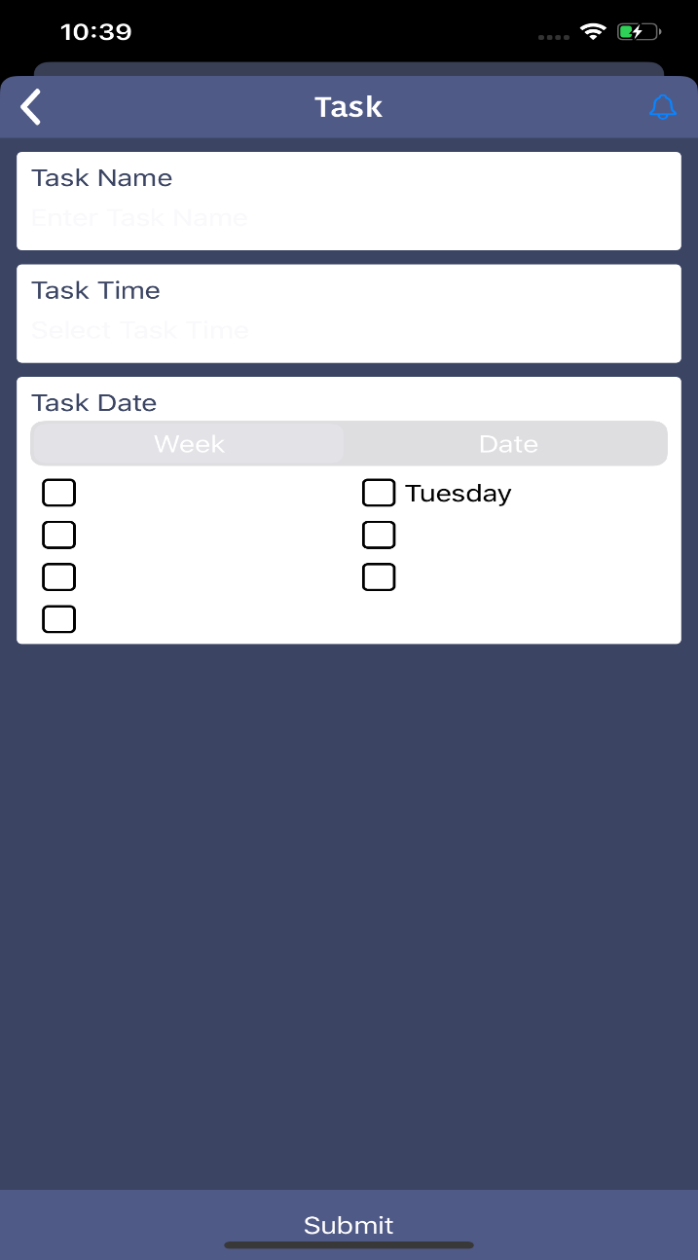
Task History
Add Task

Slide 12
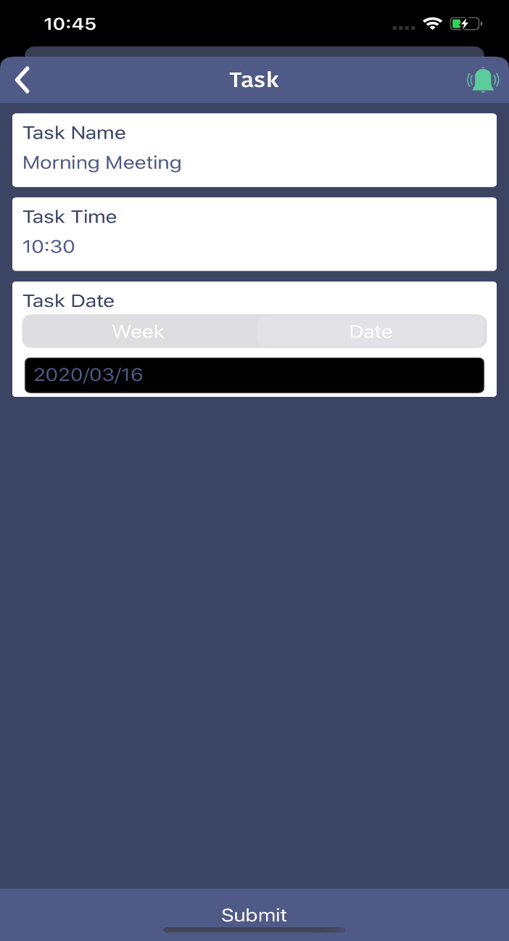
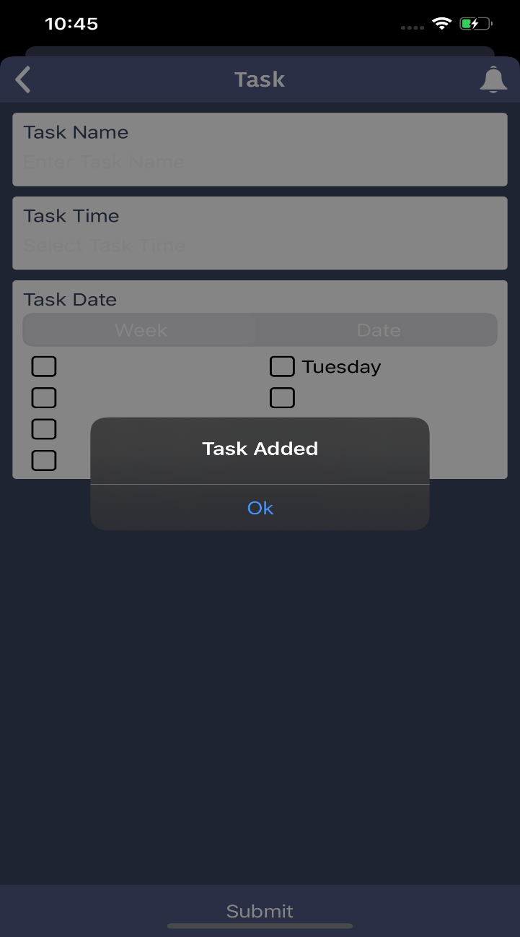
Task Details
Task Added

Slide 13
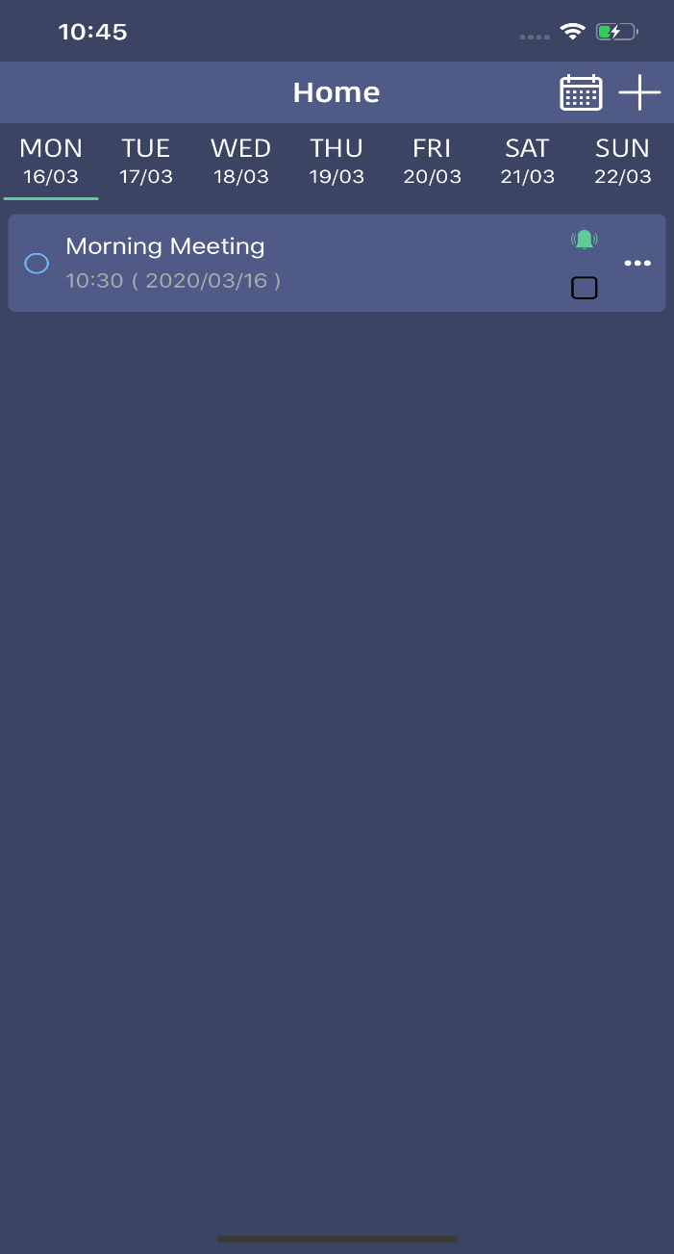
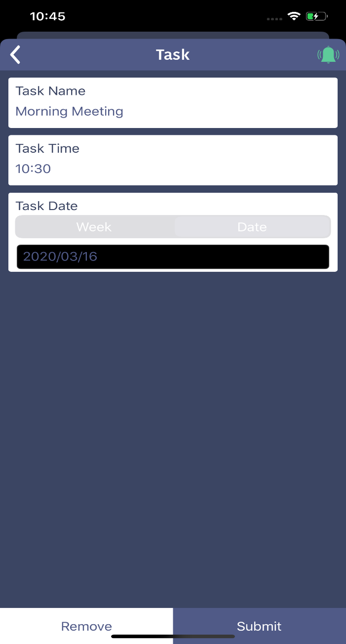
Task List
Remove Task Feature

Slide 14
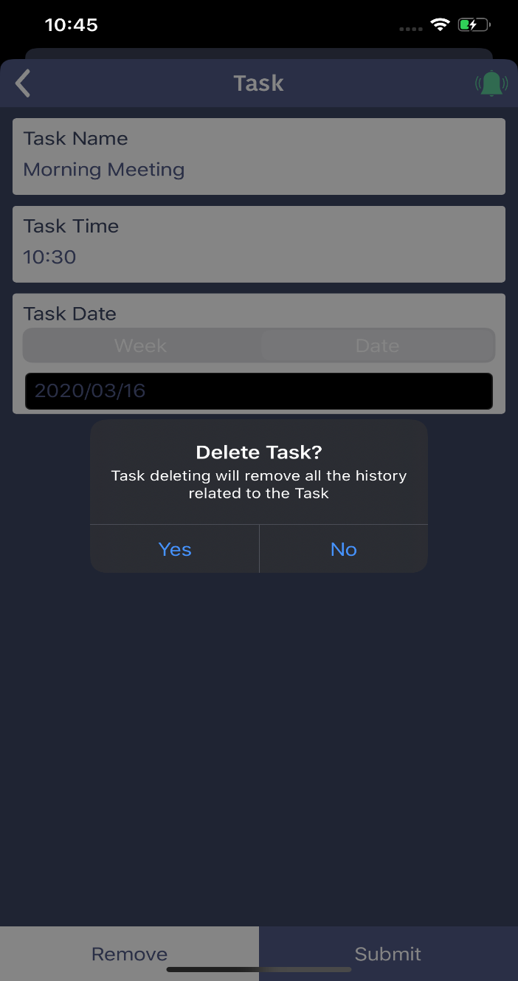
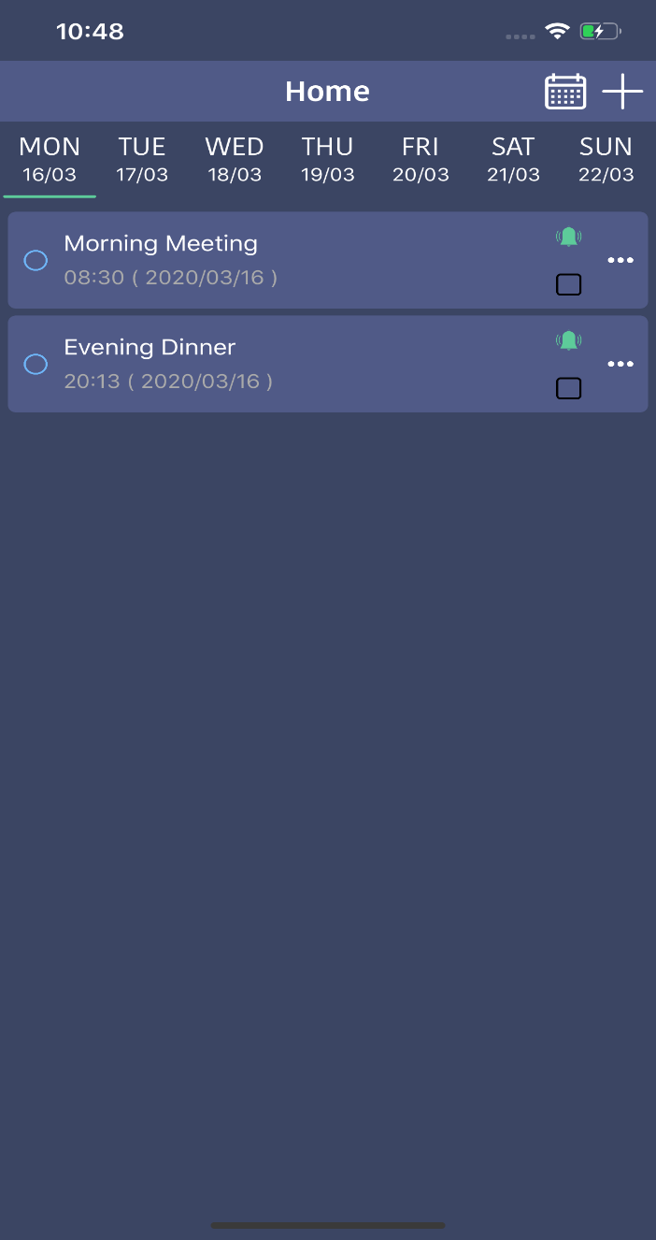
Delete Task
Multiple Task List

Slide 15
Advantages
Saves time.
Helps in achieving goal.
Helps in planning and executing daily tasks.

Slide 16
Disadvantages
One becomes completely dependent on the reminder set by this application.
This application requires active internet connection.
User need to put correct data or else it behaves abnormally.

Slide 17
References
www.youtube.com
https://stackoverflow.com
https://shsu-ir.tdl.org/shsu-ir/bitstream/handle/20.500.11875/1164/0781.pdf?sequence=1
https://ieeexplore.ieee.org/document/6208293/

Slide 18


