Slide 1
DIGITAL LITERACY
AWARENESS
INFOGRAPHIC
2026 March 31
ARTH RAJ SINGH
25MIP10048

Slide 2

WHAT DIGITAL LITERACY IS
Digital literacy is the ability to confidently and critically find, evaluate, create, and communicate information using technology, such as computers, smartphones, and the internet. It combines technical skills (using devices) with cognitive skills (evaluating content), ensuring safe and responsible participation in the digital world.

Slide 3

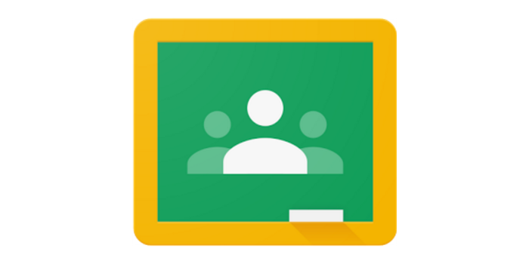

USEFUL DIGITAL TOOLS FOR STUDENTS
Notion
Kahoot
Google Classroom
Organising & Productivity
Learning & Quizzes
Student-Teacher Comunication
Notion is a comprehensive, customizable digital workspace and productivity application designed for note-taking, project management, and knowledge organization
Kahoot! is a digital game-based student response system that allows teachers and learners to interact through competitive knowledge games using existing infrastructure.
Google Classroom is web-based learning management system (LMS) that streamlines creating, distributing, and grading assignments. It acts as a digital hub for teachers to organize materials, foster communication, and manage classes online, integrating seamlessly with Google Drive, Docs, and Meet.

Slide 4
SAFE INTERNET PRACTICES
Use Strong, Unique Passwords & Managers
Enable Two-Factor Authentication (2FA)
Create complex passwords (letters, numbers, symbols) for each account to prevent a single breach from compromising your digital life. Use a password manager to store them securely.
Add an extra layer of security beyond just a password. Even if a hacker steals your password, they cannot access your account without the second factor (like a code sent to your phone).
Internet safety practices (also known as online security measures, cyber hygiene, or digital safety) involve protecting personal information, devices, and accounts from cyber threats. Essential practices include using strong, unique passwords for every account, enabling two-factor authentication (2FA), keeping software updated, and being cautious of phishing links, public Wi-Fi, and sharing personal data.
Identify Phishing and Suspicious Links
Keep Software and Security Updated
Do not click links or open attachments in unexpected emails or messages, even if they seem urgent. Verify the sender and look for inconsistencies in email addresses or website domains.
Regularly update your operating system, browser, and apps to patch security vulnerabilities that hackers frequently exploit.

Slide 5
THE END
THANK YOU
2026 March 31
ARTH RAJ SINGH
25MIP10048

