Slide 1
Extracting text from PDF
Arth Shah-axs175430
Devanshu Sheth-dds160030
Erick Skorupa Parolin-exs172930

Slide 2
Goal of Our Project
Extracting Text from PDF which has Several Columns and images.
Input:-Spanish News Article in PDF.
Output:-Extract News and Related Headlines with different attributes in JSON format.

Slide 3
Tools and Libraries Used
Programming Language:-Python
OS:-Windows 10
Libraries:-PDFMiner, BeautifulSoup, NLTK, mtranslate using Google Translate API
Clustering approach: k-means clustering

Slide 4
Our Approach
We use PDFMiner lib to read the headlines from the PDF file and store it in a html file.
Beautiful soup is used for reading the html document and parsing the headlines and news from the document.
Once the headlines are extracted from the document we perform clustering of similar headlines using k-means clustering.
We use the NLTK library to perform the clustering.
Once we our clusters are ready we output them by using JSONDump in python so as to produce the required the json file.
Additionally we translate the text using mtranslate which uses Google Translate API.

Slide 5
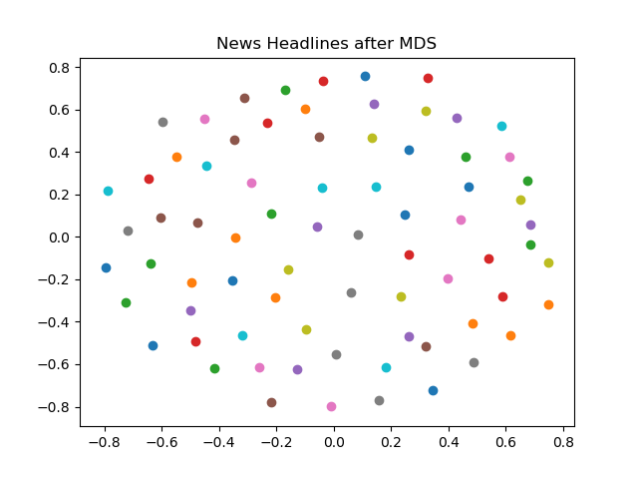
News Headlines Before Clustering
We use a technique of Multi-Dimensional Scaling to visualize the data in 2D.
Note that points that seem at different ends on the 2D image may be close in the n-dimensional space.

Slide 6
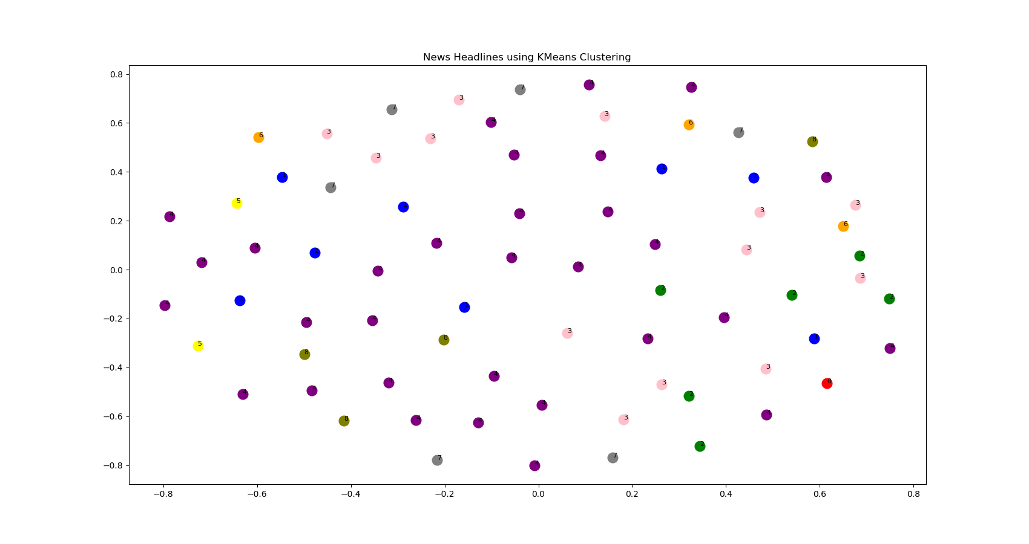
Clustered Headlines 2D Representation

Slide 7
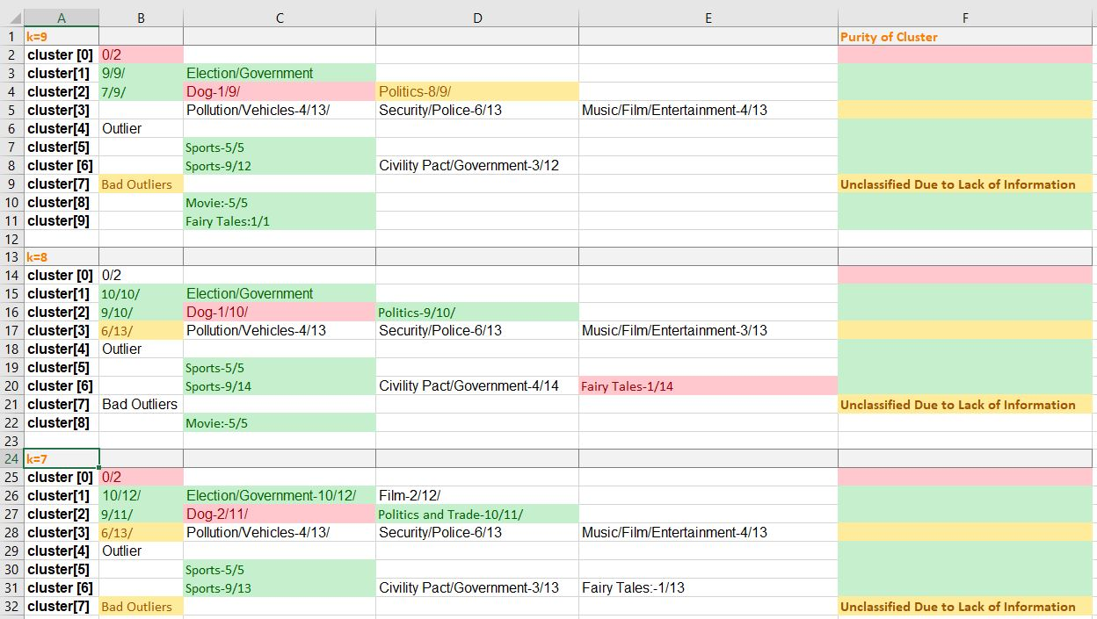
Performance Evaluation

Slide 8
Conclusion
The best clustering is achieved when k=9.
We were successfully able to provide the output in the required JSON format which was the main goal of our project.
We have successfully achieved and satisfied all the deliverables mentioned by the professor for our project.

Slide 9
Team Roles
Arth Shah:-Project Documentation, Carrying out a research on different tools and libraries required for k-means clustering and extracting text from PDF ,requirement analysis ,performance evaluation of different k-means clusters ,developing project proposal document and performing clustering of similar headlines.
Devanshu Sheth:-Performing clustering of similar headlines using k-means clustering using NLTK library, optimizing the parameters for ideal headline extraction from HTML file, converting the clustered files to json, optimizing the project to improve the clustering and final project evaluation, translation of headlines from Spanish to English and developing project proposal document.
Erick Skorupa Parolin:- Developing Files for converting PDF document to HTML using PDFMiner, parsing headlines from the HTML file using Beautiful soup, carrying out a comprehensive literature survey, carrying out requirement analysis, researching different methods developing project proposal document.

Slide 10
References
Chao, H., & Fan, J. (2004, September). Layout and content extraction for pdf documents. In International Workshop on Document Analysis Systems(pp. 213-224). Springer, Berlin, Heidelberg.
Hassan, T., & Baumgartner, R. (2005, November). Intelligent text extraction from pdf documents. In Computational Intelligence for Modelling, Control and Automation, 2005 and International Conference on Intelligent Agents, Web Technologies and Internet Commerce, International Conference on(Vol. 2, pp. 2-6). IEEE.
Ramakrishnan, C., Patnia, A., Hovy, E., & Burns, G. A. (2012). Layout-aware text extraction from full-text PDF of scientific articles. Source code for biology and medicine,7(1), 7.

Slide 11
THANK YOU!

