Slide 1
PHARMACY
ARTH SHAH
RAJAT KOTI
DEVESH RATHO

Slide 2
MODELLING OF REQUIREMENTS AS ER-DIAGRAM
Modeling of Requirements as ER-Diagram:
The requirements can be summarized/ derived from ERD as –
A patient can have can have many prescriptions (1: N)
A patient can be seen by (examined by) different doctors at the same time and doctors can examine many different patients at the same time. (M: N)
A drug includes 1 or more services and a prescription can include by 1 or more drugs simultaneously. (M: N)
A drug can be a part of more than 1 Medicinal batch. (1: N).
A drug can be supplied by more than 1 drug manufacturer; a drug manufacturer can supply more than one type of drug (M: N).
A patient can buy more than 1 medicinal batch; a medicinal batch can be a bought by more than 1 patient (M: N).

Slide 3
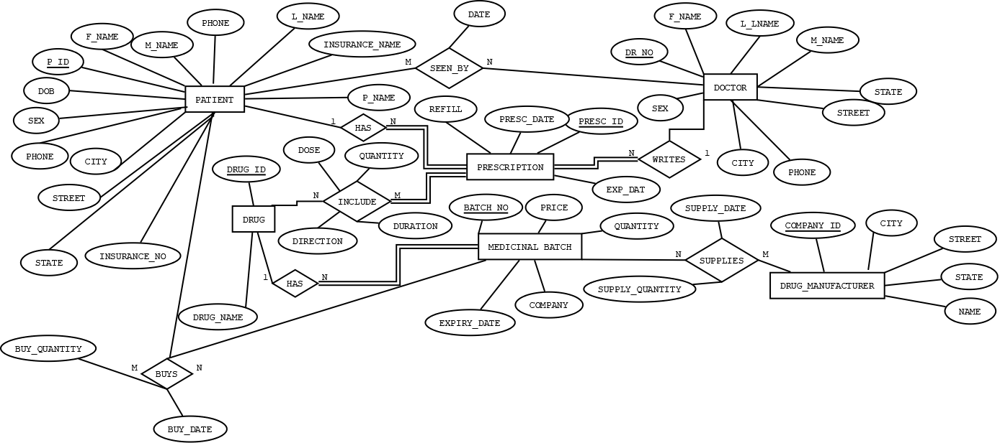
ER DIAGRAM

Slide 4
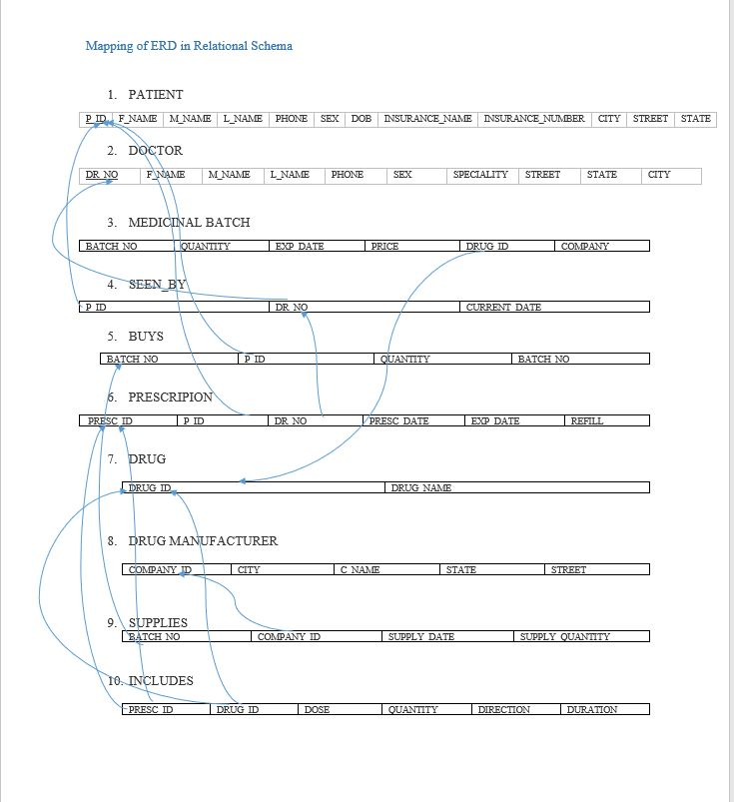

Slide 5
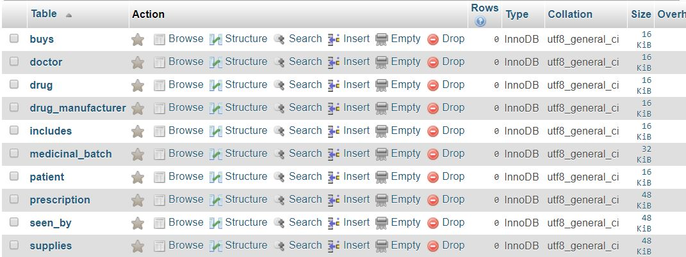
Screenshot of Created Tables

Slide 6
Normalization of the Relation Schema
PATIENT {P_ID -> PHONE, SEX, INSURANCE_NAME, INSURANCE_NO, DOB, F_NAME, M_NAME, L_NAME, STREET, CITY, STATE}
DOCTOR {DR_NO->PHONE, SEX, SPECIALITY, F_NAME, M_NAME, L-NAME, STREET, CITY, STATE}
PRESCRIPTION{PRESC_ID->PRESC_DATE, REFILL, EXP_DATE}
DRUG {DRUG_ID->DRUG_NAME}
MEDICINAL_BATCH {BATCH_NO->COMPANY, EXP_DATE, PRICE, QUANTITY}
DRUG_MANUFACTURER{COMPANY_ID->NAME, STREET, CITY, STATE
BUYS {BATCH_NO, P_ID->BUY_DATE, BUY_QUANTITY}
INCLUDE {PRESC_ID, DRUG_ID -> DOSE, QUANTITY, DIRECTION, DURATION}
SUPPLIES {BATCH_NO, COMPANY_ID -> SUPPLY_DATE, SUPPLY_QUANTITY}

