Slide 1
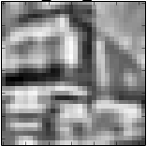
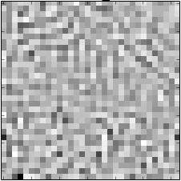
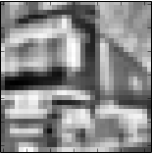
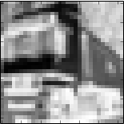
Reconstruction
W
V1 (8x8x32)
W^{T}
W: plastic weights (16x16 patch size)
Residual (32x32)
One to one identity (fixed)
Ganglion (32x32)
Center surround (fixed)
Image/Movie (32x32)
Original image

Slide 2
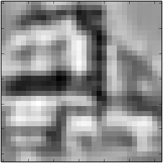
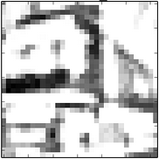
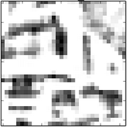
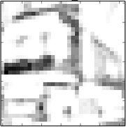
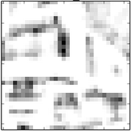
Reconstruction
Identity (E)
SPIKING
W
V1 (8x8x32)
Rectified W and W^{T} (fixed)
W^{T}₊(E)
W^{T}₋(I)
W₊(I)
W₋(E)
W^{T}₊(I)
W^{T}₋(E)
W₊(E)
W₋(I)
Residual ON (32x32)
Residual OFF (32x32)
(E)
(I)
(I)
(E)
Retina ON (32x32)
Retina OFF (32x32)
One to one identity (E)
One to one identity (I)
RATE-BASED
Ganglion (32x32)
Center surround (fixed)
Image/Movie (32x32)
Original image

