Slide 1
Catch the drop
Endless game which will rejuvenate you at times of stress

Slide 2
Game Concepts
The game idea is very simple:
Catch raindrops with a bucket.
Bucket located in the lower part of the screen
Raindrops spawn randomly at the top of the screen every second and accelerate downwards.
Player can drag the bucket horizontally via the mouse/touch or move it via the left and right cursor keys.
The game has no end, think of it as a zen-like experience .

Slide 3
Game Assets
I took the assets from the following sources:
water drop sound by junggle, see http://www.freesound.org/people/junggle/sounds/30341/
rain by acclivity, see http://www.freesound.org/people/acclivity/sounds/28283/
droplet sprite by mvdv, see https://www.box.com/s/peqrdkwjl6guhpm48nit
bucket sprite by mvdv, see https://www.box.com/s/605bvdlwuqubtutbyf4x

Slide 4
Lets see how to configure…

Slide 5
What we need…
We need libgdx project setup file . You can download it in , LibGDX Project setup tool "gdx-setup.jar“.
You can get a clear view of setting up the environment for development in , https://libgdx.badlogicgames.com/documentation/gettingstarted/Creating%20Projects.html
Lets start creating…

Slide 6
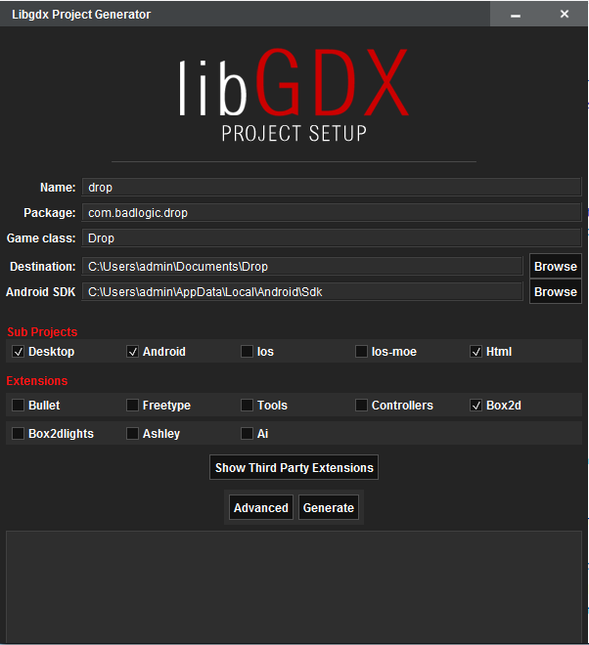

Slide 7
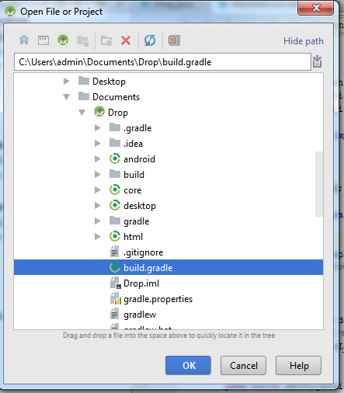
File -> Open -> path of your
build.gradle file -> ok.

Slide 8
Coding the Game
Given our requirements we can now configure our different starter classes. We'll start with the desktop project.
Open the DesktopLauncher.java class in desktop/src/…
We want a 800x480 window and set the title to "Drop".

Slide 9
package com.badlogic.drop.desktop;
import com.badlogic.gdx.backends.lwjgl.LwjglApplication;
import com.badlogic.gdx.backends.lwjgl.LwjglApplicationConfiguration;
import com.badlogic.drop.Drop;
public class DesktopLauncher { public static void main (String[] arg) { LwjglApplicationConfiguration config = new LwjglApplicationConfiguration();
config.title = "Drop";
config.width = 800;
config.height = 480;
new LwjglApplication(new Drop(), config); } }

Slide 10
In the androidmanifest.xml file , change the screen orientation to LANDSCAPE .
<activity android:name="com.badlogic.drop.AndroidLauncher" android:label="@string/app_name" android:screenOrientation="landscape" android:configChanges="keyboard|keyboardHidden|orientation|screenSize"> <intent-filter> <action android:name="android.intent.action.MAIN" /> <category android:name="android.intent.category.LAUNCHER" /> </intent-filter> </activity>

Slide 11
We also want to conserve battery and disable the accelerometer and compass. We do this in the AndroidLauncher.java file in android/src/…
public class AndroidLauncher extends AndroidApplication { @Override protected void onCreate(Bundle savedInstanceState) { super.onCreate(savedInstanceState); AndroidApplicationConfiguration config = new AndroidApplicationConfiguration(); config.useAccelerometer = false; config.useCompass = false; initialize(new Drop(), config); } }

Slide 12
Finally we want to make sure the HTML5 project also uses a 800x480 drawing area. For this we modify the HtmlLauncher.java file in html/src/…
public class HtmlLauncher extends GwtApplication { @Override public GwtApplicationConfiguration getConfig () { return new GwtApplicationConfiguration(800, 480); }

Slide 13
Loading the assets
We have to load the assets and store references to them.
For that we use , ApplicationAdapter.create().
private Texture dropImage;
private Texture bucketImage;
private Sound dropSound;
private Music rainMusic;
Notes:
For each of our assets we have a field in the Drop class so we can later refer to it. The first two lines in the create() method load the images for the raindrop and the bucket. A Texture represents a loaded image that is stored in video ram. One can usually not draw to a Texture. A Texture is loaded by passing a FileHandle to an asset file to its constructor. Such FileHandle instances are obtained through one of the methods provided by Gdx.files. There are different types of files, we use the "internal" file type here to refer to our assets. Internal files are located in the assets directory of the Android project. As seen before, the desktop and HTML5 projects reference the same directory.
Next we load the sound effect and the background music. Libgdx differentiates between sound effects, which are stored in memory, and music, which is streamed from wherever it is stored. Music is usually too big to be kept in memory completely, hence the differentiation. As a rule of thumb, you should use a Sound instance if your sample is shorter than 10 seconds, and a Music instance for longer audio pieces.
Loading of a Sound or Music instance is done via Gdx.audio.newSound() and Gdx.audio.newMusic(). Both of these methods take a FileHandle, just like the Texture constructor.
At the end of the create() method we also tell the Music instance to loop and start playback immediately. If you run the application you'll see a nice pink background and hear the rain fall.

Slide 14
public class Drop extends ApplicationAdapter {
@Override public void create()
{ // load the images for the droplet and the bucket, 64x64 pixels each
dropImage = new Texture(Gdx.files.internal("droplet.png")); bucketImage = new Texture(Gdx.files.internal("bucket.png"));
// load the drop sound effect and the rain background "music"
dropSound = Gdx.audio.newSound(Gdx.files.internal("drop.wav")); rainMusic = Gdx.audio.newMusic(Gdx.files.internal("rain.mp3")); // start the playback of the background music immediately
rainMusic.setLooping(true);
rainMusic.play();

Slide 15
Next we want to create a camera and a SpriteBatch.
The SpriteBatch is a special class that is used to draw 2D images, like the textures we loaded.
We add two new fields to the class, let's call them camera and batch:
private OrthographicCamera camera; private SpriteBatch batch;
In the create() method we first create the camera like this:
camera = new OrthographicCamera(); camera.setToOrtho(false, 800, 480);

Slide 16
Next we create the SpriteBatch (we are still in the create() method):
batch = new SpriteBatch();

Slide 17
Adding the bucket…
To describe both the bucket and raindrops we need to store their position and size. Libgdx provides a Rectangle class which we can use for this purpose.
import com.badlogic.gdx.math.Rectangle;
private Rectangle bucket;

Slide 18
In the create() method we instantiate the Rectangle and specify its initial values.
bucket = new Rectangle();
bucket.x = 800 / 2 - 64 / 2;
bucket.y = 20;
bucket.width = 64;
bucket.height = 64;

Slide 19
Rendering the bucket…
The first thing we want to do is to clear the screen with a dark blue color. Simply change the render() method to look like this:
@Override public void render()
{ Gdx.gl.glClearColor(0, 0, 0.2f, 1);
Gdx.gl.glClear(GL20.GL_COLOR_BUFFER_BIT);
}

Slide 20
it is generally a good practice to update the camera once per frame:
camera.update();
Now we can render our bucket:
batch.setProjectionMatrix(camera.combined); batch.begin(); batch.draw(bucketImage, bucket.x, bucket.y); batch.end();

Slide 21
Making the bucket move…
Time to let the user control the bucket.
if(Gdx.input.isTouched())
{
Vector3 touchPos = new Vector3();touchPos.set(Gdx.input.getX(), Gdx.input.getY(), 0);
camera.unproject(touchPos);
bucket.x = touchPos.x - 64 / 2;
}

Slide 22
What if with a keyboard…
if(Gdx.input.isKeyPressed(Input.Keys.LEFT))
bucket.x -= 200 * Gdx.graphics.getDeltaTime();
if(Gdx.input.isKeyPressed(Input.Keys.RIGHT))
bucket.x += 200 * Gdx.graphics.getDeltaTime();

Slide 23
We also need to make sure our bucket stays within the screen limits:
if(bucket.x < 0)
bucket.x = 0;
if(bucket.x > 800 - 64)
bucket.x = 800 - 64;

Slide 24
Adding Rain drops…
For the raindrops we keep a list of Rectangle instances, each keeping track of the position and size of a raindrop.
private Array<Rectangle> raindrops;
We also need to keep track of the last time we spawned a raindrop, so we add another field:
private long lastDropTime;

Slide 25
To facilitate the creation of raindrops we'll write a method called spawnRaindrop.
private void spawnRaindrop() {
Rectangle raindrop = new Rectangle();
raindrop.x = MathUtils.random(0, 800-64); raindrop.y = 480;
raindrop.width = 64;
raindrop.height = 64;
raindrops.add(raindrop);
lastDropTime = TimeUtils.nanoTime(); }

Slide 26
We need to instantiate that array in the create() method:
raindrops = new Array<Rectangle>(); spawnRaindrop();
Next to check the time last raindrop passed , add the following in render method.
if(TimeUtils.nanoTime() - lastDropTime > 1000000000) spawnRaindrop();

Slide 27
to make our raindrops move, let's take the easy route and have them move at a constant speed of 200 pixels/units per second. If the raindrop is beneath the bottom edge of the screen, we remove it from the array.
Iterator<Rectangle> iter = raindrops.iterator();
while(iter.hasNext()) {
Rectangle raindrop = iter.next();
raindrop.y -= 200 * Gdx.graphics.getDeltaTime();
if(raindrop.y + 64 < 0) iter.remove();
}

Slide 28
The raindrops need to be rendered. We'll add that to the SpriteBatch rendering code.
batch.begin();
batch.draw(bucketImage, bucket.x, bucket.y); for(Rectangle raindrop: raindrops)
{
batch.draw(dropImage, raindrop.x, raindrop.y);
}
batch.end();

Slide 29
simply add the following lines to the raindrop update loop:
if(raindrop.overlaps(bucket)) {
dropSound.play();
iter.remove();
}

Slide 30
Cleaning up…
A user can close the application at any time.
@Override
public void dispose() {
dropImage.dispose();
bucketImage.dispose();
dropSound.dispose();
rainMusic.dispose();
batch.dispose();
}

Slide 31
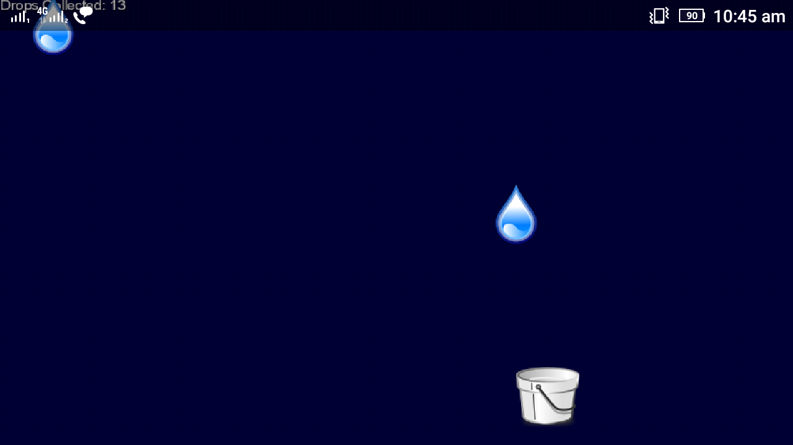
Game Screen…

Slide 32
Thank YOU!!

