Slide 1

Smart blind-stick

Slide 2


Abstract
The Smart Blind Stick project aims to develop an affordable and effective solution to enhance the mobility and independence of visually impaired individuals. This assistive device uses ultrasonic sensors to detect obstacles in real time, providing immediate feedback via a buzzer to help users avoid collisions and navigate safely. By leveraging Arduino microcontrollers and simple electronic components, the Smart Blind Stick offers a low-cost alternative to existing, expensive assistive technologies, ensuring accessibility for a broader population.
This Photo by Unknown Author is licensed under CC BY-SA-NC

Slide 3


Introduction
Visually impaired individuals often face significant challenges when navigating unfamiliar or crowded environments. Existing assistive devices, while helpful, are frequently cost-prohibitive for many users. The Smart Blind Stick is a cost-effective solution designed to address these mobility challenges. The device uses ultrasonic sensors to detect nearby obstacles and alerts the user through a buzzer, ensuring safer and more independent navigation. The project incorporates Arduino Uno/Nano microcontrollers, making it easy to develop and scale, and is designed to be lightweight and user-friendly. By providing immediate, real-time feedback, this device empowers visually impaired individuals with improved confidence and independence.

Slide 4
Motivation
Enhance Mobility: Visually impaired individuals often face challenges while navigating unfamiliar environments. A smart assistive device can improve their independence and confidence.
Affordable Solution: Current assistive technologies can be expensive. This project provides a low-cost, accessible alternative to support visually impaired individuals.
Realtime Obstacle Detection: Immediate feedback through a buzzer can help prevent accidents and improve the safety of users in everyday scenarios.
This Photo by Unknown Author is licensed under CC BY-SA-NC

Slide 5
Literature review
Research on assistive technologies for visually impaired individuals has explored various approaches to enhance mobility. Ultrasonic sensors are widely used for obstacle detection due to their accuracy and affordability (A. Smith et al., 2018), but range and response time limitations remain issues. Multisensor systems like those by R. Johnson et al. (2019) improved detection but increased cost and false positives. Advanced solutions using platforms like Raspberry Pi (M. Lee et al., 2020) provided real-time feedback but were costly and bulky. Low-cost options like P. Kumar et al. (2021) demonstrated affordability with Arduino, but lacked accuracy in complex environments. The Smart Blind Stick aims to balance cost, portability, and real-time accuracy by leveraging ultrasonic sensors with a simplified design.

Slide 6
Challenges & limitations
Current assistive technologies for visually impaired individuals face several challenges. Ultrasonic-based systems often suffer from limited detection range and slow response times (A. Smith et al., 2018), which can hinder effective navigation in dynamic environments. Multisensor approaches like R. Johnson et al. (2019) have higher costs and are prone to false positives, especially in cluttered spaces. Systems utilizing advanced platforms like Raspberry Pi (M. Lee et al., 2020) are effective but bulky and expensive, making them less accessible. Lastly, while Arduino-based solutions (P. Kumar et al., 2021) are affordable, they struggle with accuracy in complex surroundings, limiting their reliability.
This Photo by Unknown Author is licensed under CC BY-SA-NC

Slide 7
Objectives
Develop a cost-effective and portable smart blind stick using readily available components like Arduino, ultrasonic sensors, and buzzers.
Enhance real-time obstacle detection accuracy by optimizing the sensor system to reduce false positives and improve detection range.
Provide immediate and clear user feedback through a buzzer, enabling users to avoid obstacles promptly and safely.Ensure ease of use and comfort by designing a lightweight and ergonomic device suitable for daily use.
Promote accessibility by offering a low-cost solution that can be easily adopted by visually impaired individuals in need of assistive technology.

Slide 8
Innovation idea
The innovative aspect of the Smart Blind Stick lies in its affordable, real-time obstacle detection system that uses ultrasonic sensors to alert visually impaired users via a buzzer. Unlike existing solutions, this project focuses on balancing cost-effectiveness, portability, and ease of use, making it accessible to a broader audience. By leveraging Arduino-based technology, the system is not only affordable but also simple to assemble and maintain, with the potential for integration of additional sensors or features like GPS for location tracking or AI for advanced object recognition, ensuring the device can evolve with future needs.
This Photo by Unknown Author is licensed under CC BY-SA-NC

Slide 9
Scope & Application
The Smart Blind Stick is designed to assist visually impaired individuals in navigating safely through unfamiliar or crowded environments by detecting obstacles in real time. Its scope includes:
Real-time obstacle detection using ultrasonic sensors to enhance safety.
Cost-effective and portable design for widespread accessibility and ease of use.
Potential for future enhancements like GPS integration or AI-based object recognition for advanced navigation.
Applications of the project:
Daily navigation aid for visually impaired individuals in indoor and outdoor environments.
Assistive tool for mobility training and orientation in rehabilitation centers.
Use in public spaces and smart cities to enhance the safety and independence of visually impaired citizens.

Slide 10

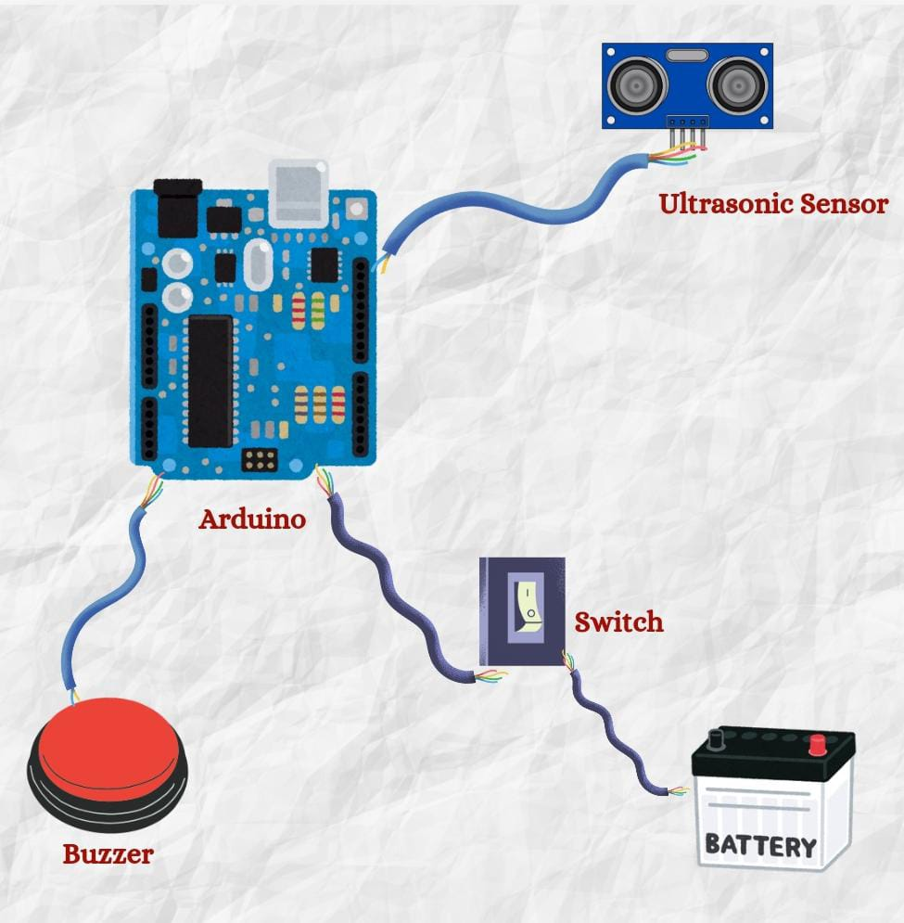

Proposed architecture diagram

Slide 11

PROPOSED MODULES
Obstacle Detection ModuleUltrasonic sensors detect obstacles and measure distance in real time.
Alert System ModuleBuzzer provides immediate audio feedback when obstacles are detected.
Power Management ModuleEfficient battery usage with low power consumption for extended operation.
Control and Processing ModuleArduino handles sensor data and triggers alerts for quick responses.
User Interface Module(Possibility) Future potential for GPS, AI, or additional feedback like vibration or voice output.

Slide 12
CONCLUSION
The Smart Blind Stick provides an affordable, practical solution for visually impaired individuals, offering real-time obstacle detection and easy-to-use audio alerts. By addressing the limitations of existing devices, such as high cost and complexity, this project enhances mobility and safety. Its simple design, based on accessible components, ensures scalability and future potential for integrating advanced features like GPS or AI. Overall, the project contributes to improving the quality of life for visually impaired individuals.
Dhruv Prajapati RA2311003012183
Arth Joshi RA2311003012146
Siddharth Sharma RA2311003012179

