Slide 1
CAR SPECIFICATIONS ARTHI.B - 23127010
II-Bsc.computer science with data analytics
Sri Ramakrishna college of arts and science

Slide 2
ABSTRACT
OVERVIEW:
This project focus on the analysis of a car specification dataset containing 2500 entries. Each entry represents in individual car and includes details such as the id, price, gender ,brand ,model ,year, title_status, mileage ,color ,state. The primary aim of the analysis is to uncover the key factors influencing car price and brand preference regarding mileage and model.

Slide 3
DATA PREPARATION
Data collection: data sourced from Kaggle contributes, includes second hand car attributes, model and brand platform presence
Data cleaning: remove duplicates ,handling missing values and organizing data into a usable format
Key fields: price, model, brand and title_status

Slide 4
DATASET DESCRIPTION: ID (Customer ID Proof Number): Unique identifier for each customer, possibly linked to their proof of identification. GENDER: Gender of the customer. This is typically recorded as male, female, or other/non-binary. PRICE: The price of the second-hand car being dealt with. This could be in the local currency. YEAR: Year of manufacture of the car. This helps in identifying the age of the vehicle. BRAND: Name of the car manufacturer (e.g., Toyota, Honda, Ford). MODEL: Specific model of the car (e.g., Camry, Civic, Mustang). MILEAGE: The distance in kilometers that the car has traveled. STATE: The state or location where the vehicle is registered or currently located. COLOUR: colour of the car(e.g., black ,silver,blue) TITLE_STATUS: The legal status of the vehicle's title, indicating if it's clean, salvaged, rebuilt, etc.

Slide 5
METHODOLOGY: Descriptive Analysis: Summarized and interpreted data to understand main characteristics and trends. Statistical Methods: Applied various statistical techniques to analyze data distribution and relationships. Visualization: Used bar charts, pie charts, and histograms to present data insights clearly.

Slide 6
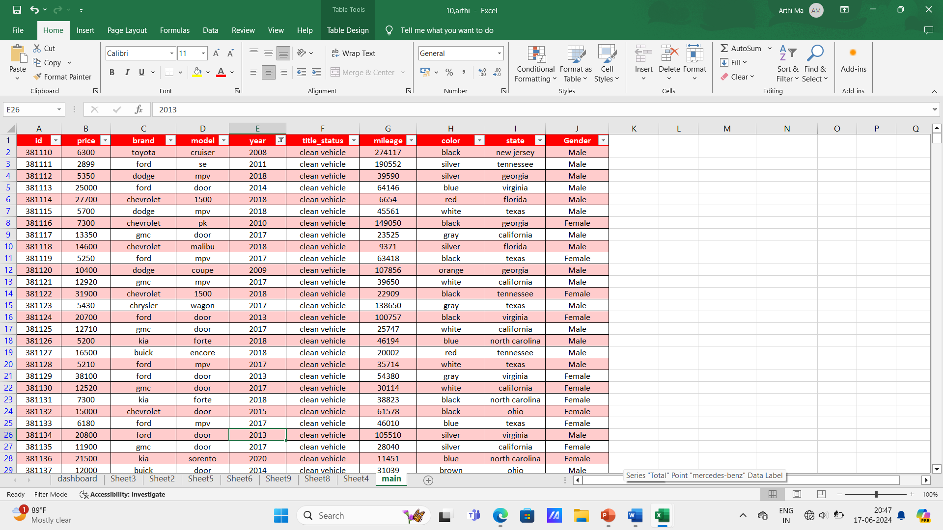
DATA SETS

Slide 7
EX : WHICH CAR SALES TO HIGHIEST PRICE

Slide 8
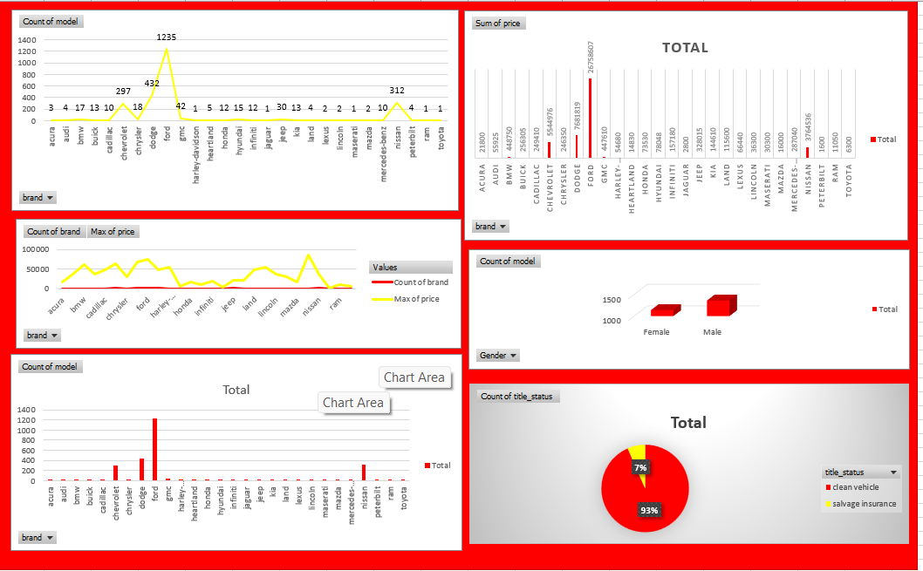
VISUALISATION IMAGE

Slide 9
SOFTWARE/TOOLS REQUIREMENTS:
The software used in this summer internship project is MS Excel (pivot table). Excel is a versatile tool for various tasks, and crop production analysis is a great example. Let's delve deeper into using Excel for this purpose
PIVOT TABLE:
Pivot Charts display data series, categories, data markers, and axes just as standard charts do.You can also change the chart type and other options such as the titles, the legend placement, the data labels, the chart location, and so on. Here's a PivotChart based on the Pivot Table example above

Slide 10
CONCLUSION

Slide 11
Thank You…

