Slide 1
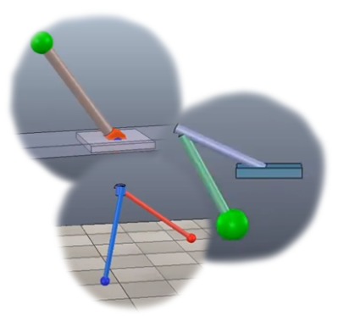

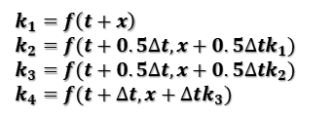
F1-score of the classification
methods | small Training dataset |  |  | large training dataset
Methods | none | edge Detector | skeletonization | edge Detector | skeletonization
tested on synthetic dataset | 0.8496 | 0.9203 | 0.9540 | 0.9832 | 0.9807
tested on captured dataset | 0.2255 | 0.8888 | 0.9028 | 0.9727 | 0.9653
$$∆x= \frac{1}{6}(k_{1}+2k_{2}+2k_{3}+k_{4})∆t$$
$$k_{1}=f\left(t+x\right)$$
$$k_{2}=f(t+0.5∆t,x+0.5∆tk_{1})$$
$$k_{3}=f(t+0.5∆t,x+0.5∆tk_{2})$$
$$k_{4}=f(t+∆t,x+∆tk_{3})$$

