Slide 1

PACE AI
Intelligent Campus Information Assistant
A source-grounded RAG system for official campus information
[Student/team names] · Guide: [Guide name]
[Department] · [Academic year]
01
Notes:
Good morning. Our project is PACE AI, a campus information assistant built around official PACE webpages and academic documents. A student can ask an ordinary question and inspect the supporting source instead of searching through several pages manually. We use retrieval-augmented generation, or RAG. That means the system retrieves relevant evidence before asking Gemini to write an answer. We chose this approach because training a new language model would require far more data and computing resources, and would still not give us clear document citations. Search and embeddings run locally, while Gemini receives the current question and selected public excerpts. Today I will explain the working application, its retrieval design and the changes we tested, followed by the limitations that remain.
Sources: README.md; app.py; src/rag_pipeline.py; original assets/pace-logo.jpg.

Slide 2
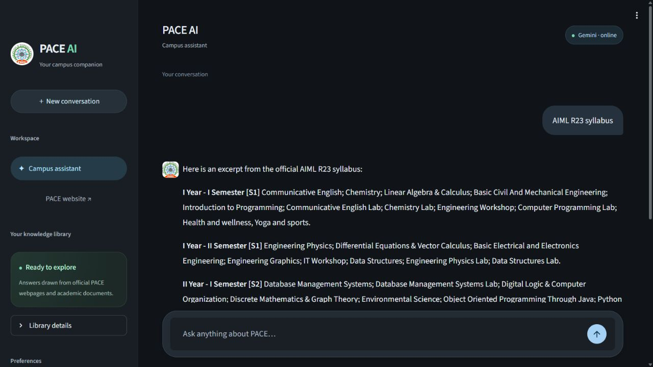
Problem and proposed solution
Before PACE AI
With PACE AI
Information spread across
webpages and long PDFs
One question with official evidence
Syllabi and regulations
Admissions and placements
Repeated manual searching
Answer text links back to the exact
webpage or PDF page.
02
Notes:
The problem is mostly one of navigation. Campus information already exists, but it appears across syllabus PDFs, regulation documents and separate admissions or placement pages. A student may find a document and still need to locate the relevant semester or page. PACE AI adds a conversational entry point to this material. The screenshot shows a real AIML R23 query. Academic scope matters here because an answer from another branch or regulation can sound plausible while being wrong. The application keeps source identity and page information with the text. For an exact syllabus overview it can extract the indexed course table directly, without calling Gemini. The resulting overview is partial, and the application tells students to open the official PDF for all semesters, credits and detailed units.
Sources: src/retriever.py; src/rag_pipeline.py; real localhost screenshot captured 12 September 2026.

Slide 3
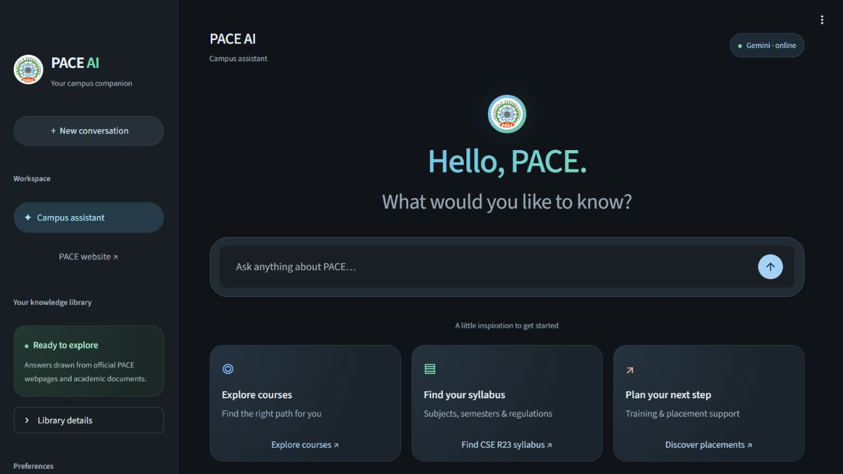
Current interface and features
Grounded answers
Gemini streaming
Evidence-based refusals
Relevant retrieval
FAISS + BM25
Branch and regulation filters
Token-aware chunks
Traceable results
PDF pages and source cards
Retrieval cache
Safe index rollback
03
Notes:
This is the actual home screen, using the original PACE crest. The interface offers suggested questions, a chat input and source cards beside answers. The important features sit behind that simple screen. FAISS searches for passages with similar meaning, while BM25 helps match exact words and course codes. Branch and regulation filters narrow the document scope. Token-aware chunks keep embedding inputs within the model limit. Gemini streams supported answers, but weak evidence produces a refusal instead. The cache stores recent retrieval results with a size and expiry limit. Candidate index selection also lets us restore the previous index safely. These are current features. Authentication, uploads and permanent conversation storage are not part of this application. The conversation shown in the interface belongs only to the current Streamlit session.
Sources: app.py; assets/ui.css; assets/spotlight.js; src/ui.py; src/retriever.py; src/index_selection.py; real home screenshot.

Slide 4
System architecture
OFFLINE PREPARATION
QUESTION-TIME PROCESSING
Public PACE webpages + PDFs
Hybrid retrieval
Crawl, extract and clean
Evidence filtering
Token-aware chunks
Gemini
Validated answer + citations
BGE embeddings
FAISS vectors
BM25 tokens
Keyword index
Streamlit interface
Both indexes
One Python application. No separate frontend/backend REST service.
04
Notes:
The architecture has two phases. Offline preparation collects public PACE pages and PDFs, cleans their text and creates chunks. Each chunk retains its source identity. BGE turns the embedding input into a vector, and FAISS stores those vectors. A second index stores BM25 keyword information. Both indexes feed hybrid retrieval at question time. Selected evidence passes a gate before entering the generation context. Gemini writes an answer and the application checks citation labels before showing source cards. The diagram shows the normal generation path. Exact syllabus navigation and greetings have shorter paths, which I will show next. Streamlit and the RAG pipeline run in one Python process. We do not currently need an application database because index files and their metadata already support this read-oriented snapshot. Persistent accounts or shared chat history would change that requirement.
Sources: build_index.py; src/cleaner.py; src/token_chunker.py; src/embeddings.py; src/vector_store.py; src/bm25_search.py; src/rag_pipeline.py; app.py.

Slide 5
Question processing workflow
Student question
Input validation
Academic scope
Retrieval cache
Evidence gate
Fusion + reranking
FAISS + BM25 search
BGE query embedding
Context construction
Gemini streaming
Citation validation
Answer + source cards
SHORTER PATHS
Greeting
Exact syllabus overview
Weak evidence
Deterministic reply
Indexed table, no Gemini
Refusal, no Gemini
05
Notes:
RAG means retrieving supporting text and using it to guide the answer. After validating a question, the pipeline detects its academic scope and checks the retrieval cache. On a cache miss, BGE represents the question as a numerical vector. FAISS compares vector similarity, while BM25 scores matching words. Combining the two helps with both paraphrases and exact academic terms. The pipeline fuses and reranks these results, rejects weak evidence and builds a bounded context. Gemini streams an answer, then citation checks ensure that source labels refer to supplied evidence. A cache hit skips repeated search work. Greetings receive a deterministic reply. Exact syllabus overviews use indexed tables. Missing evidence produces a refusal without Gemini. These controls reduce unsupported answers, but they do not prove that every generated sentence is correct. Source inspection remains important.
Sources: src/retriever.py; src/rag_pipeline.py; src/answer_policy.py; src/llm.py; config.py. Cache defaults: 128 entries, 300-second TTL. Retrieval defaults: 8 vector, 8 BM25, 4 final results. Context: at most 900 words and 3 sources.

Slide 6
Token-aware optimization
Original index
Active candidate
3,227
5,835
chunks
chunks
952 oversized inputs
0 oversized inputs
Exceeded the 512-token window
448-token complete-input limit
17/17 checks before and after
Metadata and special tokens count toward the limit. Course rows and headings stay intact.
activate
rollback
Evaluated candidate
Active selection
Original index
06
Notes:
The original index had 3,227 chunks. Token inspection found 952 complete embedding inputs above the BGE model window of 512 tokens. Long inputs risk losing information through truncation. The active candidate has 5,835 smaller chunks and no oversized inputs. Its 448-token budget counts the text together with metadata and special tokens. The chunker preserves complete course rows when they fit and carries useful headings into later chunks. Page aggregation keeps syllabus overviews complete across those smaller pieces. Both the baseline and candidate passed all 17 curated retrieval checks, so the result is no regression on this test set. It is not a claim of universal accuracy. Smaller chunks increase storage and search work, so we do not claim a general speed improvement. The original index remains available through a non-destructive rollback command.
Sources: TOKEN_CHUNKING_REPORT.md; data/candidates/token-448-20260912-v3/evaluation.json; src/token_chunker.py; src/index_selection.py. Active candidate: token-448-20260912-v3. Rollback: python select_index.py --rollback.

Slide 7
Technology stack
Application
Python 3.11 and Streamlit
Generation
Gemini REST streaming through Requests
Semantic search
BGE-small-en-v1.5, Sentence Transformers and FAISS CPU
Keyword search
rank-bm25
Ingestion
Requests, Beautiful Soup and PyMuPDF
Chunking and support
LangChain text splitters, python-dotenv and Pytest
Optional and inactive: Qwen with Transformers or llama.cpp
07
Notes:
Python 3.11 runs the application. Streamlit provides the interface and session state. Gemini is the configured language model, and the project calls its REST streaming endpoint directly through Requests. Locally, Sentence Transformers loads BAAI bge-small-en-v1.5. It produces 384-dimensional embeddings. FAISS uses inner product on normalized vectors, which gives cosine similarity. BM25 adds lexical matching. Requests and Beautiful Soup handle webpages, while PyMuPDF extracts text from PDFs. LangChain text splitters support difficult chunk splits, python-dotenv loads local configuration, and Pytest runs automated checks. Qwen support remains in the code as an optional local provider through Transformers or llama.cpp, but it is inactive. No separate REST application service or application database sits between these components. This keeps the current local deployment relatively simple.
Sources: requirements.txt; config.py; src/embeddings.py; src/vector_store.py; src/llm.py; src/token_chunker.py; README.md. Configured generation model documented as gemini-3.5-flash.

Slide 8
Security, reliability and testing
Implemented protections
89
Server-side key and ignored .env
PACE host and redirect validation
PDF size and signature checks
Prompt-injection instruction
Citation-label validation
Checksums and gated activation
Non-destructive index rollback
Localhost-only binding
automated tests passed
17/17 curated retrieval checks
Missing R99 and unrelated queries rejected
AIML R23 retained PDF pages 2 and 3
Live Gemini placement answer validated
Observed results, not a guarantee of perfect accuracy or fixed latency.
08
Notes:
The key stays on the server and the project excludes the local environment file from source control. Public PACE requests validate allowed hosts and redirects. PDF loading checks file size and signature. The prompt tells Gemini to treat retrieved text as reference data, and the application validates citation labels. These measures reduce risk, but a prompt instruction does not guarantee protection from prompt injection. Candidate checksums and quality gates help prevent accidental activation of inconsistent files. Rollback preserves both indexes. The launcher binds to localhost, and authentication is not implemented. In a fresh run, all 89 automated tests passed. The saved retrieval evaluation passed 17 cases, including missing and unrelated queries. The earlier recorded live Gemini placement check also passed. These are bounded observations, not a complete security audit or an accuracy guarantee.
Sources: Fresh pytest run on 12 September 2026: 89 passed. TOKEN_CHUNKING_REPORT.md records the live Gemini test. evaluation.json; .gitignore; src/public_http.py; src/pdf_loader.py; src/llm.py; src/index_selection.py; start.ps1.

Slide 9
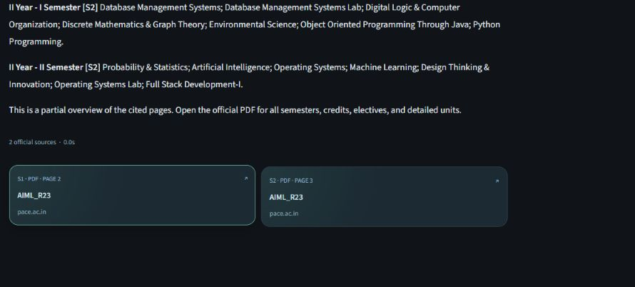
Demonstration and next steps
Live demonstration
Open PACE AI
Ask “AIML R23 syllabus”
Show semester overview
Open PDF pages 2 and 3
Ask for missing R99
Show the safe refusal
Current limitations
Future scope (not implemented)
Saved snapshot, no automatic refresh
Cold first semantic query, no OCR
No auth or persistent chat history
Small curated evaluation set
Conditional refresh and embedding reuse
Gated updates, warmup and OCR
Bounded history, auth and rate limits
Larger evaluation set
09
Notes:
For the demonstration, I open the application and ask for the AIML R23 syllabus. I show the semester overview and open the linked PDF pages 2 and 3. Then I ask for an unavailable regulation such as R99 and show the refusal. The screenshot contains the actual source cards. The current library is a saved snapshot. A website change will not automatically appear in answers until a deliberate refresh and index update. The first semantic query can also be slow because it loads the embedding model. Scanned PDFs need OCR, which we have not added. Future work includes safe change detection, conditional refresh of webpages and PDFs, reuse of unchanged embeddings and quality-gated activation. To support more users we would also need authentication, rate limits, bounded history and a reviewed concurrency design. A larger evaluation set should accompany these changes.
Sources: Real localhost source-card screenshot; src/crawler.py; src/pdf_loader.py; src/runtime.py; app.py; TOKEN_CHUNKING_REPORT.md. Source snapshot: 8 September 2026.

Slide 10
PACE AI
A searchable, source-linked assistant
for official campus information
Academic scope and document identity remain central.
Hybrid retrieval, token-safe embeddings and Gemini support the answer.
Citations and evaluated index selection make the evidence inspectable.
Thank You
Questions?
10
Notes:
To conclude, PACE AI gives students a searchable entry point to official campus information while preserving the branch, regulation and document identity behind an answer. Hybrid retrieval combines semantic matching with exact keyword evidence. Token-safe embedding inputs avoid silent truncation, and the candidate workflow lets us test an index before selecting it. Gemini improves the conversational answer, while citations let the student inspect the source. The practical value is less manual navigation, with clear boundaries when the library lacks evidence. We still have important work ahead around fresh content, cold-start latency and support for more users. The current tests show that the selected candidate preserves the cases we checked, rather than proving every possible answer correct. Thank you. I am happy to discuss the design choices or demonstrate the source links.
Sources: README.md; TOKEN_CHUNKING_REPORT.md; src/rag_pipeline.py; original assets/pace-logo.jpg.

