Slide 1
FitPilot
Your AI Fitness Coach that Sees, Thinks and Tracks
A Weather-Aware, Recovery-Driven, Pose-Checking Coach for Android
Mobile Computing Project
Team: 207 Students: Xie Yuntian, Li Xinye, Wang Haoyu
Android • Kotlin • Jetpack Compose • TensorFlow Lite • Room • BLE • TTS

Slide 2
01
FitPilot Overview
Idea in one sentence: decide what to train, watch you do it, and remember for tomorrow
• A personal AI fitness coach in your pocket — no course picking required.
• It thinks: weather + recovery + preferences → today's plan.
• It sees: camera-based pose AI counts reps and checks your form.
• It tracks: running + strength logs unite in one local database.
THINKS
Daily Decision Engine
weather + AQI + recovery
SEES
Real-Time Form Coach
MoveNet on-device AI
TRACKS
Unified Training Log
GPS / BLE HR / reps

Slide 3
02
The Gap We Address
Three pain points of working out alone → three answers FitPilot provides
Pains (today)
FitPilot's answer
Not sure what to train today — too many choices, no guidance.
Weather + AQI + recovery-aware daily recommendation.
No one watches your form — reps get sloppy, risk of injury.
On-device pose AI counts reps and flags bad form with voice.
Data scattered — running and strength live in separate apps.
One unified log that adjusts tomorrow's intensity.
Niche: few apps combine decision + live feedback + unified logs into one local, explainable coach.

Slide 4
03
Related Apps & Their Limitations
What each app does well — and what it is missing
App | Key features / components | What it lacks
Fitbod | Daily plans from muscle recovery, equipment, history (cloud, paid) | No weather dimension, no live form feedback
Keep | Course library, AI form scoring on follow-along videos, running+strength | Two separate systems; AI is server-side; pick-and-play plans
Good Habits (base) | On-device TF Lite pose, 90+ exercises, rep counting, streaks, CSV (open source) | Rep count only — no recommendation, no weather, no voice
HeartRunner | BLE heart-rate strap, GPS track, pace, Chinese voice (open source, MIT) | Running only — no strength tracking, no recommendation
wger | 500+ exercise database, workout manager, REST API (open source) | Web/Flutter, not native Android, no AI

Slide 5
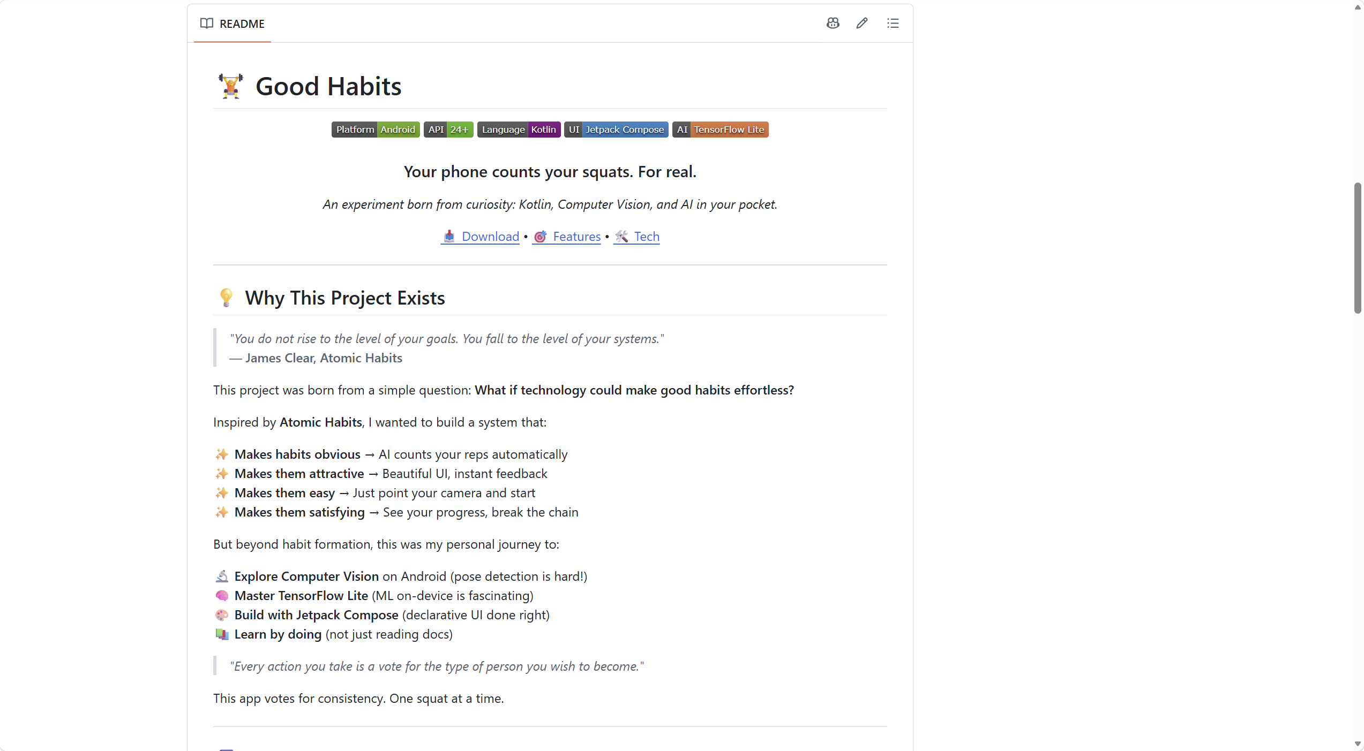
04
Open Source We Build Upon
Reuse code, not copy it — licenses matter
• Good Habits (primary base) MIT-visible GitHub project: pose-pipeline, Room data layer, Compose UI patterns — the exact stack we extend.
• HeartRunner BLE heart-rate connection + GPS + Chinese voice, MIT — we mirror its GATT code for running.
• wger AGPL — we only reference its data schema, we copy no code (avoids license contamination).
• Exercise dataset Bundled locally from Good Habits' library and open exercise JSON, so the app works fully offline.
License note
• Read AGPL / MIT terms carefully.
• State what we reuse in docs & commit log.
• Original contribution ≠ re-skinned app (report title/icon only).

Slide 6
05
New Features at a Glance
8 additions over the chosen base — mapped to the assessment dimensions
01 Equipment-Aware Daily Recommendation
Process • Storage
02 Recovery Score (0–100)
Process • Storage
03 Real-Time Pose Form Check (bench / squat / plank)
Process • AI
04 Weather + AQI Awareness
Input • Process
05 TTS Voice Coaching + HIIT + Cool-down
Output / UX
06 Running: GPS + BLE Heart Rate
Input • Output
07 Unified Multi-Scenario Closed Loop
Storage • Integration
08 Jump-Rope Auto Counting (Additional)
Process • Output

Slide 7
06
Feature 1 — Daily Recommendation Engine
Explainable pipeline: filter first, then score
How it works
Exercise library
90+ tagged exercises
• Onboarding quiz → user profile: scene (home / gym), equipment inventory, goal, frequency, level.
• Tagged exercise library each exercise carries type (cardio / strength), equipment, muscle, difficulty.
• Hard filter if equipment does not match → exercise is removed.
• Weighted scoring weather/AQI + recovery + preference + muscle balance → rank, pick top 3.
User profile filter
scene + equipment + goal
Weather / AQI gate
outdoor ↔ indoor
Score = Σ weight × dimension → Top 3 exercises

Slide 8
07
Feature 2 — Recovery Score (0–100)
Transparent, if-based formula — no black box
• Sleep check-in 40% — hours slept, if-banded to a 0–100 sub-score.
• Resting heart rate 25% — vs. personal baseline (BLE or manual).
• Fatigue check-in 20% — 1–5 subjective feel.
• Recent training load 15% — last-7-days volume vs. personal average.
• Data sources are layered forms (no hardware) + BLE (optional) + local history.
• Output high / medium / low intensity; <40 for 3 days → rest-day warning.
Recovery = 0.40·sleep + 0.25·HR + 0.20·fatigue + 0.15·load
Sleep ≥ 8 h → 100 | 6 h → 60 | 4 h → 20
HR ≤ baseline → 100 | +10 bpm → 40
Fatigue 1 (“fresh”) → 100 | 5 (“exhausted”) → 15
≥ 80
High intensity
60–79
Medium intensity
40–59
Low intensity
< 40
Rest / warning

Slide 9
08
Feature 3 — On-Device Pose Coach
AI used where it is strong: seeing your body
Joint angles
• Model TensorFlow Lite + MoveNet, runs fully on-device — offline, free, explainable.
• Rep counting bench press reps auto-detected from the pose stream.
• Form quality joint angles (shoulder / elbow / knee) decide if a rep is standard.
• Voice feedback TTS: “Rep 5 — keep elbows tucked”, in Chinese, offline.
• Extensions squat, plank, jump-rope counting.
~90°
Shoulder ≈ 90°
Elbow ~150° → too wide = bad
Visual: skeleton overlay on camera

Slide 10
09
Feature 4 — Running & The Closed Loop
Data does not sit still: it makes tomorrow smarter
• Running session GPS distance / pace (GAODE / osmdroid) + BLE heart-rate curve + voice milestones.
• AQI awareness polluted air quality → outdoor run automatically switches to an indoor plan.
• Closed loop today's workout → stored → recovery score updates → tomorrow's intensity adjusts.
• One database running + strength + HIIT all in Room; charts unify the story.
Today's workout
Store in Room
Tomorrow's plan
Update recovery

Slide 11
10
Proposed UI — Onboarding
UI mockups: complete, polished
Why this screen matters
FitPilot
Where do you usually train?
• Question wizard scene → equipment → goal → frequency → experience; one step per screen.
• Direct benefits profile feeds the recommendation engine's hard filter from day one.
• Interaction design selection cards, progress indicator, validation, easy back-navigation.
• Accessibility large touch targets, high contrast, TalkBack content descriptions.
Home
Gym
Both
Next

Slide 12
11
Proposed UI — Today's Plan Home
One screen that answers: what should I do today?
Why this screen matters
72
• Recovery ring instant glance at how fresh you are today.
• Weather / AQI banner explains the “why” behind an indoor plan — trust through transparency.
• Ranked cards exercise, sets × reps, equipment; one tap to start.
☁ Rainy, AQI 155 → indoor plan
Today's plan
Bench Press
4 × 8 · barbell
Incline Dumbbell
3 × 10 · dumbbells
Start session

Slide 13
12
Proposed UI — Strength Session (Pose Overlay)
Live camera + skeleton + rep counter + voice
Rep 5 / 8
Why this screen matters
• Dual visual cues skeleton overlay + colour-coded form status per rep.
• Big typography rep counter readable mid-workout at arm's length.
• Voice channel TTS announcements let eyes stay on the exercise.
• End screen session summary: reps, sets, form quality — goes to stats.
✓ Standard
⚠ Keep elbows tucked
TTS: “Rep 6 — keep elbows tucked”

Slide 14
13
Proposed UI — Running Page & Unified Stats
Real-time feedback while moving; trends after
Why these screens matter
Running · 07:42 / km
This week
Training load
4 sessions
• Running page live HR curve, distance / pace, map track, voice milestones.
• Unified stats one place for volume, distance, recovery trend, streak — filter by scenario.
• Charts & visualisation graphs instead of raw
Distance
18.5 km
HR 148 bpm
Recovery trend
↗ improving
Distance 3.2 km · Pace 7'42"
Streak
6 days

Slide 15
14
Tech Stack — Free · On-Device · Mainland-Accessible
Every choice has a reason
Purpose | Tool / API | Why this one
Weather + AQI | QWeather (和风) | Free quota, direct in mainland China, no VPN
Pose AI | TensorFlow Lite + MoveNet | On-device, offline, free — proven by Good Habits
Database | Room (SQLite) | Typed queries, unifies all scenarios
UI | Jetpack Compose + Material 3 | Modern declarative UI, dark mode
Network | Retrofit + OkHttp | Clean QWeather calls
Maps | GAODE / osmdroid | Mainland-accessible GPS track
Heart rate | Android BLE API | Local short-range, no cloud
Voice | Android TextToSpeech | Built-in, offline, Chinese
Architecture | MVVM + Repository | Follows Good Habits' clean structure
Altogether: zero-cost, offline-first, demo-safe — every AI decision is explainable.

Slide 16
15
Work Plan — Week 6 to Week 14
Milestones: Alpha (end of W7), Beta (end of W10), Final (W14)
Week | Work | Phase
6 | Scaffold on Good Habits, tagged dataset, onboarding quiz | Alpha sprint
7 | Alpha: recommendation engine v1 + basic logging | ★ Alpha
8 | MoveNet pose: bench-press counting + joint angles | Beta sprint
9 | TTS feedback; running session (GPS, BLE heart rate) | Beta sprint
10 | Beta: real-time form + running/HR loop complete | ★ Beta
11 | Recovery Score → closed-loop intensity adjustment | Polish
12 | QWeather AQI, unified charts, UI / dark mode | Polish
13 | Edge cases (no net / BLE / camera), docs, demo script (+bonus) | Hardening
14 | Final: video + report + live demo | ★ Final
• Risks handled no-network, no-BLE, no-camera fallbacks planned for the demo.
• Bonus if time jump-rope / HIIT / stretching (Week 13).

Slide 17
Thank You
FitPilot — your AI fitness coach that sees, thinks and tracks.
GitHub: https://github.com/Arthur-118/FitPilot
Questions welcome

