Slide 1
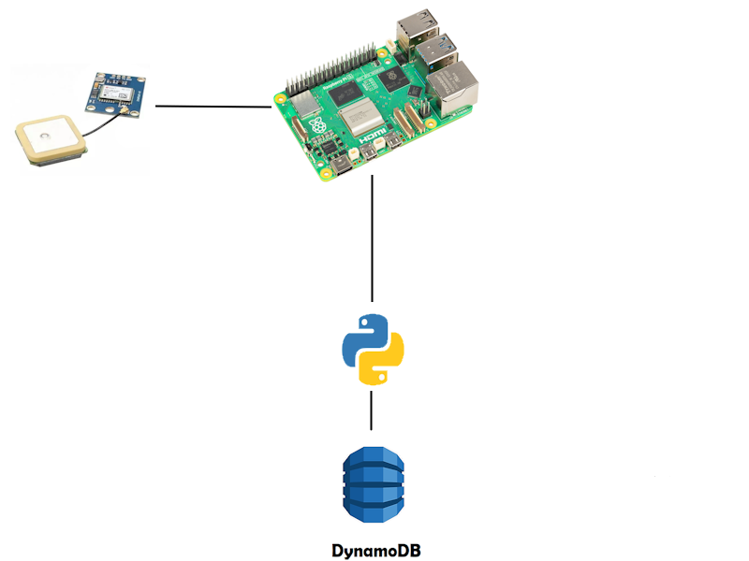
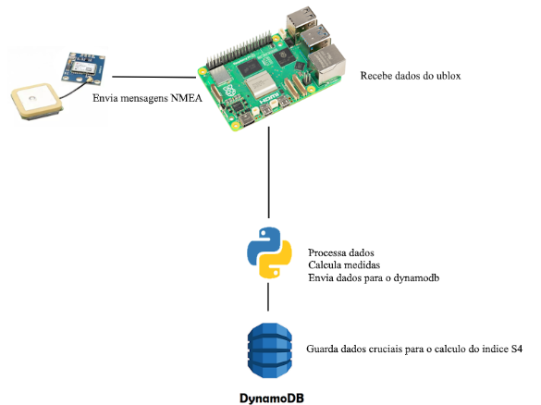
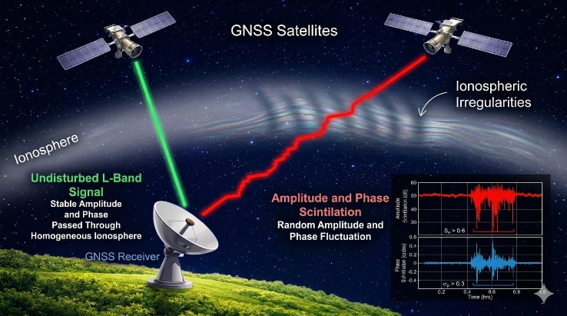
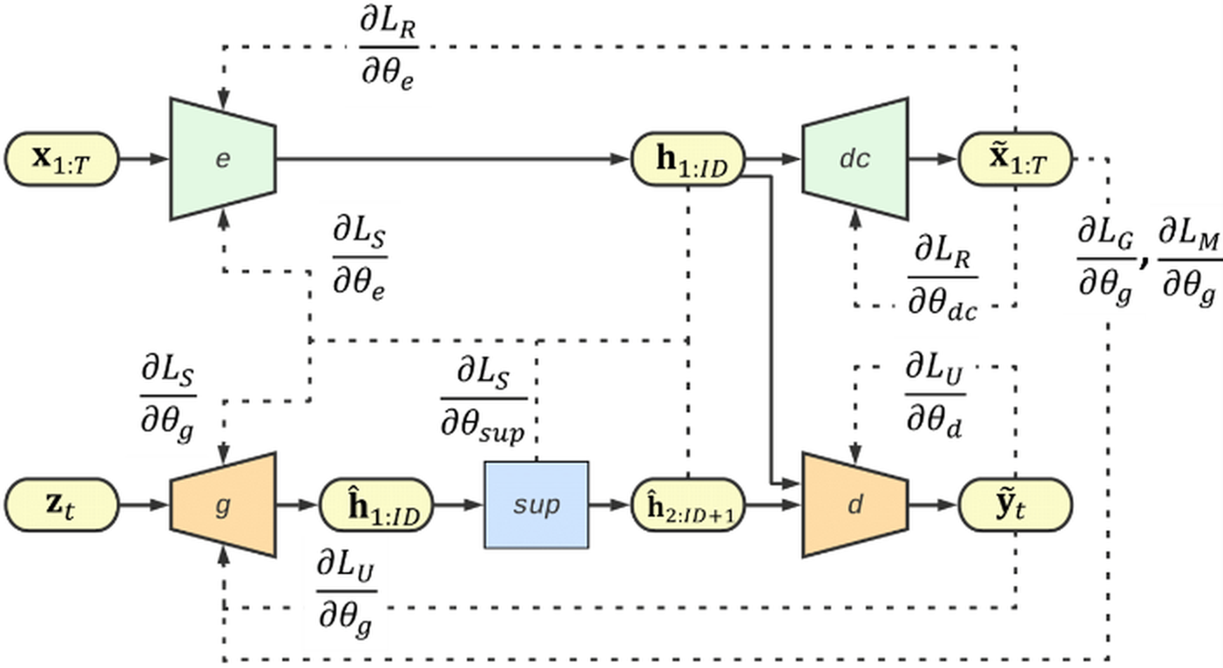
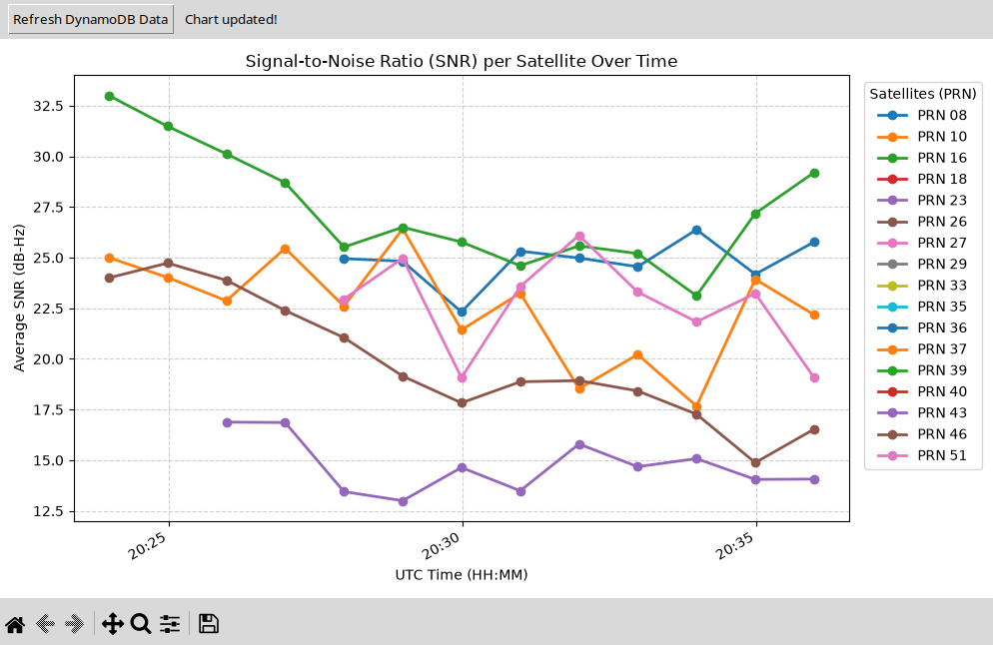
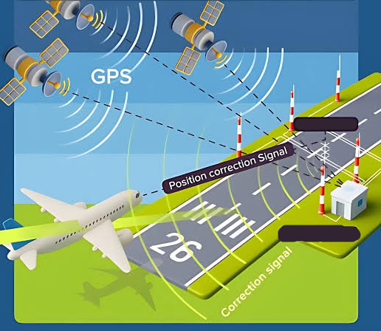
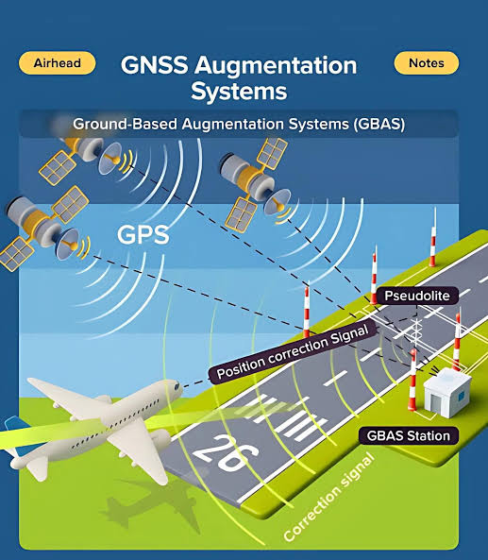
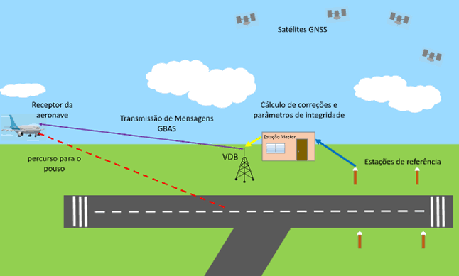
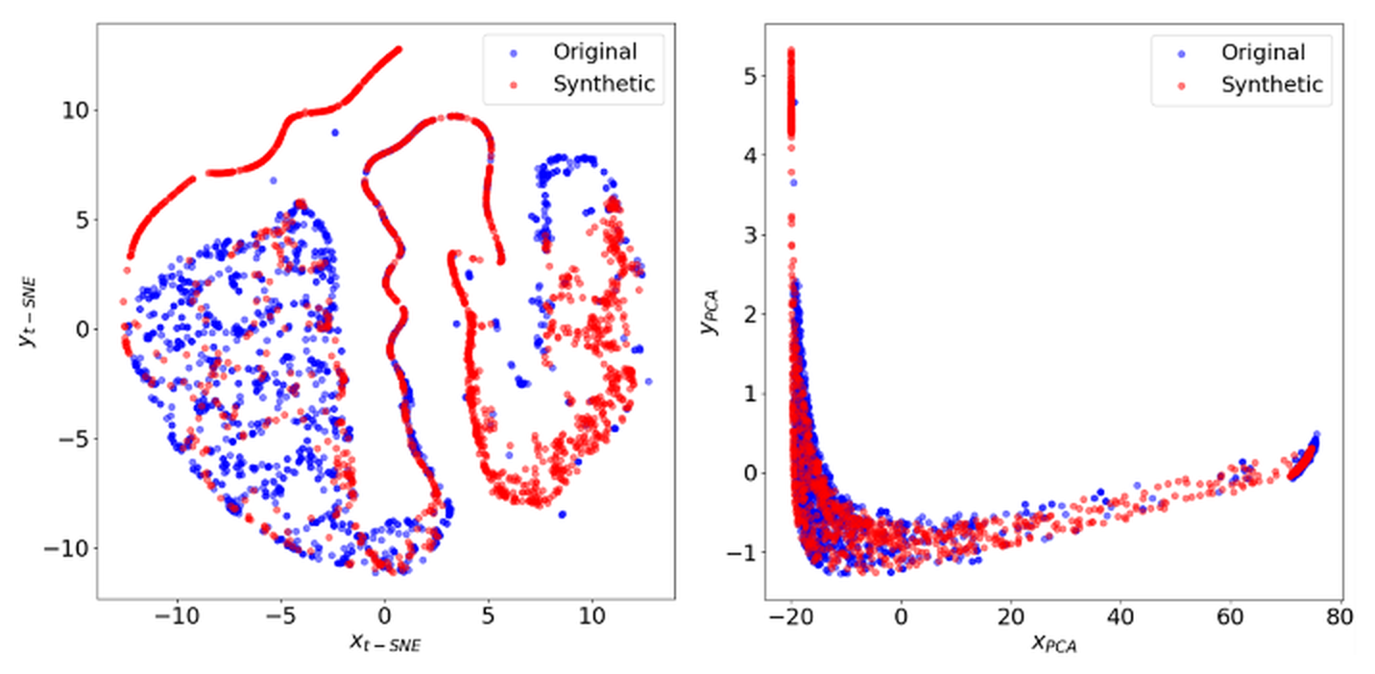
EPB-4 · 4th International Workshop on Equatorial Plasma Bubbles · INPE, São José dos Campos, Brazil · 14 to 18 September 2026
GNSS Scintillation Monitor Development
Arthur Henrique Castro Miranda Alison O. Moraes Moises Freitas
Instituto Tecnológico de Aeronáutica (ITA) · Universidade de Taubaté (UNITAU) · Instituto de Aeronáutica e Espaço (IAE)
Introduction
Method
This project aims to develop an Internet of Things (IoT)-based ionospheric scintillation monitoring system using a Raspberry Pi, the AWS IoT platform, Python, and a DynamoDB database. The proposed solution seeks to offer a low-cost alternative for detecting ionospheric irregularities, which affect GNSS signals and can compromise navigation and communication systems.
The methodology was based on integrating low-cost hardware with a resilient software architecture, structured across three main fronts: signal acquisition, local processing, and cloud persistence.
Fig. 1. Ionosphere explanation
Fig. 2. Tools listing
Results
NMEA Message Parsing: Successful continuous extraction and validation of GPRMC and GPGGA sentences at up to 300 samples per minute.
Constellation Tracking: Real-time monitoring of active satellite PRNs (e.g., PRN 10, 23, 16, 18, 26, 29, 08, 27) with dynamic matrix allocation for signal availability.
Data Completeness & Diagnostics: Automated detection of signal state, matrix filling, and unstable/no-FIX conditions per 1-minute window.
Cloud Persistence: Automated, minute-by-minute synchronization and data transfer to AWS DynamoDB for downstream S4 index calculation.
Structured Storage: Automatic creation of partition keys (dispositivo_id) and sort keys (timestamp_minuto) for efficient time-series querying.
Minute-Interval Synchronization: Reliable continuous data ingestion every 60 seconds (ISO 8601 UTC timestamps).
Telemetry & Quality Metrics: Ingestion of essential parameters including altitude data, complete matrix sample counts (amostras_matriz = 60), and tracking status (canais_vazios).
Scalable Data Architecture: Cloud-native storage optimized for high-throughput S4 scintillation index calculations and historical analysis.
Use Cases
Next steps
User Interface (UI)
Developing a user-friendly interface
Field Testing
Evaluating the system in real-world scenarios
Conclusions
The development of this project demonstrated the feasibility of using a Raspberry Pi, AWS IoT, and Python to create an efficient, scalable, and low-cost environmental monitoring system. The implemented architecture enabled automated data collection, storage, analysis, and visualization, ensuring a reliable and accessible solution for various applications.
Fig. 3. Airport landing scenario
Contact arthurh.miranda@gmail.com

