Slide 1
JWST Science Calibration Pipeline Resources Karl Gordon, Anton Koekemoer, Alicia Canipe, Bryan Hilbert, Misty Cracraft

Slide 2

Outline
MAST: data and documentation
JWST User Documentation (JDox)
JWST Pipeline Read-the-docs
Getting help
Exercise
Answers

Slide 3

MAST: data and documentation
Website:
Discovery portal:
Data retrieval:
Documentation:
https://archive.stsci.edu/
https://jwst-docs.stsci.edu/obtaining-data
https://mast.stsci.edu/portal/Mashup/Clients/Mast/data/html/MastHelp.html
https://mast.stsci.edu/portal/Mashup/Clients/Mast/Portal.html

Slide 4

JWST User Documentation (JDox)
https://jwst-docs.stsci.edu/
Provides high level information about:
Retrieving and exploring data products
Calibration plans and descriptions
Calibration pipeline algorithms and workflows
Post-pipeline data analysis

Slide 5

JWST Pipeline Read-the-docs
Software-focused calibration pipeline documentation
User manual for those who want to dig into the design details and manually run the pipeline
Provides syntax and examples
Associations
In-depth details about data products
Reference files
Expected inputs and outputs for steps
Describes processing flows, modules, and steps
Detailed descriptions of pipeline modules used for different observing modes
Lists up-to-date information for each step in the Package Index (all packages included in the software)
Continuous updates
Documentation is stored in the software repository itself
As the software is updated, the documentation is, too
https://jwst-pipeline.readthedocs.io/en/latest/

Slide 6
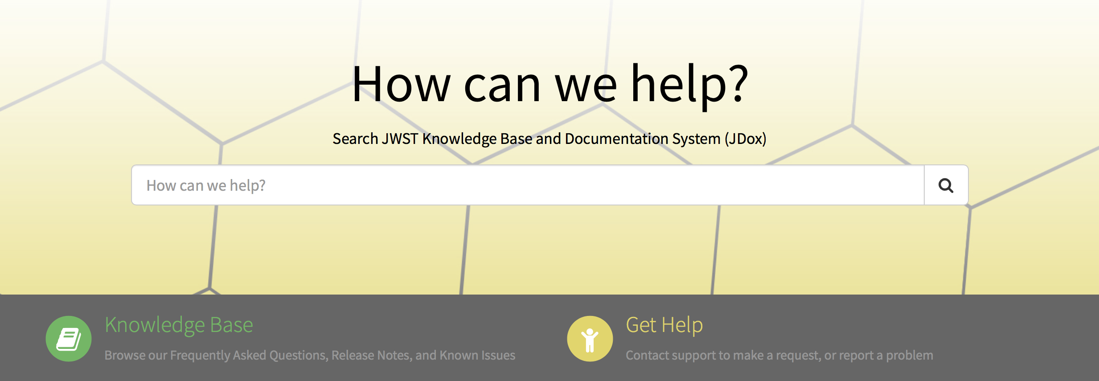
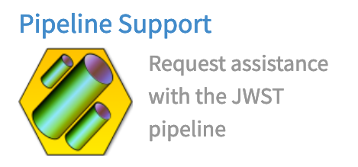
Getting help
Installation problems? Questions? Pipeline errors?
Visit the JWST Help Desk: https://stsci.service-now.com/jwst
Search the Knowledge Base for frequently asked questions and helpful tips
Login with your MyST account
Submit your questions to the pipeline group

Slide 7
Exercise
Where can I find what’s new and other recent updates for the archive?
Which data collections are currently available in MAST?
If I want to learn more about JWST associations, where should I go? (hint: there is more than one resource)
Where can I find examples of what an association looks like?
How do I install the JWST pipeline?
What do I do if I have trouble installing the software or have questions about how to run it?
Where can I find information about the different pipeline modules for the various observing modes?
If I want to reprocess NIRCam imaging data, which pipeline module(s) should I use?

Slide 8
Answers
Where can I find what’s new and other recent updates for the archive? The MAST discovery portal.
Which data collections are currently available in MAST? Hubble, Kepler, GALAX, and more, data in other archives, HSC, Gaia and TESS.
If I want to learn more about JWST associations, where should I go? JDox → Understanding Data Files → Associations Read-the-docs → Package Index → Associations
Where can I find examples of what an association looks like? Read-the-docs → Package Index → Associations → Example Association
How do I install the JWST pipeline? Follow instructions in the Read-the-docs landing page: set up a Conda environment with python, then pip install jwst.
What do I do if I have trouble installing the software or have questions about how to run it? Submit a ticket to the JWST Help Desk.
Where can I find information about the different pipeline modules for the various observing modes? Read-the-docs → Package Index → Pipeline Modules JDox → JWST Data Reduction Pipeline → Algorithm Documentation → Stages of Processing
If I want to reprocess NIRCam imaging data, which pipeline module(s) should I use? Detector1, Image2, Image3

