Slide 1
Remember that you will appear in this corner when recording in Zoom. Make a test video, adjust your slide layout, and delete this box in your final version!
Differential Impacts Across States of Gun-Control Legislation Following Parkland Shooting
Arthur Langlois
Professor G. Vicentini
Social Sciences, Humanities, Law
Undergraduate

Slide 2
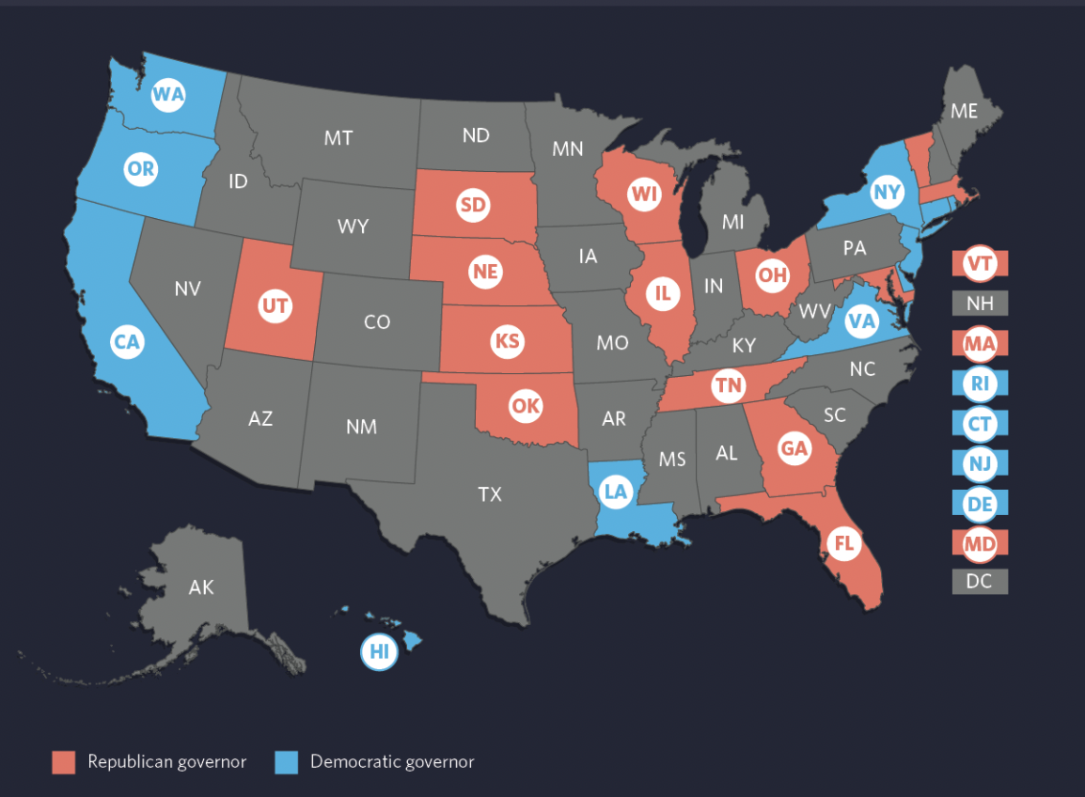
Remember that you will appear in this corner when recording in Zoom. Make a test video, adjust your slide layout, and delete this box in your final version!
BACKGROUND, MOTIVATION, AND GOALS
Usual thing happened: School shooting in Parkland High School Shooting was one of the 3,428 shootings that occurred in the US since 2014 (Gun Violence Archive, 2022)
Unusual thing happened: State regulations were put in place, with common motive: control gun access in an attempt to limit the number of gun violence (half of the states passed at least one legislation
aiming to restrict gun access)
Society bears a large cost from gun violence:
- 45,000 annual deaths linked to gun violence in the country, economic cost is estimated at $280 billion dollars.
- Significant detrimental sociological and psychological, most notably on children, community wellbeing, and on multiple generations (Cook & Ludwig, 2002, Soni & Tekin, 2020, and Dursun, 2019)
- Gun violence is largely perceived as one of the largest problem in the country, with 72% of the population perceiving it as either a “Very Big Problem” or a “Moderately Big Problem”.
- 80% democrats think gun laws should be stricter vs 20% for republicans (Pew Research Center, 2021)
Need of rigorous assessment of policies effectiveness aiming at reducing gun violence

Slide 3
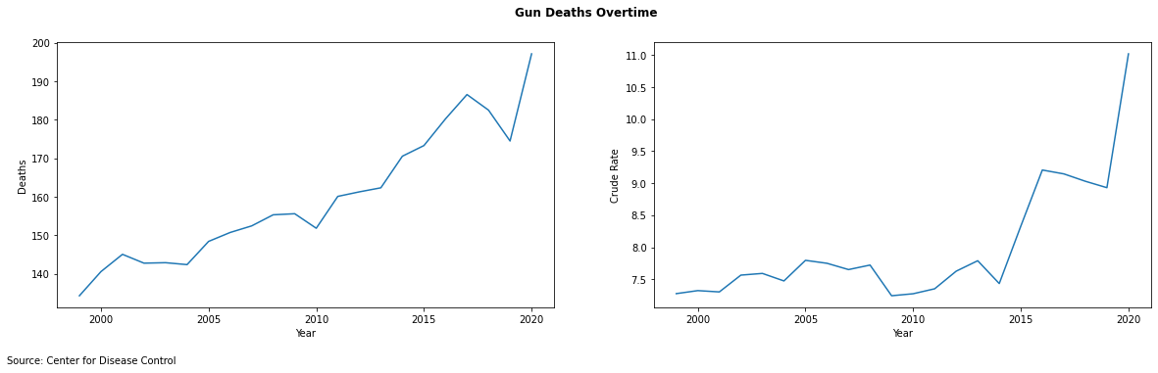
Remember that you will appear in this corner when recording in Zoom. Make a test video, adjust your slide layout, and delete this box in your final version!
PROCESS AND METHODS
Data
- CDC’s WONDER “Underlying Cause of Death” database
Panel Data: 20 years of data (1999-2020) at the state level
Variables: Ethnicity, Injury Intent, Absolute Deaths Levels, Crude Death Rate
Only 2 years of data for Post-Treatment Period
Method
Goal & Method: We will follow a synthetic control methodology in order to estimate the causal impact of the policies on 1- the total number of gun related incidents 2- the number of gun related homicides 3- the number of gun suicides. More specifically this methodology will be favored over traditional methods used in causal inference due to its interpretability and transparency (Abadie, 2021 and Arkhangelsky et al., 2019), and its prevalence in the gun control literature

Slide 4

Remember that you will appear in this corner when recording in Zoom. Make a test video, adjust your slide layout, and delete this box in your final version!
FINDINGS AND PRODUCTS
Use images on this slide to show your audience what you made or discovered.
Delete this box when you are finished.

Slide 5

Remember that you will appear in this corner when recording in Zoom. Make a test video, adjust your slide layout, and delete this box in your final version!
CONCLUSIONS AND NEXT STEPS
Use images on this slide to illustrate final take-aways about your project and next steps.
Delete this box when you are finished.

