Slide 1
Adaptive Quantitative MRI Sequence Design
with Reinforcement Learning
Arthur Allilaire · Imperial College London · BEng Final-Year Project
Supervisors: Andreas Wetscherek (ICR) · Wayne Luk (Imperial)
Can an agent learn to design MRI scans on the fly — better than a fixed protocol?
Notes:
Title. One line: can an agent learn to design MRI scans on the fly, better than a fixed protocol? Name, supervisors, BEng FYP.

Slide 2
Why this matters: the scan-time bottleneck
• MR-Linac: scan time is the bottleneck
• qMRI: measure T1/T2 — many timed images + a fit
• Today: one FIXED protocol for every patient
• Best timing depends on the unknown tissue
FIG-1 (make / source) Clean MR-Linac or qMRI T1-map image
Notes:
[Framing (15%) — motivate the problem from a real clinical pressure]
Clinical hook. MRI gives soft-tissue contrast that guides radiotherapy; acquisition time is the bottleneck. qMRI measures T1/T2 by acquiring several timed images and fitting a relaxation curve — more scan time. Today timings are fixed for every patient, but the most informative timing depends on the unknown tissue. That tension is the problem.
— Slide bullets (detail) —
• MRI guides radiotherapy (MR-Linac) — but acquisition time is the clinical bottleneck
– longer scans → motion artefacts, less on-table adaptation
• Quantitative MRI (qMRI) measures physical tissue constants T1, T2
– needs several images at different timings, then a curve fit → even more time
• Today those timings are a FIXED protocol — same for every patient
• But the most informative timing depends on the tissue you're measuring…
– …which is exactly what you don't know yet

Slide 3
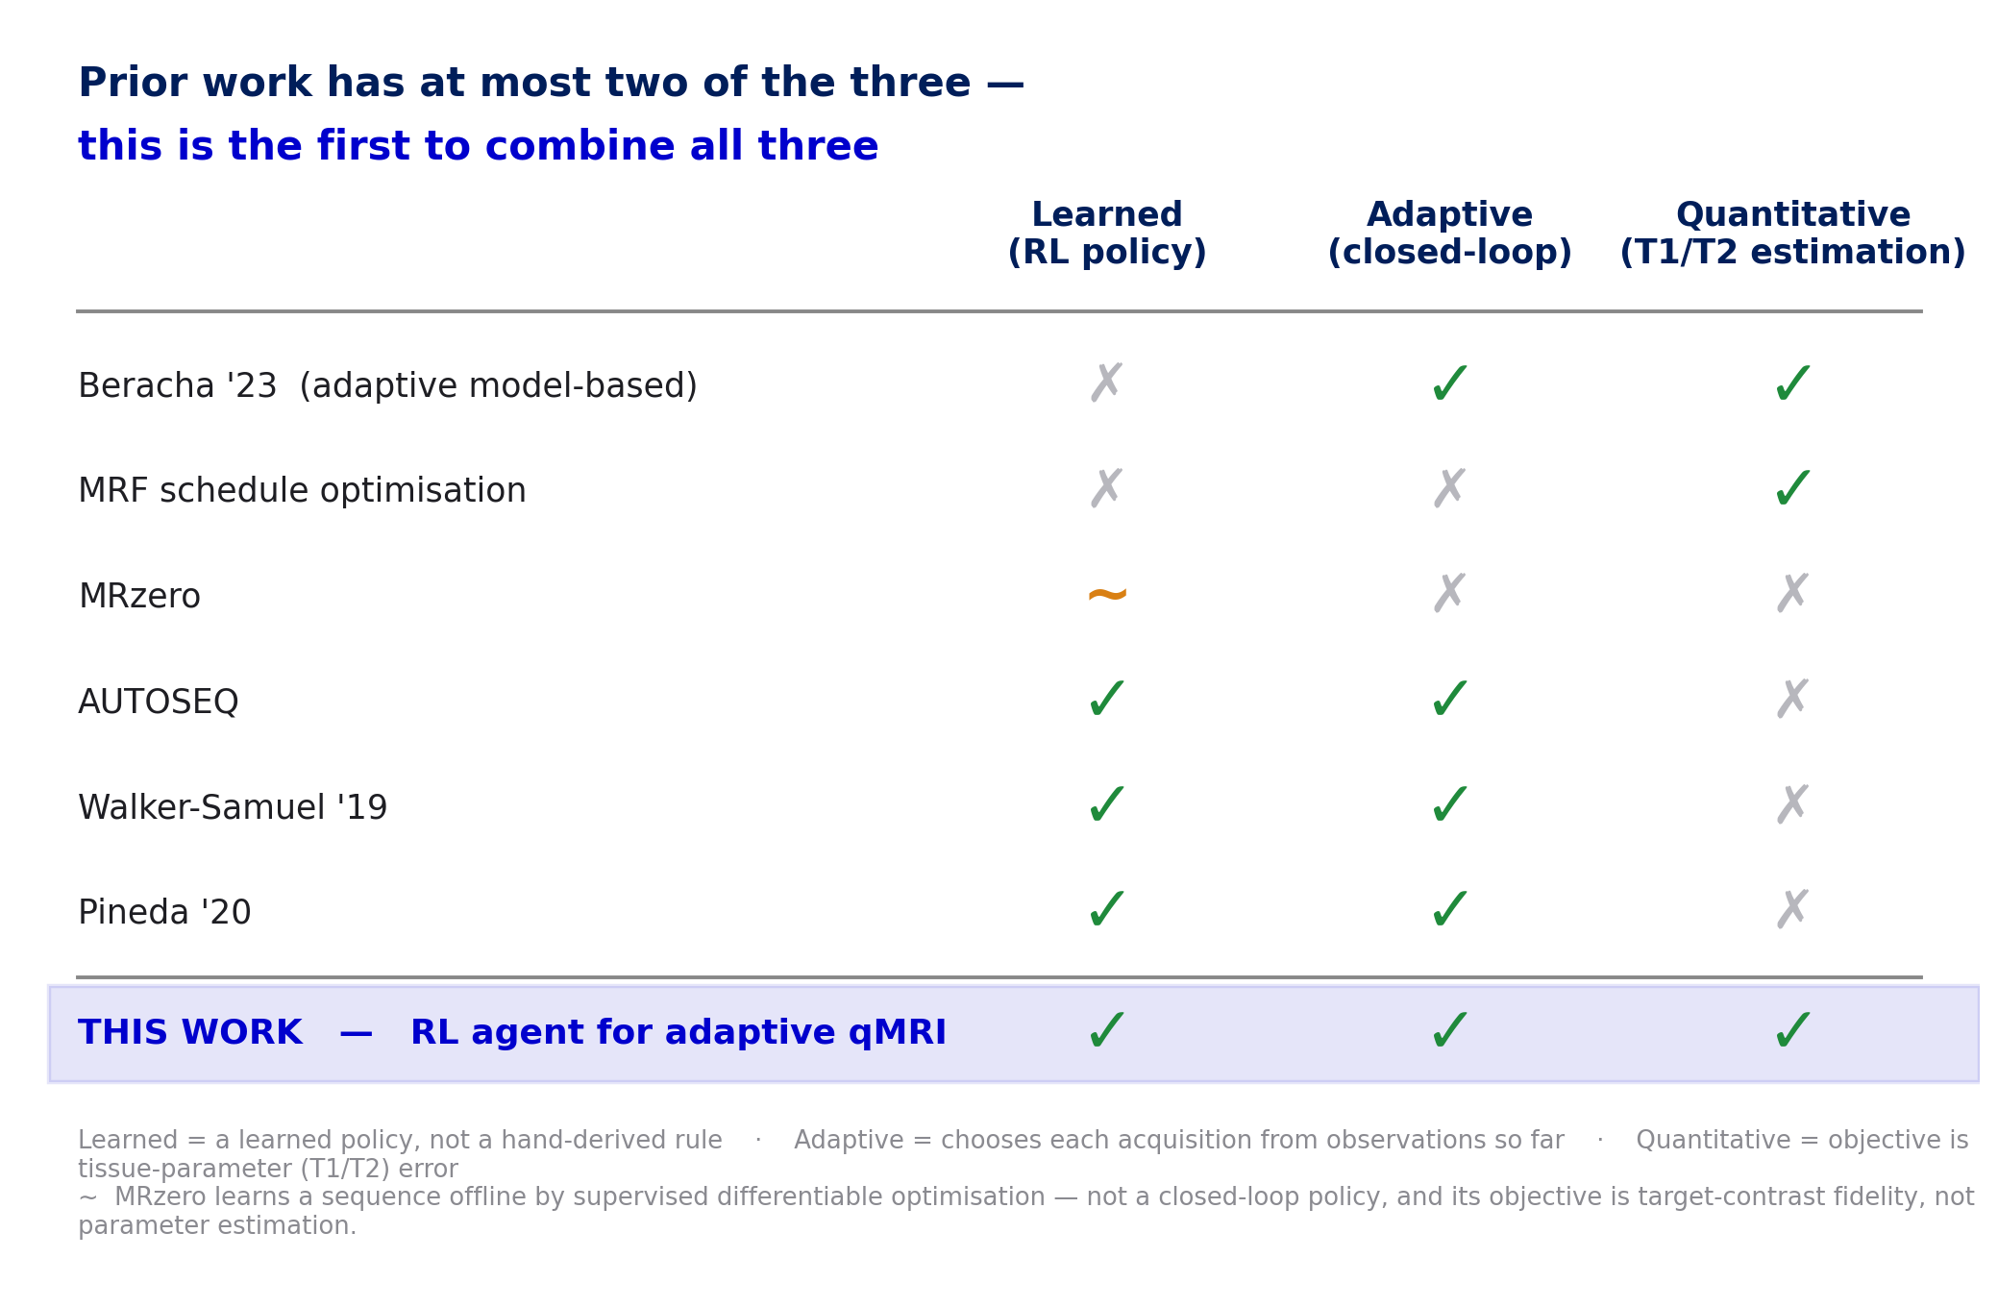
Adaptive qMRI: the idea, the gap, and our thesis
• Adaptive MRI ≈ 2.5× faster (Beracha)
• Adaptive qMRI: Bayesian model only
• RL in MRI: non-quantitative goals only
• Thesis: first RL agent for adaptive qMRI
• phantom (A1) → simulator (A2) → RL (A3)
Notes:
[Framing (15%) — state the gap as a TENSION, then the novelty claim]
Adaptive idea: choose next acquisition from current estimate (Beracha ~2.5x). The gap as a tension: adaptive qMRI is Bayesian-model-only; RL in MRI targets non-quantitative goals; nobody combined learned + adaptive + quantitative. Thesis: first RL agent for adaptive qMRI, conditioned on fitted T1, scored on T1 error. Roadmap to the three contributions — phantom, validated simulator, RL.
— Slide bullets (detail) —
• Adaptive MRI: choose the next acquisition from the current estimate (≈2.5× faster, Beracha)
• The tension:
– adaptive qMRI exists — but only as a hand-derived BAYESIAN model
– RL has controlled MRI scanners — but for NON-quantitative goals (k-space, shape)
– nobody has put a LEARNED policy on the QUANTITATIVE objective
• Thesis: the first RL agent for adaptive quantitative MRI
– conditions each acquisition on the current fitted T1; trained & scored on T1 error
• Roadmap: trustworthy phantom (A1) → validated simulator (A2) → the RL (A3)

Slide 4
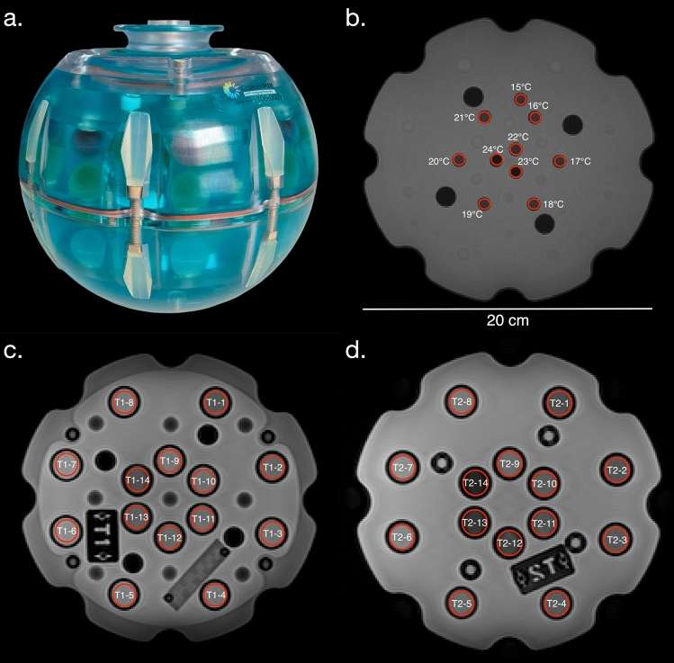
A1 — A known phantom to learn from
• Need a KNOWN object: ground-truth T1/T2
• QalibreMD Model 130 — 14 spheres, ~24 ms–1.9 s
• MRISystemPhantom.jl → KomaMRI objects
• Water (~80% spins) on its own coarsenable grid
• Open-source, ~373 tests, config + seed reproducible
Notes:
[Execution (50%) — the digital twin + reproducibility signal]
A1. The agent learns entirely in simulation so it needs a known object. QalibreMD Model 130, the standard NIST/ISMRM phantom, 14 spheres ~24ms-1.9s. I built MRISystemPhantom.jl: configurable open-source twin returning KomaMRI objects, plus ground truth, fitter, randomisation. Design decision: water (80% of spins) on its own coarsenable grid — the lever for cheap RL later. Reproducible: tested package, serialisable PhantomConfig+seed, any result regenerates from a config.
— Slide bullets (detail) —
• Agent learns in simulation → needs a KNOWN object with ground-truth T1/T2
• QalibreMD Model 130: standard NIST/ISMRM calibration phantom
– 14 spheres spanning the clinical T1 range (~24 ms to 1.9 s)
• Built MRISystemPhantom.jl — configurable twin returning KomaMRI objects
– ground-truth labels, the T1 fitter, per-episode randomisation
• Key decision: background water (~80% of spins) on its OWN coarsenable grid
– the lever that later makes RL training affordable
• Reproducible by construction: open-source pkg, ~373 tests, serialisable config + seed

Slide 5
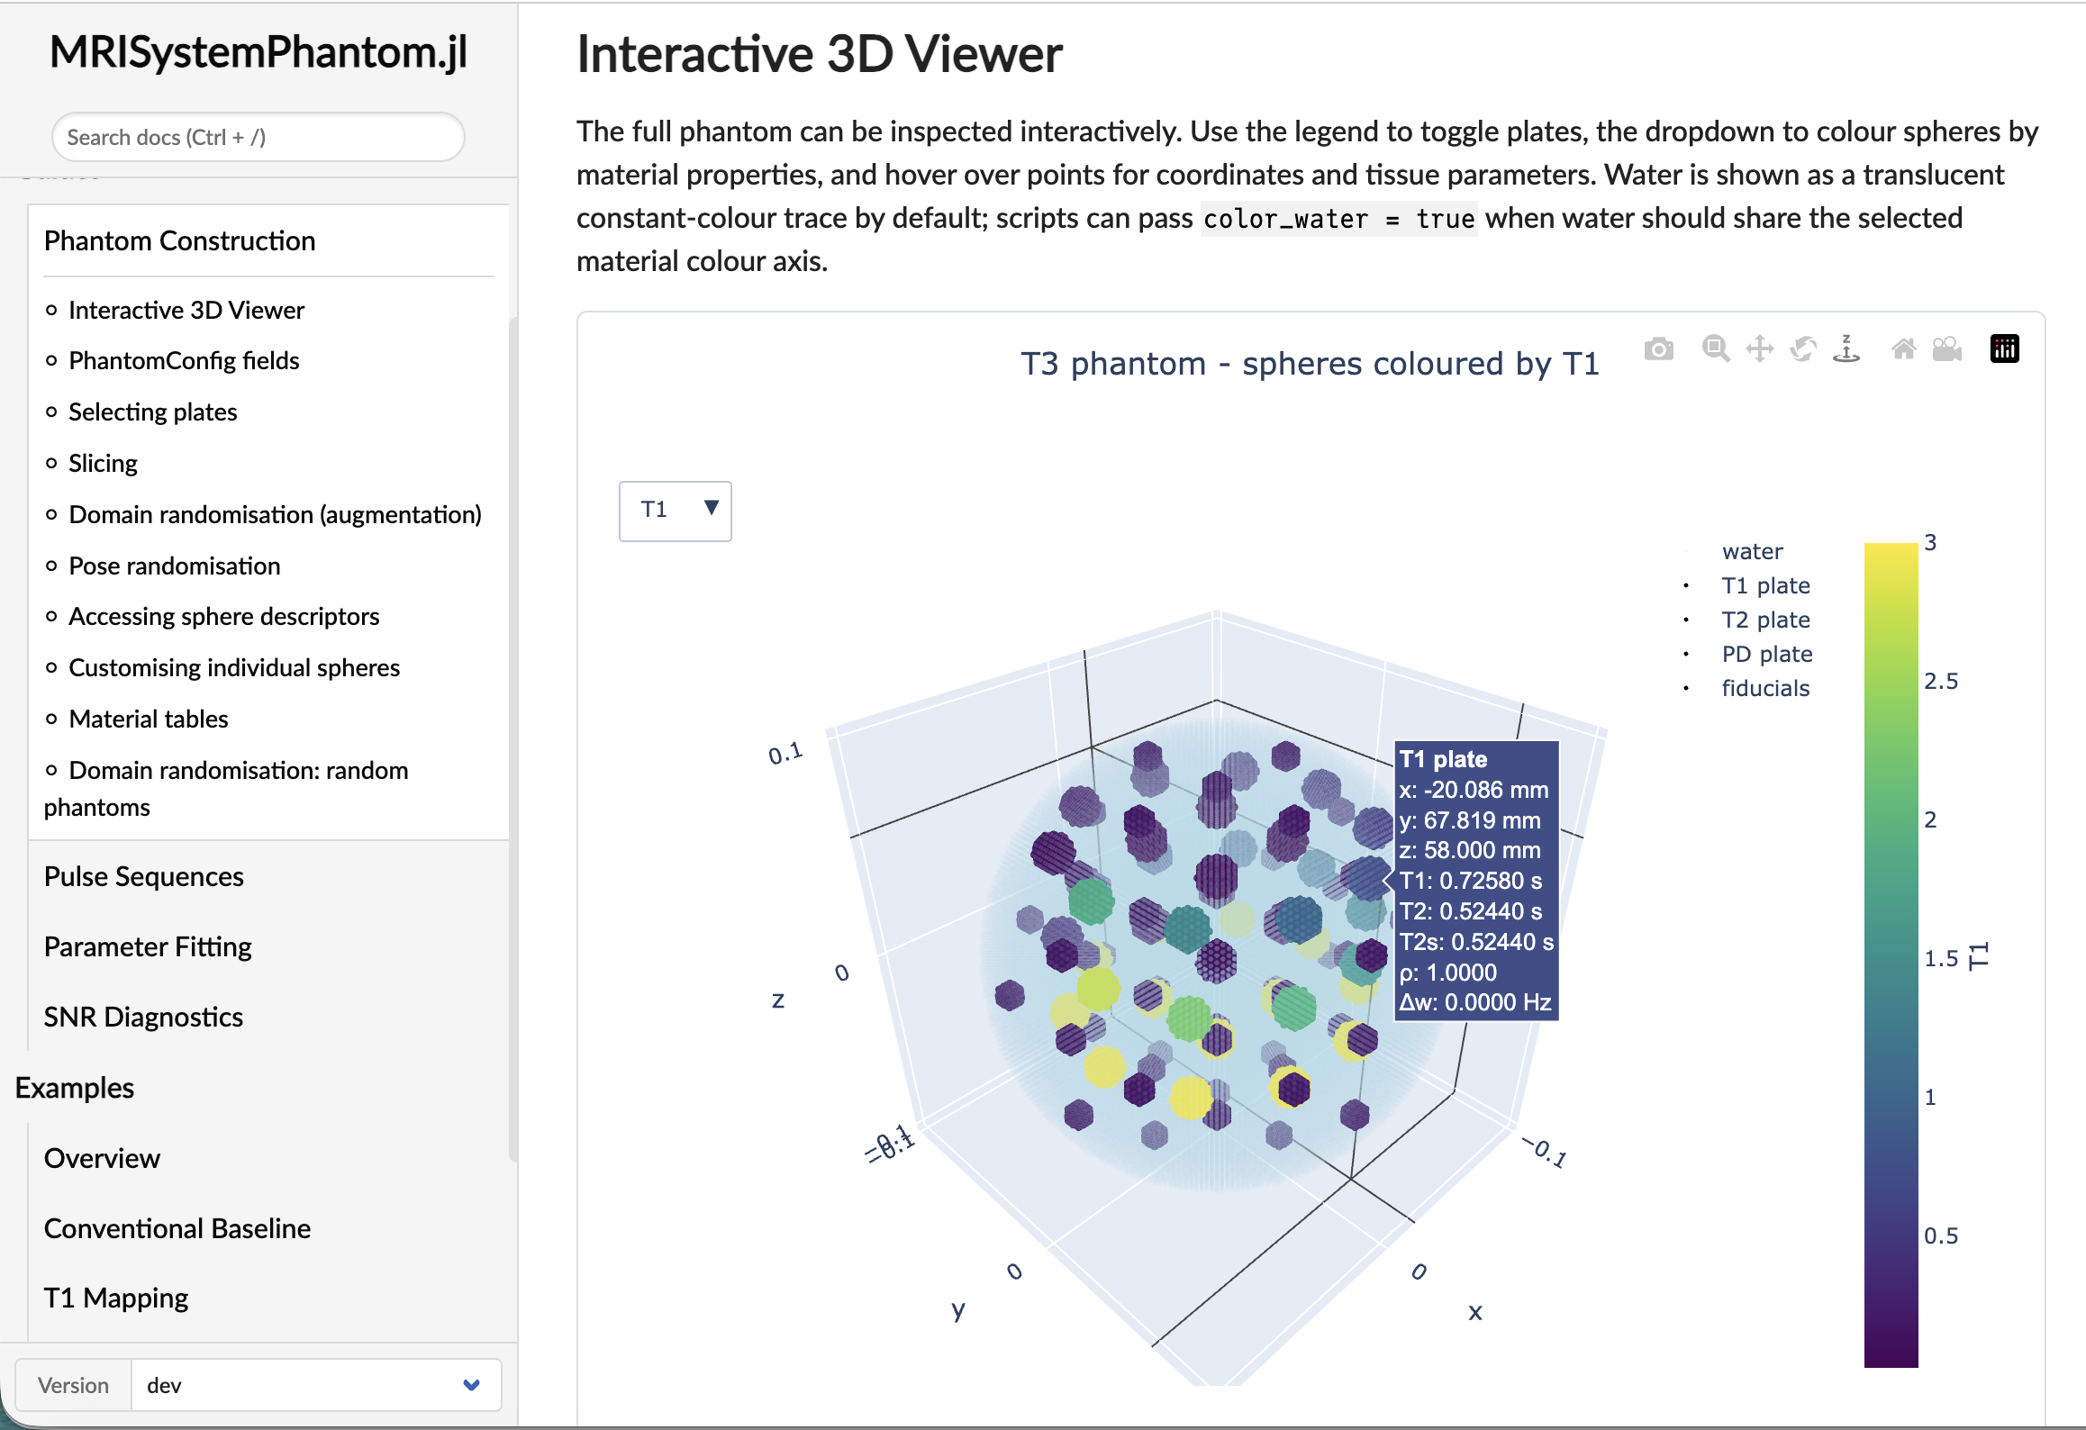
LIVE DEMO — Building and inspecting the digital phantom
• Build phantom live from a PhantomConfig
• 3-D T1 plate → Bloch sim → one IR signal
• A real KomaMRI.Phantom — no special-casing
• Fallback stills · pre-warm JIT · hard stop 5:30
Notes:
[Communication / Execution — show the twin is real, runnable engineering]
DEMO. Run examples/plot_phantom_3d.jl / t1_mapping.jl live: build from a config, show the 3-D voxelised plate coloured by T1, simulate one IR signal. Narrate that it's a real KomaMRI.Phantom. Fallback screenshots on the slide. Pre-warm Julia JIT. Hard stop at 5:30.
— Slide bullets (detail) —
• Build a phantom live from a PhantomConfig
• Show the 3-D voxelised T1 plate, coloured by T1 value
• Hand it straight to the Bloch simulator → one IR signal / reconstructed image
• “This is a real KomaMRI.Phantom — no special casing.”
– FALLBACK: pre-captured screenshots on this slide if the build stalls
– pre-warm the Julia session before the talk (avoid first-call JIT)
– HARD STOP at 5:30 — do not overrun

Slide 6
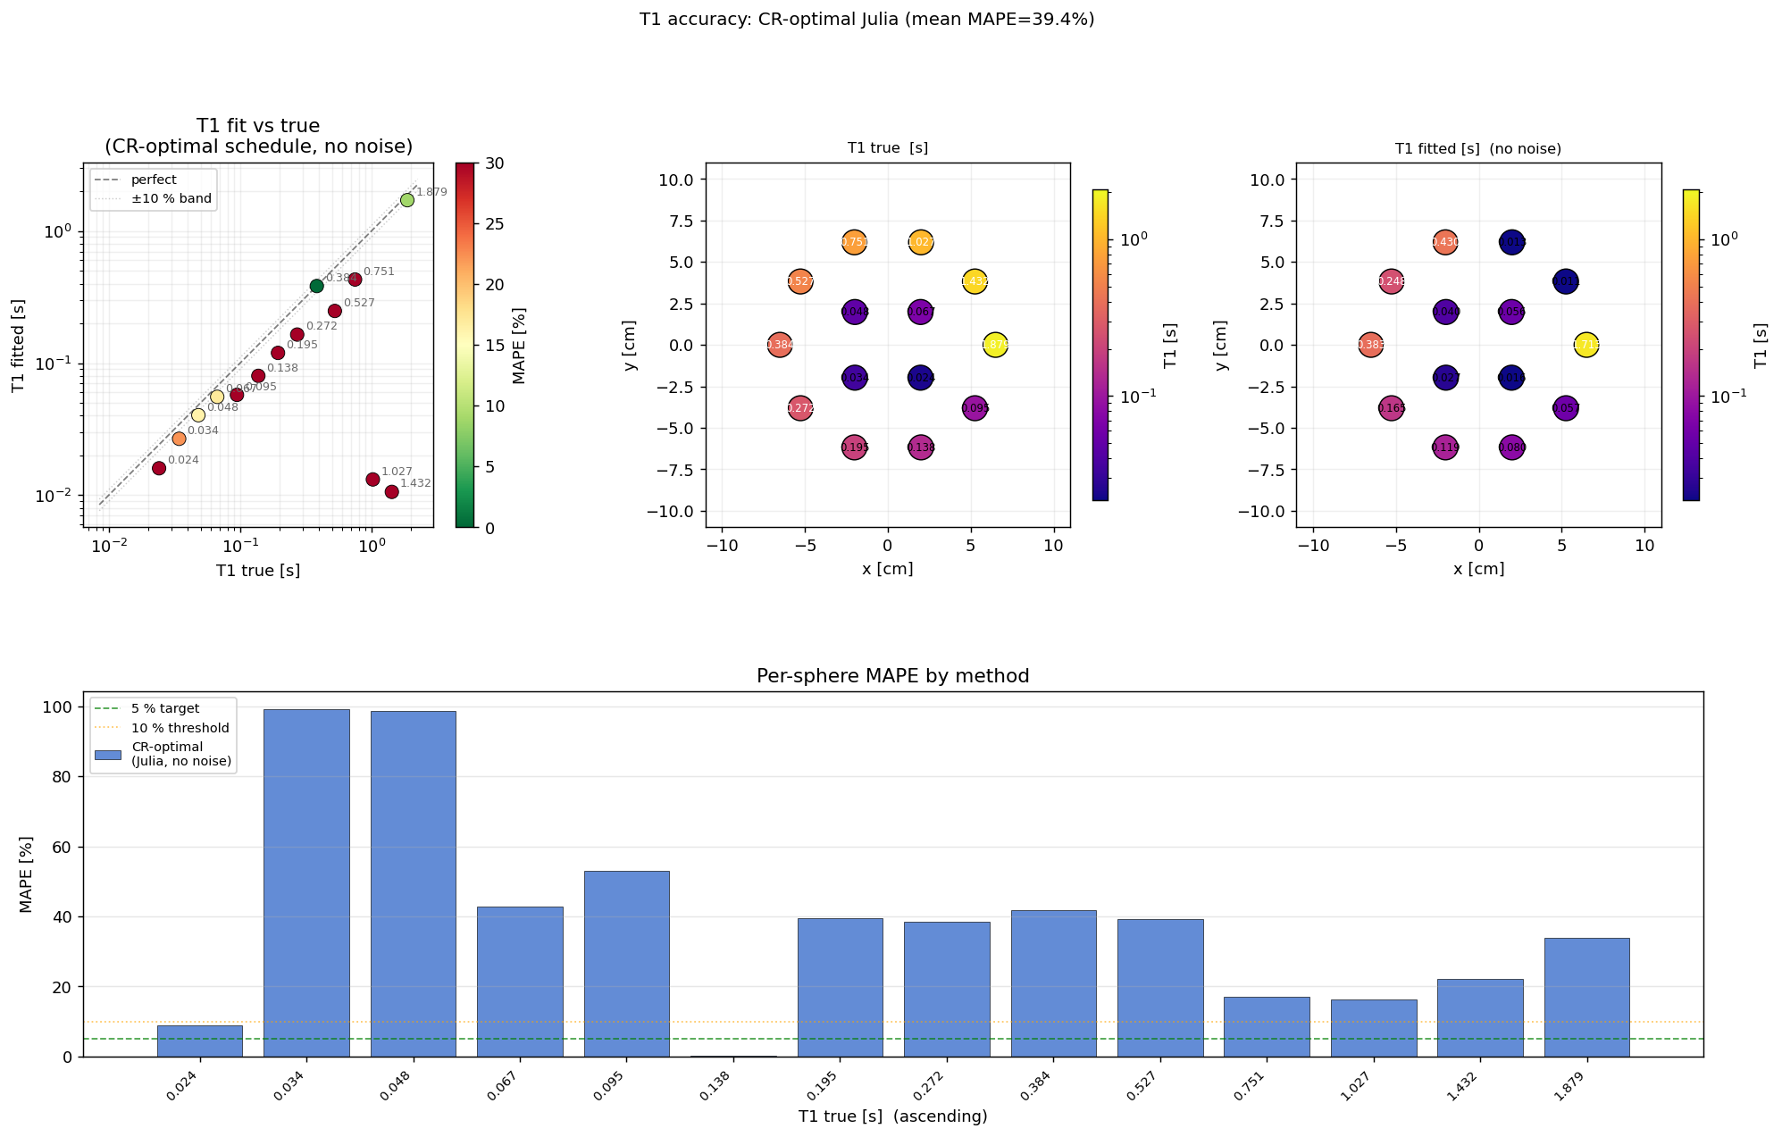
A2 — A plausible image is not a correct measurement
• Simulator must be QUANTITATIVELY right
• KomaMRI validated only on SHORT sequences
• Recovery test, no noise: 39.4% error (some ~100%)
• Spoilers worse, long TR worse → elapsed TIME, not physics
Notes:
[Execution (50%) — validation rigour: parameter recovery, not eyeballing]
A2. A simulator the agent learns from must be quantitatively correct, not just plausible. KomaMRI benchmarked only on short sequences. Validate by parameter recovery, no noise: should be exact, got 39.4% error, images looked fine. Hard part was diagnostic: spoilers made it worse (ruling out the obvious physics explanation), longer TR worse too — pointing at elapsed time, not physics.
— Slide bullets (detail) —
• If the agent learns from a simulator, it must be QUANTITATIVELY right
– KomaMRI is peer-reviewed — but benchmarked only on SHORT sequences
• Validate as qMRI demands: known phantom → fit T1 → compare, no noise
• It should be near-exact. It wasn't: 39.4% mean error, some near 100%
– and the images still looked fine
• Ruling out physics (the hard part):
– adding spoilers made it WORSE (39.4 → 44.0%)
– longer TR made it worse → driven by total elapsed TIME, not physics

Slide 7
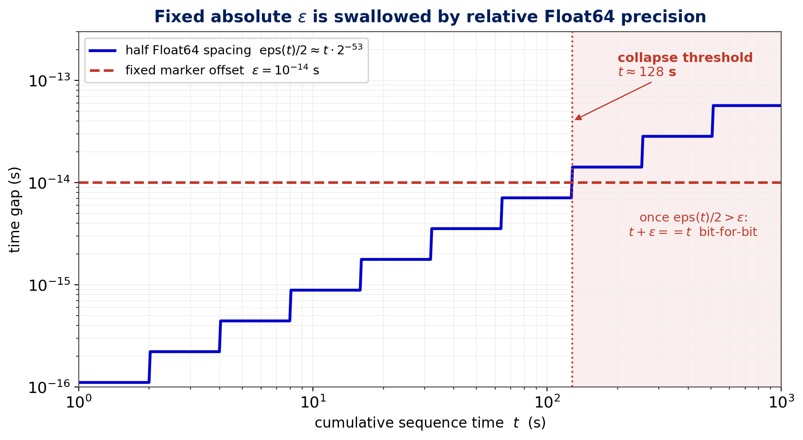
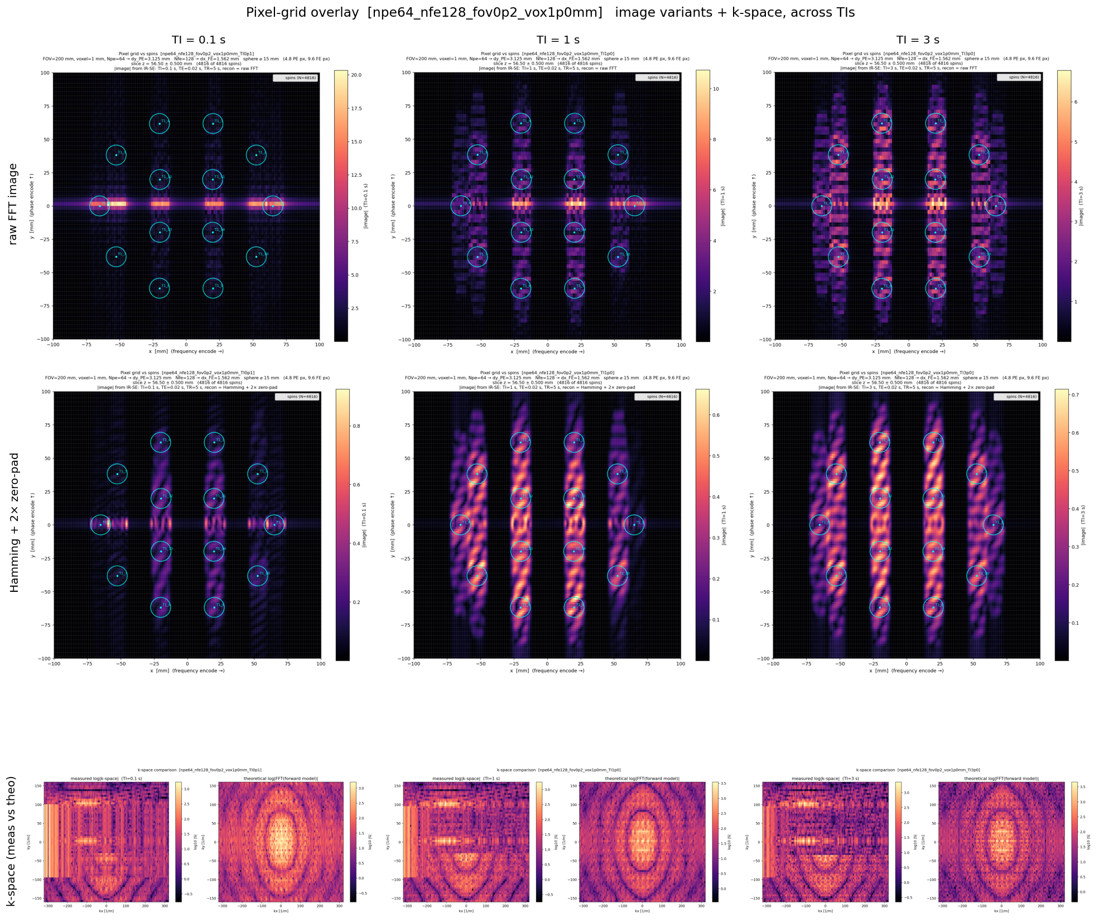
A2 — Two floating-point bugs in KomaMRI, found & fixed
• k-space collapses after a fixed cumulative TIME
• RF edge marked with a fixed ε = 1e-14 s
• Float64 is relative: eps(t) ≈ t·2⁻⁵² → t+ε == t past ~128 s
• Fixed upstream (PR #780, #789): 39.4% → 0.48%
Notes:
[Execution (50%) — minimal reproducers, upstream contribution, the 'aha']
A2 bug. Diagnostic: look at k-space directly — collapses after fixed cumulative time, regardless of shot count. Mechanism: fixed absolute ε=1e-14 marks the RF edge, but Float64 precision is relative (eps(t)≈t·2⁻⁵²); past ~128s t+ε==t, edge markers collapse, wrong RF for one sample = 5% of a 1ms pulse → 20-25% jump → biased T1. Minimal reproducers, fixed upstream, PR #780 merged, #789 open. 39.4→0.48%. This is what makes Part 3 trustworthy.
— Slide bullets (detail) —
• Decisive diagnostic: k-space collapses after a fixed cumulative TIME
• Mechanism: RF edge marked with a FIXED ε = 1e-14 s…
– …but Float64 precision is RELATIVE: gap grows as eps(t) ≈ t·2⁻⁵²
– past ~128 s, t+ε == t bit-for-bit → edge markers collapse
– wrong RF for one sample = 5% of a 1 ms pulse → 20–25% signal jump
• Reduced to minimal reproducers, fixed, contributed upstream: PR #780 (merged), #789
• Result: 39.4% → 0.48% mean error (max 1.2%)
– novel failure mode for an MRI simulator; bites exactly in the long-sequence RL regime

Slide 8
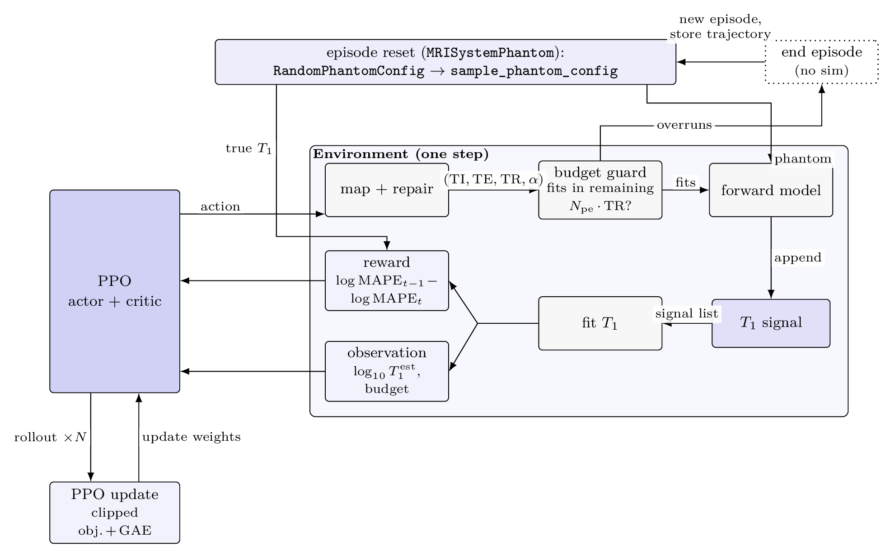
A3 — The RL formulation
• Episode: 2-D IR scan, 240 s budget
• State: per-sphere T1 est + budget
• Action: next TI (and TR)
• Reward: dense Δlog MAPE
• PPO (SB3), Julia in-process
• σ=50 → SNR 17–28
Notes:
[Execution (50%) — the MDP and the engineering of the loop]
A3 formulation. Episode = 2-D IR scan through the T1 plate under a 240s budget. State: running per-sphere T1 estimates + budget; agent sees estimates not pixels. Action: next TI (and TR). Reward dense: Δlog MAPE — because an early terminal-bonus version collapsed to a fixed policy. PPO via SB3, Julia in-process. Noise σ=50 → SNR 17-28, clinical.
— Slide bullets (detail) —
• Episode = a 2-D inversion-recovery scan through the T1 plate, fixed time budget (240 s)
• State: running per-sphere T1 estimates + budget used
– agent never sees pixels — only the fitter's estimates (real qMRI interface)
• Action: the next block's timings — inversion time TI (and TR)
• Reward: DENSE — per-step improvement in log-error, Δlog MAPE
– why dense: an early version with a big terminal bonus collapsed to a fixed policy
• Stack: Gymnasium + Stable-Baselines3 PPO, Python↔Julia, simulator in-process
• Noise calibrated: σ=50 → SNR ≈ 17–28, clinical IR range

Slide 9
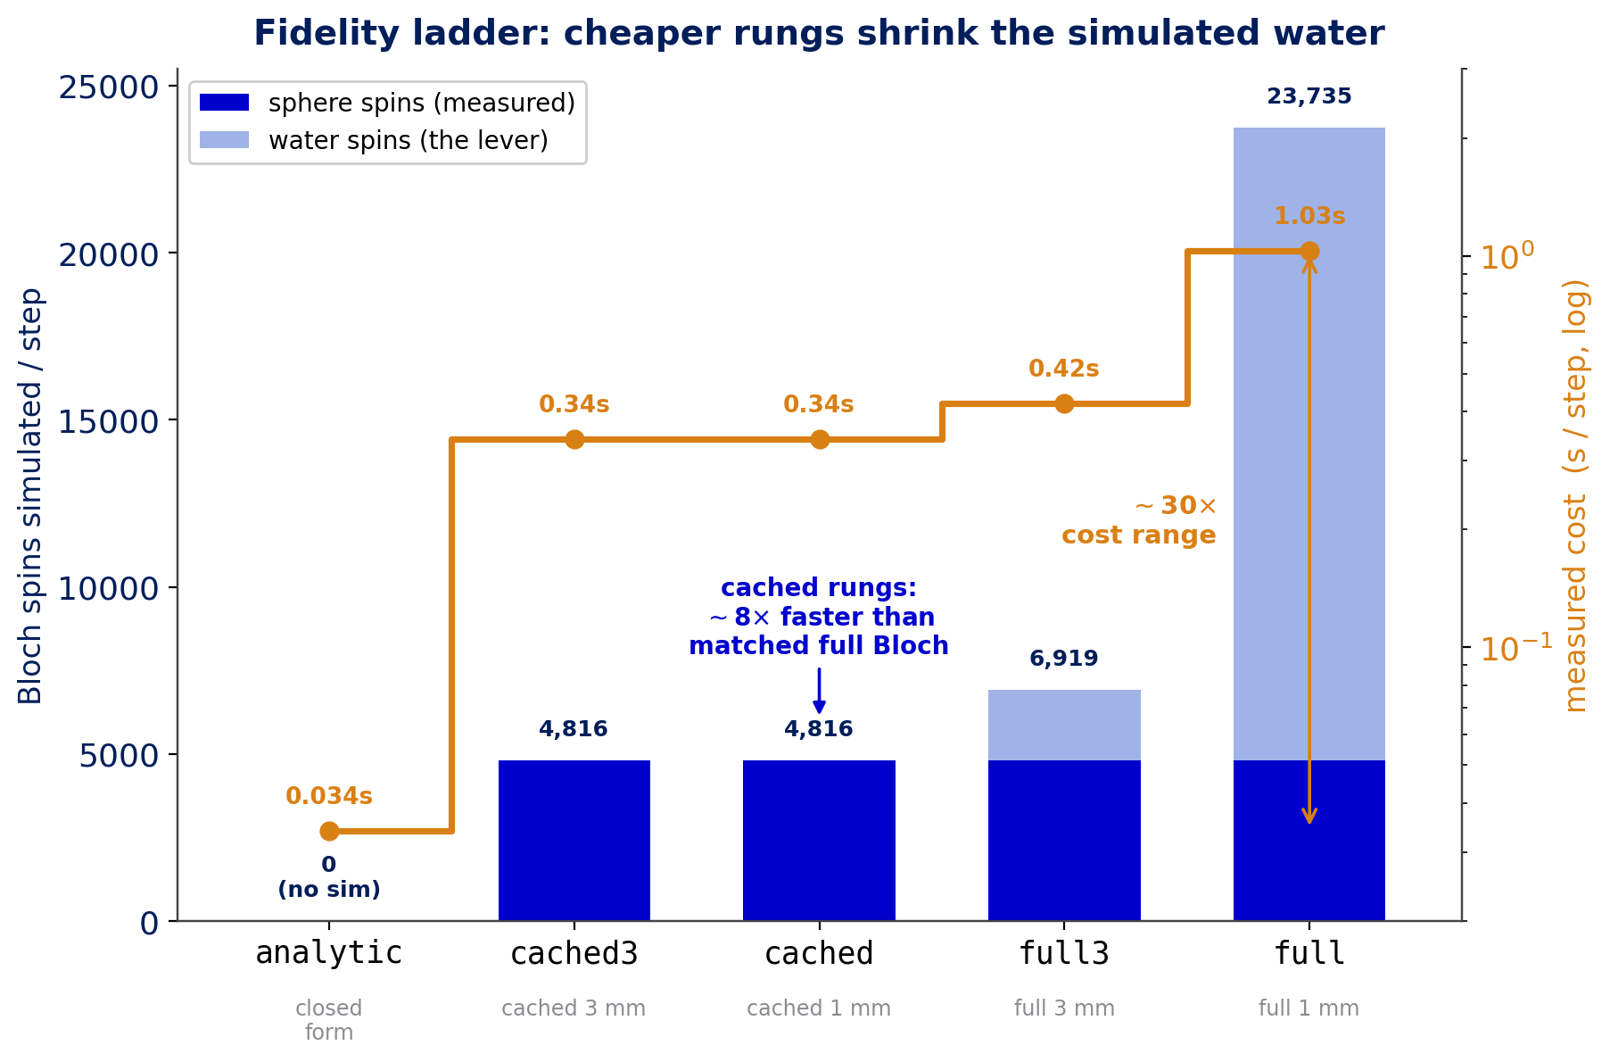
A3 / C2 — The cost wall and the multi-fidelity ladder
• Full-Bloch step ≈ 4 s → 200k steps ≈ 9 days
• 80% of spins are water the agent never measures
• Lever: coarsen water · cache water
• ~30× cost ladder, one policy warm-started up
Notes:
[Execution (50%) — adapting a technique with INSIGHT (cached-water linearity)]
C2 cost wall. Full-Bloch step ~4s CPU → 200k steps ~9 days. 80% of spins are water the agent doesn't measure. Two levers: coarsen water (rescale PD to conserve magnetisation), or cache it exploiting linearity S_full=S_spheres+S_water — homogeneous water factorises, new timing just rescales a template computed once, ~8x saving, matches full-Bloch to 0.12%. Net ~30x ladder, warm-start one policy up the rungs. Next slide: the linearity that makes caching exact.
— Slide bullets (detail) —
• The wall: a full-Bloch step ≈ 4 s on CPU → a 200k-step run is ~9 DAYS
– RL normally trains on environments millions of times cheaper
• Key observation: 80% of spins are background water the agent never measures
• Two levers, both on the water:
– coarsen it (own grid, proton density rescaled to conserve magnetisation)
– cache it — exploit simulator LINEARITY: S_full = S_spheres + S_water
– homogeneous water factorises → new timing just rescales a cached template
– ~8× per-step saving, matching full-Bloch T1 fits to 0.12%
• Net: a ~30× cost-range ladder, warm-starting one policy up the rungs

Slide 10
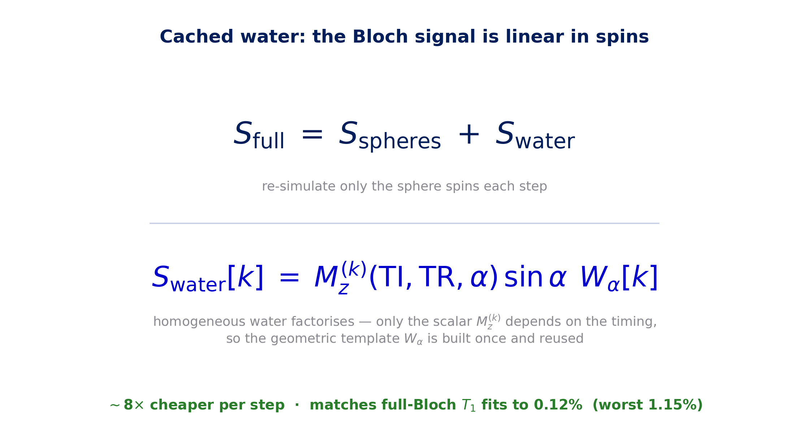
A3 / C2 — Cached water: exploiting simulator linearity
• Bloch is LINEAR in spins → k-space separates
• Homogeneous water FACTORISES per shot
• Build template once, rescale per timing
• ~8× cheaper · 0.12% T1 match
Notes:
[Execution (50%) — the insight that makes the cheap rungs trustworthy]
Cached-water linearity. Bloch is linear in spins so k-space separates exactly: S_full = S_spheres + S_water. Water is one homogeneous material so its contribution factorises per shot — only the scalar Mz^(k) depends on the timing, the geometric template W_α is built once and reused. A new timing just rescales the template; only the sphere spins are re-simulated. ~8× cheaper, matches full-Bloch to 0.12%. This is what makes the cheap rungs trustworthy, not just fast.
— Slide bullets (detail) —
• Bloch simulation is LINEAR in spins → the k-space separates exactly
• Water is a single homogeneous material → its term FACTORISES per shot
– only the scalar Mz^(k) depends on the timing (TI, TR, α)
– the geometric template W_α is built ONCE, then reused
• So a new timing just rescales a cached template — only spheres re-simulated
– ~8× cheaper per step; matches full-Bloch T1 fits to 0.12%

Slide 11
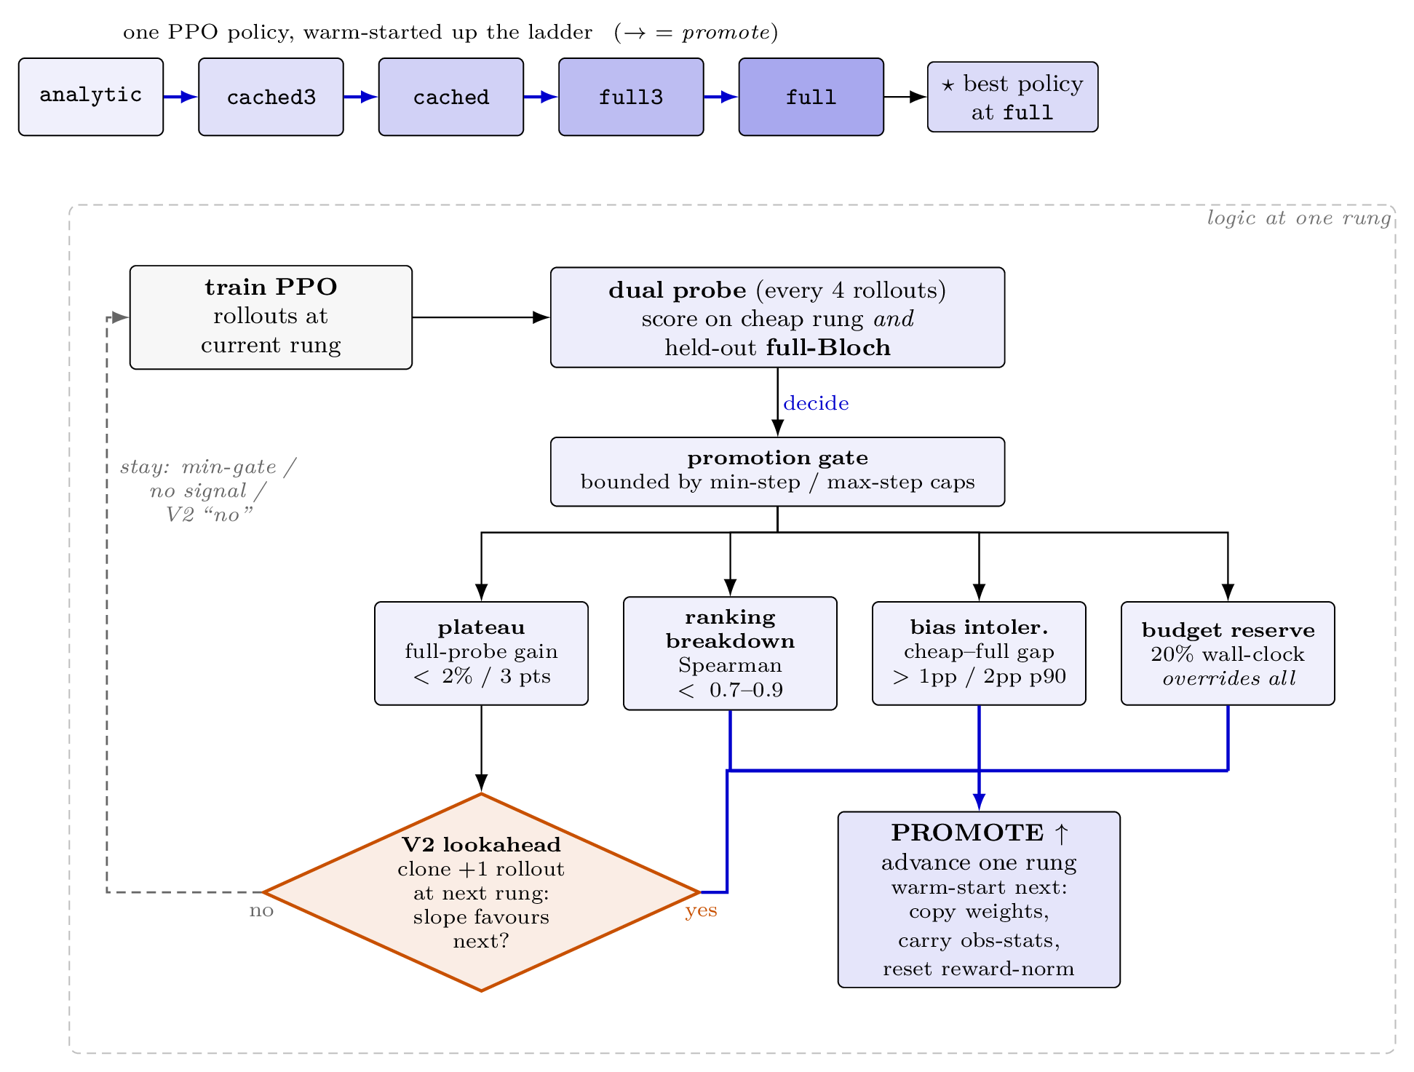
A3 — The trust problem: bias-aware promotion
• Cheap biased rung games its own score
• Score on a held-out FULL-sim probe
• Promote on plateau / ranking breakdown
• Keep a GLOBAL-BEST checkpoint
Notes:
[Execution (50%) / Evaluation (20%) — methodological care]
Promotion. A cheap biased rung games its own score, so promotion and checkpointing are scored on a held-out full-sim probe, never the cheap number. Promote on plateau or ranking breakdown. Keep a global-best checkpoint on target fidelity — the last policy is often not the best. Honest: thresholds hand-tuned, future work.
— Slide bullets (detail) —
• A cheap, biased rung can keep RAISING ITS OWN SCORE by exploiting its bias
• So promotion + checkpoint selection are scored on a held-out FULL-simulator probe
– never the cheap rung's own number
• Promote on: target plateau, or ranking breakdown (Spearman vs full sim drops)
• Keep a GLOBAL-BEST checkpoint on the target fidelity
– the last policy in a curriculum is often NOT the best (we'll see this in Run A)
• Honest note (Q&A): thresholds are hand-tuned, not derived — flagged as future work

Slide 12
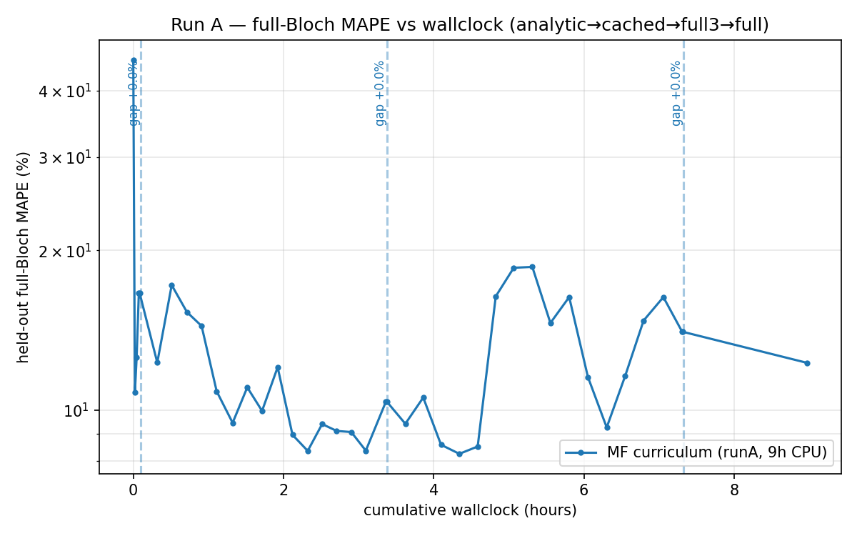
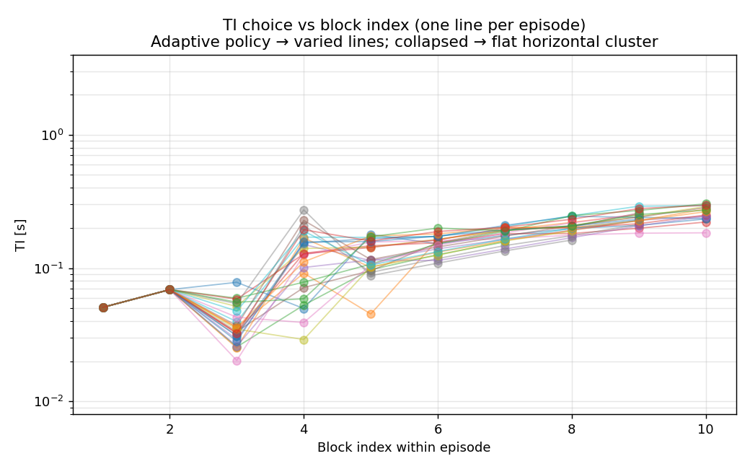
Limitation — where adaptivity does not help (Run A)
• Run A: full 14-sphere plate, whole T1 range
• Fixed Cramér–Rao WINS: 4.70% vs 9.4–11.7%
• Agent is adaptive (TI tracks estimate), not collapsed
• Longest sphere beyond TI reach — coverage ceiling
• Lessons → global-best; test where there's variation
Notes:
[Evaluation (20%) — the honest negative result, dedicated framing]
Limitation slide. Run A = full 14-sphere plate spanning the whole T1 range — hardest case for adaptivity, one fixed schedule already near-optimal. Fixed CR wins 4.70% vs 9.4-11.7%. But the agent IS adaptive (TI varies, tracks estimate); longest sphere beyond TI reach. Lessons: global-best necessary; need a task with variation. Motivates Run B.
— Slide bullets (detail) —
• Run A = full 14-sphere plate, spanning the ENTIRE clinical T1 range
– the hardest case for adaptivity — one fixed schedule already serves a near-fixed fleet
• Result: the fixed Cramér–Rao schedule WINS (4.70% vs the agent's 9.4–11.7%)
– an honest negative
• But the agent is genuinely adaptive, not collapsed:
– TI varies within/across episodes, tracks the running T1 estimate
– longest sphere is beyond its TI reach — an action-coverage ceiling
• Lessons → Run B: global-best is necessary; test adaptivity where there's something to adapt to

Slide 13
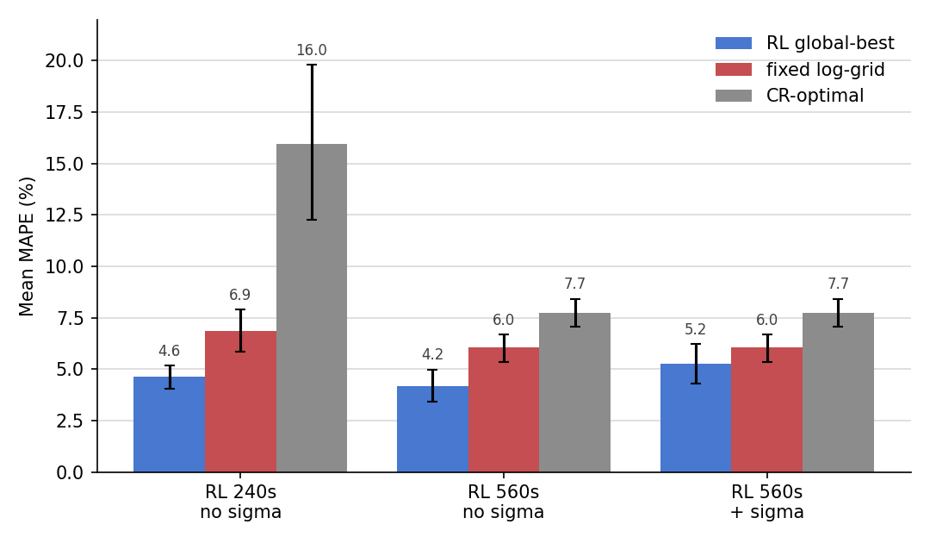
Run B — adaptivity helps when the task varies
• Fair: held-out seeds, 24 eps, CIs, matched budget + fitter
• 5 spheres, T1 resampled every episode
• RL 4.62% vs fixed 6.86% (CIs disjoint); CR 15.96%
• Not just more blocks: regrid at policy TR → worse
• Adaptive PLACEMENT; holds at 560 s (4.16 vs 6.04)
Notes:
[Execution + Evaluation — fair comparison, alternative explanation ruled out]
Run B. Say the fair-comparison line once: held-out seeds, 24 episodes, CIs, matched budget + same fitter. 5 spheres, T1 resampled each episode. RL 4.62% vs fixed 6.86%, CIs don't overlap; CR collapses (15.96%). Is it just more measurements? No — re-solve grid at policy's own TR, it does worse → gain is adaptive placement. Probe-then-refine; holds at 560s.
— Slide bullets (detail) —
• Fair comparison (covers every result): strict held-out seeds, 24 episodes, 95% CIs,
– same scan budget + same fitter for RL and every fixed baseline
• Run B: 5 spheres, T1 resampled continuously every episode (variation a grid can't anticipate)
• RL 4.62% vs best fixed log-grid 6.86% at 240 s — non-overlapping CIs
– Cramér–Rao schedule collapses (15.96%): solved for a nominal fleet
• Is the gain just MORE measurements? No.
– re-solve the fixed grid at the policy's own shorter TR → it does WORSE
– → the gain is adaptive PLACEMENT, not block count
• Behaviour: probe-then-refine. Advantage holds at 560 s (4.16% vs 6.04%)

Slide 14
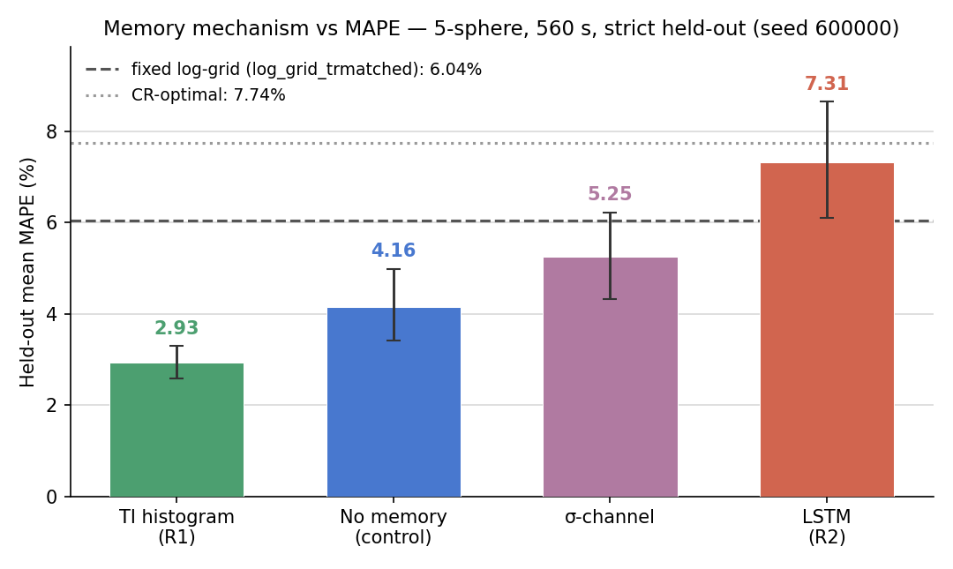
Key finding — what the policy should remember
• History = which TIs you've bought (partially observed)
• Carry it: σ · LSTM · TI-coverage histogram
• histogram ≫ none > σ > LSTM
• Best: 2.93% MAPE, 95.8% < 5% (vs 6.04%)
• LSTM tracked estimate (r=+0.78) & lost; histogram coverage (r=−0.12) & won
Notes:
[Execution + Evaluation — a genuine research insight, controlled ablation]
Climax. Partially-observed problem: estimate is a lossy summary of which TIs bought. Three memories: σ, LSTM, TI-coverage histogram. histogram >> no-mem > σ > LSTM. Histogram 2.93%, 95.8% under 5%, vs 6.04% fixed, CI separate from all. Twist: LSTM learned the intuitive estimate-tracking rule (r=+0.78) and lost; histogram is coverage-driven (r=-0.12) and won. What you remember matters as much as whether you adapt. LSTM caveat: 5x slower, undertrained.
— Slide bullets (detail) —
• Partially-observed: the estimate is a lossy summary of WHICH TIs you've bought
• Three ways to carry that history: fitter uncertainty (σ), an LSTM, a TI-coverage histogram
• Result: histogram ≫ no-memory > σ-channel > LSTM
– histogram = best in the project: 2.93% MAPE, 95.8% of episodes < 5% (vs 6.04% fixed)
• The twist:
– LSTM learned the INTUITIVE rule (longer T1 → longer TI, r=+0.78) — and LOST
– histogram conditions on which TI bins are unsampled (r=−0.12) — and WON
• Takeaway: what you remember matters as much as whether you adapt
– LSTM caveat (Q&A): ~5× slower/step → undertrained at equal wall-clock

Slide 15
Quantitative positioning against published work
• Not like-for-like — tasks differ
• Prior work: stronger hardware validation
• Ours: closed-loop RL on fitted-T1, validated pipeline
• Beracha heuristic: 6.04→2.93% ≈ ~4× acceleration
FIG-9 (make) distil quant-anchor table to 3–4 comparable bars
Notes:
[Evaluation (20%) — contribution situated vs baselines, honest caveats]
Positioning. Not like-for-like; prior work has stronger hardware validation. We contribute a different object: closed-loop RL scored on fitted-T1 error in a validated pipeline. By Beracha's own precision->time heuristic, 6.04->2.93% (~2.06x precision) ~ 4x acceleration, top of their range, harder task.
— Slide bullets (detail) —
• Not a like-for-like ranking — tasks differ
• Prior work has stronger hardware validation (Beracha, MRzero, Walker-Samuel)
• This work contributes a different OBJECT:
– a closed-loop RL policy scored on fitted-T1 error in a VALIDATED 2-D pipeline
• Using Beracha's own precision→time heuristic:
– 6.04% → 2.93% (~2.06× precision) ≈ ~4× acceleration
– top of their reported range — on a harder fleet task, not one voxel

Slide 16
Contributions & future work
• 1. Open-source phantom twin
• 2. Validation → fixed two KomaMRI bugs (39.4→0.48%)
• 3. First RL agent for adaptive qMRI (2.93 vs 6.04)
• Impact: ~4× acceleration, MR-Linac bottleneck
• Not claiming: sim-only, one seed, fitter confound
• Future: wider actions; T2/PD; Bayesian baseline; LSTM
Notes:
[Evaluation (20%) — broader impact + what does NOT generalise]
Close. Three contributions: twin; validation fixing two upstream bugs; first RL agent for adaptive qMRI (2.93 vs 6.04, plus coverage>estimate-tracking finding). Why it matters: scan-time bottleneck, MR-Linac, ~4x accel. What I'm NOT claiming: sim-only, one seed, single-fitter confound; next step physical phantom; 14-sphere favours fixed. Future work. Thanks — questions.
— Slide bullets (detail) —
• 1. Open-source executable twin of a calibrated phantom
• 2. Validation-by-recovery → fixed two upstream KomaMRI bugs (39.4 → 0.48%)
• 3. First RL agent for adaptive qMRI — best 2.93% vs 6.04%; coverage-memory finding
• Why it matters: less scan time at equal accuracy = the MR-Linac bottleneck (~4× accel)
• What I'm NOT claiming (reflection): simulator-only, one seed/arm, single-fitter confound
– honest next step is a physical-phantom benchmark; full 14-sphere still favours fixed
• Future: wider action space; T2/PD plates; greedy-CRLB Bayesian baseline; step-matched LSTM

Slide 17
Backup slides — anticipating Q&A
Notes:
Backup deck = anticipating objections (an Execution-band signal). Likely challenges: fitter confound, single seed, simulator-only, LSTM compute caveat.

Slide 18
Backup — Reward screening (why Δlog MAPE)
• Per-step −MAPE penalty collapsed to a ZERO-measurement policy (summed penalties punish measuring)
• Terminal-only was too sparse; progress rewards best
• Δlog MAPE won the 30k PPO screen (0.830) — chosen before committing Bloch compute
• Ties back to the degenerate single-voxel collapse (terminal-bonus lesson)
reward-screen table (tab:e2-reward-screen)
Notes:
[Backup — Q&A]
Reward screening detail. neg-MAPE collapses to no blocks; terminal too sparse; Δlog MAPE best (0.830). Chosen on the cheap analytic env before Bloch compute.

Slide 19
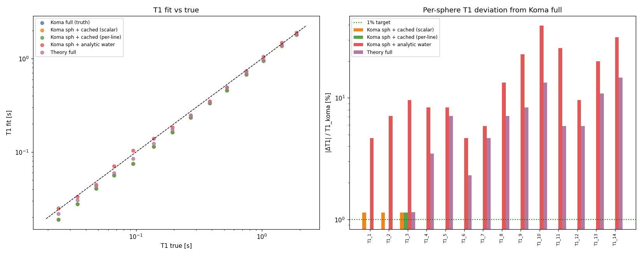
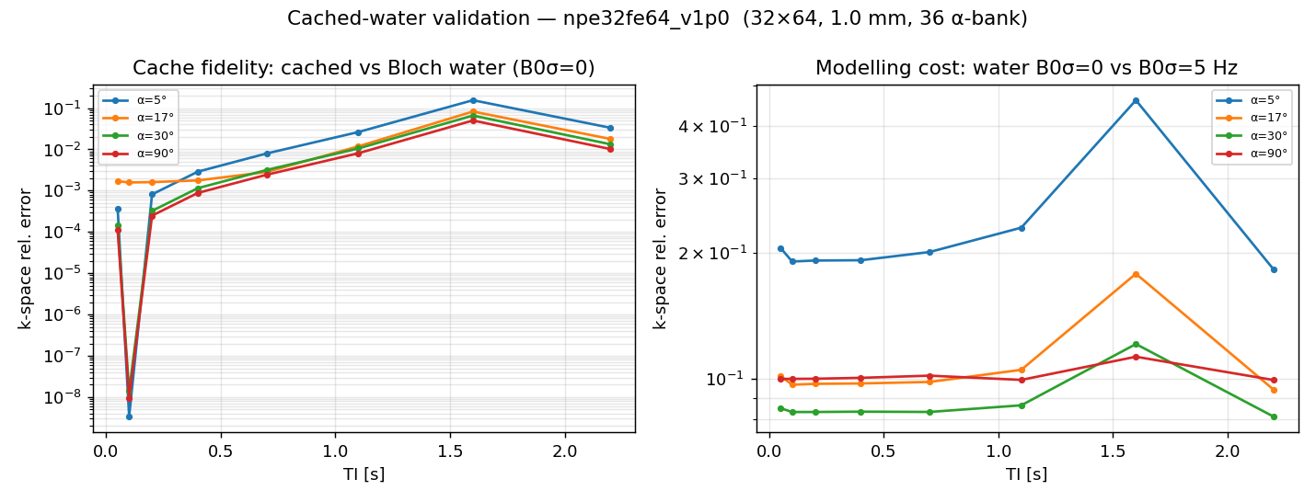
Backup — Cached-water validation
• Cached model matches full-Bloch T1 fits to 0.12% (worst 1.15%)
• Modelling water analytically instead is too crude: up to ~40% per-sphere deviation
• α-matched template bank: exact at matched flip angle, blended off-grid
Notes:
[Backup — Q&A]
Cached water matches full-Bloch to 0.12%; analytic water ~40% off. Template bank keyed to flip angle.

Slide 20
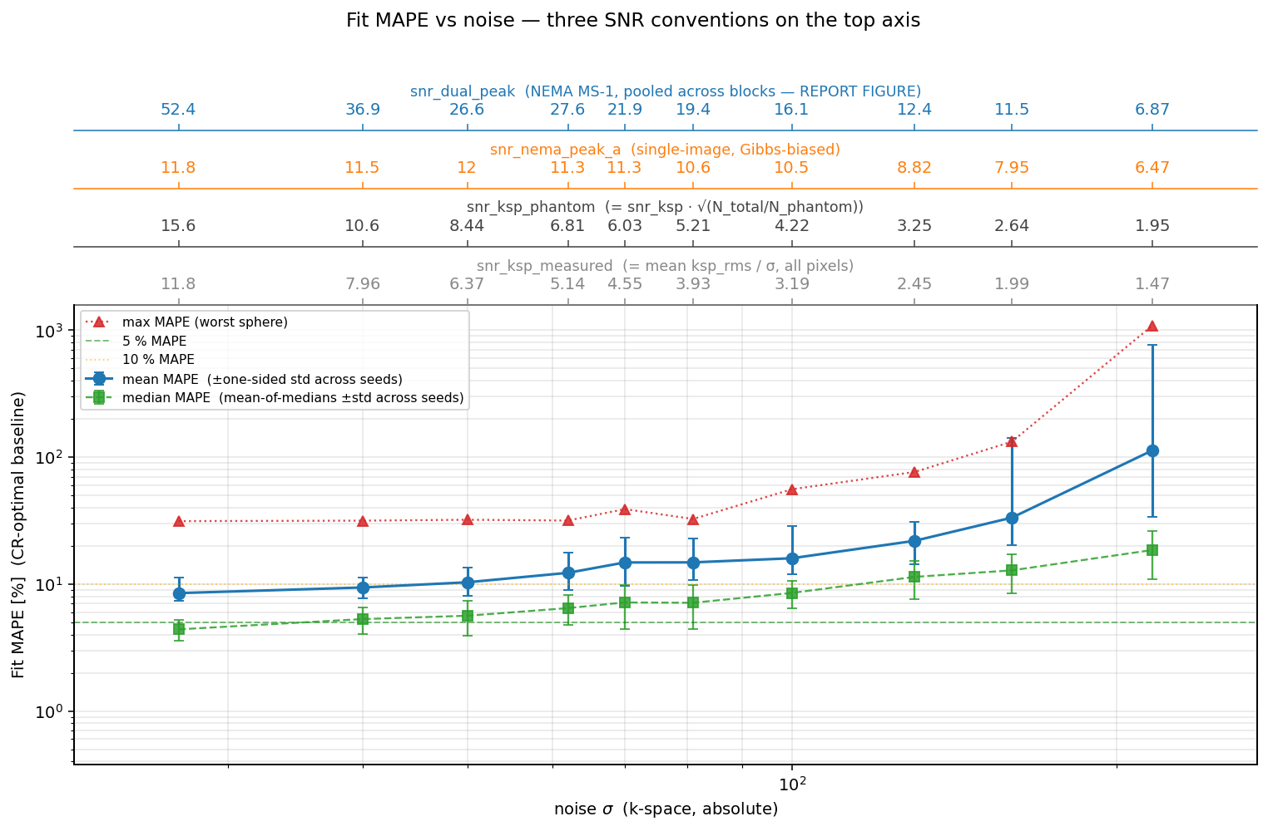
Backup — Noise calibration (σ = 50)
• σ=50 → NEMA SNR ≈ 17 (plate avg) to 28 (bright spheres) — clinical IR range
• 25-seed sweep: T1 fits degrade gracefully to σ≈85, collapse beyond
• So the task is noise-LIMITED but not estimation-broken
Notes:
[Backup — Q&A]
Noise σ=50 → SNR 17-28, clinical. Graceful to σ≈85. Noise-limited, not broken.

Slide 21
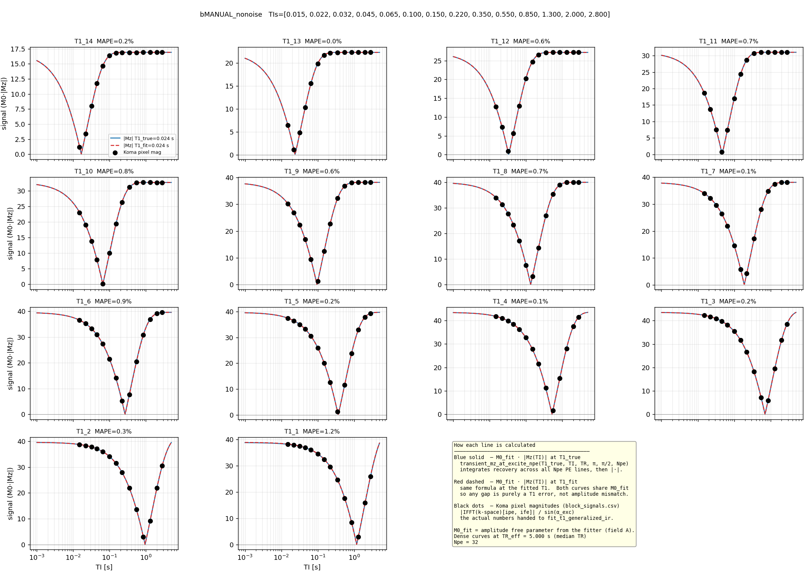
Backup — The second KomaMRI bug + fitter floor
• Bug 2: closing-knot collapse AFTER time-rebasing (T0 + t) — same ε mechanism, later in pipeline
– reproducer: +52% jump at shot 18 (270 s), then a wrong plateau
• Fitter grid floor: 300 log-spaced T1 candidates → ~1% quantisation floor by construction
– so reported MAPE can't fall below ~1%; 500-point grid reaches ~0.48%
Notes:
[Backup — Q&A]
Second bug: closing-knot collapse after rebasing, 52% jump at shot 18. Fitter floor: 300-point log grid → ~1% quantisation; 500 points ~0.48%.

Slide 22
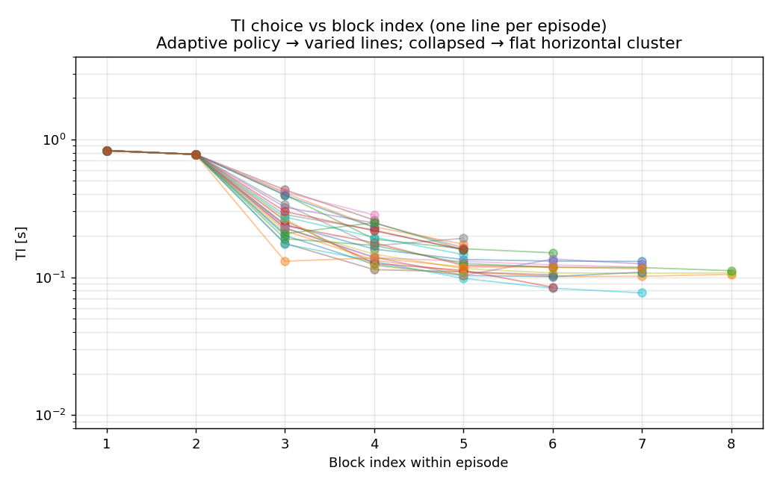
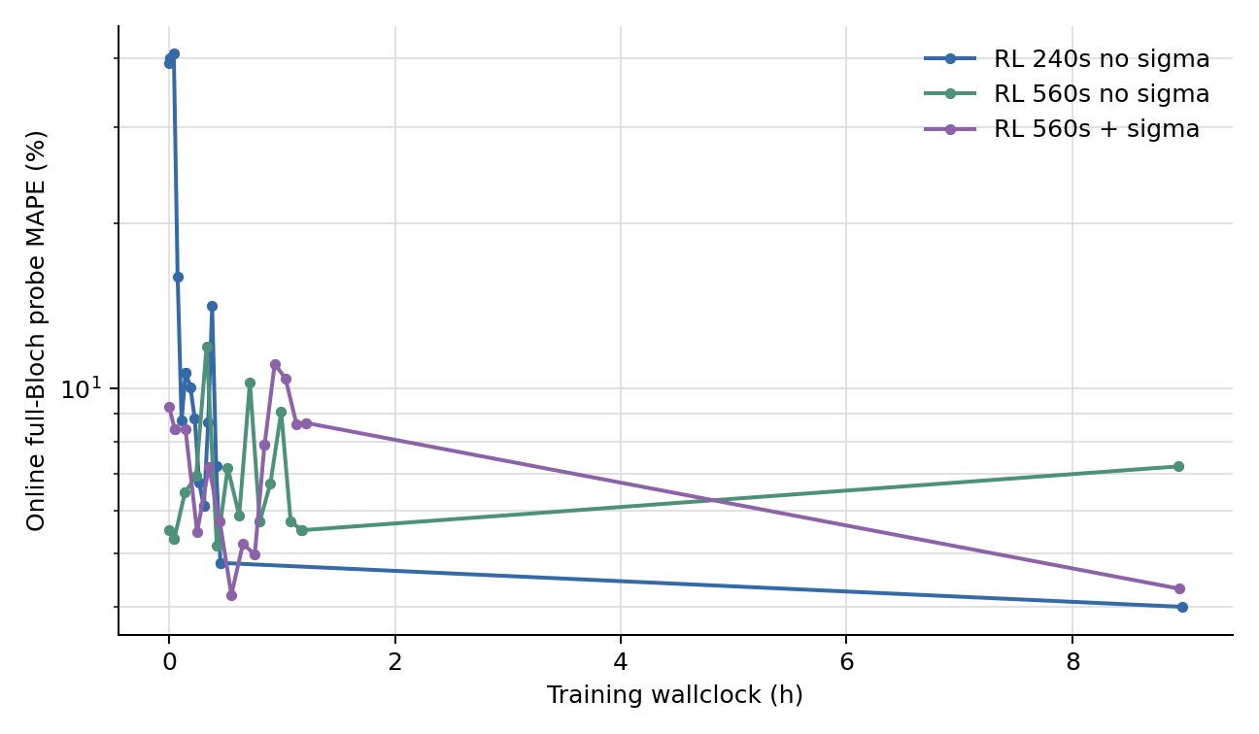
Backup — Run B policy behaviour
• 240 s policy: 5.92 blocks avg, ZERO timing repairs
• Opens with two high-TI probes (~0.78–0.83 s), then shorter adaptive refinements
• TI vs current estimate r=−0.72: a two-phase probe-then-refine, not a monotonic rule
Notes:
[Backup — Q&A]
Run B behaviour: ~6 blocks, zero repairs, two high-TI probes then refine, r=-0.72 two-phase strategy.

Slide 23
Backup — Fixed comparators (Cramér–Rao baselines)
• Fixed schedules aren't hand-chosen — they're Cramér–Rao-optimal
• CRLB = variance floor for any unbiased estimator, set by design + noise
• static-OPTIMAL (solved for nominal fleet) vs static-AVERAGE (robust log grid)
– CR wins when the fleet matches (Run A); collapses under per-episode variation (Run B)
(no figure — speak it)
Notes:
[Backup — Q&A]
Fixed comparators are CR-optimal, not hand-picked. CRLB = variance floor. static-optimal vs static-average; CR wins Run A, collapses Run B.

